Slide 1

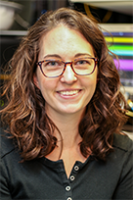
Society for Industrial and Applied Mathematics
First Annual Meeting of University Nevada, Reno Student Chapter
Featuring Plenary Speaker
Dr. Marylesa Howard
Applied Mathematician and Supervisor at Nevada National Security Site
December 5 ○ 3:30 - 6:00 ○ MS 215
Free food and SIAM Memberships
for Students
3:30 - 3:45 -- Coffee
3:45 - 4:00 -- Introduction to SIAM
4:00 - 4:45 -- Plenary talk:
The Science of Nuclear Security
4:45 - 5:00 -- New Member Signup and Photo
5:00 - 6:00 -- Reception with food
More details at:
https://siam-unr.github.io/

