Slide 1
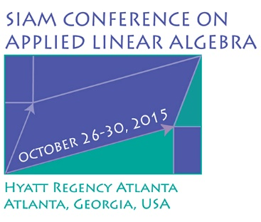
SIAG/LA Business Meeting
Tuesday October 27th from 1:45pm-2:30pm
International Ballroom – Lower Level 1
Hyatt Regency Atlanta
Atlanta, Georgia
During the SIAM Conference on Applied Linear Algebra (LA15).

Slide 2
SIAG/LA15 Business Meeting
SIAG/LA Officers
Chair: Danny C. Sorensen
Vice Chair: James G. Nagy
Program Director: Françoise Tisseur
Secretary: David S. Bindel

Slide 3
SIAG/LA Conference History

Slide 4
SIAG/LA Conference LA15
Organizing Committee Co-Chairs Chen Greif, The University of British Columbia, Canada James Nagy, Emory University, USA
Organizing Committee Zhaojun Bai, University of California, Davis, USA Zhong-Zhi Bai, Chinese Academy of Sciences, China Petros Drineas, Rensselaer Polytechnic Institute, USA David Gleich, Purdue University, USA Bruce Hendrickson, Sandia National Laboratories, USA Beatrice Meini, Università di Pisa, Italy Alison Ramage, University of Strathclyde, United Kingdom Zdenek Strakos, Charles University of Prague, Czech Republic Françoise Tisseur, University of Manchester, United Kingdom Sabine Van Huffel, KU Leuven, Belgium

Slide 5
Next Conference: LA 18
2018 SIAM Conference on Applied Linear Algebra
May 4-8, 2018
Hong Kong Baptist University, Hong Kong
Local organizer: Michael K. Ng

Slide 6
Gene Golub SIAM Summer School 17
Call For Proposals
Information: www.siam.org/about/com golub.php
www.siam.org/students/g2s3/summer call.php
Letter of Intent: Deadline 31 Jan 2016
Two weeks, 40 students, $103,500

Slide 7
SIAG/LA15 Business Meeting
Announcements
SIAG/LA electronic mail list – siam-la@siam.org
SIAG/LA website: http://siags.siam.org/siagla/
SIAM News: Story Ideas
SIAM Blogs

Slide 8
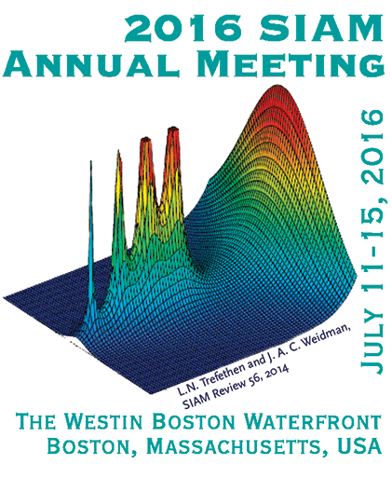
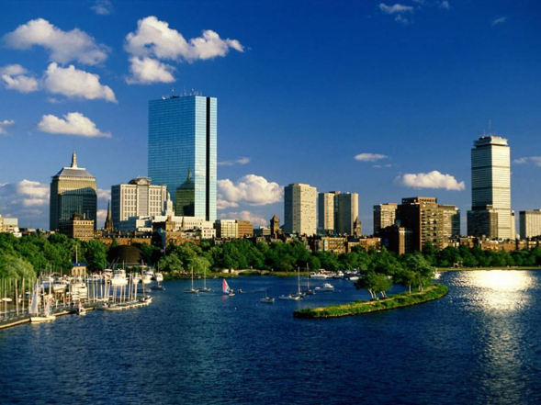
SIAM Annual Meeting (AN16)
July 11-15, 2016
The Westin Boston Waterfront
Boston, Massachusetts, USA
Important Deadlines:
January 11, 2016 – Minisymposium proposals
February 1, 2016 – Contributed lecture, poster, and minisymposium presentation abstracts
SIAG/LA track at AN16:
Organized by Françoise Tisseur

Slide 9
SIAG/LA Activities
Householder Symposium XIX (289 applications, 157 accepted)
ILAS - SIAG/LA Sponsored Speakers (Andreas Frommer 2014, Fernando Teran 2016)
Co-Sponsor for - IWASEP 10 (June 2014, Dubrovnik) - PRECON 15 (June 2015, Eindhoven)
SIAG/LA Minisymposium Tracks - SIAM AN14 (5 tracks, 10 sessions - ICIAM 2015 (5 tracks)

Slide 10
SIAG/LA Membership Report
As of 12/31/2014

Slide 11
SIAG/LA Membership History

Slide 12
For SIAM Student Members
Free or discounted memberships
Student Chapters
Prizes
Educational Resources
Fellowship and research opportunities
Career options and guidance
Join 2 SIAM Activity Groups for free!

Slide 13
Encourage Student Membership
SIAG/LA Themed Poster Session
AN 16
Other Ideas are Welcomed

Slide 14
SIAG/LA Member Demographics

Slide 15
SIAG/LA Members By Employer Type

Slide 16
SIAG/LA Membership by Gender
Non Students
Students

Slide 17
SIAG/LA Departments

Slide 18
SIAG/LA Members By Geography

Slide 19
Join SIAM Today!
If you paid non-member registration fees, you’ll get a discounted membership
Non-member registrant: Receive a $130 credit and join for only $15 (normally $145!)
Non-member mini-speaker/organizer registrant: Receive a $65 Credit and join for only $80 (normally $145!)
If you’re not a SIAG/LA member, but are a SIAM member, join SIAG/LA for free (Students can always join up to 2 SIAGS for free!)
SIAM and SIAG Memberships are a good way to be network with others in your specialty and the community

Slide 20
Benefits of SIAM Membership
SIAM News
SIAM Review
Unwrapped
80-90% journal discount
30% book discount
20-30% conference discount
Eligible to nominate or be nominated as a SIAM Fellow
Participate in SIAM Governance
Join SIAM Activity Groups
Nominate 2 Students for free membership
Prizes to recognize excellence
CML – Combined Membership Directory

Slide 21
SIAG/LA Future Plans
Possible Other Activities?
Other Business?

Slide 22
SIAG/LA Contacts
Chair: Danny C. Sorensen
sorensen@rice.edu
Vice Chair: James G. Nagy
nagy@mathcs.emory.edu
Program Director: Francoise Tisseur
ftisseur@ma.man.ac.uk
Secretary: David S. Bindel
bindel@cs.cornell.edu

