Slide 1


SIAG/LA
BUSINESS MEETING
Universitat Politécnica de Valencia
Valencia, Spain
Tuesday, June 19, 2012, 18:50 to 19:50

Slide 2

SIAG/LA OFFICERS through 12/31/12
Chair: Michele Benzi
Vice Chair: Andreas Frommer
Program Director: Chen Greif
Secretary: H. Sue Thorne

Slide 3
ANNOUNCEMENTS
  SIAG/LA election 2012
  SIAG/LA Charter renewal 2012
  SIAG/LA website www.math.temple.edu/~siagla/
  SIAG/LA electronic mail list
  siam-la@siam.org
  SIAM News: Story ideas

Slide 4
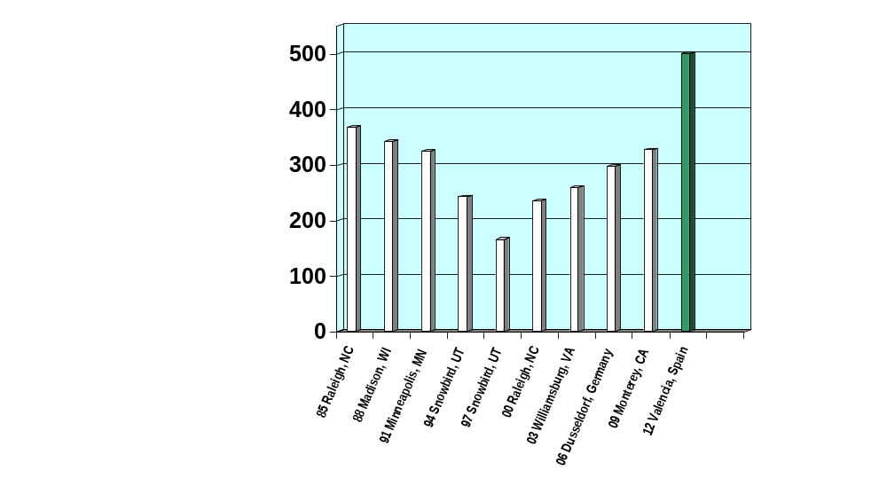
CSE Conference History
SIAG/LA CONFERENCE HISTORY
Number of
Conference
Attendees

Slide 5
SIAG/LA CONFERENCE LA12
  Universitat Politécnia de Valencia,
  Valencia, Spain - June 18-22, 2012
Michele Benzi (Co-chair) Emory University, USA
Rafael Bru (Co-chair) Univ. Politècnica de València, Spain
Jose Mas (Co-chair) Univ. Politècnica de València, Spain

Slide 6

2013 Gene Golub
SIAM Summer School
3rd International Summer School
on Numerical Linear Algebra (ISSNLA)
July 22- August 2, 2013
Fudan University
Shanghai, China
http://g2s3.cs.ucdavis.edu/

Slide 7
CONFERENCES IN COOPERATION WITH SIAG/LA
June 3-7, 2013
18th ILAS Conference, Providence, RI
June 8-13, 2014
Householder Symposium XIX on Numerical Linear Algebra, Domain Sol Cress Spa, Belgium

Slide 8
NEXT CONFERENCE: LA15
Possible locations
Timing
Co-chairs:
Chen Greif, Univ. British Columbia
James Nagy, Emory University

Slide 9
SIAG/LA PRIZE
SIAG LINEAR ALGEBRA PRIZE
2012 recipients:
Grey Ballard, James Demmel, Olga Holtz, and Oded Schwartz
Sou-Cheng T. Choi, Christopher C. Paige, and Michael A. Saunders

Slide 10
Join SIAM!
• If you paid non-member registration fees, you’ll get
a discount on membership:
  Non-member registrants receive $130 credit, and an
  offer to join for $6.
  Non-member mini speaker/organizer registrants receive $65 credit and an offer to join or $71.
  If you’re not a SIAG/LA member, but are a SIAM member, join SIAG/LA for free.
  SIAM and SIAG memberships are a good way to be seen/remembered.

Slide 11
Benefits of SIAM Membership
SIAM News
SIAM Review
Unwrapped (member e-news)
Discounts
80%-95% journal
30% book
20%-30% conference
Eligible to nominate or be nominated as a SIAM Fellow
Participate in SIAM governance
Join SIAM Activity Groups
Nominate 2 students for free membership
CML - combined membership directory
For Students:
Student chapters
Prizes
Educational resources
Fellowship and research opportunities
Career options/guidance

Slide 12

SIAG/LA
MEMBERSHIP
REPORT
(as of 12/31/11)

Slide 13
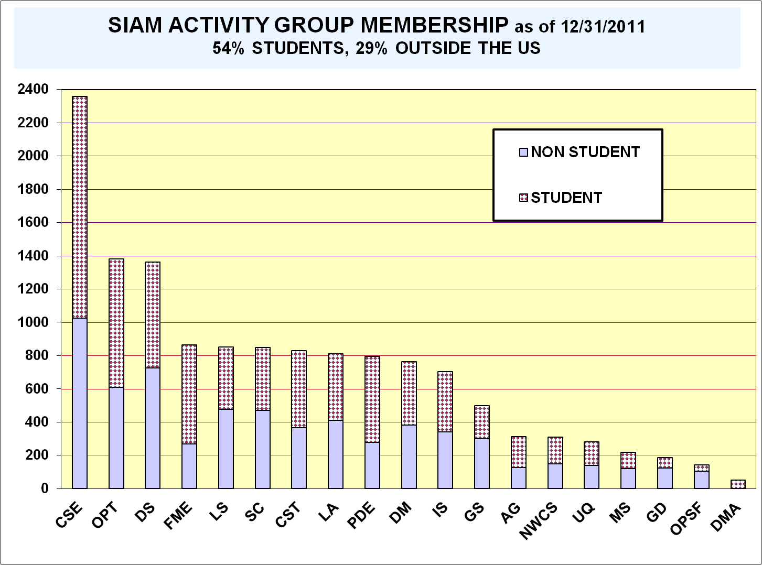

Slide 14
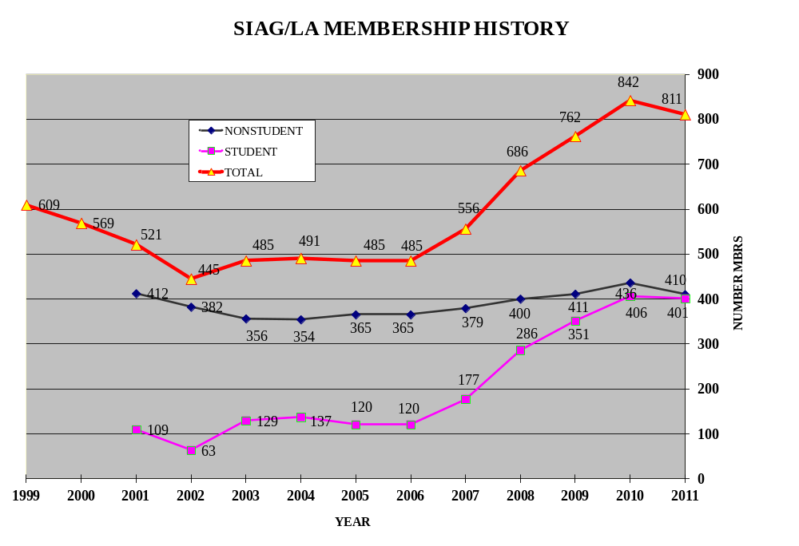

Slide 15


SIAG/LA MEMBERS
812 as of 12/31/11

Slide 16
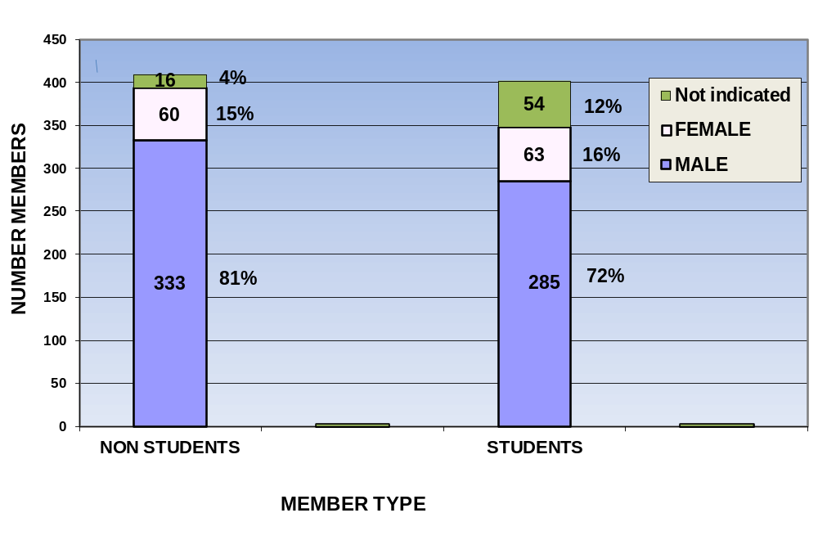
SIAG/LA MEMBERSHIP BY GENDER
MALE 76% FEMALE 15% not indicated 9%

Slide 17


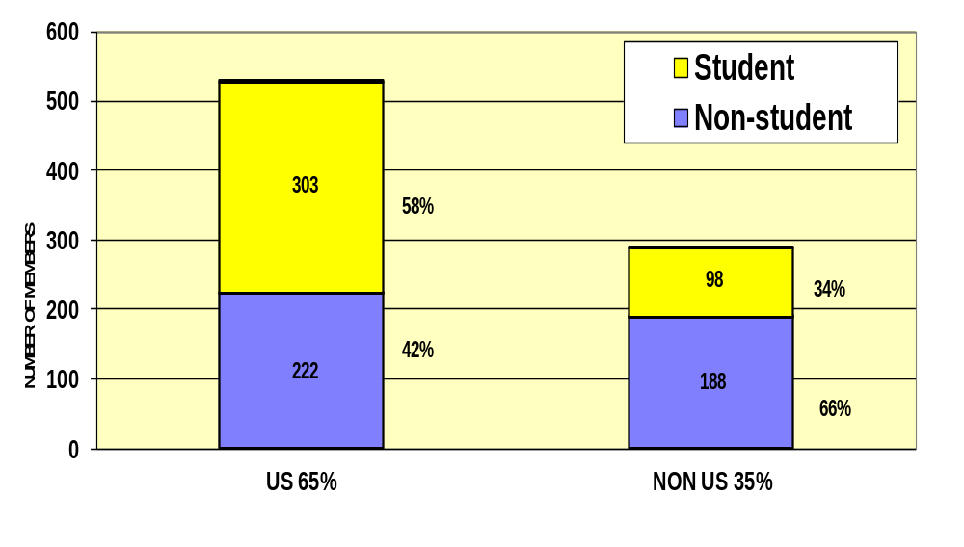
SIAG/LA MEMBERS BY GEOGRAPHY
65% US, 35% Outside US

Slide 18
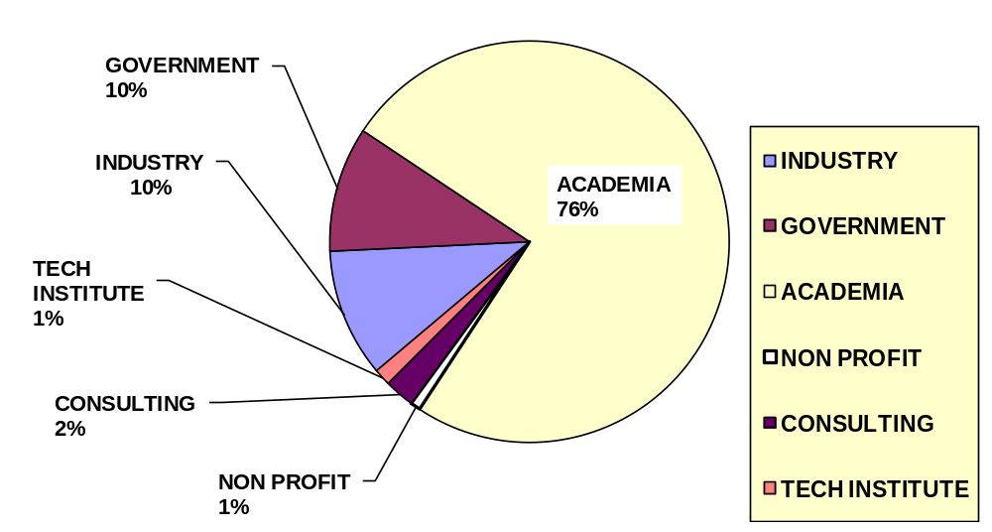
SIAG/LA MEMBERS BY EMPLOYER TYPE not including students

Slide 19
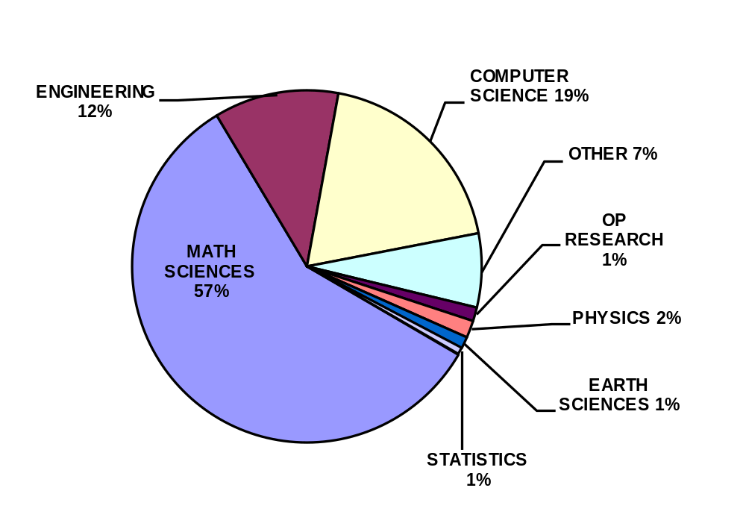
SIAG/LA DEPARTMENTS

Slide 20

SIAG/LA FUTURE PLANS
Possible Other Activities?
Other Business?

Slide 21

SIAG/LA CONTACTS
Chair: Michele Benzi benzi@mathcs.emory.edu
Vice Chair: Andreas Frommer
frommer@math.uni-wuppertal.de
Secretary: H. Sue Thorne
sue.thorne@stfc.ac.uk
Program Director: Chen Greif greif@cs.ubc.ca

