Slide 1

Easwari Engineering College
ADMIN DASHBOARD – CHENNAI CIVIC ISSUES REPORTING AND MANAGING SYSTEM
“CIVIC CONNECT”
Under the guidance
of
Dr. E. Moulieswaran
Assistant Professor
Dept of MCA
Name : S Karthee
Reg No: 310624622021
Dept : MCA

Slide 2
INTRODUCTION
Urban cities like Chennai face issues such as potholes, garbage overflow, water leakage and streetlight failures.
Citizens often struggle to report these problems efficiently.
Traditional complaint systems are slow and lack transparency.
This project proposes a web-based civic issue reporting and management system.
It allows citizens to easily report problems and administrators to monitor and resolve them.

Slide 3
PROBLEM STATEMENT
Citizens find it difficult to report civic issues quickly.
Manual complaint systems are slow and inefficient.
Authorities may not receive accurate location or image evidence.
Tracking complaint status is often not possible.
There is a need for a centralized digital platform to report and manage civic problems.

Slide 4
MOTIVATION OF THE PROJECT
Growth of smart city initiatives.
Increasing use of smartphones and internet services.
Need to improve communication between citizens and municipal authorities.
Encourage public participation in city maintenance.
Improve transparency and faster issue resolution.

Slide 5
OBJECTIVES OF THE PROJECT
Develop an online platform for reporting civic issues.
Allow users to upload images and descriptions of problems.
Enable administrators to manage and resolve complaints.
Provide tracking of complaint status.
Improve communication between citizens and authorities.

Slide 6
LITERATURE REVIEW
Research Project / System | Year | Contributions | Limitations
CPGRAMS (Centralized Public Grievance Redress and Monitoring System) | 2007 | Provides a centralized national platform for citizens to submit grievances to government departments and track complaint status. | Requires registration with Aadhaar/OTP, lacks precise GPS-based location tagging, and has limited public transparency.
BBMP Sahaaya | 2016 | Enables citizens to report civic issues using a mobile application with photo upload and category-based complaint submission. | Requires installation of a mobile app and offers limited public dashboards for monitoring complaints.
FixMyStreet | 2007 | Introduces a map-based civic reporting platform with public visibility of complaints, encouraging community participation. | High chances of duplicate complaints and limited prioritization or grouping of similar issues.
SeeClickFix | 2008 | Provides a civic engagement platform with public issue feeds, mobile access, and integration with municipal work-order systems. | Commercial paid platform that may not be affordable for smaller municipalities and developing regions.
Chennai Civic Issues Reporting System (Proposed) | 2026 | Offers a web-based civic issue reporting system with GPS location tagging, role-based dashboards, real-time tracking, and analytics visualization. | Currently limited to web platform and requires internet connectivity for real-time updates.

Slide 7
LIMITATIONS OF EXISTING SYSTEMS
Manual complaint handling in many municipalities.
Limited real-time updates for citizens.
Lack of centralized and digital complaint tracking.
Poor communication between citizens and authorities.
Limited data analysis of civic issues.

Slide 8
PROPOSED SYSTEM
A web-based civic issue reporting platform.
Citizens can report issues with description and images.
Complaints are stored in a centralized database.
Admin dashboard monitors and manages reported issues.
Users can track the status of their complaints.

Slide 9
SYSTEM ARCHITECTURE
User Interface (Citizen Portal)
Backend Server (Node.js / Express)
Database (MongoDB)
Admin Dashboard
Issue Management and Notification Modules

Slide 10
MODULES OF THE SYSTEM
User Module – Allows users to submit complaints.
Image Processing Module – Stores uploaded issue images.
Database Module – Stores issue data and user details.
Admin Monitoring Module – Displays reported issues.

Slide 11
MODULES OF THE SYSTEM
Notification system for status updates.
Admin alerts for newly reported issues.
Tracking system for complaint progress until resolution.

Slide 12
SYSTEM WORKFLOW
User logs into the system.
User reports an issue with description and image.
Complaint is stored in the database.
Admin views complaints through the dashboard.
Admin updates or resolves the issue.
User tracks complaint status.

Slide 13
ALGORITHMS USED
Authentication algorithm for user login.
CRUD operations for complaint management.
Database query processing for issue tracking.
Image upload and storage handling.

Slide 14
Technology Stack
Frontend: HTML, CSS, JavaScript
Backend: Node.js and Express.js
Database: MongoDB Compass Local Storage
Development Tools: Visual Studio Code and GitHub

Slide 15
SYSTEM REQUIREMENTS
Hardware: Computer or smartphone with internet connection.
Software: Web browser, Node.js runtime.
Database: MongoDB Compass
Development Tools: VS Code.

Slide 16
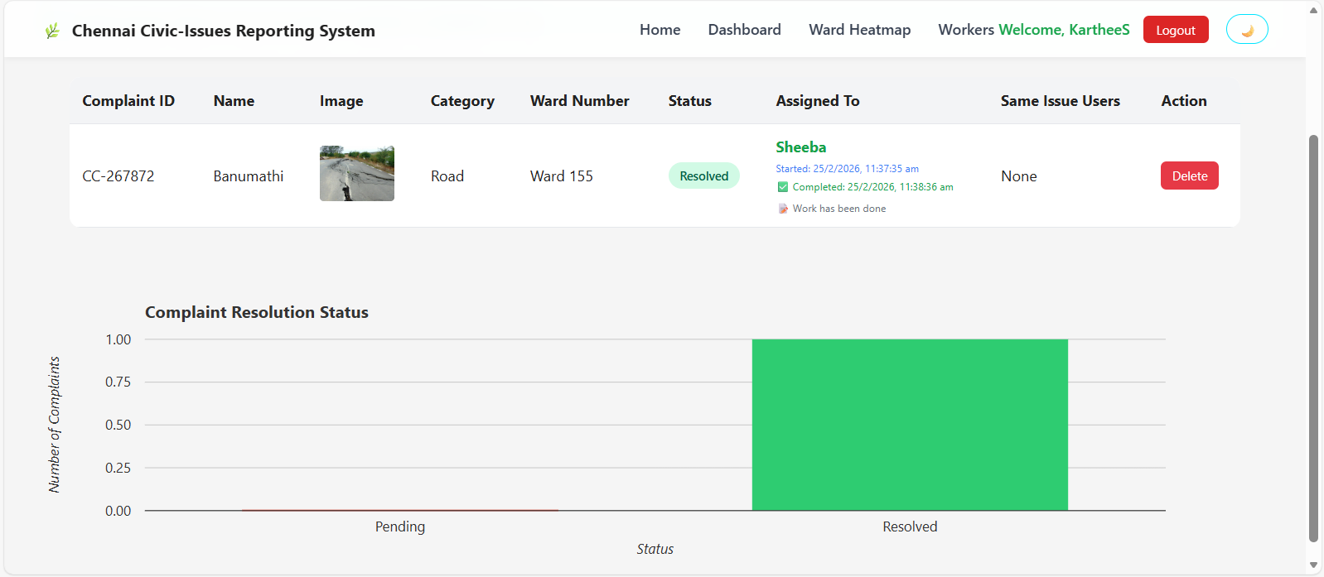
APPLICATION SCREENSHOT
Admin Page

Slide 17
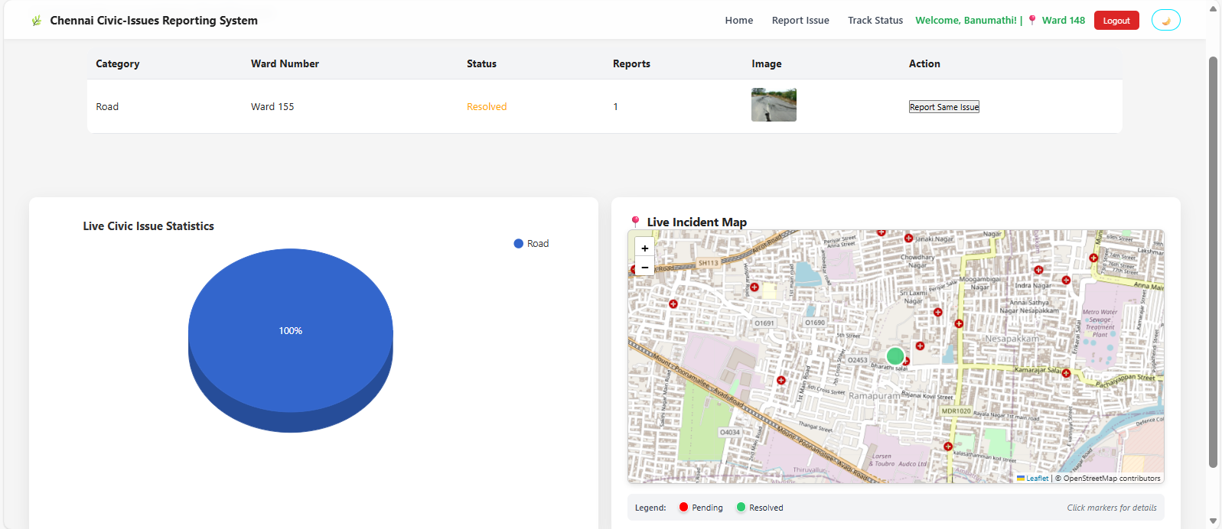
APPLICATION SCREENSHOT
Admin Page

Slide 18
ADVANTAGES
Easy reporting of civic issues.
Improves communication between citizens and authorities.
Provides transparent complaint tracking.
Maintains digital records of reported issues.

Slide 19
LIMITATIONS
Requires internet connectivity.
Developed as a Website not as a Mobile App
System performance depends on admin responsiveness.
Large number of complaints may require system scaling.

Slide 20
FUTURE ENHANCEMENTS
Mobile application integration.
Notification and Alert System should be Enabled.
AI-based issue prioritization.
Integration with government smart city platforms.

Slide 21
CONCLUSION
The system provides a digital platform for reporting civic issues.
It improves transparency and communication.
Authorities can efficiently monitor and resolve problems.
This contributes to better city management.

Slide 22
THANK YOU

