Slide 1
Taxonomy of visualization

Slide 2
Writing plotting code is hard
Picking the right plot can be even harder

Slide 3

How to get ideas for plots
Google search similar plots
Notes:
```{python}
people_df = pd.DataFrame(
{
"name": ["Alice", "Bob", "Charlie"],
"age": [25, 30, 28],
"city": ["Lagos", "London", "Lima"],
}
)
people_df
```

Slide 4
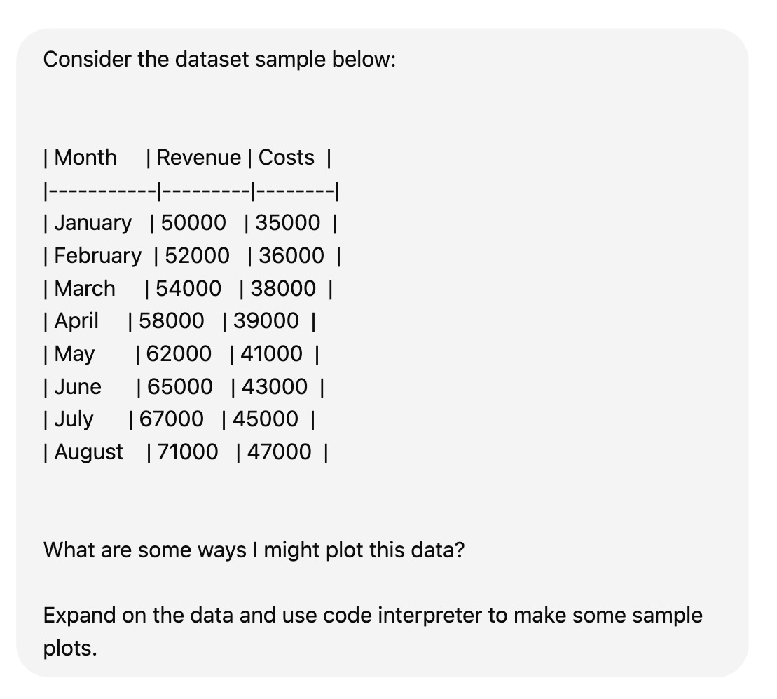
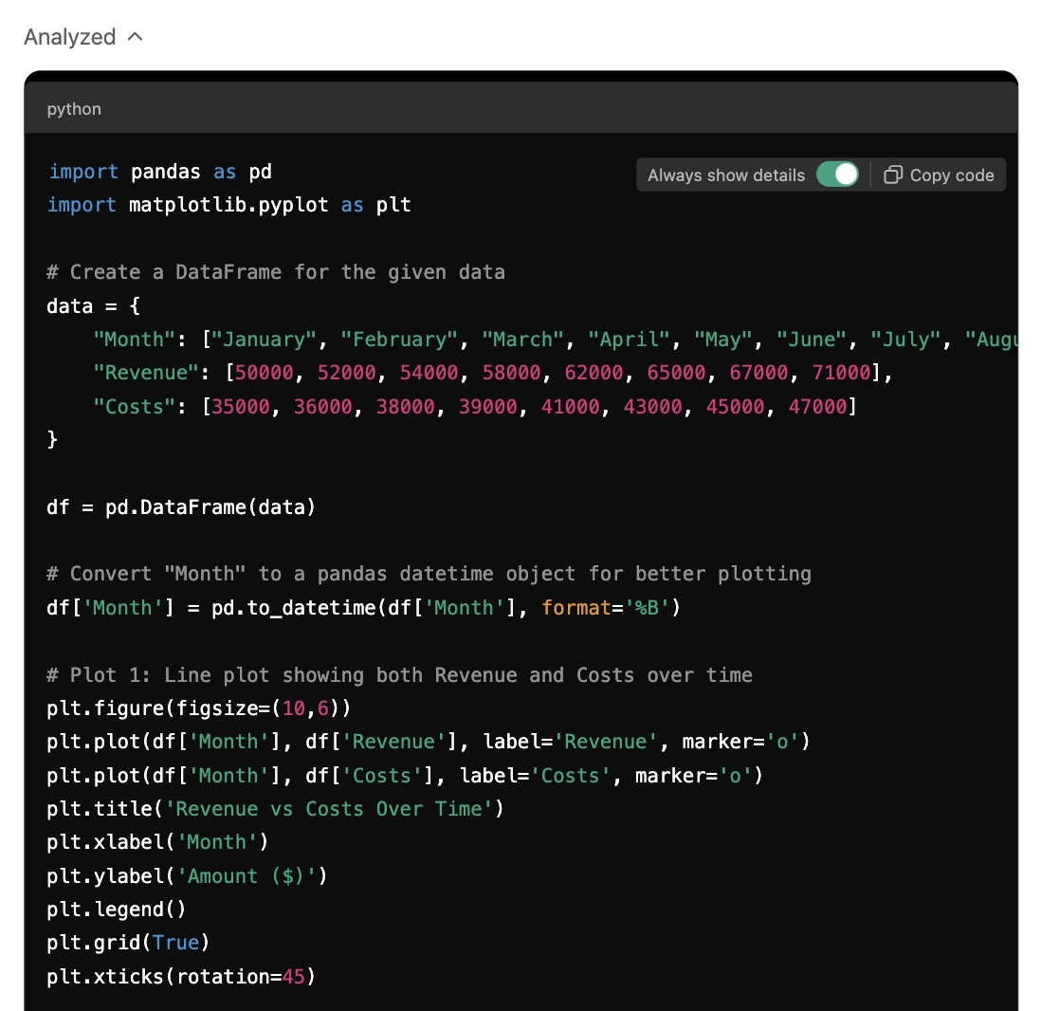
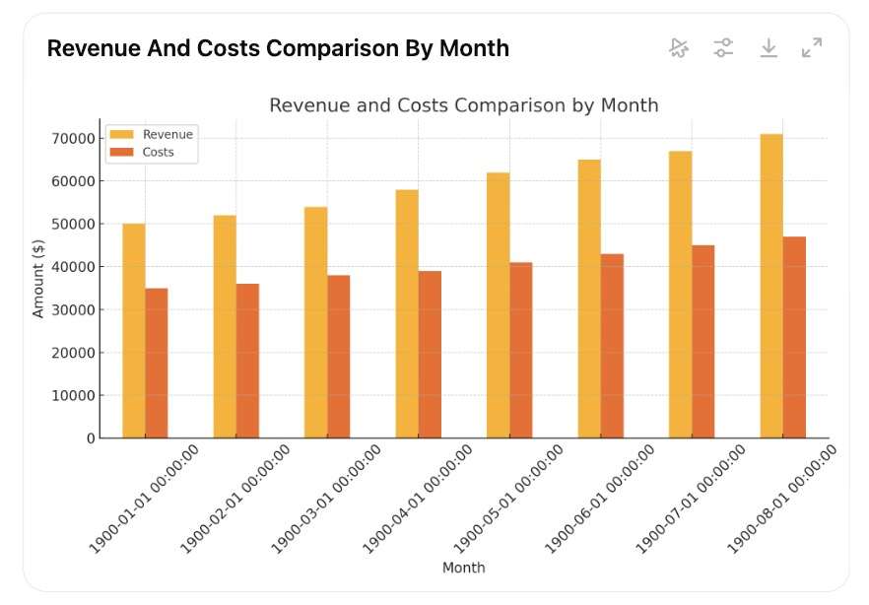
How to get ideas for plots
Google search similar plots
Ask an LLM
Notes:
```{python}
people_df = pd.DataFrame(
{
"name": ["Alice", "Bob", "Charlie"],
"age": [25, 30, 28],
"city": ["Lagos", "London", "Lima"],
}
)
people_df
```

Slide 5
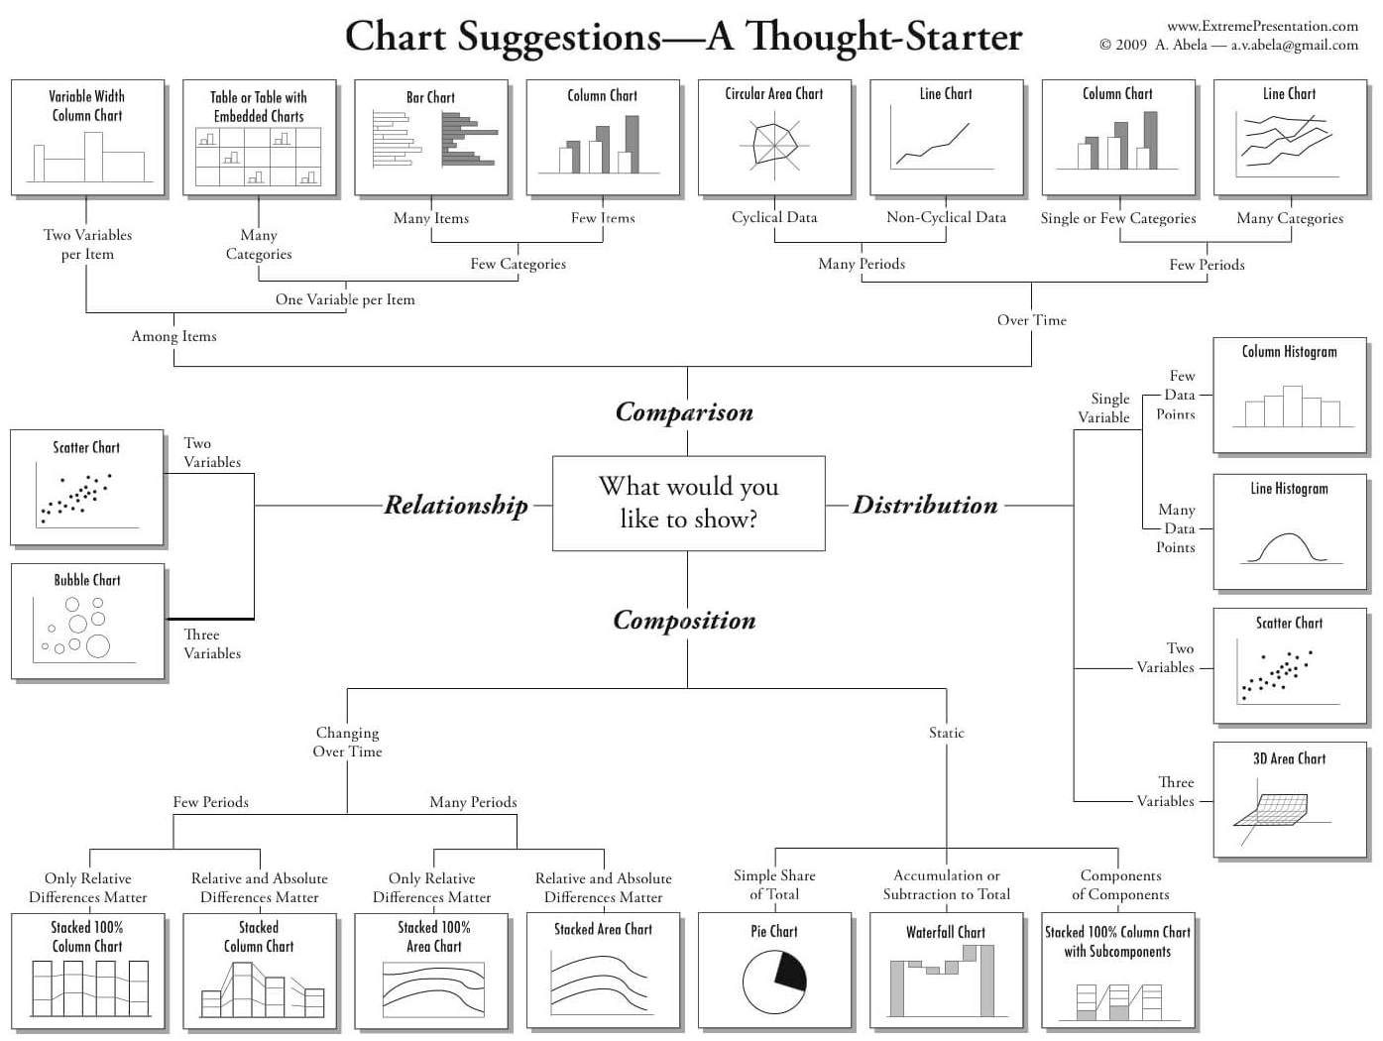
How to get ideas for plots
Google search similar plots
Ask an LLM
Look through a taxonomy chart
Notes:
```{python}
people_df = pd.DataFrame(
{
"name": ["Alice", "Bob", "Charlie"],
"age": [25, 30, 28],
"city": ["Lagos", "London", "Lima"],
}
)
people_df
```

Slide 6

A simple (and limited) data viz taxonomy with the tips dataset
Questions that can be answered with this data
One Variable (Univariate)
Numeric
• What is the distribution of tips?
• (Guess the second)
Categorical
• Are there more male or female diners?
• (Guess the second)
Two variables (Bivariate)
Numeric vs. Numeric
• Does tip amount go up with bill amount?
Categorical vs Numeric
• Which sex has higher bills/tips more?
• (Guess the others)
Categorical vs Categorical
• How does sex ratio differ by day of week?
total_bill | tip | sex | day
16.99 | 1.01 | Female | Sun
10.34 | 1.66 | Male | Sun
21.01 | 3.5 | Male | Sun
23.68 | 3.31 | Male | Sun
24.59 | 3.61 | Female | Sun
17.82 | 1.75 | Male | Sat
18.78 | 3.0 | Female | Thur
… | … | … | …
240 rows

Slide 7
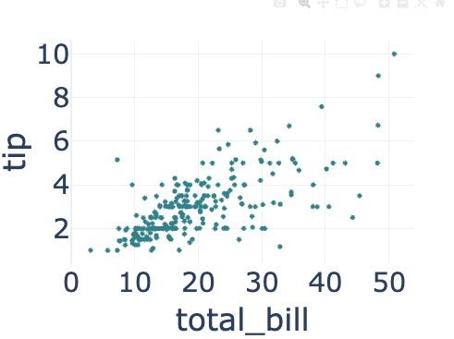
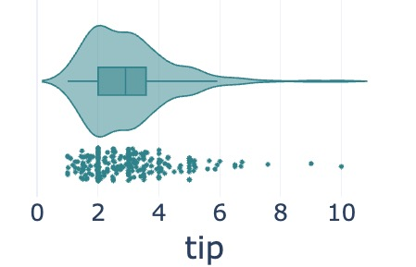
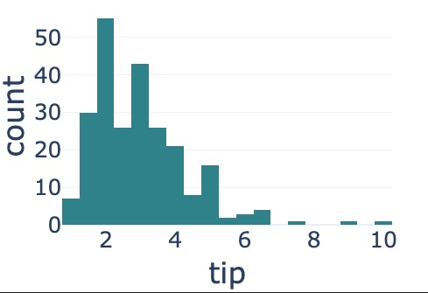
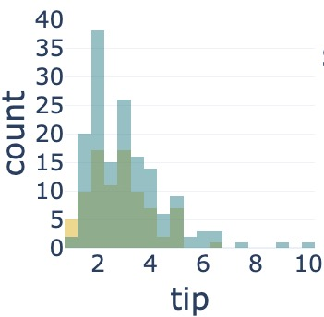
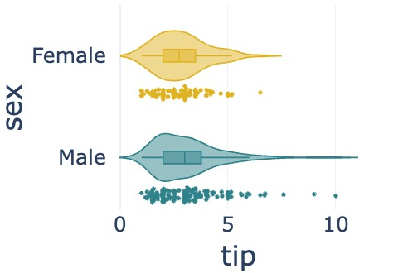
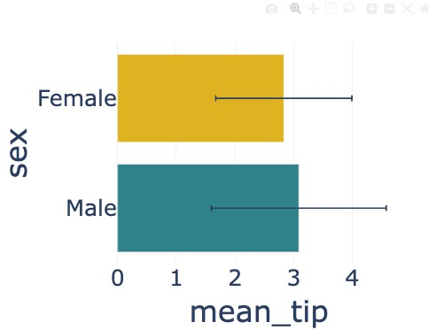

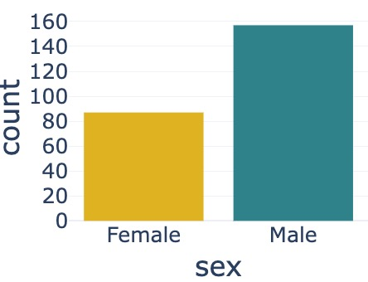
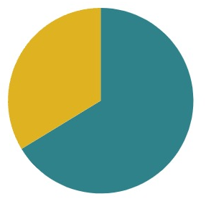
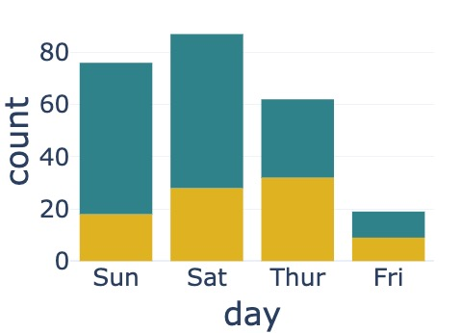
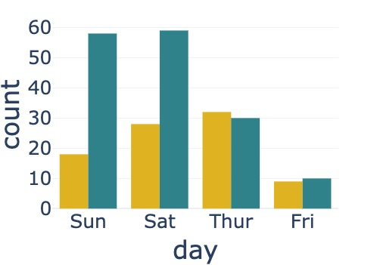
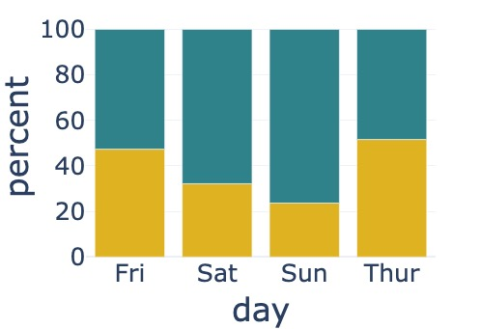
A simple (and limited) data viz taxonomy with the tips dataset
•Does tip amount go up with bill amount?
• What is the distribution of tips?
Numeric vs Numeric
Scatterplot
Violin/box/jitter plot
Histogram
Numeric
total_bill | tip | sex | day
16.99 | 1.01 | Female | Sun
10.34 | 1.66 | Male | Sun
21.01 | 3.5 | Male | Sun
23.68 | 3.31 | Male | Sun
24.59 | 3.61 | Female | Sun
17.82 | 1.75 | Male | Sat
18.78 | 3.0 | Female | Thur
… | … | … | …
• Which sex tips more?
Grouped Histogram
Grouped
violin/box/jitter plot
Bar chart (summary stats)
One
Variable
Two
Variables
Numeric
vs Categorical
Pie Chart
Bar Chart
Categorical
• How does sex ratio differ by day of week?
Stacked Bar Chart
Grouped Bar Chart
Percent-stacked bar Chart
• Are there more male or female diners?
Categorical vs Categorical

Slide 8
Practice: Identify visualization
country | continent | lifeExp | gdpPercap | income_group
Afghanistan | Asia | 43.828 | 974.58033 | Low & Middle Income
Albania | Europe | 76.423 | 5937.0295 | Low & Middle Income
Argentina | Americas | 75.32 | 12779.379 | Low & Middle Income
Austria | Europe | 79.829 | 36126.4927 | High Income
Bahrain | Asia | 75.635 | 29796.04 | High Income
1. How does country GDP per capita vary across continents?
2. Is there a relationship between country GDP per capita & life expectancy?
3. How does life expectancy vary between the country income groups?
4. What is the relationship between continent & income group?
Scatterplot
Violin/box/jitter plot
Histogram
Numeric vs Numeric
Numeric
Grouped Histogram
Grouped
violin/box/jitter plot
Bar chart (summary stats)
One
Variables
Two
Variables
Numeric
vs Categorical
Pie Chart
Bar Chart
Categorical
Stacked Bar Chart
Grouped Bar Chart
Percent-stacked bar Chart
Categorical vs Categorical

Slide 9
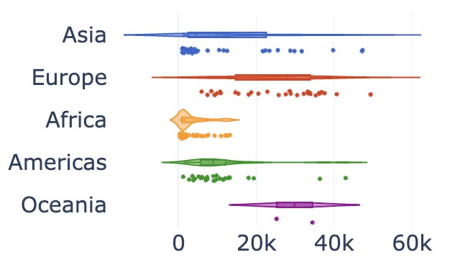
Practice: Identify visualization
country | continent | lifeExp | gdpPercap | income_group
Afghanistan | Asia | 43.828 | 974.58033 | Low & Middle Income
Albania | Europe | 76.423 | 5937.0295 | Low & Middle Income
Argentina | Americas | 75.32 | 12779.379 | Low & Middle Income
Austria | Europe | 79.829 | 36126.4927 | High Income
Bahrain | Asia | 75.635 | 29796.04 | High Income
1. How does country GDP per capita vary across continents?
1.
Scatterplot
Violin/box/jitter plot
Histogram
Numeric vs Numeric
Numeric
Grouped Histogram
Grouped
violin/box/jitter plot
Bar chart (summary stats)
One
Variables
Two
Variables
Numeric
vs Categorical
Pie Chart
Bar Chart
Categorical
Stacked Bar Chart
Grouped Bar Chart
Percent-stacked bar Chart
Categorical vs Categorical

Slide 10
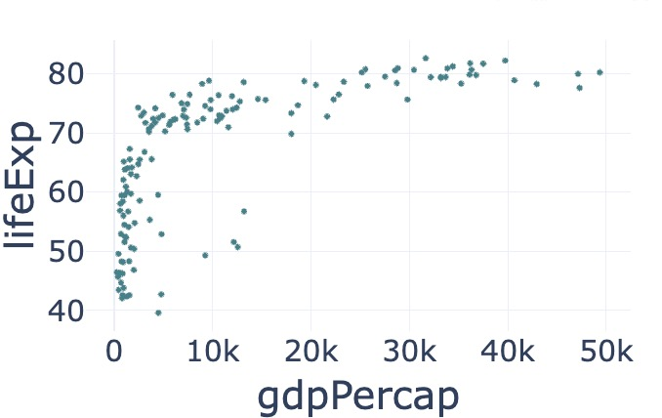
Practice: Identify visualization
country | continent | lifeExp | gdpPercap | income_group
Afghanistan | Asia | 43.828 | 974.58033 | Low & Middle Income
Albania | Europe | 76.423 | 5937.0295 | Low & Middle Income
Argentina | Americas | 75.32 | 12779.379 | Low & Middle Income
Austria | Europe | 79.829 | 36126.4927 | High Income
Bahrain | Asia | 75.635 | 29796.04 | High Income
1. How does country GDP per capita vary across continents?
2. Is there a relationship between country GDP per capita & life expectancy?
2.
Scatterplot
Violin/box/jitter plot
Histogram
Numeric vs Numeric
Numeric
Grouped Histogram
Grouped
violin/box/jitter plot
Bar chart (summary stats)
One
Variables
Two
Variables
Numeric
vs Categorical
Pie Chart
Bar Chart
Categorical
Stacked Bar Chart
Grouped Bar Chart
Percent-stacked bar Chart
Categorical vs Categorical

Slide 11
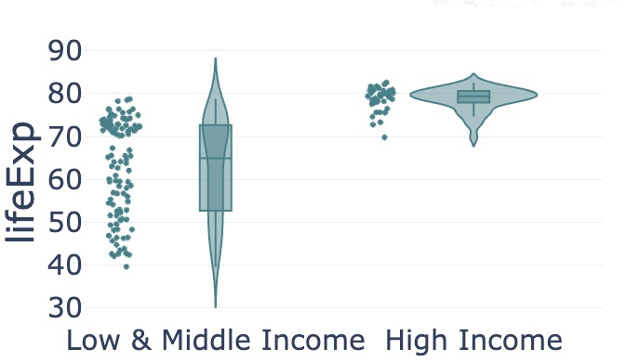
Practice: Identify visualization
country | continent | lifeExp | gdpPercap | income_group
Afghanistan | Asia | 43.828 | 974.58033 | Low & Middle Income
Albania | Europe | 76.423 | 5937.0295 | Low & Middle Income
Argentina | Americas | 75.32 | 12779.379 | Low & Middle Income
Austria | Europe | 79.829 | 36126.4927 | High Income
Bahrain | Asia | 75.635 | 29796.04 | High Income
1. How does country GDP per capita vary across continents?
2. Is there a relationship between country GDP per capita & life expectancy?
3. How does life expectancy vary between the country income groups?
3.
Scatterplot
Violin/box/jitter plot
Histogram
Numeric vs Numeric
Numeric
Grouped Histogram
Grouped
violin/box/jitter plot
Bar chart (summary stats)
One
Variables
Two
Variables
Numeric
vs Categorical
Pie Chart
Bar Chart
Categorical
Stacked Bar Chart
Grouped Bar Chart
Percent-stacked bar Chart
Categorical vs Categorical

Slide 12
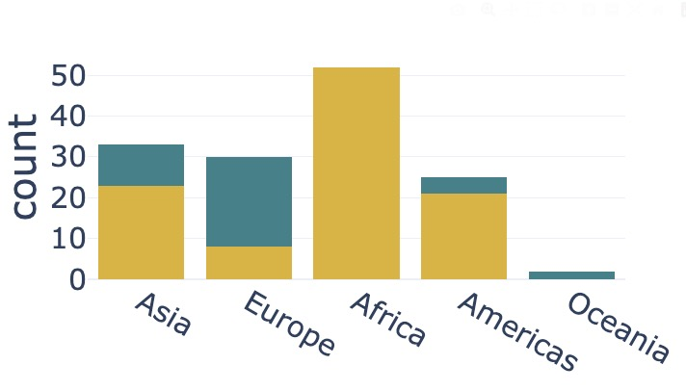

Practice: Identify visualization
country | continent | lifeExp | gdpPercap | income_group
Afghanistan | Asia | 43.828 | 974.58033 | Low & Middle Income
Albania | Europe | 76.423 | 5937.0295 | Low & Middle Income
Argentina | Americas | 75.32 | 12779.379 | Low & Middle Income
Austria | Europe | 79.829 | 36126.4927 | High Income
Bahrain | Asia | 75.635 | 29796.04 | High Income
1. How does country GDP per capita vary across continents?
2. Is there a relationship between country GDP per capita & life expectancy?
3. How does life expectancy vary between the country income groups?
4. What is the relationship between continent & income group?
4.
Scatterplot
Violin/box/jitter plot
Histogram
Numeric vs Numeric
Numeric
Overlaid Histogram
Grouped
violin/box/jitter plot
Bar chart (summary stats)
One
Variables
Two
Variables
Numeric
vs Categorical
Pie Chart
Bar Chart
Categorical
Stacked Bar Chart
Grouped Bar Chart
Percent-stacked Bar Chart
Categorical vs Categorical

Slide 13
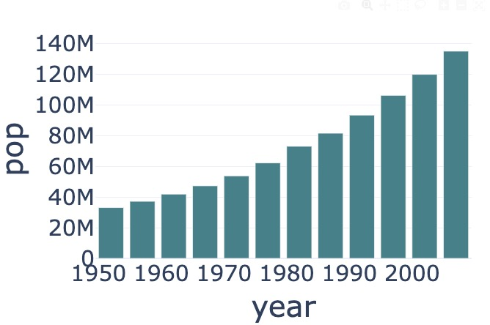
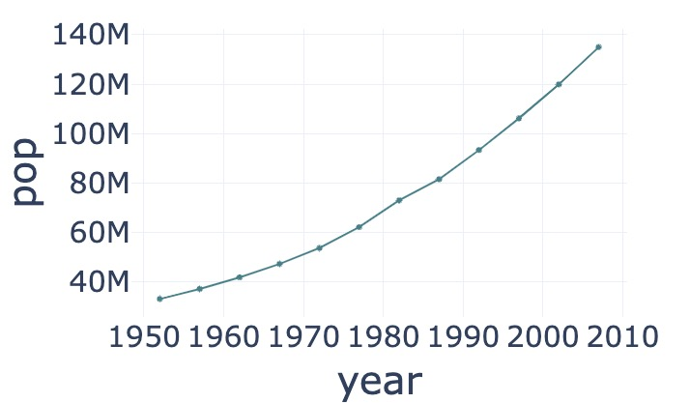
Time series
Usually bar charts or line charts with markers.
Nigerian population over time
Year | Population
1952 | 33119096
1957 | 37173340
1962 | 41871351
1967 | 47287752
1972 | 53740085
1977 | 62209173
1982 | 73039376
1987 | 81551520
1992 | 93364244
1997 | 106207839
2002 | 119901274
2007 | 135031164
Notes:
```{python}
people_df = pd.DataFrame(
{
"name": ["Alice", "Bob", "Charlie"],
"age": [25, 30, 28],
"city": ["Lagos", "London", "Lima"],
}
)
people_df
```

Slide 14
•Does tip amount go up with bill amount?
• What is the distribution of tips?
Numeric vs Numeric
Scatterplot
Violin/box/jitter plot
Histogram
Numeric
• Which sex tips more?
Grouped Histogram
Grouped
violin/box/jitter plot
Bar chart (summary stats)
Numeric
vs Categorical
One
Variable
Two
Variables
Pie Chart
Bar Chart
Categorical
• How does sex ratio differ by day of week?
Stacked Bar Chart
Grouped/Clustered Bar Chart
Percent-stacked bar Chart
• Are there more male or female diners?
Categorical vs Categorical

