Slide 1
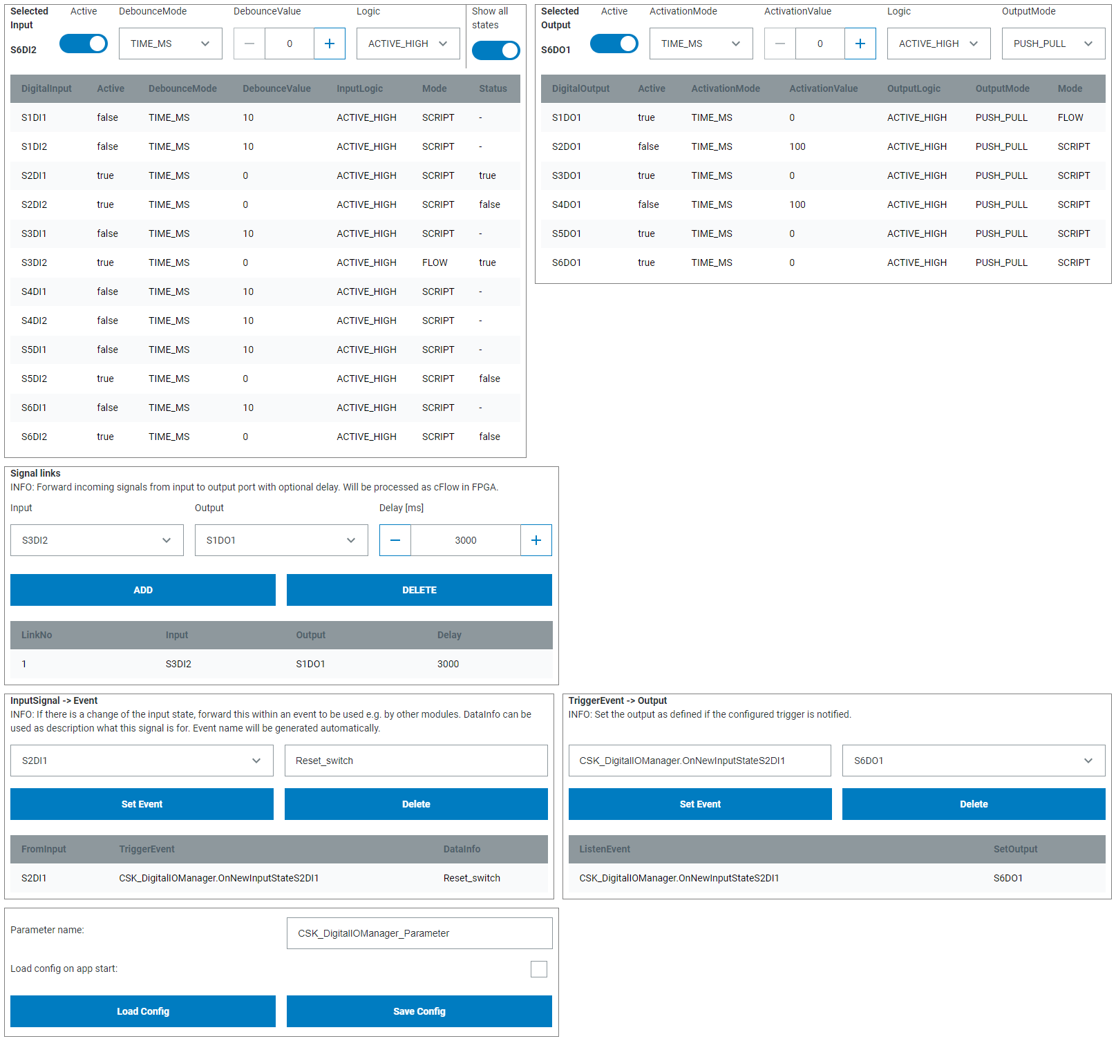
SAMPLE
SAMPLE
SAMPLE
SAMPLE

