Slide 1
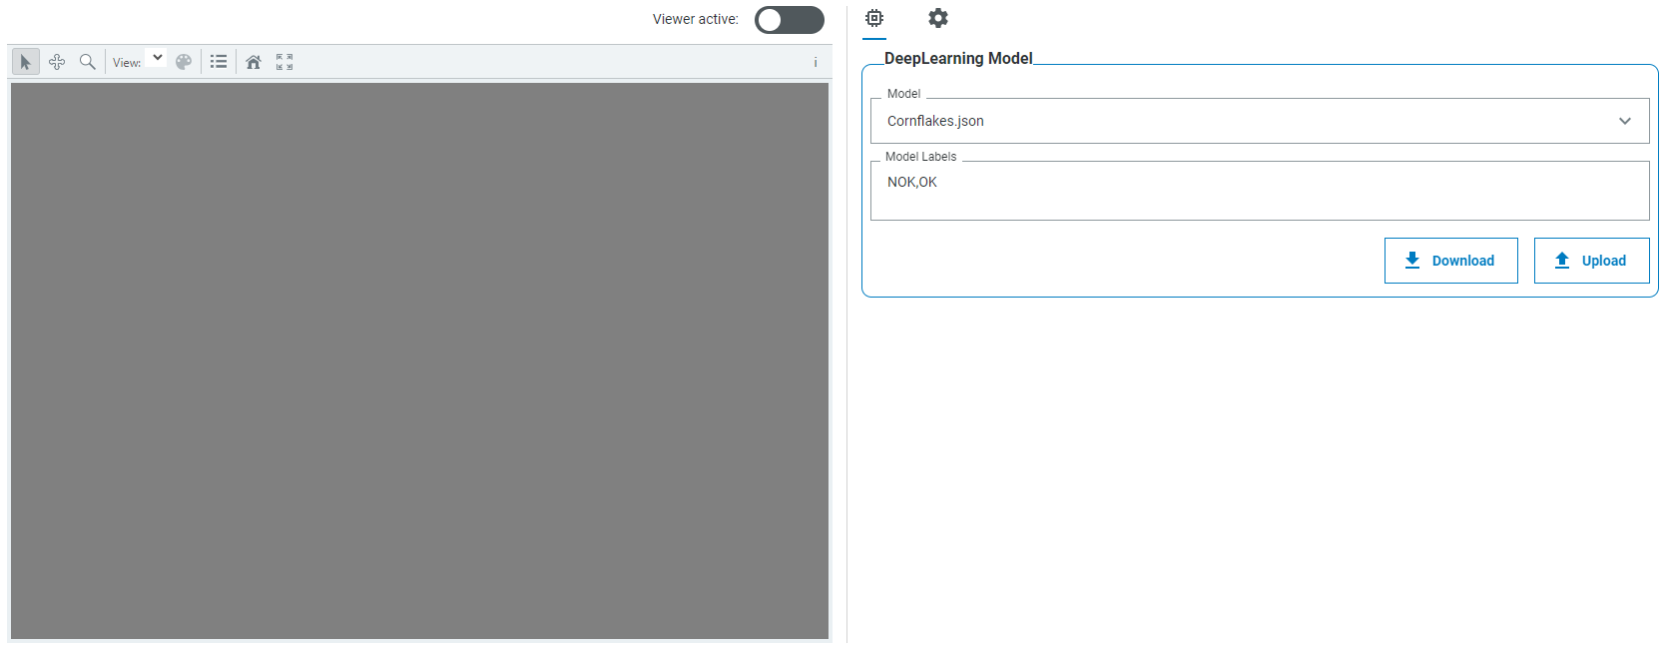
SAMPLE
SAMPLE

