Slide 1
Medico Guide
A multidimensional hybrid healthcare assistant
Ayushi, Chhavi, Meghna, Pragya

Slide 2
HEALTHTECH
Create solution to deal with these
two major challenges faced
by patients
PERSONAL MEDICAL ASSISTANT

Slide 3
CONTENTS
BASIC IDEA
DOMAIN/INDUSTRY OF THE APP
FEATURES OF APP
BENEFITS OF APP
TECHNOLOGIES USED
PERMISSIONS FOR THE APP
NEEDS FOR THE APP
WHY IS THE IDEA UNIQUE

Slide 4
01
BASIC IDEA

Slide 5
WHAT ARE WE MAKING
WHO ARE WE WORKING FOR
01
02
HOW WILL WE HELP
WHAT DO WE CONCERN ABOUT
03
04
A MULTIDIMENSIONAL HYBRID HEALTHCARE ASSISTANT
COLLEGE STUDENTS WHO ARE CONSTANTLY ENGAGED IN TECHNICAL DEVICES FOR EXTENDED PERIODS
GIVES WAYS TO IMPROVE PHYSICAL HEALTH, MENTAL HEALTH CONDITIONS AND THE MENSTRUAL CYCLE OF FEMALES
MENTAL , PHYSICAL AND MENSTRUAL HEALTH

Slide 6
02
DOMAIN/INDUSTRY

Slide 7
MENTAL HEALTH
PHYSICAL HEALTH
WOMEN’S HEALTH
Helps students fight against anxiety and depression
Keeps a track of physical activities and sleep patterns
Gives Menstrual cycle related suggestions

Slide 8
03
FEATURES

Slide 9
MONITORS DAILY PERFORMANCE
DO SCREEN TIME MONITORING
SIMPLE YOGA SUGGESTIONS/MEDITATION
VOICE ASSISTANCE AND CHATBOT
physical movements; walks, sleep patterns etc
Monitor screen time and Gives Suggestions to Take Break
For user care
Anytime & time Specific, Notifications to Meditate Periodically

Slide 10
SUGGESTIONS FOR DOCTOR’S APPOINTMENT
RELAXING PLAYLIST
FORUM
MONITORS MENSTRUAL CYCLE
Relaxing Sounds for all kinds of frame of minds; Motivational voice interviews (Volunteer professionals)
The app suggests the doctor names, according to the problems user have along with the complete information of the doctor that helps in contacting them easily
A forum having all users connected to each other where they can share their issues.
Monitors cycle and gives suggestions or remedies for problems related to that (ex. Cramp remedies etc.)

Slide 11
04
BENEFITS

Slide 12
BENEFITS
01
02
03
04
05
HANDY DURING WORK FROM HOME/ ONLINE CLASSES OF COLLEGE STUDENTS
USEFUL DURING MENSTRUAL CYCLE OF COLLEGE STUDENTS
(FEMALES)
VOICE ASSISTANT TO PROVIDE CONSTANT GUIDANCE
IMPROVED RELAXATION TECHNIQUES LIKE PODCAST AND FORUM
EASY CONSULTATION WITH DOCTORS- IF REQUIRED

Slide 13
05
TECHNOLOGY USED

Slide 14
Technology Stack
InVision
Android Studio
MySQL
For Prototype Design
For Application Development
For Database Connectivity in App

Slide 15
06
PERMISSIONS REQUIRED FOR APP

Slide 16
Permissions Required
Location
Speaker
Calendar
Text
Storage

Slide 17
07
NEEDS FOR APP TO GET STARTED

Slide 18
Needs for the application
Doctors
Motivational Speakers
Tie-up with Doctors and Counsellors for Professional help in health related issues
Connect with Motivational Speakers to post their Content on this app

Slide 19
08
UNIQUENESS OF APP

Slide 20
UNIQUE SELLING PROPOSITION
ACCESS TO EXCLUSIVE PODCASTS AND FORUMS
ONE SINGLE PLATFORM
DEALS WITH PHYSICAL,MENTAL AND MENSTRUAL HEALTH AT ONE PLACE
MOTIVATIONAL TALKS AND EXPERT INTERVIEWS TO COPE WITH DAILY LIFE STRESS. INTERACTION WITH FELLOW COMMUNITY MEMBERS CAN HELP IN FEELING LESS LONELY
EXCELLENT RECOMMENDATION SYSTEM
VOICE ASSISTANT
PROVIDE CONSTANT GUIDANCE AND ANSWER FAQS
PROVIDES SUGGESTIONS FOR AUDIO, YOGA, EXERCISES, PODCASTS AND FOOD HABITS ETC

Slide 21
CONCLUSION
As we have discussed above, our app consists of some major features that people deal with in present time. Our app is simple to use and is user friendly.
Although the target audience of our app are the students, we have also included some features that are beneficial for the entire community. The app covers various solutions on the issues faced by students, but, it also has features like motivational videos, relaxing sounds etc. that is beneficial for all.

Slide 22
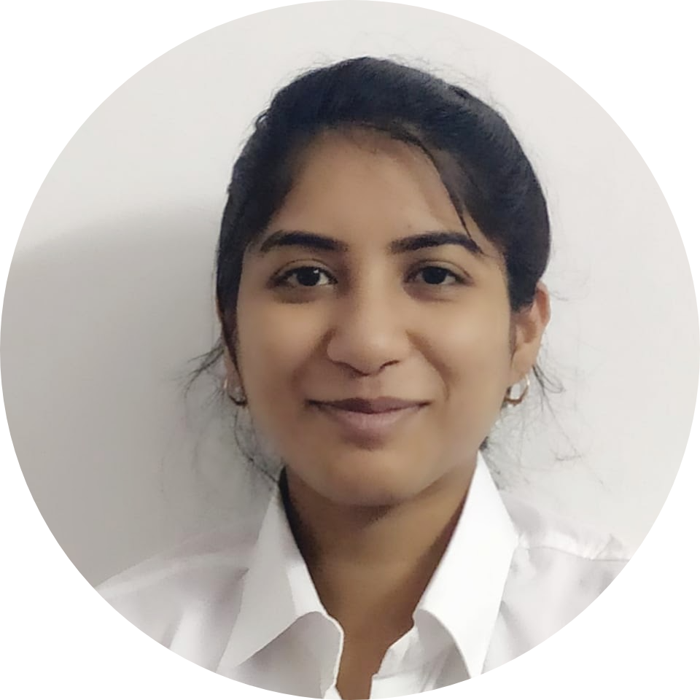
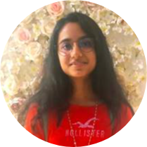
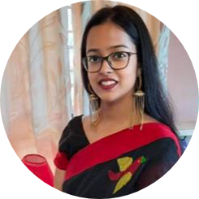
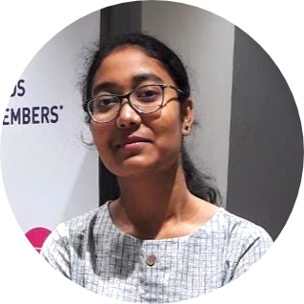
MediCoders - OUR TEAM
AYUSHI KHARE
CHHAVI TRIVEDI
MEGHNA DAS
PRAGYA PARMITA SAMBODHI
GITHUB
LINKEDIN
GITHUB
LINKEDIN
GITHUB
LINKEDIN
GITHUB
LINKEDIN

Slide 23
THANK YOU!
Please keep this slide for attribution
Notes:
MEGHNA- DO NOT DELETE

