Slide 1
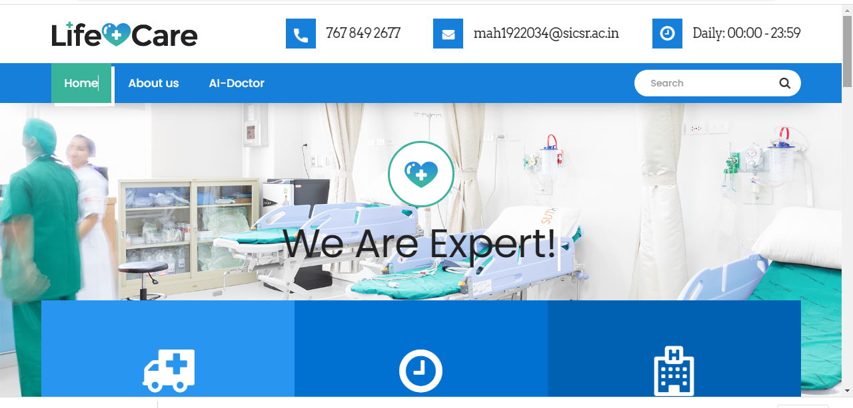
Our topic is health care so here is our model called the AI-doctor web-service and taking it further.

Slide 2
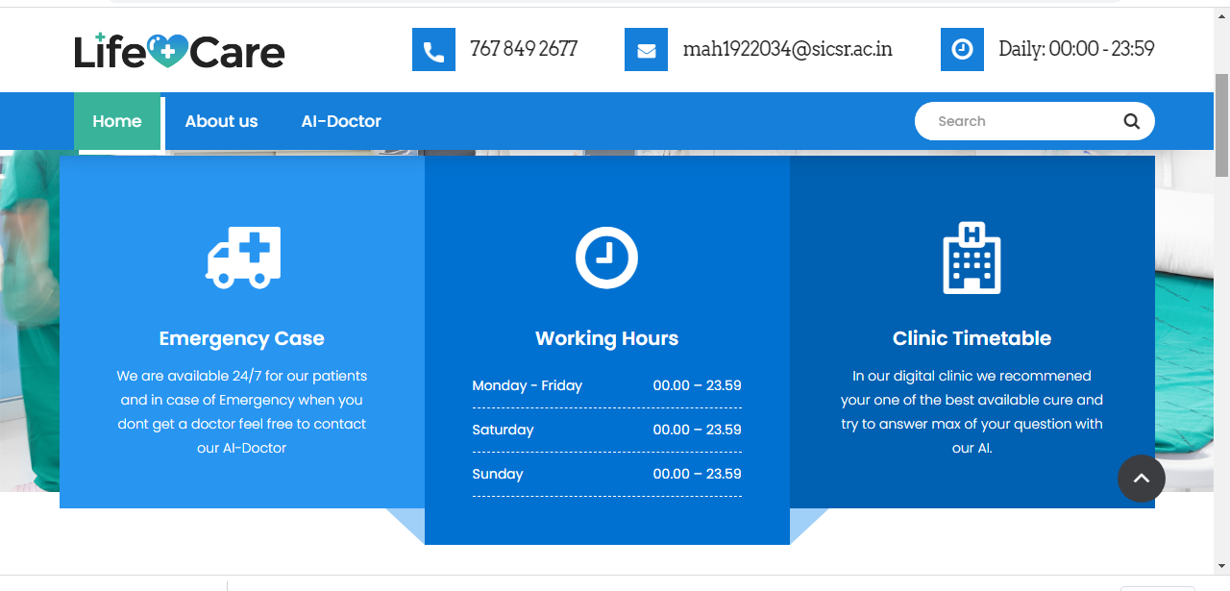
As its COVID 19 time doctor are very busy and are not available easily so we introduced this model so that we can serve humanity and take the burden of doctor for a period of time .

Slide 3
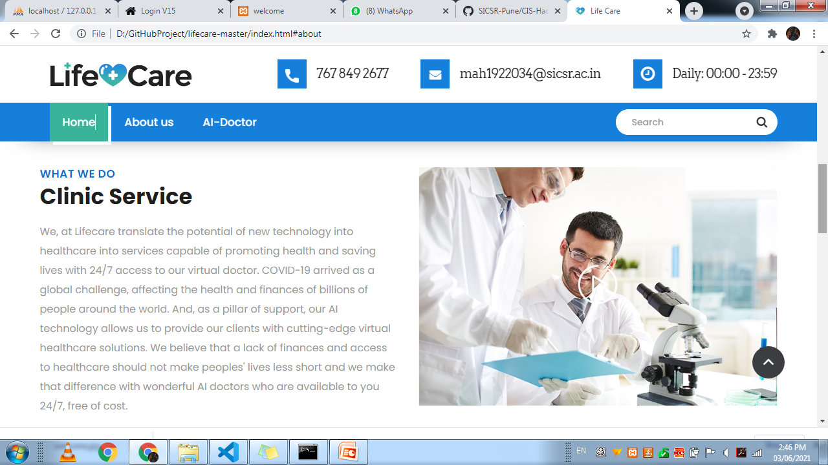
ABOUT US

Slide 4
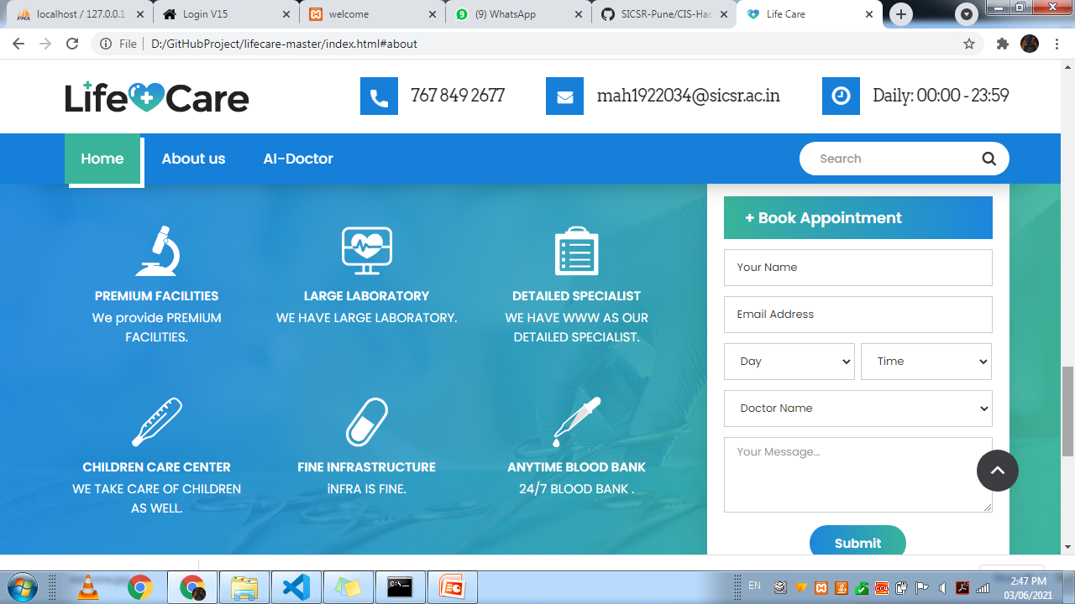
This is the way through which you can contact our AI doctor

Slide 5
Ideology behind the concept is that we used Python to integrate an AI chat bot which is in the form of a doctor which is going to fetch you information from the WWW and assist you when you are not able to contact your doctor or you are hesitating to go to the doctor because you cant open up with your problem so here we will give you the best solution

