Slide 1
Computer Principles for Programmers
Hardware + Software = Platform
Notes:
Overview of Some Important System Terminology, System Programming, System Programming/Software Design Principles, and History of Operating Systems

Slide 2
Agenda
Quiz
News
Discussion
  Introductory Concepts
  Hardware vs Software vs Firmware
  Principles of Systems Design
  Operating System Concepts
  Short History of System Software Development
  Task Manager & APIs

Slide 3
Quiz

Slide 4
News of the Week

Slide 5
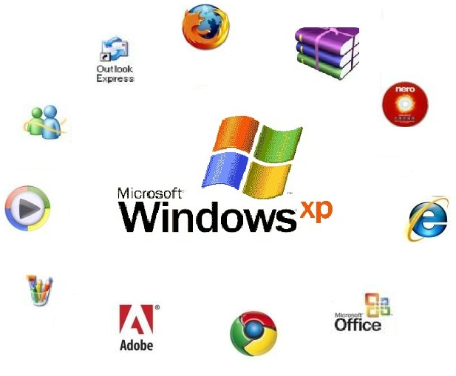
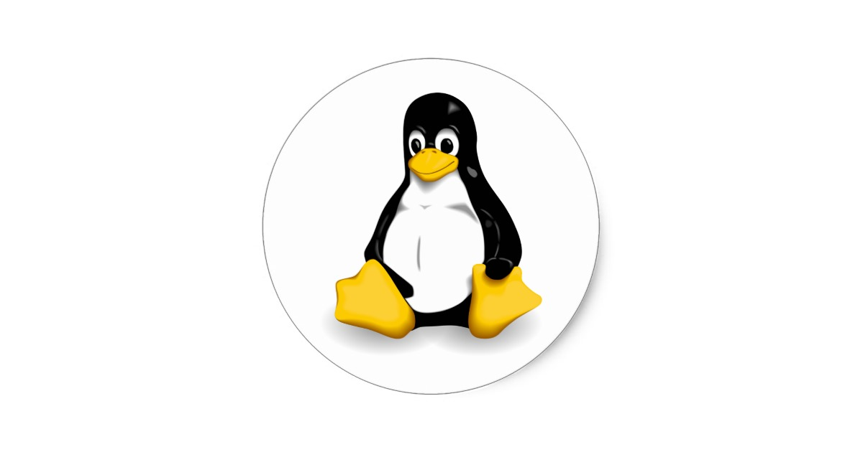
Systems
Operating System (OS)
manages hardware & software resources, provides common services for Application Software.
Application Software
  A program (or “app”) designed to perform a group of coordinated user functions, tasks, or activities in order to solve a problem.
Platform: hardware + OS + development enviro
TUX penguin
Torvald's UniX
Notes:
Server and small systems market share:
OS - A low level program that allows end user devices like keyboards, mice, and screens to communicate with computer hardware and controls the execution of application programs.
TUX is the Linux mascot. “(T)orvalds (U)ni(X)”.
https://en.wikipedia.org/wiki/Usage_share_of_operating_systems#Desktop_and_laptop_computers
Application Software, including Web Apps, is the primary focus of the School of ICT’s software development programs.
A Platform is a combination of hardware + OS + development environment. E.g. “Wintel.NET” which is Windows running on Intel CPU/hardware using ASP.NET which is a web framework for building modern web apps and services using Microsoft development tools such as Visual Studio. There are courses using this technology.
What are other platforms? iOS + Android tablets & smartphones (increasing shipments), Desktop + laptop PCs (declining shipments); in 2011 sales of mobile devices exceeded PCs. The big three personal computing platforms are Apple mac & iOS, Android, and Windows. Apple has 13.7% of smartphone market share in 2017Q1 but all of the profits. Android platforms have the rest of market share but little of the profit. Blackberry in-service devices are fading fast and their market share was zero in 2016Q4. The iOS App Store earned 75 percent more revenue than the Google Play Store in 2015 despite Apple's much smaller number of devices in service. Apple iOS users spend more than four dollars for every Android dollar on all purchases made through mobile devices.
The server market platforms: The most common operating system for mainframes is IBM's z/OS. In The midrange market is IBM Power Systems running AIX (UNIX) and IBM i/OS. The small server market includes Windows server and Linux servers.

Slide 6
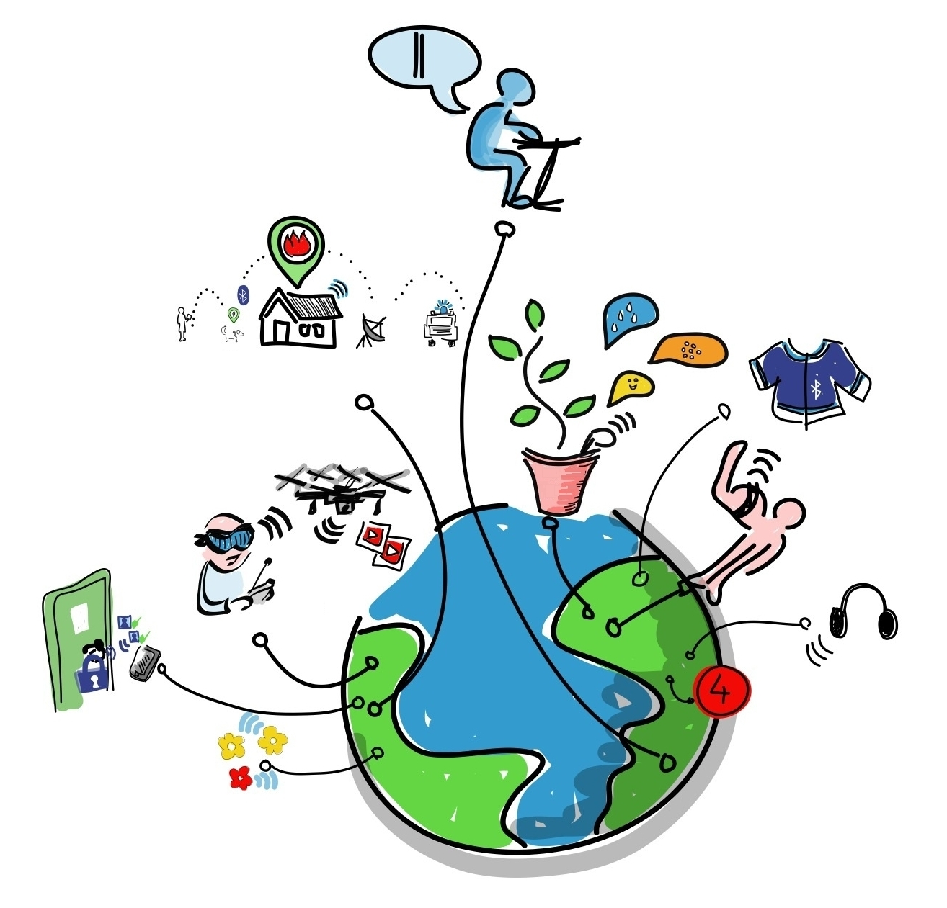
Firmware and the Internet of Things
As of 2017Q4, there are more IoT devices on the planet than people.
In 2019, there will be
twice as many.
In 2021, there will be three times as many.
By Wilgengebroed on Flickr [CC BY 2.0 (http://creativecommons.org/licenses/by/2.0)], via Wikimedia Commons
Notes:
Embedded systems are small computers that have a microcontroller/microprocessor inside running a program from firmware. Examples: Digital alarm clocks, microwave ovens and other kitchen appliances, Christmas lights that blink in patterns, vehicles have many embedded systems: throttle control to go, automatic transmissions to continue going, traction control systems to go safely, ABS (Anti-skid Braking Systems) to stop in the minimum distance.
Firmware is a combined OS and application running on small embedded systems. These systems have very limited storage. Your microwave oven might be capable of configuration as to whether it makes that annoying beep but it will not remember that you usually turn it on at 70% power for 4 minutes to heat up a can of soup.
Software is the most temporary and malleable. Firmware is semi-permanent software that’s tied more directly to the hardware and updated less often, and hardware is the physical components that are most permanent. IoT applications run on small devices where reduced processor use means less heat, where reduced memory footprint means smaller chips; all of which means reduced power consumption and better battery life. C language is particularly good at this.
Firmware plus networking is the basis of many IoT devices. https://en.wikipedia.org/wiki/Internet_of_things
Legal scholars suggest to look at "Things" as an "inextricable mixture of hardware, software, data and service".
The Internet of Things or IoT is the internetworking of physical devices, vehicles (also referred to as "connected devices" and "smart devices"), buildings, and other items—embedded with electronics, software, sensors, actuators, and network connectivity that enable these objects to collect and exchange data.
http://www.businessinsider.com/what-is-the-internet-of-things-definition-2016-8
The Internet of Things Needs a Code of Ethics
https://www.theatlantic.com/technology/archive/2017/05/internet-of-things-ethics/524802/
Social and Ethical Behavior in the Internet of Things (important article (referenced above) by Vint Cerf – a father of the internet – and Francine Berman, computer-science professor at Rensselaer Polytechnic Institute and a long-time expert on computer infrastructure. https://cacm.acm.org/magazines/2017/2/212443-social-and-ethical-behavior-in-the-internet-of-things/fulltext
Connectivity FYI: https://www.rs-online.com/designspark/eleven-internet-of-things-iot-protocols-you-need-to-know-about,
https://www.postscapes.com/internet-of-things-protocols/
http://datasmart.ash.harvard.edu/news/article/internet-of-things-in-focus-859
http://www.zdnet.com/article/your-forgotten-iot-gadgets-will-leave-a-disastrous-toxic-legacy/
http://www.zdnet.com/article/dell-outlines-iot-strategy-plans-to-spend-1-billion-on-r-d-over-three-years/
http://www.zdnet.com/article/iot-devices-will-outnumber-the-worlds-population-this-year-for-the-first-time/
Programming for embedded systems
https://barrgroup.com/embedded-systems/books/embedded-c-coding-standard
https://embeddedgurus.com/stack-overflow/2008/06/efficient-c-tips-1-choosing-the-correct-integer-size/

Slide 7
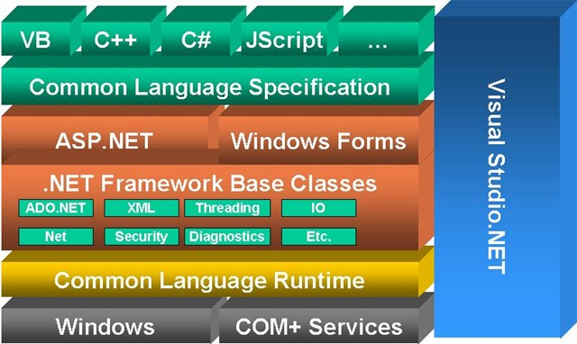
ASP.NET PLATFORM
Notes:
The .NET platform can create local standalone applications deployed to a single PC (Windows Forms) although the browser with its JavaScript engine is now the default User Interface platform.
The ASP – Active Server Pages aspect of .NET interacts with Microsoft’s web server, IIS - Internet Information Services, to run applications via a client’s browser.
There are courses using this platform in the School of ICT.
Programs written in any language for .NET Framework execute in a software environment named Common Language Runtime (CLR), an application virtual machine that provides services such as security, memory management, and exception handling. This is similar to the Java Virtual Machine concept.
The Model-View-Controller (MVC) architectural pattern is commonly used by most object oriented development platforms. MVC separates an application into three main components: the model (data domain), the view (User Interface), and the controller (handle user interaction, work with the model, and ultimately select a view to render that displays UI). This pattern is used in most object oriented development platforms. In theory, the same controller could use a browser/web view, a different view for a local application on a desktop's big screen display, keyboard, and mouse and a different view for a smartphone. The same controller talks to a model where the underlying data store could be changed from a traditional relational DB (e.g. Oracle or IBM's DB2) to a noSQL DB (e.g. MongoDB). ADO.NET allows programmers to access data and data services from any type of database. Data stores and SQL access are abstracted away from the application into a data Model.
https://msdn.microsoft.com/en-us/library/dd381412(v=vs.108).aspx ASP.NET MVC Overview
https://msdn.microsoft.com/en-us/library/ff649643.aspx (identified as "Retired Content" but a good explanation of MVC concepts)
https://msdn.microsoft.com/en-us/magazine/mt842512.aspx Simpler ASP.NET MVC Apps with Razor Pages
Web programming experts know the info here –> https://codeburst.io/how-browsers-work-6350a4234634

Slide 8
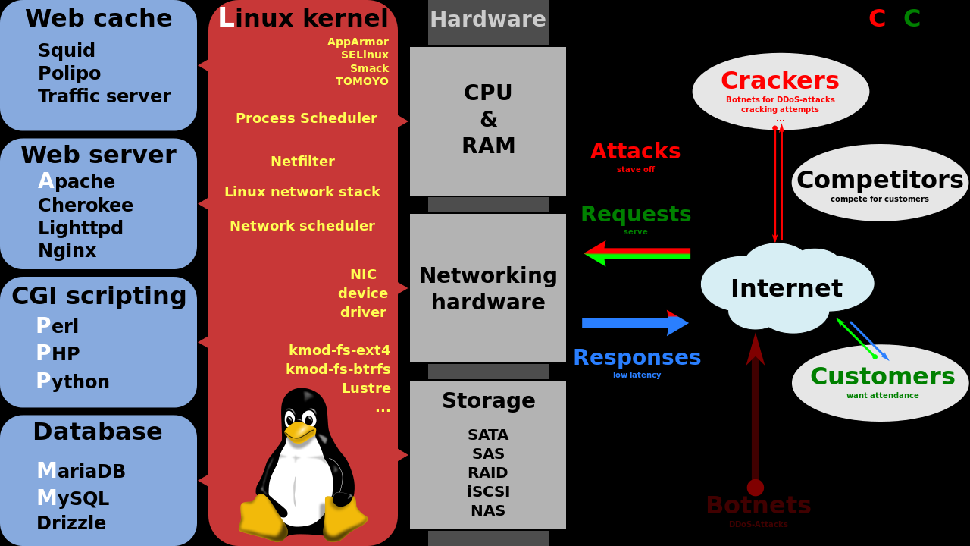
LAMP stack
By Shmuel Csaba Otto Traian, CC BY-SA 3.0, https://commons.wikimedia.org/w/index.php?curid=28224098
Notes:
Illustration By Shmuel Csaba Otto Traian, CC BY-SA 3.0, https://commons.wikimedia.org/w/index.php?curid=28224098
From https://en.wikipedia.org/wiki/LAMP_(software_bundle)
Another common platform is the LAMP stack an open source web platform used to run dynamic web sites and servers. It includes Linux OS, Apache web server, MySQL database, and PHP/Python/Perl programming. Linux OS runs on a variety of hardware from PCs to IBM mainframes.
There are courses using aspects of this platform throughout the School of ICT.

Slide 9
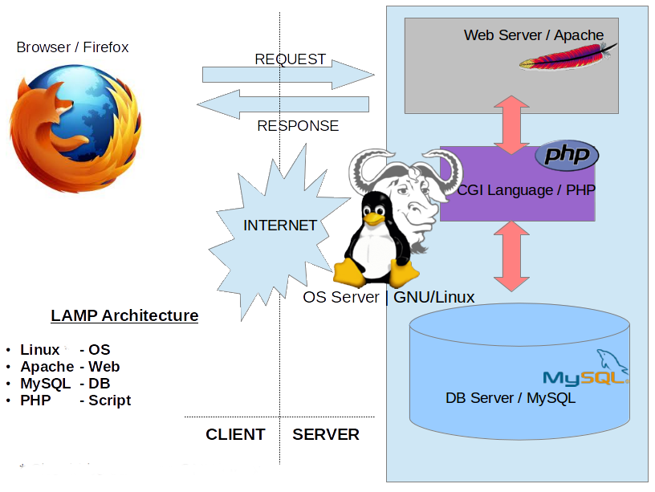
LAMP stack
Attribution: K7.india at English Wikipedia
Notes:
Inside the LAMP stack.
CGI - Common Gateway Interface, a standard for dynamic generation of web pages by a web server. Allows a web page to call a program.
PHP - PHP originally stood for Personal Home Page, but it now stands for the recursive acronym PHP: Hypertext Preprocessor.
GNU: GNU's Not Unix (another clever recursive acronym…and RMS is clever. Google: RMS GNU)

Slide 10
Hardware components cryptic quiz
What do all these TLAs mean? (Three Letter Acronyms)
4+ letter versions are xTLAs (extended TLAs)
What MOBO is on your machine?
A single CPU, FPU, or GPU may contain multiple ALUs.
RAM, SDRAM, DDRn (main memory, volatile)
BIOS, EEPROM, UEFI (firmware, non-volatile memory)
SSD, HDD, CD-ROM, FDD (2ndary, non-volatile storage)
USB, SD card
SIM card
(in the computer occasionally used to talk to other people)
NIC, Wi-Fi
Nothing on this slide will be on the quiz.
Notes:
➔ These will not be on the quiz.
MOtherBOard
Machine – what geeks call computers
Central / Floating-point / Graphics Processing Unit, Arithmetic Logic Unit performs calcs on integer binary numbers.
Synchronous Dynamic Random-Access Memory (SDRAM) is any Dynamic Random-Access Memory (DRAM)
DDR - Double data rate synchronous dynamic random-access memory (DDR SDRAM), DDR versions 1 - 4
BIOS – Basic Input/Ouput System that boots up a computer from an EEPROM Electrically Erasable Programmable Read Only Memory
UEFI - Unified Extensible Firmware Interface (UEFI) is a specification that defines a software interface between an operating system and platform firmware.
UEFI replaces the Basic Input/Output System (BIOS) firmware interface originally present in all IBM PC-compatible personal computers,
SSD solid-state drive , Hard Disk Drive, Compact Disc-Read Only Memory, Floppy Disc Drive
USB – Universal Serial Bus, Secure Digital Card (SD card)
SIM (Subscriber Identity Module)
NIC – Network Interface Card
Wi-Fi = Wi-Fi Alliance hired Interbrand to create a name that was "a little catchier than ''IEEE 802.11b Direct Sequence.' Wi-Fi is a word invented as a pun upon the word hi-fi.

Slide 11
Software Terminology
Program
EXecutable File (EXE)
MS Word
Process
Program in execution (loaded in memory)
WINWORD.EXE
Threads
Tasks performed inside the process
- mouse clicks
- spell check
- send to printer
Important OS Terms
Notes:
Program – a program is an application in an executable file, commonly with an EXE and/or DLL (Dynamic Linked Library) file extension. For example MS Word’s WINWORD.EXE. It is a file on a drive ready to be executed, i.e. run.
When a program file is run, the OS creates a process. Unique resources are reserved and memory addresses allocated for each process.
Some programs like PowerPoint will have a single process with one or more threads (AKA child process or sub-process) for each PPT file being edited. Other programs will have separate processes for each task, e.g. Chrome.
[ use Task Manager to show WINWORD.EXE as the process for MS WORD ]
Inside a process, a specific action is performed in a “thread”. More than one thread can run concurrently. For example, a thread listens for a mouse click, another thread waits for you to finish typing a word and spell checks it. You can print a document and immediately continue using Word while the printing thread runs in the background.
Programming with threads is covered in our object oriented programming classes using C++, C# or Java.
About Processes and Threads
https://msdn.microsoft.com/en-us/library/windows/desktop/ms681917(v=vs.85).aspx
"Each process provides the resources needed to execute a program. A process has a virtual address space, executable code, open handles to system objects, a security context, a unique process identifier, environment variables, a priority class, minimum and maximum working set sizes, and at least one thread of execution. Each process is started with a single thread, often called the primary thread, but can create additional threads from any of its threads.
A thread is the entity within a process that can be scheduled for execution. All threads of a process share its virtual address space and system resources. In addition, each thread maintains exception handlers, a scheduling priority, thread local storage, a unique thread identifier, and a set of structures the system will use to save the thread context until it is scheduled. The thread context includes the thread's set of machine registers, the kernel stack, a thread environment block, and a user stack in the address space of the thread's process. "

Slide 12
Principles of Systems Design
Layered Architecture
Memory Protection
Modular Design
Multitasking
Virtual Memory
Virtualization

Slide 13
1. Layered Architecture
End User
Programmer
Software
Engineer
Hardware
Engineer
Interface
Application Software
System Services
System Software
Hardware
Notes:
Users use Apps but they don’t change them.
Programmers create Apps and use System Services through APIs (more about that in a moment)
Software Engineers and computer scientists create services and high level Operating System functions that humans see and interact with.
Hardware (Electrical and Computer) Engineers design the hardware and low level system software that lets an operating system talk to the hardware.

Slide 14
2. Memory Protection
User Mode
Request
Application
Reply
Server Service
User Mode
API
Service Call
Kernel Mode
Executive Services
System Call
Hardware
Notes:
For the operating system to be more reliable, memory must be protected from bad programs or bad hardware.
increased memory protection can also provide increased security.
Thus the system is more reliable because an application program has no direct access to memory, resources or hardware. It only has the ability to request access. The request is done through an API (Application Program Interface – more on next slide), the operating system service will contact the kernel executive services which will make a system hardware call to perform the appropriate action. When the action is completed, a reply is sent back through the stack to the application program that called the API.

Slide 15
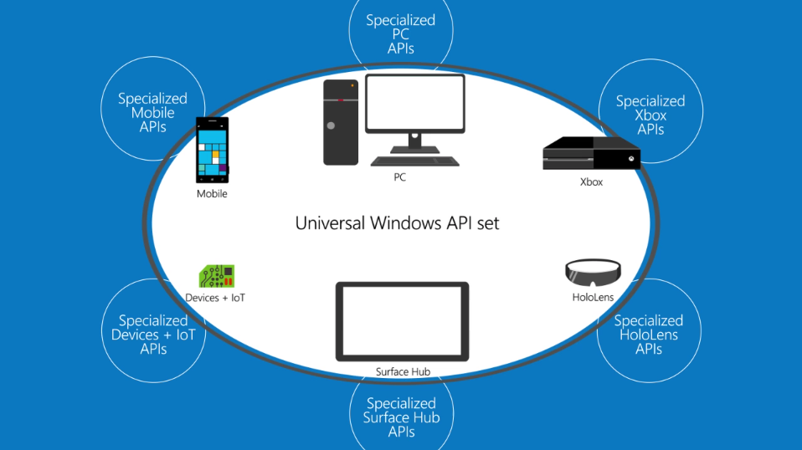
Application Programming Interface (API)
Notes:
APIs are the glue between the OS and Apps. Your app wants to prompt the user to open or save a file. The programmer does not want to know how to navigate the storage hardware or the directory tables to hardware addresses or even the dialog box that the user sees. Press Ctrl-O in Word or PowerPoint. Do you want to write that? And do it again for each platform? Not any more. We use APIs. An API is, loosely, a procedure call with parameters. E.g.call OpenFile([path\]fileName, fileHandle). Your program asks the OS for a file by name, the system sends back a “handle” which is an OS reference to that file, now opened and allocated to your program. Your program uses the handle to read and write the file, and finally close it.
The benefit is that a single API makes the applications more “portable”. For example, an application written for a Windows PC, could work on Surface Tablets, Windows Phones (not too many of those), Xbox, and Windows Server. The local implementation of the API will be different depending on the platform, but your program will not know the difference.
The disadvantage of this approach is that the APIs must be rigidly defined and adhered to which can limit programming flexibility. Advantage is… changes to an OS or hardware can be made without changing the API interface. The OS or hardware can be overhauled and improved without breaking application software because the API remains the same.
See https://www.youtube.com/watch?v=s7wmiS2mSXY in this week’s activity.

Slide 16
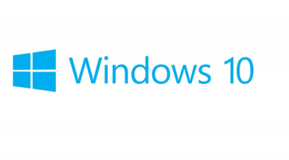
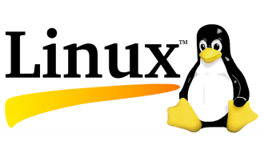
3. Modular Design
MicroKernel
Monolithic Kernel
System Services
System Services
Task Management
File Management
GUI Interface
Device Management
Task Management
File Management
GUI Interface (Shell)
Device Management
Notes:
A modular operating system has a clear delineation of functions such as Task Management, File Management, Device Management and a GUI interface. Each function operations as a “stand-a-lone” program, called a service. Each service runs in its own memory space. This makes it easier to update modules without having to change the whole system. It also makes programming easier by defining the function components and “abstracting” them or hiding the details from the programmer.
The opposite approach is to design a monolithic system which provides the same services, but the relationship between the components is not as clear. Consequently, a simple change in one service, could have a “ripple” effect throughout the operating system. For example, a change in hardware could mean that the operating system must be recompiled to incorporate the new device driver in order for the hardware to work.
In a monolithic kernel OS, the program runs as a single large static binary file process running entirely in a single address space. Basic OS services such as task management, file management, and device management all run in same memory space. Entire services are loaded on boot up and reside in memory and work is done using system calls.

Slide 17

Modular vs Monolithic Design
Micro Kernel
Monolithic Kernel
Advantages
More reliable
Easy update, patch, extend
Advantages
Runs faster
Fewer bugs\security issues
Disadvantages
Slower performance
Larger source code
Task Management complex
Disadvantages
Difficult to update, patch, extend
Recompiling kernel time consuming
Notes:
One OS is not better than the other, just different. The question is which one is best for your circumstances, tasks, software availability.

Slide 18

4. Multi-tasking & Multi-processing
Operating System appears
to run multiple processes
at the same time.
Why multi-tasking?
CPU is usually waiting
on Input/Output operations
CPU + RAM are fast, I/O is slow
Multi-processing: Separate processes run simultaneously on multiple CPU cores sharing memory and peripherals.
Parallel processing: A single process uses multiple CPUs/cores simultaneously.
Notes:
Since the beginning of operating systems users have wanted to do multiple tasks at the same time and have the ability to switch between running applications. Now, it is considered normal, not so in the early days.
Multitasking uses a single CPU but switches in time slices between tasks (task=application or process).
Multiprocessing means true parallel execution of multiple but separate processes on separate CPUs within a system.
Parallel processing means a single process or task using multiple CPUs simultaneously; this requires specific application programming or an OS which carefully manages a single process's threads to avoid race conditions.
These three types of processing can all occur within the same system. The Operating System controls access to shared memory and peripherals and schedules tasks among CPUs. All contemporary PCs, tablets and smartphones have multiple CPU "cores" on a single chip.
Why multitasking? CPU + RAM are fast, I/O is slow.
MS-Word is formatting your document for printing by sending it to the print spooler which uses a holding area on secondary storage (a drive) to buffer the even slower device.
You’ve asked Outlook to check your email while that happens. But it is slow due to network bandwidth constraints and traffic on your intranet.
So you open a tab in your browser and begin that big download to your USB drive which takes time. Your internet connection is fast (for an outside network connection) and you are using a USB 3.0 device but your older computer has only USB 2.0 ports so the throughput to the your USB drive will be slow. But is the write speed slower than the internet connection? Maybe not.
So you start playing Solitaire. It runs in fast CPU + ram but the I/O to the mouse and screen is slow. Nevertheless, the mouse and screen I/O is usually faster than you can move your hand or read.
Finally, the printer spits out your document, you have new email from your course instructor, the download is finally complete…but you are still playing Solitaire.

Slide 19
4. Multi-tasking
Run
I/O Wait………..….
Run
I/O, CPU wait
Run
Process 1
Time slice expired
CPU Wait
Run
I/O wait....CPU wait
Run
Process 2
Run
Run
Wait
Run
Run
Run
CPU
Notes:
There are many strategies to multitasking depending the needs of the system. Some aspects of the operating system get priority over applications. A PC running your applications treats most apps equally. Your phone pays a little more attention to incoming signals (someone is calling you, a text arrives) than you punching numbers into the calculator app but you don’t notice because you are slowest thing running.
A computer controlling a robot pays attention in “real-time”, i.e. the robot always comes first, its interrupt signals are processed with higher priority than other OS tasks. Real-time responses are often understood to be in the order of milliseconds, and sometimes microseconds. E.g. fly-by-wire aircraft controls, anti-lock brakes in a car. The computer checks for signals from the outside world, from outside its “system boundary”, so frequently that, to a human or the robot, it appears to be operating continuously in human perceived real time. As far as the robot knows, the computer system is always available to process the robot's output and does not delay in directing the robot's next action. In "real-time", the computer is always waiting on the robot, the robot is never waiting for the computer.
https://en.wikipedia.org/wiki/Human_multitasking
Human multitasking is an apparent human ability to perform more than one task, or activity, over a short period (1 hour). An example of multitasking is taking phone calls while typing an email and reading a book. Multitasking can result in time wasted due to human context switching and apparently causing more errors due to insufficient attention. Studies have shown that it is impossible to focus on more than one task at a time. However, if one is proficient at one of the tasks at hand, then it is possible to do these tasks.

Slide 20
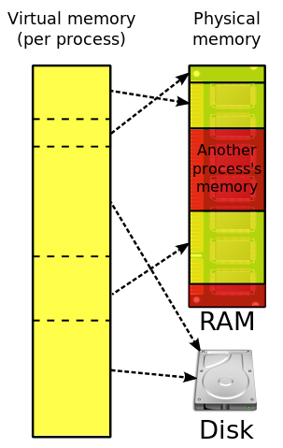
5. Virtual Memory
A 32 bit process uses up to 2GB of RAM.
Many processes can be run even though they exceed physical memory.
Memory management swaps between limited physical RAM and ~unlimited~ virtual memory on a drive.
Multi-tasking switches between processes and may trigger VM swapping.
Thrashing:
The system spends more time swapping processes than running them.
It occurs when a computer's virtual memory subsystem is in a constant state of over commitment with a high degree of process switching (multi-tasking).
Notes:
Why can a 32 bit process can access only 2GB of RAM? A 32 bit unsigned integer can address 4GB (long int data types).
https://superuser.com/questions/1163749/why-do-32-bit-processes-have-a-2gb-ram-limit
"In the NT platform the 4 GB virtual address space is by default divided into 2 parts, the lower 2 GB for process address space and the upper 2 GB for system use."
When to worry about thrashing? When your program uses large arrays of data structures.
Consider dynamic memory allocations
Consider deleting elements. The easy way is to just forget the index or effectively blank out an element or mark it deleted. However, when using large arrays, REUSE deleted elements. Or, maintain a stack or queue of pointers to available array elements. This way, you could dynamically add another chunk of array elements as needed instead of the largest number you think you would ever need.
Virtual memory and caching are memory management techniques developed for multiprocessing operating systems.
Virtual memory is a separate memory space for each program, all programs running may, in total, need more than the actual physical RAM (main memory) capacity. The OS manages this overallocation of physical memory by using slower secondary storage as if it was primary storage. The operating system “swaps” data between these fast and slow areas as needed by the applications running; the applications do not know the difference. To the application, it looks like it has the system to itself with as much memory as it needs. "In the interests of performance, security, and reliability, each process has it's own private 2 GB address space but there is only one system address space. Processes are isolated in their own private address space and cannot see others. System address space is off limits to normal processes and is accessible only to kernel level components such as the OS itself and device drivers. If a process goes astray it can only hurt itself, other processes and the OS are unaffected."
Caching is storing the most frequently used data in the fastest memory. There is expensive, very fast cache memory between the CPU and slower RAM. Available physical RAM is allocated to cache data going to and from slow I/O devices. HDDs have their own caching. Embedded cache on the HDD captures write operations quickly allowing the program to continue asap while the HDD cache and hardware independently perform the slow physical write operations.
Systems that employ virtual memory use hardware more efficiently than systems without virtual memory and make programming of applications easier. Operating systems have sophisticated algorithms to manage virtual memory and caching. The programmer rarely has to worry whether their executable program with its variables and data buffers will ‘fit’ into physical memory. To the program, it looks like it has the entire system to itself with as much memory as it needs.
https://en.wikipedia.org/wiki/Thrashing_(computer_science)
Thrashing occurs when a computer's virtual memory subsystem is in a constant state of paging, rapidly exchanging data in memory for data on disk, to the exclusion of most application-level processing. This causes the performance of the computer to degrade or collapse. The situation may continue indefinitely until the underlying cause is addressed

Slide 21
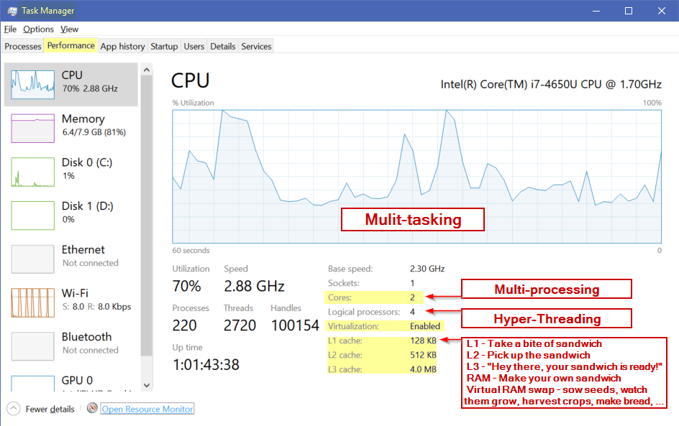
CPU cores and caches
Notes:
Intel® Hyper-Threading Technology (Intel® HT Technology) uses processor resources more efficiently, enabling multiple threads to run on each core. As a performance feature, it also increases processor throughput, improving
overall performance on threaded software.
https://www.intel.com/content/www/us/en/architecture-and-technology/hyper-threading/hyper-threading-technology.html
The logical processors in a hyper-threaded core share the execution resources. These resources include the execution engine, caches, and system bus interface; the sharing of resources allows two logical processors to work with each other more efficiently, and allows a logical processor to borrow resources from a stalled logical core (assuming both logical cores are associated with the same physical core). A processor stalls when it is waiting for data it has sent for so it can finish processing the present thread. https://en.wikipedia.org/wiki/Hyper-threading

Slide 22
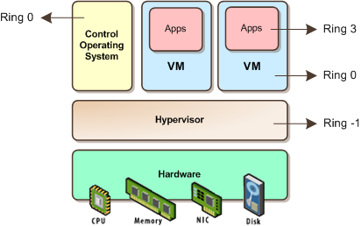
6. System Virtualization with Hyper-V
Picture taken from: http://itechthoughts.files.wordpress.com/2009/11/vbasics10.png?w=412&h=258
Notes:
A strong trend in business today is system virtualization. VMware has built a huge business doing this on the Intel platform. IBM did it long before on mainframes and Power System-i. Because CPUs are grossly under utilized, system virtualization allows businesses to run multiple instances of the same or different operating systems on the same hardware to better utilize its resources. This saves money on buying more machines, the space needed to house those machines, and the electricity to power and cool those machines. Secondly, on the Intel x86 platform, different types software rarely played well together; the web service stole memory from the database service and neither liked the accounting system which clogged the I/O channels. By virtualizing, each major application/service got its own (virtual) machine and communicated through a (virtual) network as if between different servers.
Each “guest” OS is managed by a Virtual Machine (VM) that simulates a complete hardware platform, known as a partition. The VM and IT administrator controls how much CPU, memory, and storage is allocated to each partition.
Linux is increasingly being run on mainframes and midrange servers in virtualized partitions – because it is cheaper to do that rather than run server farms of white boxes.

Slide 23
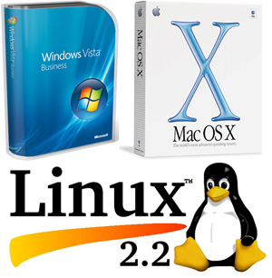
Notes: Short History of Small Systems OS
Notes:
Not on the quiz…

Slide 24
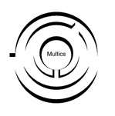






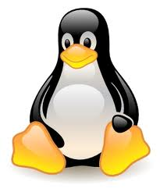
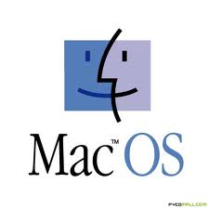

Simplified History of mini and micro systems…
Notes:
In 1964, a project called “Multics” (Multiplexed Information and Computing Service) was launched. This was the first open source project to develop a multiuser, multiprocessor OS. ( the term open source had not been developed yet) The project leader was MIT with major contributors from General Electric, and Bell Labs (the research division of AT&T). See https://en.wikipedia.org/wiki/Multics
Multics was not a success. However, the ideas in Multics went on to be very successful.
The design and features of Multics greatly influenced the Unix operating system, which was originally written by two ex-programmers from the older project, Ken Thompson and Dennis Ritchie. Ritchie developed C to develop UNIX. The name Unix (originally Unics) is itself a pun on Multics. The C language allowed the OS to be very portable (unlike the Assembler of Multics) requiring only a relatively small amount of machine-dependent code to be replaced when porting Unix to other computing platforms. This greatly contributed to its success.
UNIX was designed by computer scientists for computer scientists to conduct research. The earliest distributions of Unix from Bell Labs in the 1970s included the source code to the operating system, allowing researchers at universities to modify and extend Unix. As the project matured, some of the contributors to the project decided in 1983 to create commercial versions of the OS, System V (five) -- which is why today there are many different versions of UNIX IBM AIX, HP/X, Solaris. Through the 1970s and into the 1980s, the University of California at Berkeley continued to share its version of UNIX, known as the Berkeley Standard Distribution (BSD).
Subsequently, many lawyers became rich sorting out whose UNIX intellectual property was whose. The 1992 lawsuit and injunction on distribution slowed development of the free-software descendants of BSD. Linus Torvalds has said that if 386BSD or the GNU kernel had been available at the time, he probably would not have created Linux.
OpenBSD descended from BSD after the lawsuit dust settled. It is important as an OS because it has different goals than Linux. The MAC Leopard OS and iOS are a BSD-based variants.
VMS operating systems was developed by DEC (Digital Equipment Corporation) for its VAX line of computers and in the 80’s the VAX was the most popular minicomputer (small mainframe, VAX is also in common use today along with the IBM iSeries or PowerServer with IBM-i or the original AS-400 which is taught at Seneca) and is still in common use today.
VMS is important for 2 reasons:
it was the first to develop the use of Virtual memory which is now a standard feature of all operating systems.
the project leader for VMS was a man by the name of Dave Cutler, who had worked on both Multics and UNIX projects.
DEC was purchased by HP and today, HP is project leader for OpenVMS (the latter is not open source, but uses open standards)
CP/M stands for Control Programming Module. It was designed by Gary Kildall when he worked for Intel. He left Intel and formed a company called Digital Research Inc (DRI) Unlike UNIX, CP/M is a single user, single task operating system. CP/M is important because it was the first operating system designed for the new microcomputer (PC). IBM had developed the PC hardware but it not have an operating system. IBM failed to come to licensing terms with DRI and turned to a new company called Microsoft to develop the OS. Microsoft did not actually have or own what it sold to IBM at the time of the deal. Microsoft later bought all rights to a clone of CP/M called QDOS (Quick and Dirty Operating System) for $75,000 and renamed it PC-DOS for IBM, the Personal Computer Disk Operating System. Bill Gates wisely negotiated a non-exclusive arrangement with IBM so Microsoft could sell MS-DOS. Because everything in the IBM PC was off-the-shelf components except for the BIOS, the clone computer market could flourish. MS-DOS was the basis of the Microsoft residential code base for the Windows 9x operating systems (Windows 95, 98 and Me).
Microsoft wanted to develop a new operating system that could be used for large commercial enterprises. In 1988, Microsoft formed what would become the development team for the Microsoft Windows NT® product. The team's goal was to develop a 32-bit, multi-user, multi-process operating system that was better than UNIX. At the same time, DEC had cut back on Dave Cutlets project to build an more efficient OS, not based on UNIX design. Discouraged by DEC ‘s decision, Microsoft was able to hire Dave Cutler and most of his programming team to develop this more efficient OS which became known as NT (New Technology AKA Not Today). DEC also believed Cutler brought source code to Microsoft and sued. Microsoft eventually paid US$150 million and agreed to support DEC's Alpha CPU chip on NT.
https://superuser.com/questions/1163749/why-do-32-bit-processes-have-a-2gb-ram-limit
"In the NT platform the 4 GB virtual address space is by default divided into 2 parts, the lower 2 GB for process address space and the upper 2 GB for system use."
This was a design decision made in the interests of performance, security, and reliability. Each process has it's own private 2 GB address space but there is only one system address space. Processes are isolated in their own private address space and cannot even see others. There is provision for sharing address among 2 or more processes when necessary. System address space is off limits to normal processes and is accessible only to kernel level components such as the OS itself and device drivers. If a process goes astray it can only hurt itself, other processes and the OS are unaffected.

