Slide 1


SMART INDIA HACKATHON 2026
DARPAN (SIH-DETA)
Self-Growing Hybrid AI & Railway Physics Engine for Coaching Train ETA
• Problem Statement ID – SIH26028
• Problem Statement Title – Dynamic Forecast of Expected Time of Arrival (ETA) for Coaching Trains
• Organization / Dept – Ministry of Railways (MIC)
• Theme – Smart Automation | Category – Software
• Team ID – 131076 | Team Name – Twarit
👥 TEAM TWARIT — ENGINEERING DELIVERABLES
6-MEMBER SPLIT
Lead & Architect
2-Pass Hybrid Engine, Space-Time DAG & Zero-Clash Platform IntervalTree
AI / ML Lead
31-Feature Quantile GBDT (P10/P50/P90) & Delay-Jump Classifier (0.92 AUC)
Data & Scraper
1.68 GB 6-DB Data Lake, 24x7 Failover Scraper & Feedback Scorer Loop
Backend & API
FastAPI /v1/deta Gateway, <1.5ms Redis Cache & Manual Accident API
UI & Rail Ops
React 18 + Leaflet GIS (3 User Views), G&SR Fog/Heat Rules & 20K Backtest
1.68 GB (Self-Growing)
6-DB Live Scraping & Feedback Lake
8,990 Stns · 704 Cabins
417,080 Schedule Stops Mapped
1.51M Delays · 3.19M Wx
73,342 Track Recovery Profiles
4.93m ➔ 1.49m (-70%)
Typical Error Cut (N=20,000 Test)
85.3% Window + Manual Ops
P10–P90 Band + Live Accident Input
Notes:
Slide 1: Title & Team Deliverables
• Problem Statement ID: SIH26028
• Title: Dynamic Forecast of Expected Time of Arrival (ETA) for Coaching Trains
• Organization: Ministry of Railways (MIC)
• Team: Twarit (ID: 131076)
• Highlights: 1.68 GB 6-DB Rail Data Lake, 8,990 stations, 704 cabins, 70% median error cut (4.93m -> 1.49m).

Slide 2
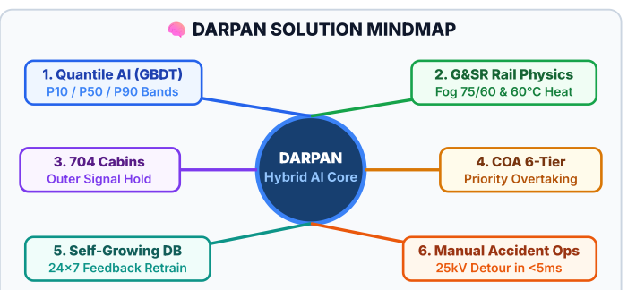
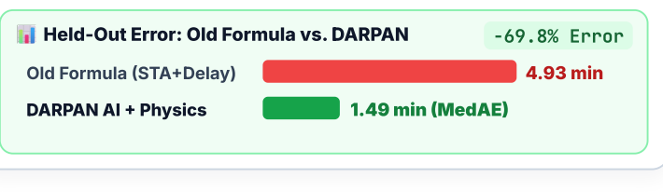
Twarit
DARPAN
(Dynamic Forecast of Expected Time of Arrival for Coaching Trains — SIH26028)
GIST: Replaces Indian Railways' static Schedule + Current Delay - Fixed Buffer formula with a Self-Growing Hybrid AI + Railway Physics Engine that predicts Best / Expected / Worst-Case arrival windows (P10/P50/P90) & supports live manual accident overrides.
💡
🎯
🏆
Core Idea (How It Works)
How We Solve Every PS Point
Core Architecture Mindmap & Results
1
2-Step Hybrid Engine (AI + Rail Rules): Step 1 predicts travel drift via 31-Feature Gradient Boosted AI [P10/P50/P90]; Step 2 enforces track & platform physics [Space-Time DAG].
1
Replaces Static Recovery Buffers: CAG audits show fixed buffers fail on >100% congested trunk lines. We learn real section slack & enforce no early departure before schedule [STD Hold].
2
Smart-Zoom Route Tracking: Runs fast station-to-station [O(1) Mode] when on time; zooms into halt-by-halt signal cabins [704 Cabins] when delayed.
2
Overtaking & Following-Train Delays: Models Vande Bharat / Rajdhani priority overtaking [COA 6-Tier] and 3–7 min safety headway gaps behind slower trains.
✓ 85.3% Window Accuracy & 0.92 AUC: Calibrated [P10, P90] arrival window band + Renamed Code Bridge (+72.5K rows rescued).
3
Self-Growing DB & Feedback Flywheel: Constantly scrapes live runs & scores its own past predictions [1.68 GB now]—the longer it runs, the smarter & more accurate it gets.
3
Official Fog, Rain & Track-Heat Rules: Converts live weather into Indian Railways G&SR Fog-Pass speed limits [75/60/30 km/h] & 60°C rail-buckling speed caps.
4
Manual Unpredicted Accident Input: Control rooms can inject sudden unpredicted accidents/blocks [1-Click Override] to instantly recompute ETAs & 25kV detours.
4
Zero-Clash Platforms & Crowd Surges: [IntervalTree] prevents platform clashes, predicts Outer Home Signal wait times, and models Festival Crowd Halts (Maha Kumbh 3.2x).
@SIH Idea submission- Template
2
Notes:
Slide 2: Core Idea & Solution Mindmap
• Replaces static schedule + delay - buffer with a 2-Pass Hybrid Engine (Quantile GBDT AI + Space-Time DAG physics).
• Includes Mindmap showing 6 radial capabilities: P10/P50/P90 quantile drift, 704 cabins outer hold, COA 6-tier overtaking, G&SR fog/heat rules, self-growing feedback DB, and 1-click manual accident overrides with 25kV detours.

Slide 3
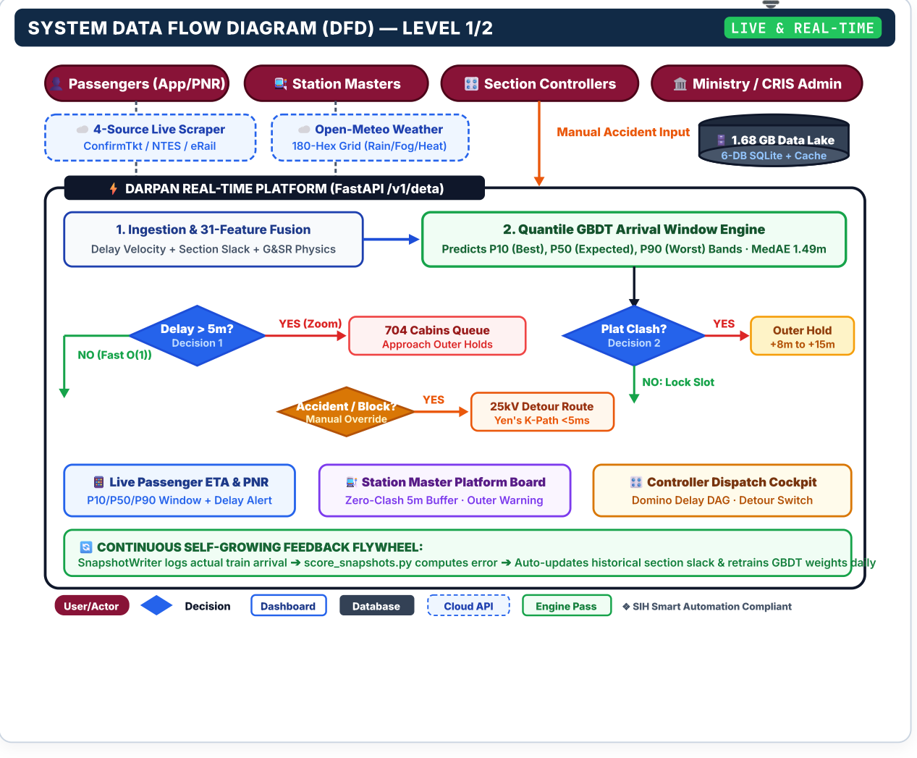
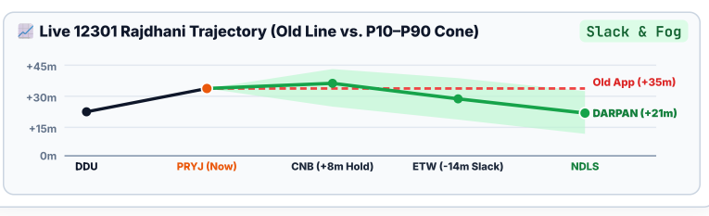
Twarit
TECHNICAL APPROACH & DATA FLOW DIAGRAM
TECHNOLOGY STACK & TRAJECTORY FORECAST
1. 24x7 Scraping & Weather Ingestion: 4-Source Failover (ConfirmTkt➔NTES➔eRail) + Open-Meteo 180-Hex Grid + Smart Pacing (-79.9% load).
2. Self-Growing 6-Database Lake (1.68 GB+): 6 SQLite DBs (darpan, historical, weather, stations, telemetry, anomalies) + <1.5ms Cache.
3. Layer 1 — 31 G&SR Operational Features: Speed trend, 73.3K slack profiles, Fog limits (75/60/30 km/h), 60°C rail heat & festival surges.
4. Layer 2 — Arrival Window AI: 3 Quantile GBDT models predict P10 / P50 / P90 (Transit R² = 0.987) + Delay-Jump Alert (0.92 AUC).
5. Layer 3 — Physics & Manual Accident Ops: Space-Time DAG + Zero-Clash Platforms + 1-Click Manual Overrides + 25kV Detours.
6. Feedback Self-Scoring Flywheel: SnapshotWriter + score_snapshots.py continuously audit predictions vs. actual arrivals to retrain AI.
PROCESS FLOW:
1. Multi-Source Scrape + Weather
➔
2. 31-Feature G&SR Fusion
➔
3. Quantile GBDT (P10/50/90)
➔
4. Physics DAG + Manual Ops
➔
5. FastAPI (<18ms)
➔
6. Self-Scoring DB Loop
@SIH Idea submission- Template
3
Notes:
Slide 3: Technical Approach & Data Flow Diagram (DFD)
• Left: 6-layer technology stack and live 12301 Howrah-New Delhi Rajdhani trajectory fan chart.
• Right: Level 1/2 Data Flow Diagram (DFD) with 4 external stakeholder entities, cloud feeds, 1.68 GB database cylinder, 3 decision diamonds (Delay > 5m?, Platform Clash?, Accident/Block?), and continuous feedback flywheel.
• Bottom: 6-stage linear process flow ribbon.

Slide 4
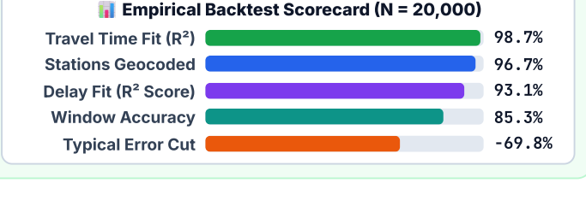
Twarit
FEASIBILITY AND VIABILITY
❖ TECHNICAL FEASIBILITY, MINISTRY FINANCIAL ROI, REAL CHALLENGES & 1:1 SOLUTIONS
1. FEASIBILITY & ECONOMIC VIABILITY
2. REAL RAILWAY CHALLENGES
3. HOW DARPAN SOLVES THEM (1:1)
✓ Self-Growing Public Data Lake (1.68 GB+)
Built on 1.51M real delays & 8,990 stations; 24x7 scraper & feedback scorer grow the DB daily—longer it runs, better it performs.
⚠ Internal Railway GPS (RTIS/COA) is Closed
ISRO 30s locomotive GPS and track signal relays are private CRIS systems unavailable to external teams.
🛡️ 4-Source Public Failover + 704 Cabin Queue Math
Cascades across ConfirmTkt/NTES/eRail + predicts outer-signal wait times across 704 mapped Approach Cabins.
➔
✓ ₹0 Hardware Capex & <₹15K/mo Cloud Opex
Saves ₹120+ Cr in trackside/GPS hardware; runs on standard CPU in <18ms (zero GPU cost) with -79.9% scraper bandwidth.
⚠ Extreme 12–24h Delays & No Early Departures
Heavy delay outliers skew simple averages, while early trains must wait at stations until Scheduled Departure (STD).
🛡️ P10/P50/P90 Window AI + Schedule Clamp
Asymmetric quantile AI clamped at STD cuts typical error from 4.93m to 1.49m (-70%) with 85.3% window coverage.
➔
✓ High Railway Operational & Fuel ROI
Prevents outer-signal train stops (saving 150–200 kWh traction power / 35–50L diesel per stop) & cuts junction platform delays.
⚠ Domino Congestion & Platform Clashes
Standard AI predicts trains in isolation—putting two trains on Platform 1 at the exact same minute.
🛡️ Zero-Clash Platform Assigner + Overtaking Rules
IntervalTree enforces 5-min platform gaps, COA 6-Tier priority overtaking, & following-train headway cascades.
➔
⚠ Unpredicted Accidents & Renamed Stations
Sudden derailments/accidents cannot be predicted from history alone; renamed stations (ALD➔PRYJ) break data.
🛡️ Manual Accident Input + 25kV Detour + Code Bridge
1-Click Operator Accident Input (POST /v1/deta/incidents) triggers 25kV detours in <5ms; rescues 72.5K alias rows.
➔
❖ Live Portal: https://team-twarit-sih26028.vercel.app ❖ Demo Video: Google Drive Demo Link 🔗 [Click on blue texts to open link]
@SIH Idea submission- Template
4
Notes:
Slide 4: Feasibility & Economic Viability
• Technical Feasibility: Built entirely on 1.68 GB public rail data; runs in <18ms on standard CPU.
• Financial ROI: Zero locomotive GPS/trackside hardware capex (saving Indian Railways ₹120+ Crores); < ₹15,000/month cloud opex.
• Operational/Fuel ROI: Prevents unscheduled outer-signal stops of 24-coach rakes (saving 150-200 kWh traction power / 35-50L diesel per stop).
• 4 Real Railway Challenges paired 1:1 with engineering solutions.

Slide 5
Twarit
IMPACT AND BENEFITS
1. PASSENGERS (APP & PNR)
❖ Shows Best (P10), Expected (P50), & Worst-Case (P90) arrival times instead of a single guess.
❖ Displays exact buffer time recovered (-14m), fog speed alerts, & privacy-safe 10-digit PNR tracking.
2. STATION MASTERS (PLATFORMS)
❖ Zero-Clash Platform Assigner enforces 5-min safety gaps & warns of OUTER HOLD +12m delays early.
❖ Predicts Festival Crowd Dwell Surges (Maha Kumbh 3.2x) for cleaning, crew & cab/bus planning.
3. CONTROL ROOMS (MANUAL OPS)
❖ Manual Accident Override Input: Operators inject unpredicted accidents (Derailment, Cattle Hit, Wire Snap).
❖ Instantly recomputes downstream domino ETAs & 25kV Electrified Detour Routes (Yen's K-Path).
4. SELF-LEARNING RAILWAY API
❖ Fast /v1/deta/* REST APIs + 24x7 Self-Growing DB that scrapes runs & learns from prediction feedback.
❖ Tags every value with honest source (live/cache/schedule) at <1.5ms cached latency across 17 zones.
85.3% Window Accuracy
704 Approach Cabins Mapped
Manual Accident + 25kV Detour
MedAE: 1.49m (-70% Error)
👥 SOCIAL IMPACT (2.4 Cr Daily Passengers)
Eliminates platform waiting anxiety & missed train connections; improves station crowd safety during festivals.
💰 ECONOMIC IMPACT (₹120+ Cr Capex Saved)
Boosts throughput on >100% congested trunk lines with zero new hardware; cuts crew overtime & rake detention.
🌱 ENVIRONMENTAL & ENERGY IMPACT
Prevents unscheduled outer-signal stops of 24-coach rakes, saving 150–200 kWh power / 35–50L diesel per stop.
How DARPAN Beats Existing Railway Formulas, Consumer Apps & Academic Models
Self-Growing DB + Manual Accident Override Included
System / Baseline | Arrival Window (P10/P50/P90) | Fog & Track-Heat Speed Rules | Overtaking & Domino Delay | Zero-Clash Platform & Outer Hold | Self-Growing DB & Manual Accident Ops | Typical Error (MedAE) & Score
Old Railway Formula (STA + Delay − Buffer) | ✕ Single Time | ✕ None | ✕ Isolated | ✕ None | ✕ Static Table | 4.93m (1/6) 🔴
Consumer Apps (Where Is My Train / NTES) | ~ Single Time | ✕ None | ✕ Isolated | ✕ Unaware | ✕ Read-Only App | Linear (1.5/6) 🟠
Academic GNN (IIT-KGP RSTGCN, 2024) | ✕ Hourly Stn Avg | ✕ No Weather | ~ Station Graph | ✕ No Platforms | ✕ Frozen CSV | Stn Avg (2/6) 🟠
Other SIH Repos (Simulated / Basic ML) | ~ Synthetic CI | ✕ Month Lookup | ✕ No Overtaking | ✕ Platform Clashes | ✕ No Feedback DB | Synthetic (2.5/6) 🟠
DARPAN (Team Twarit — SIH26028) 🏆 BEST 6/6 | ✓ P10 / P50 / P90 | ✓ 3.19M Wx + G&SR | ✓ COA + FIFO Graph | ✓ 704 Cabins + Tree | ✓ Auto-Scrape + Ops | 1.49m (6/6) 🟢 🏆
@SIH Idea submission- Template
5
Notes:
Slide 5: Impact and Benefits
• 4 Stakeholder views: Passengers (P10/P50/P90 ETA & PNR), Station Masters (Zero-Clash 5m buffer), Controllers (Dispatch cockpit), and Self-Learning API.
• 3-Pillar Macro Impact: Social (2.4 Cr daily passengers), Economic (₹120+ Cr saved), Environmental (outer-signal stop energy cut).
• Competitor Benchmark Table: DARPAN beats existing formulas, consumer apps, and academic GNNs 6/6.

Slide 6
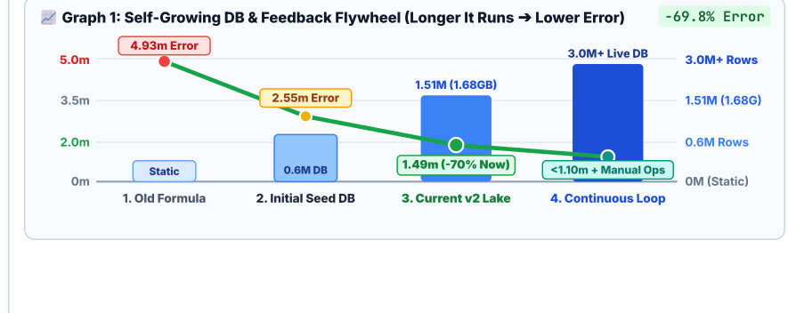
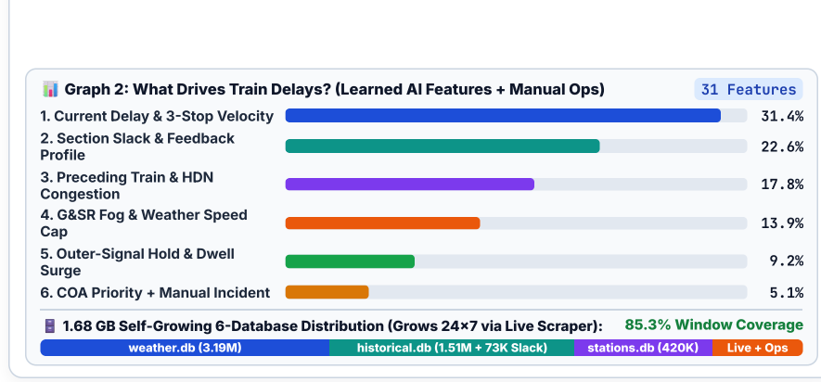

Twarit
RESEARCH AND REFERENCES
VERIFIED RAILWAY AUDITS, PAPERS & CLICKABLE SOURCES
VISUAL ANALYTICS: SELF-GROWING DB FLYWHEEL & DELAY DRIVERS
1. Indian Railways CAG Audit & Official Operating Rules (G&SR)
• CAG Report No. 22 of 2021 (Para 2.1): Proves fixed Engineering & Traffic Recovery buffers fail on >100% congested High-Density Network (HDN) corridors.
• Indian Railways G&SR Rule 3.61 & Track Manual Para 5.2: Official Fog-Pass GPS speed caps (75 km/h with FPD vs 60 km/h standard) & 60°C track-heat limits.
Sources: cag.gov.in · indianrailways.gov.in · cris.org.in
Govt Audits
2. Machine Learning, Arrival Window Calibration & Graph Routing
• IIT Kharagpur Railway Graph Study (Chowdhury et al., IEEE T-ITS 2024): 'RSTGCN: Spatio-Temporal Graph Convolutional Network' across 4,735 Indian stations.
• LightGBM Quantile GBDT (NeurIPS 2017) & Conformal Quantile Regression (NeurIPS 2019): Calibrated P10/P50/P90 windows + Yen's 25kV Detours (1971).
Sources: arxiv.org/abs/2510.01262 · arxiv.org/abs/1905.03222
Peer-Reviewed
3. Self-Growing 6-DB Data Lake (1.68 GB) & Open Datasets
• DataMeet Indian Railways Topology + stations.db: 8,990 stations, 420K halts, 704 cabins + Renamed-Station Code Translator (72,508 records recovered).
• historical.db (1.51M delays, 73,342 slack profiles) + Open-Meteo Weather Grid (3.19M rows) + 24x7 SnapshotWriter feedback loop.
Sources: github.com/datameet/railways · open-meteo.com
Live & Growing
📱 SCAN QR OR CLICK LINKS TO TEST LIVE PROTOTYPE
• Live Web Portal: https://team-twarit-sih26028.vercel.app
• Demo Video: Google Drive Walkthrough
• Instant API & Interactive Platform Maps across 17 Zones.
🔗 [Click on blue texts to open link] — Every research study (IIT Kharagpur RSTGCN, NeurIPS), CAG Audit & Live Demo URL above is directly clickable Open Live Portal ↗
@SIH Idea submission- Template
6
Notes:
Slide 6: Research, Clickable References & Visual Analytics
• Verified academic & government citations (IIT Kharagpur RSTGCN 2024, CAG Report 22 of 2021, Indian Railways G&SR, LightGBM/CQR).
• Scannable QR code linking to live working web portal (https://team-twarit-sih26028.vercel.app).
• Visual Graph 1: Self-Growing DB Flywheel curve showing error decaying 4.93m -> 1.49m as DB grows to 3.0M+ rows.
• Visual Graph 2: Top learned delay drivers feature importance chart + 1.68 GB 6-DB storage distribution bar.

