Slide 1
Demonstration of UAT Automation using Python-Selenium
the
The Process
The Solution
Selenium
The Problem

Slide 2
the
The Process
The Solution
Selenium
The Problem

Slide 3
the
The Process
The Solution
Selenium
The Problem

Slide 4
the
The Process
The Solution
Selenium
The Problem

Slide 5
the
The Process
The Solution
Selenium
The Problem

Slide 6
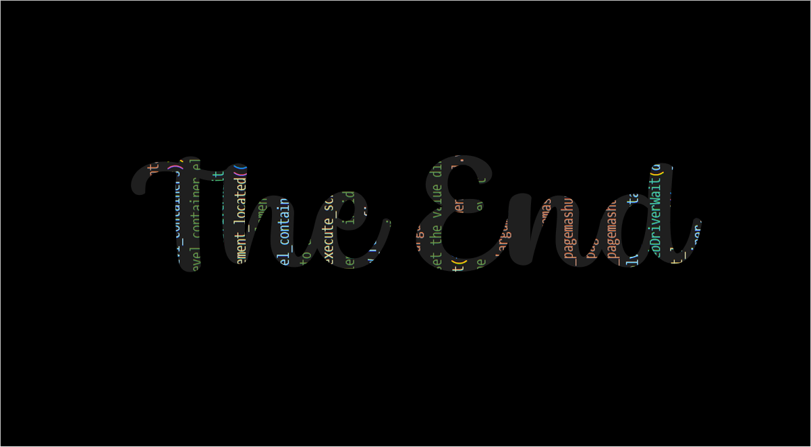
the
The Process
The Solution
Selenium
The Problem

