Slide 1





User Acceptance Testing Automation – Productivity Time Savings
Automation on giving user inputs in SPACE(Thingworx) for UAT
Chidharth M
2023-06-01

Slide 2
UAT Automation
Giving user inputs in SPACE(Thingworx UI) for UAT
Requirement & Challenge:
For checking Multiple test runs, user need to enter 16 parameters in SPACE tool to validate for each test case manually:
Manual testing includes 16 different values (3 text field + 13 dropdown) to generate the deliverables (STEP, CAD model & drawings) which are later manually inspected for accuracy. All those inputs also need to be documented as Testcases for future validation.
Current scenario involves initially collecting the valid, unique testcases in excel and passing those test cases manually in SPACE tool. This is highly repetitive & time-consuming even for 500 test cases (100 test cases per KV)
Proposed Solution:
Automation of complete end-to-end testing process from inputs to results generation by building a standalone tool (SPACE_UAT.exe) using python-selenium packages. Ability to execute multiple instances simultaneously is an added advantage.
Notes:
Hitachi Energy in the Hitachi Power Grids Business Unit

Slide 3
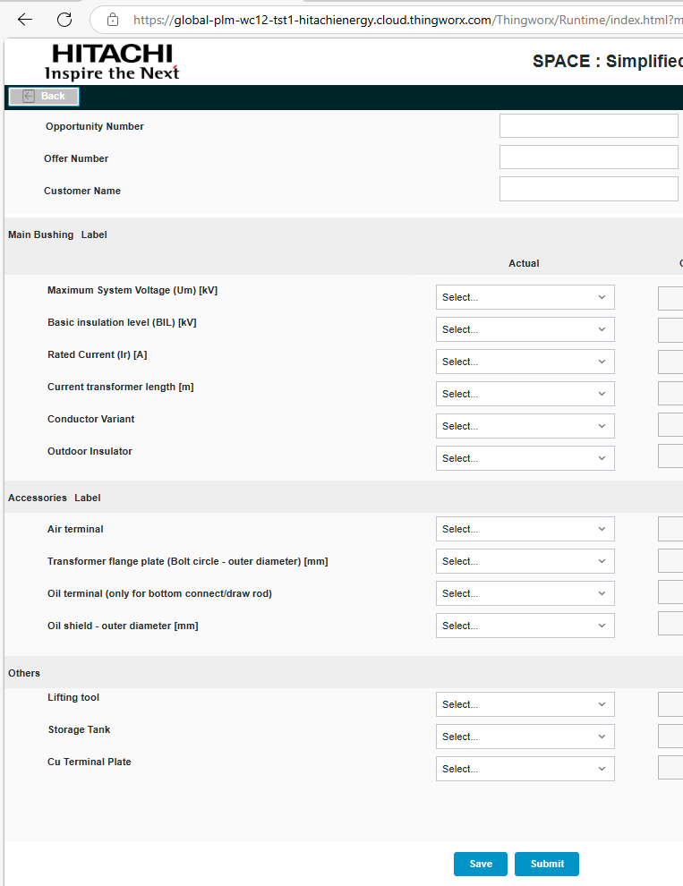
UAT Automation
To-Be Process
Run SPACE_UAT.exe
As-Is Process
Create a list of test cases for each KV
Manually enter those in SPACE tool
Notes:
Hitachi Energy in the Hitachi Power Grids Business Unit

Slide 4
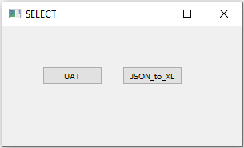
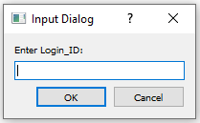
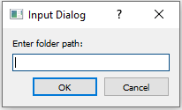
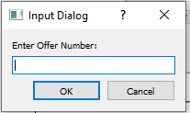
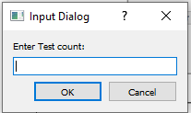
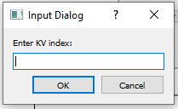
Steps for UAT automation using SPACE_UAT.exe
Run SPACE_UAT.exe & Choose required activity
UAT
To automatically enter values for selected KV
JSON_to_XL
To document the entered testcases
Alphanumeric values like a1 or b1. Alphabets for uniqueness & number for count increments
Move the required JSON files to a folder and give the folder path
A number from 1-5 for corresponding KV order in the dropdown list

Slide 5
Estimated Productivity Hours Savings.
Time estimated for manual process
TCS GROUP | Product | Total testcases required | Manual Hrs. for 100 testcases | Total Manual hrs. | Remarks
 | AirRIPflex
Bushing | 1 | 500 | 40 | (A)
 |  |  |  | 200
Time estimated for automated process
TCS GROUP | Product | Total testcases required | Actual Hrs. for 100 testcases by executing 1 instance | Total hrs. for | Remarks
 | AirRIPflex |  |  | 500 test cases by executing 5+ instance
Bushing | 1 | 500 | 1.40 hrs. | (B) | 5+ instances can be executed simultaneously, So Total hrs saved is based on no. of instances executed
 |  |  |  | 2
 |  | Total Efforts Spent Hrs. (C) |  | 8
 |  | Total Hours Saved (A-B-C) |  | 190
*Total Hours will increase in future while onboarding other products

