Slide 1
DATS 6450 · BIG DATA ANALYTICS · FINAL PROJECT
THE THREE KINGS
How Reddit Reacted to India's
Heartbreak and Redemption
Group 9 · Nikhil Obuleni · Viharika Vemparala · Siddardha Reddy

Slide 2
01 · FOUNDATION
A 478 GB question, asked of 4 billion Reddit rows.
478 GB
567 M
3.68 B
46
RAW DATASET
SUBMISSIONS
COMMENTS
SUBREDDITS
Pandas can't open this. Even a single month doesn't fit in memory.
Spark 3.5.1 on EC2 reading Parquet from S3 over the s3a connector.
First job (filtering 478 GB to cricket subreddits) took 3.5 hours.

Slide 3
02 · FRAMING
One problem. Ten answerable questions.
EDA
NLP
ML
Q1. Which king dominates Reddit activity?
Q2. Volume + sentiment between loss and win?
Q3. Did the dominant subreddits change?
Q4. Player-specific posts vs. team India posts?
Q5. Sentiment around each player and event?
Q6. Most distinctive words for each player?
Q7. Latent topics during loss vs. win period?
Q8. Classify high-engagement posts (top 25%)?
Q9. Predict comment count via regression?
Q10. Cluster cricket subreddits via K-Means?

Slide 4
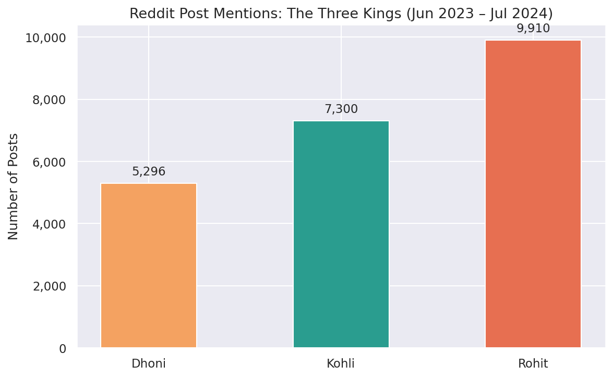
EDA · Q1
Volume tells one story. Engagement tells another.
THE FINDING
Rohit got mentioned the most (9,910 posts).
But Dhoni gets the highest avg score per post (99.7).
Smaller fanbase, more devoted.
PLAYER | POSTS | AVG SCORE
Dhoni | 5,296 | 99.7
Kohli | 7,300 | 91.6
Rohit | 9,910 | 72.4

Slide 5
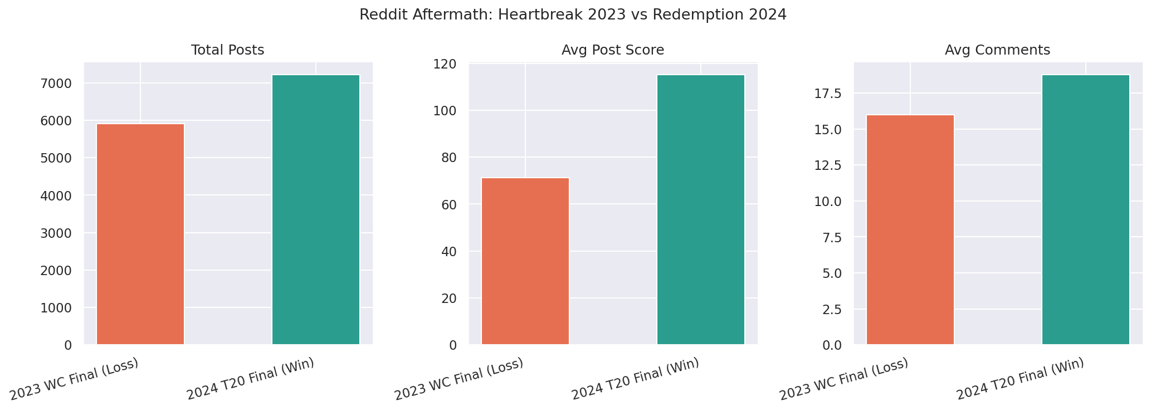
EDA · Q2
Joy travels further than grief.
+22%
+62%
+17%
MORE POSTS
HIGHER AVG SCORE
MORE COMMENTS
Same fanbase, same scale event. Wins amplify, losses compress.
Top win post outscored the top loss post by 51%.

Slide 6
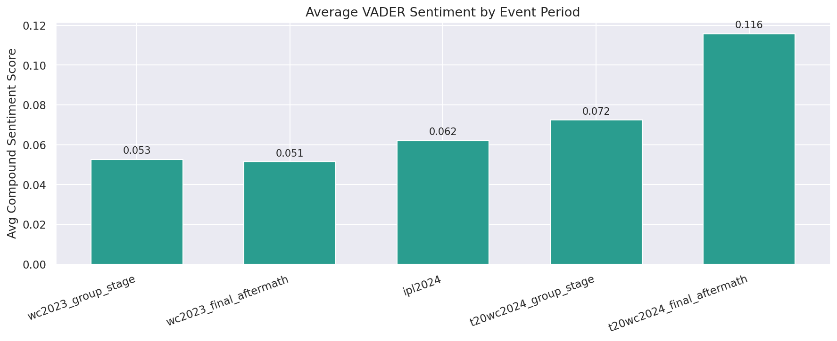
NLP · Q5
Reddit's mood follows the scoreboard.
PROGRESSION
WC 2023 group stage
+0.053
WC 2023 final aftermath
+0.051
IPL 2024
+0.062
T20 2024 group stage
+0.072
T20 2024 final aftermath
+0.116
VADER compound score: -1 (negative) to +1 (positive).
Loss aftermath to win aftermath: 2.3x more positive.

Slide 7
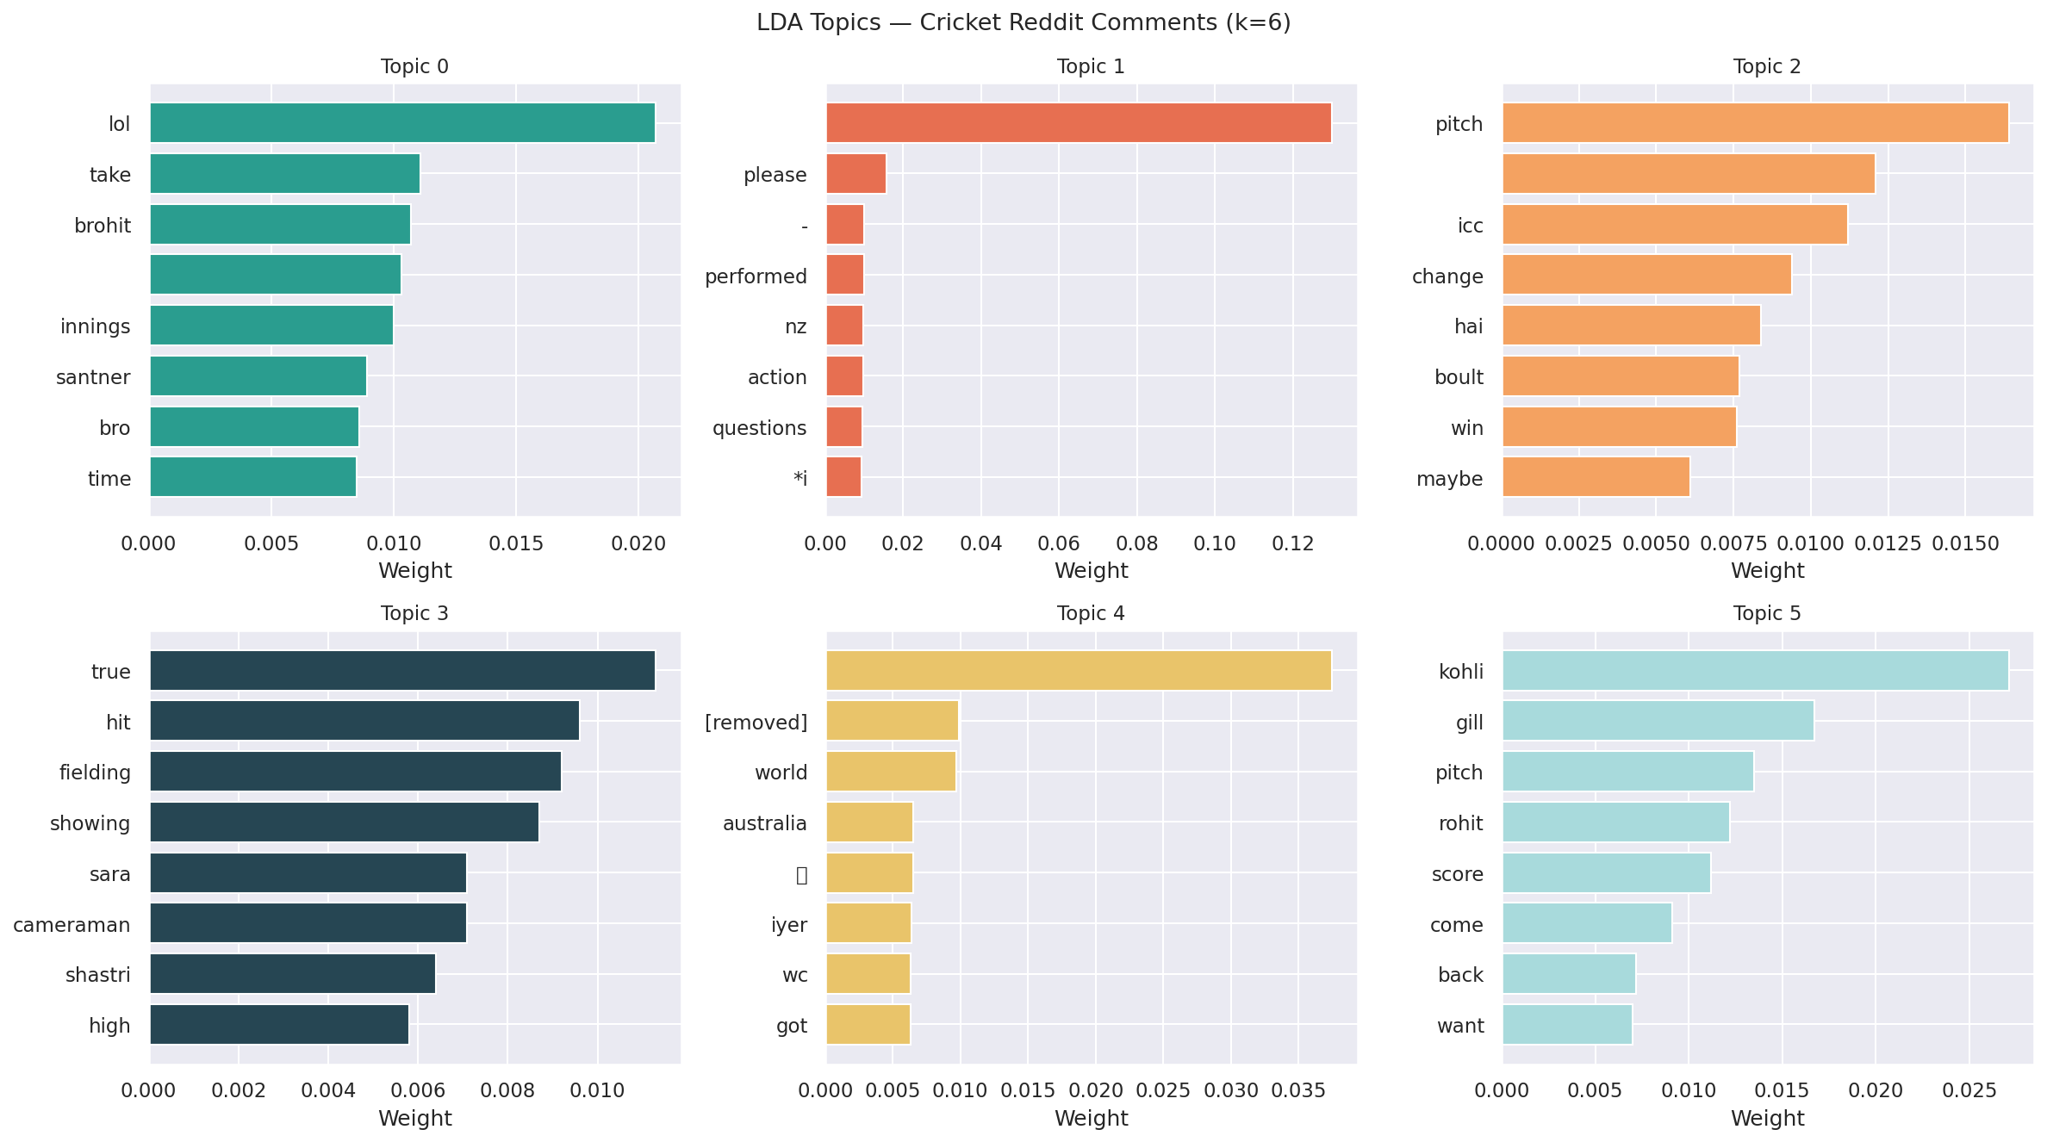
NLP · Q7
LDA discovered cricket's conversation genres.
6 topics from 50,000 cricket comments. We never told it what cricket is.
Topic 5 = player performance. Topic 4 = world cup geopolitics. Topic 0 = memes.

Slide 8
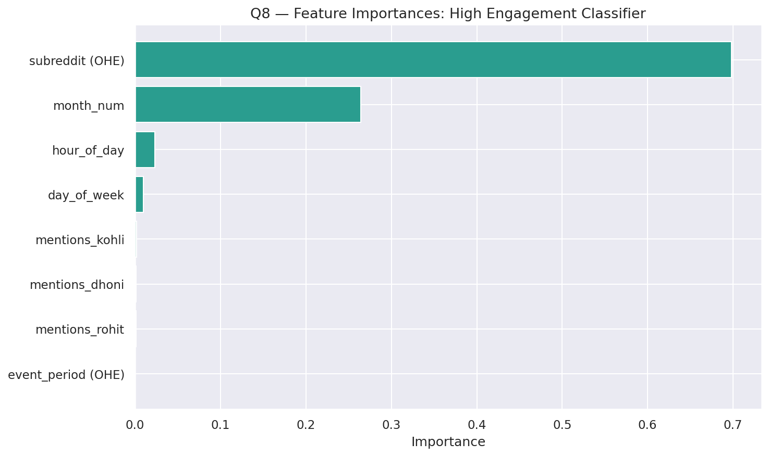
ML · Q8
Engagement is community-driven, not content-driven.
RANDOM FOREST CLASSIFIER
0.673
73.86%
AUC-ROC
ACCURACY
70%
of virality is just
which subreddit you're in.
Time of day, day of week, player mentions: barely matter.

Slide 9
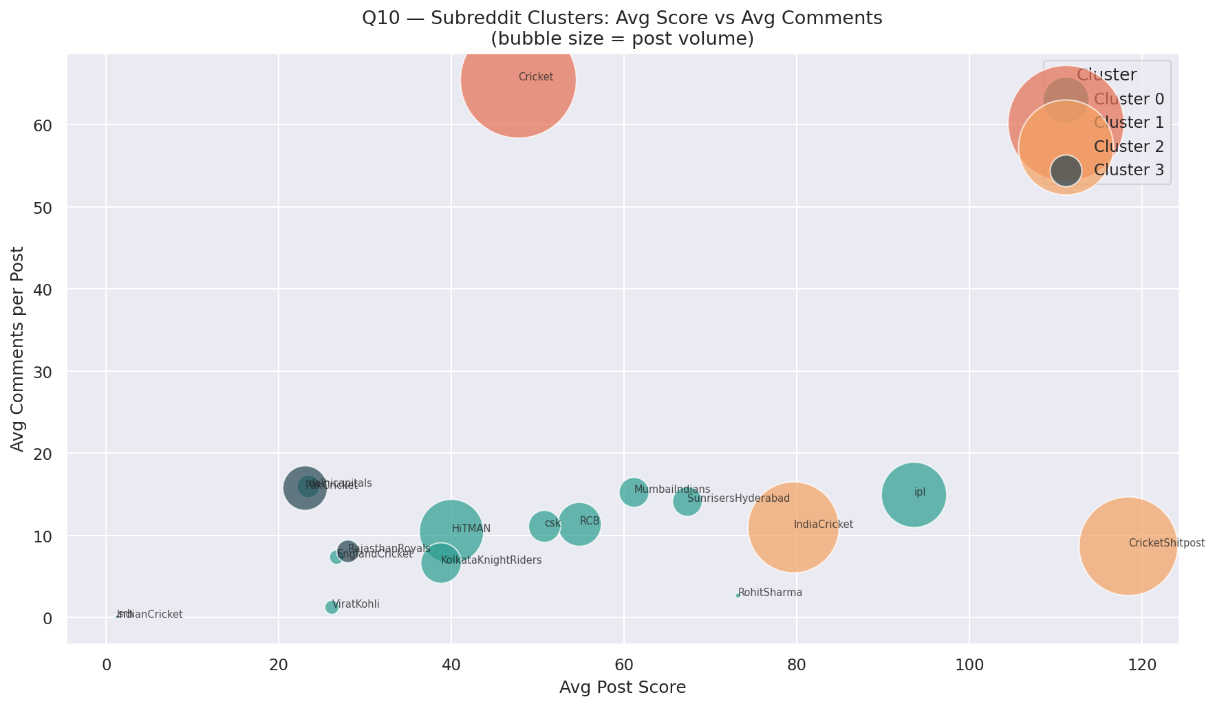
ML · Q10
K-Means recovered cricket Reddit's natural structure.
FOUR BEHAVIORAL CLUSTERS
Mainstream Giant
r/Cricket alone
Viral Content
CricketShitpost, IndiaCricket
Fan Communities
RCB, MI, CSK, IPL, +8 more
Rivalry / Niche
PakCricket, RR, SRH
We never told K-Means about cricket. It found the structure on its own.

Slide 10
06 · SO WHAT?
Three recommendations the data actually supports.
01
BROADCASTERS
Subreddit choice matters 70x more than time of day.
Hit r/Cricket and r/CricketShitpost first.
02
SPONSORS
Dhoni for endearment ROI (+0.108 sentiment).
Rohit for reach (most mentions). Kohli for both.
03
BCCI COMMS
Loss tail: 3 days. Win tail: 7 days.
Plan press and merchandise around the 7-day win window.

Slide 11
THANK YOU.
Questions?
Nikhil Obuleni · Viharika Vemparala · Siddardha Reddy

