Slide 1


+
BUSINESS PROPOSAL PITCH
Managed IT, Practice Systems &
Financial Services
for Simmons Medical Practice
Prepared by ABC Partners · Presented to Dr Paul Simmons · 26 July 2026
SIMMONS MEDICAL PRACTICE — DIGITAL TRANSFORMATION PROJECT TEAM
Team Lead
Network
Cybersecurity
Backend
UI / UX
AI Engineering

Slide 2

AGENDA
Where We're Headed
1
ABC Partners
Who we are, our values, history & the team behind this proposal
2
Simmons Medical Practice
A quick snapshot of the practice, and the problem in its own words
3
Root Cause Analysis
Why these problems exist, not just what they are
4
Proposed ICT Solutions
Six focus areas: network, apps, staff portal, database, security, AI
5
Unique Value Propositions
What every recommendation was measured against
6
Accounting Modernisation
Xero, bank feeds & monthly reconciliation
7
Project Management
Timeline, procurement, budget & next steps
ABC Partners × Simmons Medical Practice
Agenda
02 / 26

Slide 3
ABC PARTNERS
Who We Are
Built to deliver exactly this: combined IT and accounting for medical practices
IT &
Network
N
Network & Cloud Security Certified
Recognised certifications across our technical team
$
CPA-Qualified Accountants
In-house, not outsourced
ABC
Partners
1
One Team, Not Two Vendors
IT and accounting under a single point of contact
+
Built for Medical Practices
Already supporting general & allied health clinics
Accounting
Advisory
Managed IT & Financial Partnership
OUR SLOGAN
ABC Partners × Simmons Medical Practice
ABC Partners
03 / 26

Slide 4
ABC PARTNERS
The Team Behind This Proposal
Narottam
Divya
Siddhanth
Team Leader
Network Engineer
Cybersecurity
Client relationship, scope & delivery
Infrastructure, connectivity & Wi-Fi
Access control, backup & compliance
Fatemeh
Parneet
Kiran
Backend Developer
UI / UX Designer
AI Engineer
Data layer, integration & API design
Patient & staff experience design
Applied AI & automation features
ABC Partners × Simmons Medical Practice
ABC Partners · Team
04 / 26

Slide 5
SIMMONS MEDICAL PRACTICE
About Simmons Medical Practice
24 Grafton Street, Toowong QLD 4066
3
Full-time GPs
1
Visiting skin specialist (weekly)
2
Reception staff (1 FT + 1 PT)
2
Nursing staff (1 FT + 1 PT)
100%
Bulk-billed patient base
1 mo
Until current IT contract ends
ABC Partners × Simmons Medical Practice
Simmons Medical Practice
05 / 26

Slide 6
SIMMONS MEDICAL PRACTICE
SMP Problem Analysis
Information provided directly by Dr Simmons
1
Ageing, Unreliable Network
Outages hit reception, consulting rooms and the visiting specialist's room alike — bulk-billing claims can fail mid-consult when the connection drops.
2
IT Contract Ending in 1 Month
The current support arrangement concludes within weeks, leaving a hard deadline to transition without disrupting patients or staff.
3
Disconnected Accounting
Accounting software sits apart from the patient management system, duplicating data entry for billing and reconciliation.
4
No Automated Reminders
The patient management system can't trigger SMS/email reminders, contributing to avoidable missed appointments.
5
No Proactive Technology Advice
Investment decisions are reactive rather than planned — there's no standing forum for forward-looking guidance.
ABC Partners × Simmons Medical Practice
Problem Analysis
06 / 26

Slide 7
ROOT CAUSE ANALYSIS
Why These Problems Exist
Fishbone (Ishikawa) diagram, grouped by root cause
Technology
Process
Ageing network hardware
No structured technology advisory process
Disconnected PMS & accounting software
Reactive, not planned, investment
No automated patient reminders
Manual reconciliation between systems
Simmons Medical Practice's Systems Can't Keep Pace With Growth
Specialist & wife share his logins
Renewal treated as like-for-like, not a review point
No second admin or delegated access
No proactive guidance from outgoing provider
Dr Simmons is the sole IT/data administrator
Current IT contract ends within 1 month
People
Vendor & Contract
ABC Partners × Simmons Medical Practice
Root Cause Analysis
07 / 26

Slide 8
PROPOSED ICT SOLUTIONS
Individual Focus Areas
Each team member owns one layer of the solution
1
Networking
2
Applications for Clients
3
Staff Portal
DI
Divya
PA
Parneet
PA
Parneet
Reliable, segmented infrastructure across every room
Patient-facing booking & reminders
A live dashboard for Dr Simmons
4
Database
5
Cyber Security
6
AI Engineering
FA
Faye
SI
Siddhanth
KI
Kiran
The data model behind every system
Access control, backup & compliance
Workflow automation & scalable applied AI
ABC Partners × Simmons Medical Practice
Proposed ICT Solutions
08 / 26

Slide 9
PROPOSED ICT SOLUTIONS · NETWORKING
Network Architecture — Physical Layout
Ground floor, indicative — not to scale, rooms inferred from the brief
N
Waiting Room /
Reception
Consulting
Room 1
Consulting
Room 2
Consulting
Room 3
Wi-Fi · Admin AP
Wi-Fi · Clinical AP
Wi-Fi · Clinical AP
Wi-Fi · Clinical AP
CORRIDOR
Server /
Comms Cupboard
Nurse /
Treatment Room
Specialist
Room (visiting)
Dr Simmons'
Office
UDM-Pro + Switch
Wi-Fi · Admin AP
Wi-Fi · Clinical AP
Wi-Fi · Admin AP
Clinical Zone
Admin Zone
Infrastructure
ABC Partners × Simmons Medical Practice
Physical Layout
09 / 26

Slide 10
PROPOSED ICT SOLUTIONS · NETWORKING
Network Architecture — Network Diagram
Logical topology — segmented by VLAN, port and IP addressing shown
Internet (ISP)
Offsite Cloud Backup
WAN
UniFi Dream Machine Pro
Firewall · Router · Controller · 10.10.0.1
Gi0/1
UniFi Switch Lite 8 PoE
10.10.40.2
Gi0/2 · PoE
Gi0/3 · PoE
Gi0/4
UniFi U6-LR
AP — Clinical Wing · 10.10.40.10
NAS
UniFi U6-LR
AP — Reception / Admin · 10.10.40.11
10.10.40.20
VLAN 40 · Infra
VLAN 10 · Clinical 10.10.10.0 /24
VLAN 20 · Admin & Reception 10.10.20.0 /24
GP 1
GP 2
GP 3
Specialist
VLAN 30 · Guest Wi-Fi 10.10.30.0 /24
Recep. 1
Recep. 2
Printer
Nurse
.11
.12
.13
.14
Patient devices — isolated, no LAN access · DHCP
.11
.12
.13
.14
ABC Partners × Simmons Medical Practice
Network Diagram
10 / 26

Slide 11
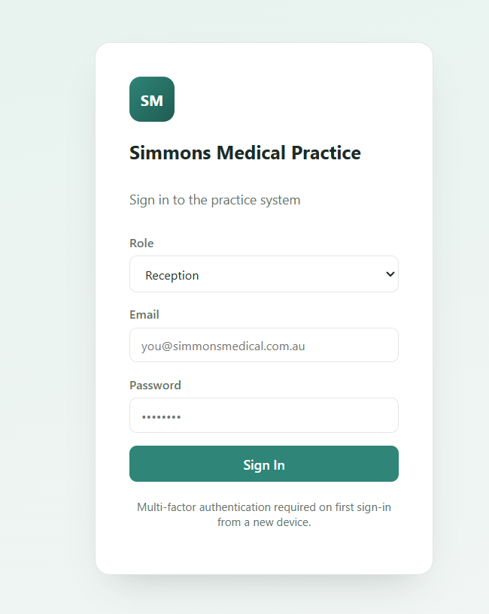
PROPOSED ICT SOLUTIONS · APPLICATIONS FOR CLIENTS
Applications for Clients
User interface, features & how they benefit the business
Patient Books Online or Calls Reception
9:41
HotDoc Confirms + Sends SMS / Email Reminder
Simmons Medical Practice
Reminder: appt with Dr Simmons, Tue 10:30am.
Reply C to confirm or R to reschedule.
Best Practice Bp Premier — Clinical Record Updated
Confirm
Reschedule
Automated Recall / Follow-up Scheduled
FEATURES
BUSINESS BENEFIT
✓ Online booking synced live with Best Practice
✓ Automated SMS / email appointment reminders
✓ Two-way confirm / reschedule replies
✓ Automated recall prompts (care plans, screenings)
✓ Directly targets missed appointments (Pain Point #4)
✓ Reception spends less time on reminder phone calls
✓ Higher attendance protects Medicare billing revenue
HotDoc reminder — illustrative
ABC Partners × Simmons Medical Practice
Applications for Clients
11 / 26

Slide 12
PROPOSED ICT SOLUTIONS · STAFF PORTAL
Application for Staff Portal
User interface, features & how they benefit the business
Practice Dashboard — Dr Simmons
MATCHES LIVE PROTOTYPE
1,177
Appointments (Q1 2026)
83%
Attendance Rate
11.7%
No-show Rate
$3,782
Revenue at Risk — 75 rejected claims
No-show Rate by Provider
Claims Breakdown (977 lodged)
Reminders cut no-shows from 19.7% to 7.1% — 2.8× fewer, when one is sent
FEATURES
BUSINESS BENEFIT
✓ Live KPI tiles — appointments, no-show rate, recalls due
✓ Attendance trend and booking-channel reporting
✓ Reconciliation status between Xero and Best Practice
✓ Single sign-on scoped to each staff member's role
✓ Gives Dr Simmons the forward-looking view he told us he lacks
✓ Replaces ad hoc, reactive advice with a standing view of the practice
✓ Surfaces reconciliation issues before month-end, not after
ABC Partners × Simmons Medical Practice
Staff Portal
12 / 26

Slide 13
PROPOSED ICT SOLUTIONS · UI/UX
What the Interfaces Look Like
Screens labelled here are built and demonstrable in the live prototype
MOBILE — PATIENT APP
BROWSER — STAFF & ADMIN PORTAL
Home
Upcoming appointment, quick actions, reminder card
1
Patient Records
Role-scoped view, specialist segregation enforced
1
2
Results Inbox
Pathology, radiology & referrals, flagged for review
Book
4-step booking wizard — reason, provider, time, confirm
2
3
Imaging & Files
Tiered object storage, retention-period aware
4
Claims & Billing
Medicare reconciliation, rejected-claim flags
Assistant
AI chat — books, reschedules, answers FAQs, escalates
3
5
Reports
KPIs and the full analytics dashboard (admin roles)
Profile
Details, notification preferences, appointment history
6
Security & System
Controls, backup status, access log
4
7
Users & Access
Roles and permissions administration
Both apps are built and clickable in the live prototype — ask to see it
ABC Partners × Simmons Medical Practice
UI / UX
13 / 26

Slide 14
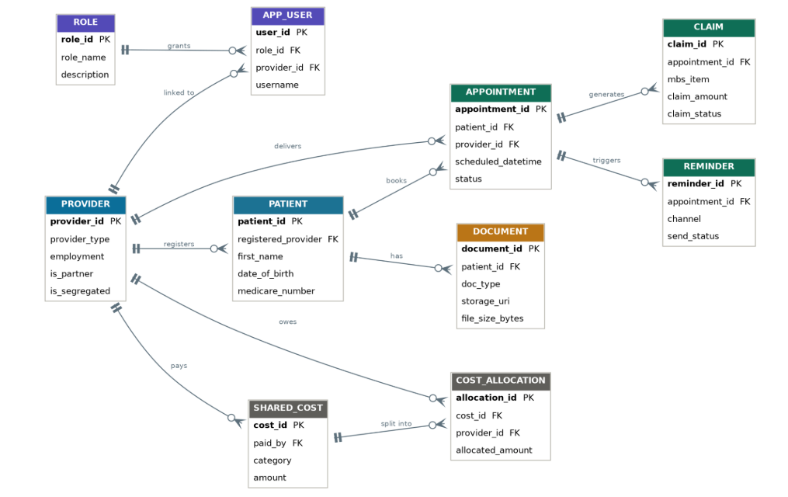
PROPOSED ICT SOLUTIONS · DATABASE
SMP Database
Features and strategies behind every system
FEATURES & STRATEGIES
✓ Integration Middleware / API Layer — Slide 12 (Staff Portal)
✓ Role-based access (is_partner / is_segregated) — Slide 15 (Access & Identity)
✓ Medicare billing assist (mbs_item) — Slide 18 (AI Engineering)
✓ Encrypted imaging archive (DOCUMENT.storage_uri)
NEW: GP COST-SHARING & REIMBURSEMENT
Dr Simmons pays shared equipment and consumable costs upfront (SHARED_COST), then COST_ALLOCATION splits and tracks what each GP owes for reimbursement — directly addressing a requirement from the original practice brief.
Entity-relationship diagram designed by the project's Backend Developer (Faye)
ABC Partners × Simmons Medical Practice
SMP Database
14 / 26

Slide 15
PROPOSED ICT SOLUTIONS · CYBER SECURITY
Access Control & Identity
Least-privilege, role-based — enforced by the database, not the screen
ROLE
Patient
Records
Results &
Imaging
Claims &
Billing
Reports
Security &
Users
Dr Simmons
Owner — full admin
●
●
●
●
●
Helen Simmons
Delegated admin
●
●
◐
●
◐
GP / Clinician
e.g. Dr James Chen
●
●
◐
◐
–
Nurse
e.g. Mary Kelly
●
◐
–
–
–
Reception
e.g. Sophie Nguyen
◐
–
–
–
–
Visiting Specialist
Segregated — own patients only
◑
◑
◐
–
–
●
Full access
◐
Read only
◑
Own patients only
–
No access
Access is enforced by the database itself, not the screen — a locked module means the query never returns that data for the signed-in role.
ABC Partners × Simmons Medical Practice
Access & Identity
15 / 26

Slide 16
PROPOSED ICT SOLUTIONS · CYBER SECURITY
Backup, Continuity & Data Protection
Nine controls, running today in the prototype's security module
Hosting
Cloud, Australian region
Encryption
At rest and in transit
Backups
3-2-1, restore-tested regularly
✓
✓
✓
Redundancy
Automatic failover active
Ransomware Protection
Endpoint plus immutable backups
Patching
OS and clinical software current
✓
✓
✓
Remote Access
Multi-factor, no local copies
Secure Printing
Badge release, no unclaimed prints
Breach Monitoring
Access logging and alerts, breach-scheme ready
✓
✓
✓
Materially reduced ransomware exposure vs. self-managed IT — no single point of failure, no single point of control.
ABC Partners × Simmons Medical Practice
Backup & Continuity
16 / 26

Slide 17
PROPOSED ICT SOLUTIONS · CYBER SECURITY
Compliance & Governance
What the practice is obligated to meet, and how the system meets it
AUDIT LOG — EVERY VIEW RECORDED
7-Year Record Retention
25 years for minors — Qld Health / RANZCP guidance
09:41:03 Dr Paul Simmons opened module: security
09:41:47 Helen Simmons opened record: Noah Brown
09:42:15 Dr James Chen opened record: Olivia Taylor
Notifiable Data Breaches
Applies regardless of turnover — health service providers are always covered (OAIC)
09:43:02 Sophie Nguyen opened module: patients
Every view is logged against the signed-in user — not just who has access, but who looked, when.
Australian Data Residency
Patient data never leaves Australian jurisdiction
“Access is enforced by the database itself, not the screen — a locked module means the query never returns that data for the signed-in role.”
ABC Partners × Simmons Medical Practice
Compliance & Governance
17 / 26

Slide 18
PROPOSED ICT SOLUTIONS · AI ENGINEERING
AI Engineering
Workflow, Automation & Scalability — layered on the data foundation
S
P
$
?
R
Ambient Clinical Scribing
Buy-and-integrate transcription drafts consult notes for GP review.
No-show Prediction
Scores upcoming bookings against attendance history to target reminder follow-up.
Billing & Coding Assistance
Flags likely missed Medicare items before claims are submitted.
Patient Triage / FAQ Bot
Handles common booking and practice questions, escalating anything clinical.
Chronic Disease Recall Automation
Prompts overdue recalls (e.g. care plans, screenings) automatically.
ⓘ Human-in-the-loop by design: every AI output is reviewed by clinical or admin staff before it reaches a patient record or claim.
APPLIED THROUGH THREE LENSES
Workflow
Automation
Scalability
Sits inside existing HotDoc / Best Practice screens — no new system for staff to learn
Reminders, recalls and no-show scoring run on a schedule, not on staff initiative
Same data foundation supports more practitioners or a second site without a redesign
ABC Partners × Simmons Medical Practice
AI Engineering
18 / 26

Slide 19
PROPOSED ICT SOLUTIONS · AI ENGINEERING
AI Virtual Patient Assistant
Beyond a chatbot — an intelligent digital front desk for Simmons Medical Practice
Patient
KEY BENEFITS
✓ Available 24/7
✓ Reduces receptionist workload
✓ Faster patient support
✓ Improves appointment management
✓ Integrates with existing systems
AI Virtual Patient Assistant
Answers Common Enquiries
Books Appointments
Reschedules / Cancels
Sends Reminders
Clinic Information
Escalates Complex Cases
Patient Management System
Presenter cue: The assistant handles routine administrative tasks so staff can focus on patients requiring personal support.
Reception / Clinical Staff
ABC Partners × Simmons Medical Practice
AI Virtual Assistant
19 / 26

Slide 20
PROPOSED ICT SOLUTIONS · AI ENGINEERING
AI Engineering Roadmap
✓
Live Prototype
↑
Future Enhancements
✓ AI Virtual Patient Assistant
✓ Appointment Booking
✓ FAQs & Patient Enquiries
✓ Appointment Reminders
✓ Care Navigation
→ Ambient Clinical Scribing
→ Billing & Coding Assistance
→ No-show Prediction
→ Chronic Disease Recall Automation
Responsible AI: Every AI-generated recommendation is reviewed by clinic staff before becoming part of patient records or administrative processes.
ABC Partners × Simmons Medical Practice
AI Roadmap
20 / 26

Slide 21
UNIQUE VALUE PROPOSITIONS
What Every Recommendation Was Measured Against
Client-Focused
Secure
Productive
Booking, reminders and recalls designed around the patient experience
Role-based access, encryption and 3-2-1 backup by design
Automation removes duplicate admin work across systems
Reliable
Integrated
Compliant
Segmented, monitored network with redundant backup
One data model behind every system — no duplicate entry
Meets Notifiable Data Breaches and health record retention obligations
Competitive Advantage
Team Qualifications
Track Record
One point of contact for IT and accounting — no separate vendors working in isolation.
Network & cloud security certifications, plus CPA-qualified accounting staff.
Reduced non-attendance and consolidated reporting in comparable practice transitions.
ABC Partners × Simmons Medical Practice
Unique Value Propositions
21 / 26

Slide 22
SUPPORTING DETAIL
Accounting Modernisation
Bank Feeds
(Direct Connection)
Xero
(Central Ledger)
Monthly Reconciliation
(by ABC Partners)
Single Current View
Billing data exported from Best Practice feeds into Xero — no duplicate entry between clinical and financial records.
Managed Reconciliation
ABC Partners runs the monthly reconciliation routine, not practice staff.
Reconciliation Target
Monthly reconciliation completed within 2 business days of month-end (service commitment).
ABC Partners × Simmons Medical Practice
Accounting
22 / 26

Slide 23
PROJECT MANAGEMENT
Timeline & Procurement
12-week program — 3 months to go-live
Month 1
Month 2
Month 3
W1
W2
W3
W4
W5
W6
W7
W8
W9
W10
W11
W12
Procurement — hardware & licensing
W1–W2
Network install & configuration
W2–W4
Network testing & handover
W4
Bp Premier + HotDoc setup & config
W4–W6
Parallel run (old + new PMS)
W6–W8
Staff training
W7–W8
Go-live cutover (PMS / HotDoc)
W8
Xero setup, migration & reconciliation
W9–W11
First Quarterly Review
Procurement lead time is the first task — network hardware and licensing ordered in Week 1.
ABC Partners × Simmons Medical Practice
Timeline & Procurement
23 / 26

Slide 24
PROJECT MANAGEMENT
Investment — Researched, Itemised
NETWORK HARDWARE (ONE-OFF)
ANNUAL RETAINER (RECURRING MONTHLY)
Item | Qty | Cost
UniFi Dream Machine Pro (UDM-Pro) — gateway / firewall / controller | 1 | $539
UniFi Switch Lite 8 PoE | 1 | $276
UniFi U6-LR Wi-Fi 6 access point | 2 × $276 | $552
Cabling, mounts & contingency (~10%) | — | $137
Hardware Subtotal |  | $1,504
Service | Scope | $ / Month
Best Practice Bp Premier — licensing | 3 FT + 1 visiting practitioner | $446.83
HotDoc — patient engagement & reminders | 4 active practitioners | $341.20
Xero Comprehensive — incl. payroll | 1 organisation | $107.00
Cloud backup — AU-hosted (server + 2 devices) | 3 endpoints | $52.00
Managed IT retainer — helpdesk, patching, endpoint security & monitoring | 8 user seats × $195 | $1,560.00
Monthly Subtotal |  | $2,507.03
IMPLEMENTATION LABOUR (ONE-OFF)
Scope | Est. Hours | Cost
Network install, config & testing (Month 1) | 16 hrs | $3,520
Bp Premier + HotDoc migration & staff training (Month 2) | 24 hrs | $5,280
Xero setup, data migration & reconciliation (Month 3) | 12 hrs | $2,640
Labour Subtotal |  | $11,440
8 user seats = 3 GPs + 1 visiting specialist + 1 FT/1 PT reception + 1 FT/1 PT nursing (incl. Dr Simmons's wife's hours), across ~7 shared workstations.
OPTIONAL ADD-ON SERVICES
• Annual equipment test & tag (~35 items)
$272.50 / yr
Scoped at a market rate of $190–270/hr for AU network & systems consulting (mid-point $220/hr used); hours are a planning estimate, confirmed after the site visit.
• Annual network security audit (scoped, entry-level)
from $5,000 / yr
Annual Retainer Total: $30,084 / yr
One-off Implementation Total: $12,944
First-Year Investment (Implementation + 12-Month Retainer): $43,028 ex-GST
ABC Partners × Simmons Medical Practice
Investment
24 / 26

Slide 25

PROJECT MANAGEMENT
Conclusion & Next Steps
Changing IT and financial systems involves more than technology — it depends on trust between the practice and the people supporting it. We'd welcome the opportunity to support Simmons Medical Practice through this transition and beyond.
GET IN TOUCH
ABC Partners
Level 3, 88 Eagle Street, Brisbane QLD 4000
(07) 3000 1122
partners@abcpartners.com.au
1
Confirm scope on a short follow-up call with Dr Simmons
2
Site visit to finalise pricing (Appendix A) and sign-off
Proposal submitted to:
3
Begin Month 1 — network upgrade — ahead of contract end
Dr Paul Simmons
Simmons Medical Practice — 24 Grafton Street, Toowong QLD 4066
ABC Partners × Simmons Medical Practice
Next Steps
25 / 26

Slide 26
APPENDIX
Sources & References
Every researched figure in this deck traces back to one of the sources below
Primary source: Business Proposal — Simmons Medical Practice, submitted 26 July 2026 (ABC Partners). This deck is the accompanying pitch presentation.
VENDOR & PRODUCT PRICING
MARKET RESEARCH — BUDGET FIGURES
COMPLIANCE REFERENCES
Best Practice Software — Bp Premier pricing
bpsoftware.net/premier-pricing
HotDoc — practice pricing
support.hotdoc.com.au
Xero — AU pricing plans
xero.com/au/pricing-plans
Ubiquiti UniFi hardware — AU retail
thetechgeeks.com, mrwifi.com.au, ozbargain.com.au
AU-hosted cloud backup pricing
i360cloud.net.au/cloudbackups
Managed IT services pricing guide (AU)
kmtech.com.au, stanfieldit.com, valont.com.au
IT consulting hourly rates (AU)
aalpha.net, sbaas.com.au
Penetration testing / security audit cost (AU)
arankish.com.au, cyberpulse.com.au
Test & tag pricing (AU)
gotestandtag.com.au, thelocalguystestandtag.com.au
Health record retention — Qld Health / RANZCP
health.qld.gov.au, ranzcp.org
Notifiable Data Breaches scheme — OAIC
oaic.gov.au
ABC Partners × Simmons Medical Practice
Sources
26 / 26

