Slide 1


How to be an Android developer

Slide 2
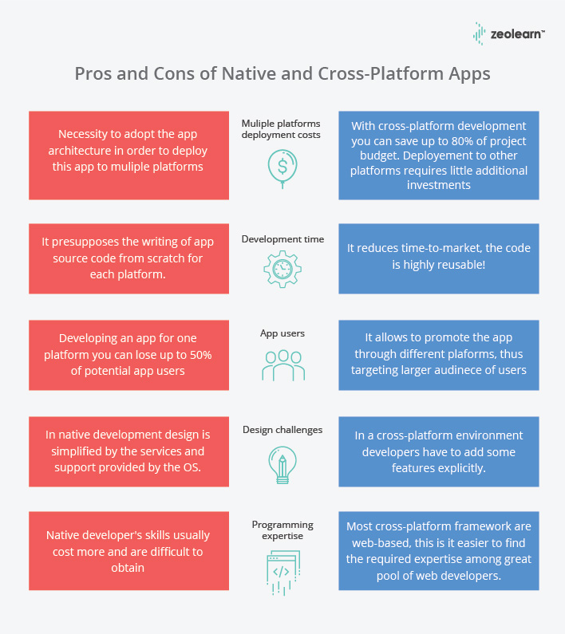

Slide 3

Native vs. Cross-Platform
Performance Native apps make the best use of resources and utilize the platform’s capabilities up to its full potential Winner - Native
Features Native apps can make use of the device’s native feature, especially with iOS, which runs only on Apple’s proprietary devices Winner - Native
Feasibility Native app development takes twice as much time as cross-platform apps. The cost is also higher since it usually requires building more than one app. Cross-platform apps are relatively cheaper in terms of development and maintenance, You are investing in a single app and that is all you will have to maintain However, sometimes, the higher number of issues and bugs outweigh this advantage. Winner – Tie
Source: Native VS Cross-Platform Apps | Differences Between Native and Cross-Platform Apps (zeolearn.com)
Notes:
https://kotlinlang.org/

Slide 4
Conclusion
Native apps seem far superior in terms of performance and user experience
Simple applications like games and content distribution apps are usually developed as a cross-platform app while apps with specific features are native.
Cross-platform is also preferred for B2B apps where deployment time is of utmost importance. Many small businesses also opt for cross-platform due to their limited budget
It is important for you to choose a platform that meets your needs, requirements, as well as your target audience
Notes:
https://kotlinlang.org/

Slide 5
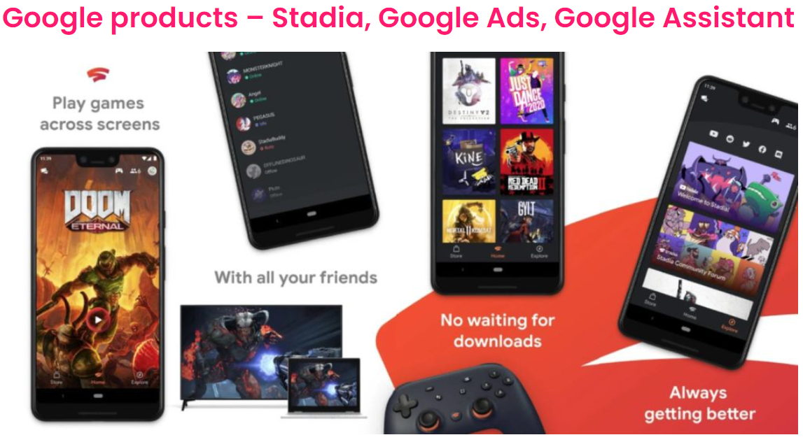

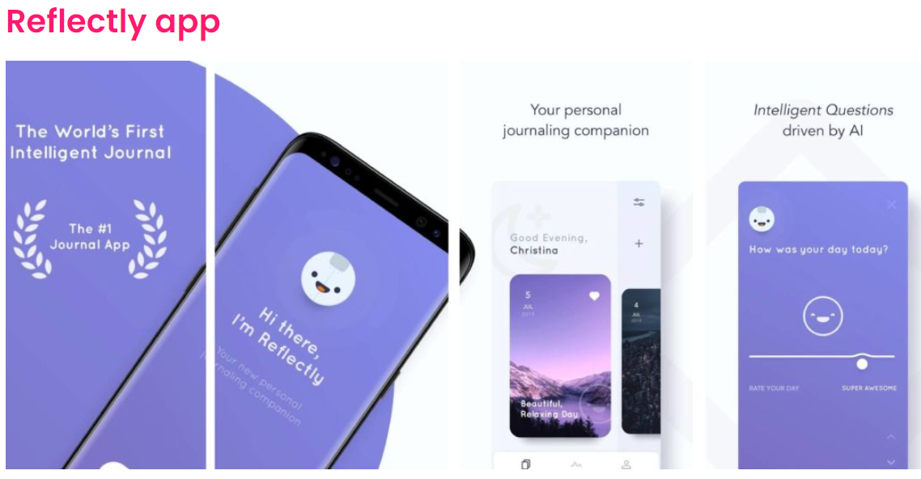
Apps made with Flutter

Slide 6
Resources for Getting started with Flutter
https://events.withgoogle.com/30-daysofflutter/#content
(Last date to register is 31st Jan, 11:30pm PST.)
Video Resource
https://www.youtube.com/playlist?list=PL4cUxeGkcC9jLYyp2Aoh6hcWuxFDX6PBJ
Reading Resources
https://flutter.dev/docs/get-started/install
https://www.tutorialspoint.com/flutter/flutter_introduction_to_dart_programming.htm
https://flutter.dev/docs/get-started/codelab

Slide 7
Top Applications/Companies Using React Native
Facebook Ads Manager. Ads Manager is the first full React Native, cross platform app built by Facebook. ...
Bloomberg. Bloomberg app provides global business and finance news to the users. ...
AirBnB. ...
Gyroscope. ...
Myntra. ...
Discord. ...
Instagram.

Slide 8
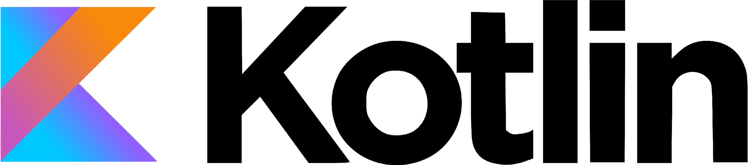

Slide 9
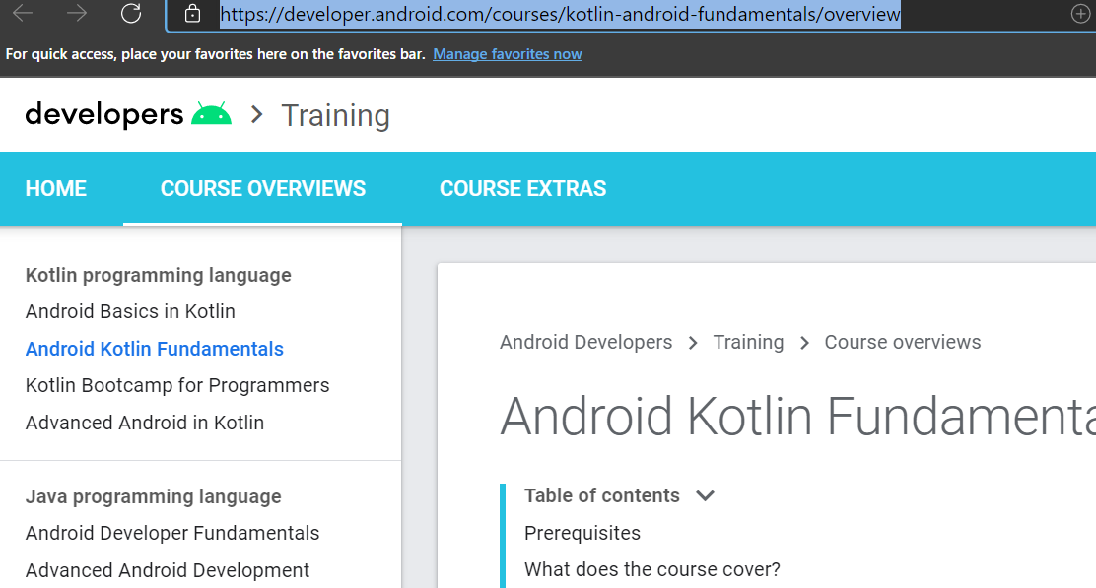
RESOURCES –KOTLIN : https://g.co/android/studyjams Android Kotlin Fundamentals | Training Courses | Android Developers VIDEO: Kotlin Bootcamp for Programmers – Udacity Developing Android Apps with Kotlin – Udacity Advanced Android with Kotlin - Udacity

Slide 10
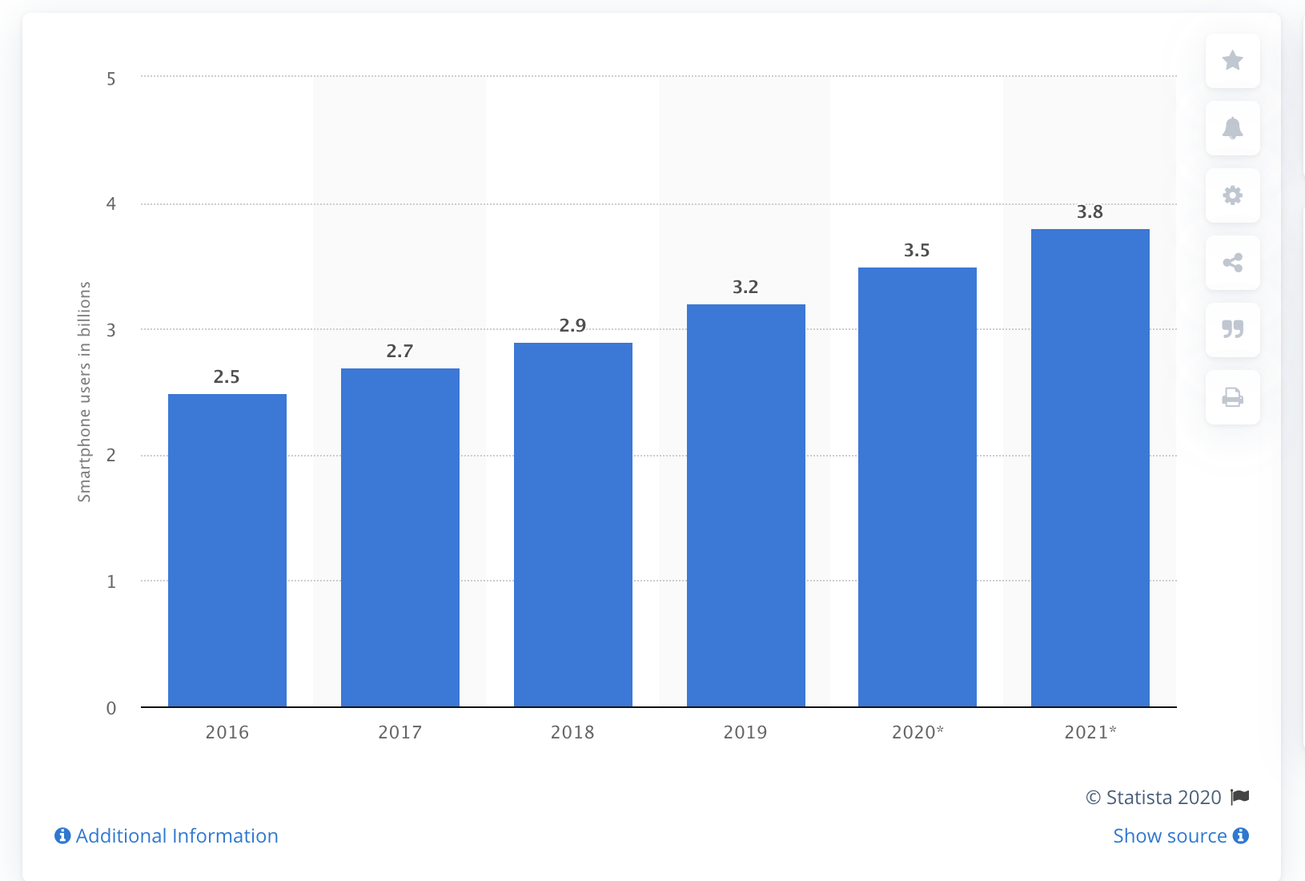
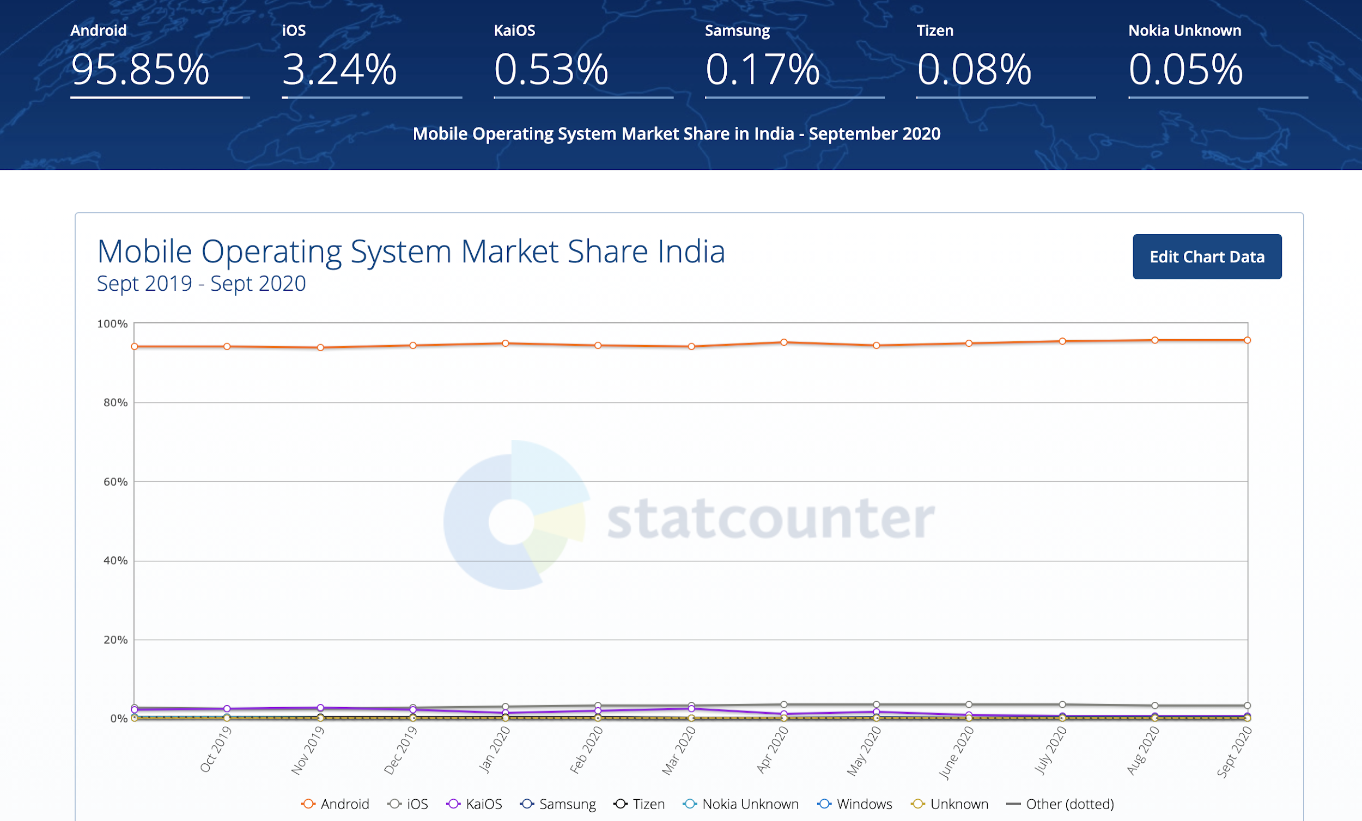
Why Android

Slide 11
Kotlin Advantages
01
02
03
04
05
06
Kotlin is free and open
Expressive and Concise
Safer code
Interoperable
Structured concurrency
Android is Kotlin first since 2019
Notes:
https://kotlinlang.org/

Slide 12
Top Applications/Companies Using Kotlin
Google
Pinterest
Square
Trello
Evernote
Tinder
Netflix
Airbnb
Zomato

Slide 13

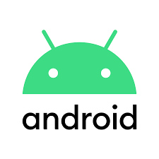

Slide 14
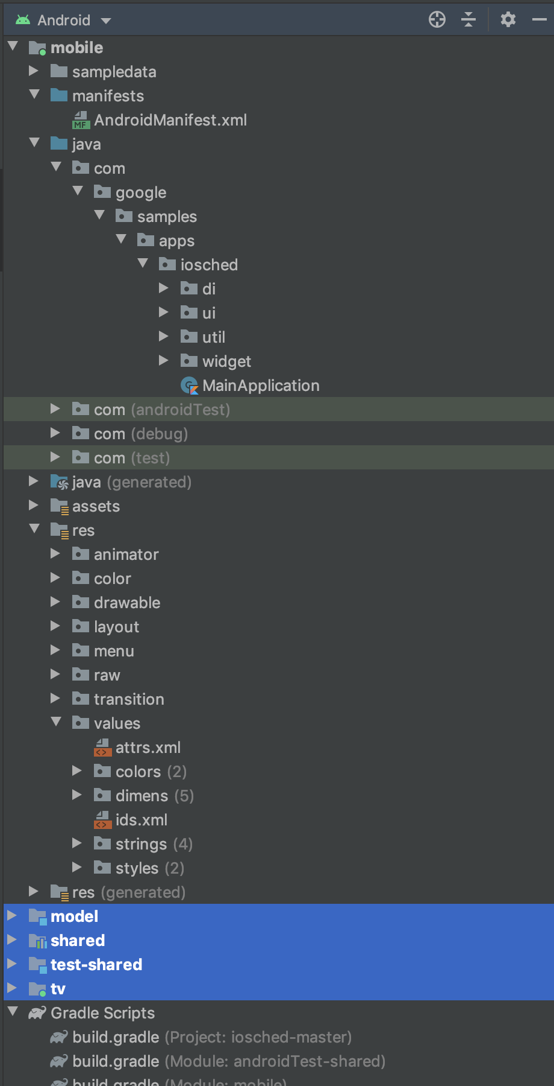
Project structure

Slide 15
Android components
Activities
Services
Broadcast receivers
Content providers

Slide 16


Google Sample Apps
Architecture Samples
Google IO App
Plaid App
Sunflower App

Slide 17

Questions

