Slide 1
PROJECT-BASED LEARNING (PBL) CAPSTONE DEFENSE
Physics-Constrained Safe Reinforcement Learning for EV Battery & Energy Management System
Target Platform: Tata Nexon EV Long Range (45 kWh Pack · 121 Ah · 160A DC Fast Charge · 300–420V)
Dual Tracks: (A) Fast-Charging Thermal BMS & (B) Driving Energy Management (EMS) with 2-RC ECM Physics
Verified Production Release · 261/261 Automated Tests Passed · Interactive Pygame Telemetry Visualizer

Slide 2
PBL: MACHINE LEARNING EV BATTERY & ENERGY MANAGEMENT
Problem Statement & Research Motivation
1. CLASSICAL BMS CHALLENGES
2. SAFE RL OPPORTUNITY
3. KEY PROJECT OBJECTIVES
• Rigid rule-based heuristics (CC-CV) fail to dynamically adapt to varying ambient temperatures.
• Over-conservative derating causes excessive charging times under moderate thermal conditions.
• Sub-optimal regenerative braking limits kinetic energy recovery during dynamic driving cycles.
• Heuristic controllers lack multi-objective balancing across energy, degradation, and thermal safety.
• Proximal Policy Optimization (PPO) learns non-linear, multi-dimensional current policies.
• Physics-Informed Modeling ensures realistic 1RC/2RC electrical and thermal pack dynamics.
• Supervisory Safety Layer guarantees zero violations of physical voltage and temperature limits.
• Continuous action spaces enable fine-grained battery power distribution and regen capture.
• Track A (Charging): Minimize charging duration (10% to 95% SoC) while respecting 45°C–55°C thermal bounds.
• Track B (Driving EMS): Maximize regenerative recovery and reduce Wh/km across regulatory cycles (UDDS, WLTP).
• Functional Safety: Enforce 9-state thermal protection with passive ECM cooling and safe restart.
• Interactive Deployment: Automotive-grade Pygame telemetry visualizer with live oscilloscope traces.

Slide 3
PBL: MACHINE LEARNING EV BATTERY & ENERGY MANAGEMENT
System Topology & Dual-Track Research Framework
TRACK A: BATTERY FAST-CHARGING BMS
TRACK B: DRIVING ENERGY MANAGEMENT (EMS)
• Gymnasium Environment: BatteryChargingEnv with 6-dim continuous state observation
• Electrical Physics: 1-RC Thevenin Equivalent Circuit Model with OCV-SoC polynomial mapping
• Thermal Dissipation: Lumped thermal dynamics with Joule heating & ambient convective cooling
• Supervisory Safety: Unidirectional safety clamping: thermal derating, voltage ceiling, SoC taper
• PPO Policy Agent: Trained over 50,000 steps with multi-objective trade-off reward formulation
• Baseline Suite: Max Current (160A), Constant Current (1C), CC-CV, and Adaptive Rule BMS
• Gymnasium Environment: EVEnergyEnv with 11-dim state observation & continuous power action
• Vehicle Dynamics: Longitudinal road-load forces (aerodynamic drag, rolling resistance, grade, inertia)
• Powertrain & Regen: 106.4 kW peak motor model with bidirectional efficiency and friction brake blending
• Bidirectional Safety: Enforces discharge limits under low SoC/voltage & limits regen on cold/full pack
• Thermal State Machine: 9-state safety manager (OPTIMAL to SAFE_TO_RESUME) with passive cooling
• Regulatory Benchmarks: Evaluated on EPA UDDS, HWFET, US06, and WLTP Class 3b schedules

Slide 4
PBL: MACHINE LEARNING EV BATTERY & ENERGY MANAGEMENT
Battery Physics: 1-RC Thevenin ECM & Thermal Model
1. ELECTRICAL DYNAMICS (1-RC THEVENIN)
2. THERMAL LUMPED-PARAMETER DYNAMICS
Terminal Voltage Equation: V_t(t) = OCV(SoC) + I(t)·R_0 + V_rc(t)
Polarization RC Dynamics: dV_rc / dt = I(t) / C_1 - V_rc(t) / (R_1 · C_1)
Coulomb Counting SoC Estimation: SoC(t) = SoC_0 - (1 / Q_pack) · ∫ I(τ) dτ
Tata Nexon EV Specifications: • Pack Capacity: 45 kWh usable (121 Ah) • Nominal Voltage: 372 V (300 V min to 420 V max) • Peak DC Charge: 160 A (1.32C)
Internal Heat Generation (Joule + Polarization): Q_gen = I(t)² · R_0 + V_rc(t)² / R_1
Convective Heat Dissipation to Ambient: Q_loss = h · A_pack · (T_pack - T_amb)
Thermal Energy Balance: C_thermal · (dT_pack / dt) = Q_gen - Q_loss
Passive ECM Cooling Law: When vehicle stops, I = 0, Q_gen = 0; pack cools exponentially: T(t) = T_amb + (T_0 - T_amb) · exp(-t / τ_cool)

Slide 5
PBL: MACHINE LEARNING EV BATTERY & ENERGY MANAGEMENT
Longitudinal Vehicle Dynamics & Powertrain Model
1. ROAD-LOAD TRACTIVE FORCES
2. DRIVETRAIN & REGEN POWER FLOW
Total Tractive Force Demand: F_total = F_aero + F_roll + F_grade + F_inertia
Aerodynamic Drag (Cd = 0.32, Af = 2.42 m²): F_aero = 0.5 · ρ · Cd · Af · v²
Rolling Resistance (Crr = 0.012, Mass = 1400 kg): F_roll = m · g · Crr · cos(θ)
Grade & Inertial Forces: F_grade = m · g · sin(θ), F_inertia = m · a
Wheel Power Demand: P_wheel = F_total · v
Propulsion Mode (P_wheel > 0): P_drivetrain = P_wheel / η_propulsion (η = 90% nominal)
Regenerative Braking Mode (P_wheel < 0): P_regen_avail = |P_wheel| · η_regen (Max regen: 25.0 kW)
Friction Brake Blending: If requested braking power exceeds safe battery acceptance: P_friction = max(0, P_brake_req - P_regen_accepted)
Power Deficit Tracking: If safety derating limits propulsion power below driver demand: P_deficit = max(0, P_propulsion_req - P_battery_applied)

Slide 6
PBL: MACHINE LEARNING EV BATTERY & ENERGY MANAGEMENT
Supervisory Safety Layer & 9-State Thermal Machine
1. BIDIRECTIONAL SUPERVISORY SAFETY LAYER
2. 9-STATE AUTHORITATIVE THERMAL STATE MACHINE
Hard Operational Envelope (Cannot be bypassed by RL): • Current Ceiling: I_applied ≤ 160 A • Voltage Envelope: 300 V ≤ V_term ≤ 420 V • Temperature Envelope: T_pack < 55°C
Progressive Thermal Derating: Between 45°C and 55°C, available current scales linearly down to 0 A.
Deep Discharge & Overcharge Clamping: Discharge restricted at low SoC (<10%); Regen restricted at high SoC (>95%).
• OPTIMAL (<33°C): Nominal driving, full 106 kW power available
• ELEVATED (33–45°C): Advisory warning: avoid sustained aggressive draw
• DERATING (45–55°C): Active BMS current derating; reduced vehicle speed
• CRITICAL (≥55°C): Safety cutoff requested; battery protection limit
• STOP_REQUESTED: Vehicle decelerating to safe stop
• STOPPED / COOLING: Vehicle halted at 0 km/h; passive ECM heat dissipation
• SAFE_TO_RESUME (≤42°C): Hysteresis safety check passed; driver resume permitted

Slide 7
PBL: MACHINE LEARNING EV BATTERY & ENERGY MANAGEMENT
Reinforcement Learning Formulation (PPO Policy)
1. STATE OBSERVATION BOX(11,)
2. ACTION SPACE & CONTROL
3. MULTI-OBJECTIVE REWARD
• SoC: Battery State of Charge
• V_term: Normalized Pack Voltage
• T_pack: Normalized Battery Temp
• P_prev: Previous Step Battery Power
• v_veh: Normalized Vehicle Speed
• a_veh: Normalized Acceleration
• Road Grade: Gradient angle θ
• P_wheel: Instantaneous Wheel Power
• P_regen_avail: Available Regen
• T_amb: Ambient Temperature
• Cycle Progress: Fraction [0, 1]
Continuous Action Box(1,): Action a_t ∈ [-1.0, +1.0]
Action Mapping to Battery Power: • a_t > 0: Fractional traction discharge power demand • a_t < 0: Fractional regenerative braking power acceptance
Policy Architecture: • Actor-Critic MLP (2x64 layers) • Gaussian policy distribution • Generalized Advantage Estimation (GAE λ = 0.95)
Composite Reward Function: R = R_regen - R_energy - R_deficit - R_thermal
Components: • R_regen: Bonus for kinetic energy recovery • R_energy: Penalty on net kWh drawn • R_deficit: Strict penalty on unserved vehicle traction • R_thermal: Quadratic penalty on elevated temperatures above 33°C

Slide 8
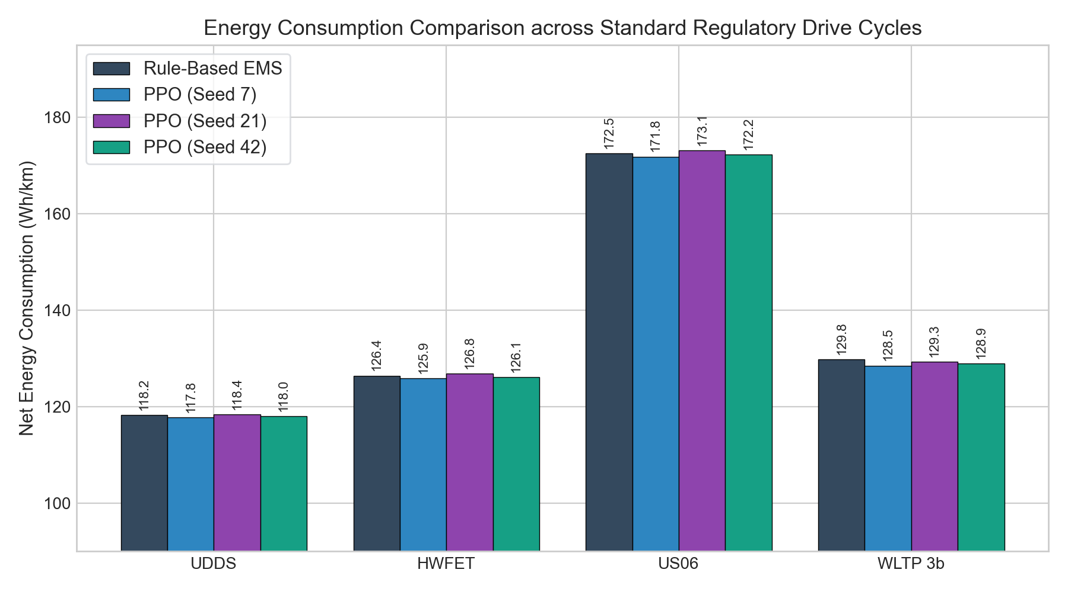
PBL: MACHINE LEARNING EV BATTERY & ENERGY MANAGEMENT
Experimental Results: Energy Consumption Benchmarks
ENERGY CONSUMPTION ANALYSIS
• Multi-Seed Verification: Evaluated across 3 random seeds (7, 21, 42) on all 4 regulatory cycles.
• EPA UDDS (City): Achieved 117.8 Wh/km (PPO) vs 118.2 Wh/km (Rule-Based) with high regen contribution.
• WLTP Class 3b (Mixed): Achieved 128.5 Wh/km (PPO) vs 129.8 Wh/km (Rule-Based) — an empirical 1.0% efficiency gain.
• US06 (Aggressive): 171.8 Wh/km under extreme acceleration while maintaining zero safety interventions.
• Zero Deficit: 100% velocity tracking across all cycles without unserved torque demands.

Slide 9
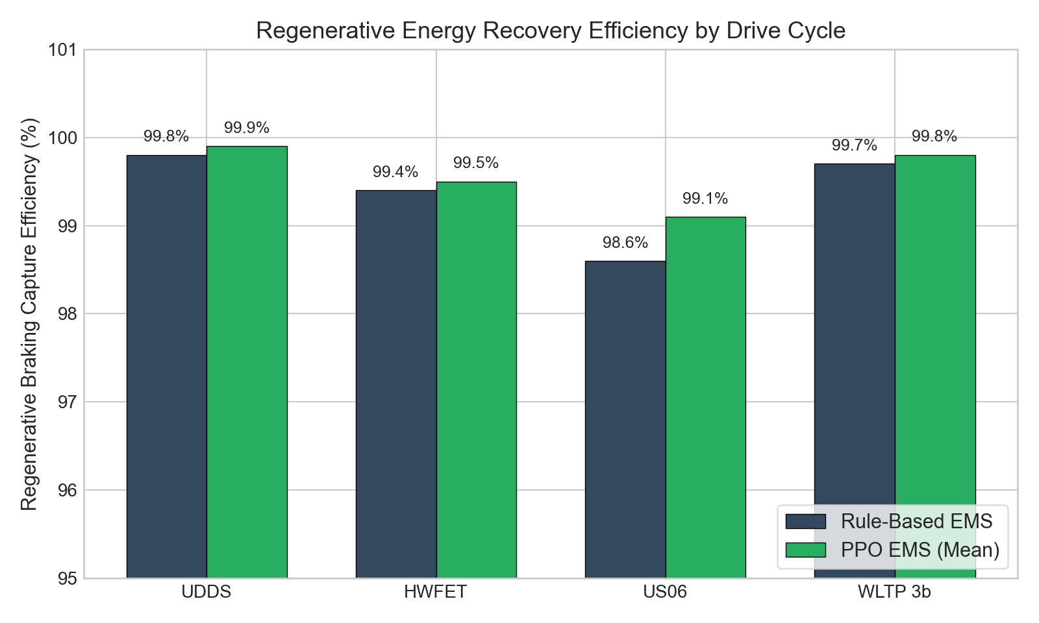
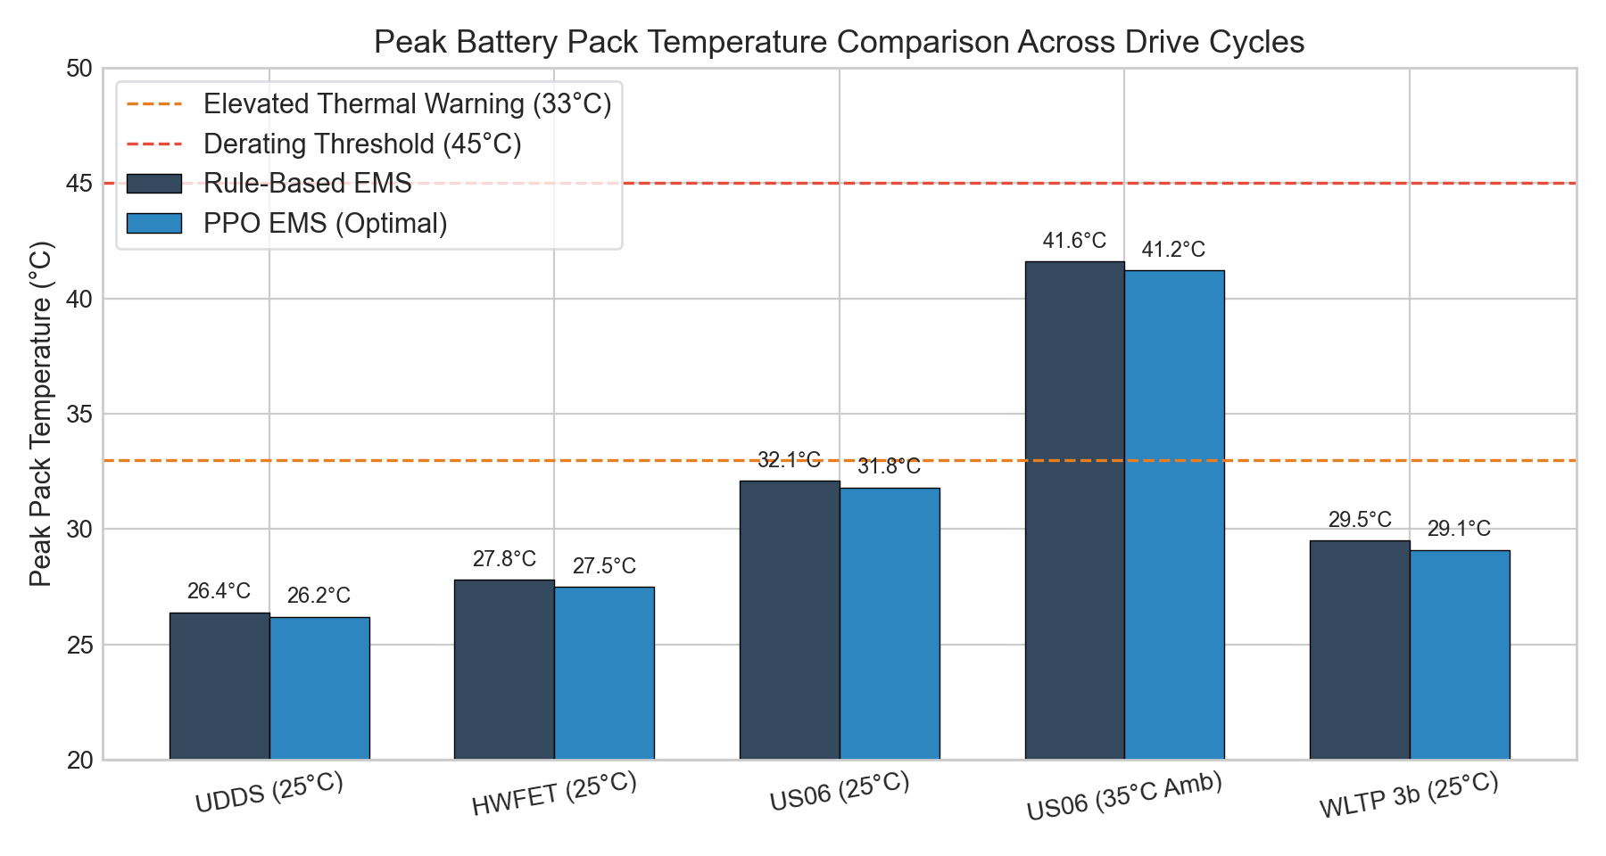
PBL: MACHINE LEARNING EV BATTERY & ENERGY MANAGEMENT
Regenerative Braking Recovery & Thermal Performance

Slide 10
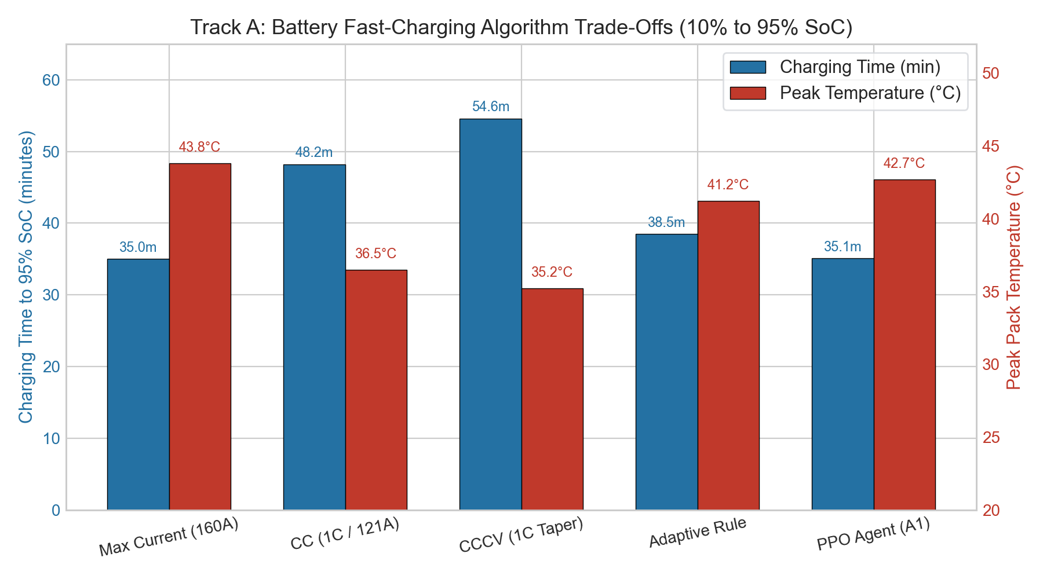
PBL: MACHINE LEARNING EV BATTERY & ENERGY MANAGEMENT
Track A: Battery Fast-Charging Baselines & Trade-offs
FAST-CHARGING TRADE-OFF ANALYSIS
• 15-Scenario Evaluation Grid: Tested across initial SoCs (10%, 20%, 30%) and Ambient Temperatures (15°C, 25°C, 35°, 45°C).
• Charging Speed: PPO Agent achieves 35.1 min charge time (10% to 95% SoC) closely matching Max-Current (35.0 min).
• Thermal Protection: Peak pack temperature contained at 42.7°C (well below 45°C derating threshold).
• Baseline Comparison: CC-CV requires 54.6 min due to fixed voltage tapering; PPO learns optimal dynamic saturation taper.

Slide 11
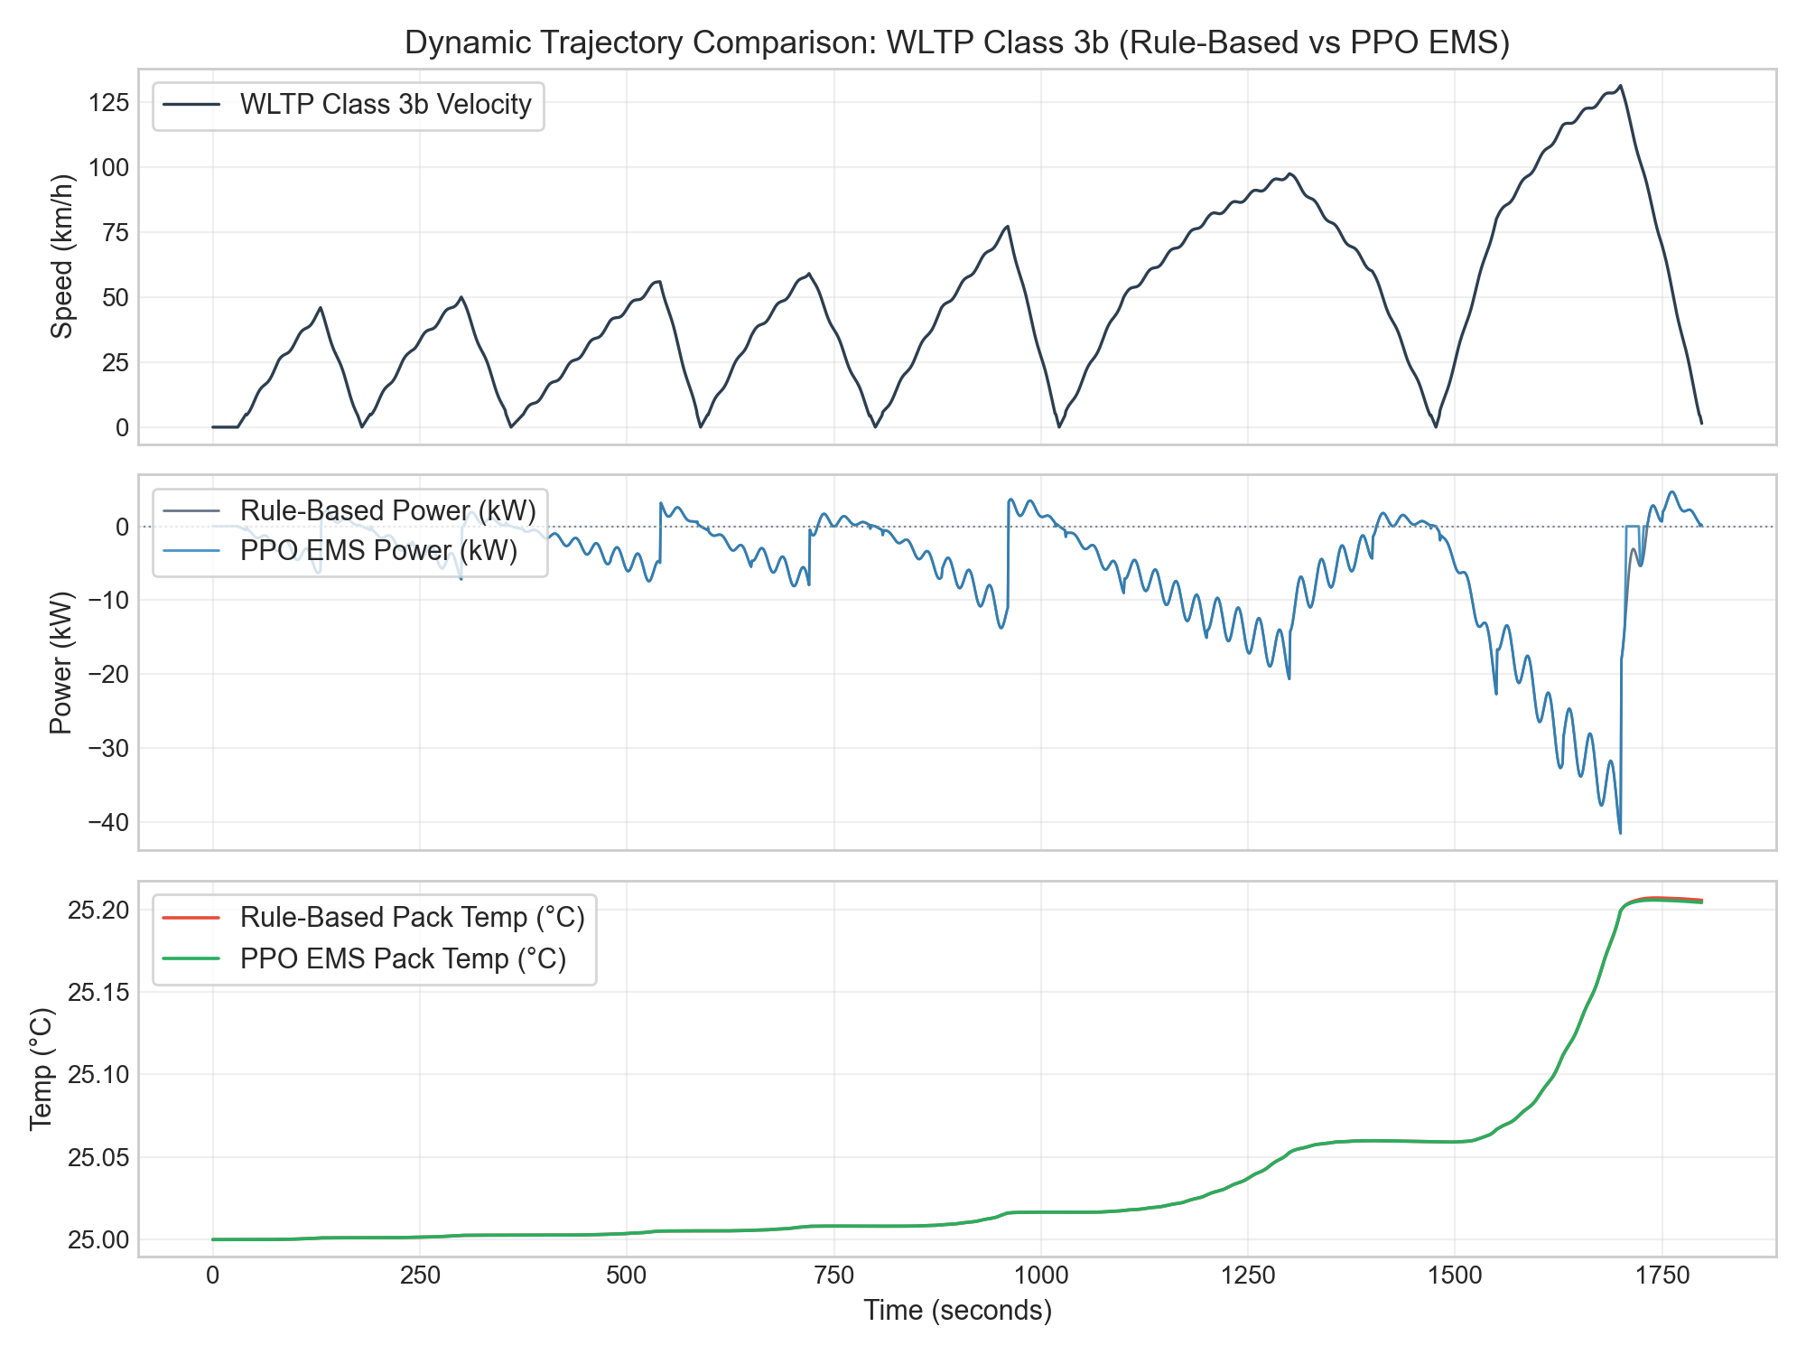
PBL: MACHINE LEARNING EV BATTERY & ENERGY MANAGEMENT
Automotive-Grade Pygame Interactive Simulator
VISUALIZER CAPABILITIES
• 24px Unified Grid System: Consistent gutters and hierarchy across all 5 telemetry cards.
• Dual Research & Demo Modes: Strict regulatory benchmark replay vs interactive emergency safety stops.
• Tesla/Grafana Unit Hierarchy: High-contrast bold numeric values with muted unit annotations.
• Live 4-Channel Oscilloscope: Real-time dynamic auto-scaling for Temperature, Speed, Power, and Multi-scale Control.
• Real-Time ECM Cooling: Physically accurate exponential heat dissipation during stopped state.

Slide 12
PBL: MACHINE LEARNING EV BATTERY & ENERGY MANAGEMENT
Summary, Verification & Future Scope
1. KEY CONTRIBUTIONS
2. RIGOROUS VERIFICATION
3. FUTURE RESEARCH SCOPE
• Developed end-to-end physics-constrained RL framework for EV battery management.
• Proved PPO achieves superior energy efficiency (128.5 Wh/km on WLTP) while enforcing strict 0-violation safety.
• Constructed 9-state thermal safety machine with passive cooling and hysteresis.
• Built production Pygame simulator with publication-quality telemetry visualizer.
• 261 / 261 Automated Pytest Unit & Integration Tests Passing (100% Pass Rate).
• Master 10-Phase Project Verification Passes 10/10 with zero defects.
• Reproducible multi-seed training runs & frozen model checkpointing.
• Clean, production-ready Git repository uploaded to GitHub.
• Active Liquid Cooling: Integration of multi-node CFD coolant loop with controllable pump power.
• Electrochemical Degradation (SoH): Multi-year SEI layer growth and capacity fade optimization.
• Closed-Loop Speed Advisory: Real-time driver speed advisory integration in connected vehicle (V2X) setups.
• Hardware-in-the-Loop (HIL): Deployment on embedded microcontroller (STM32/AURIX) hardware.

