Slide 2
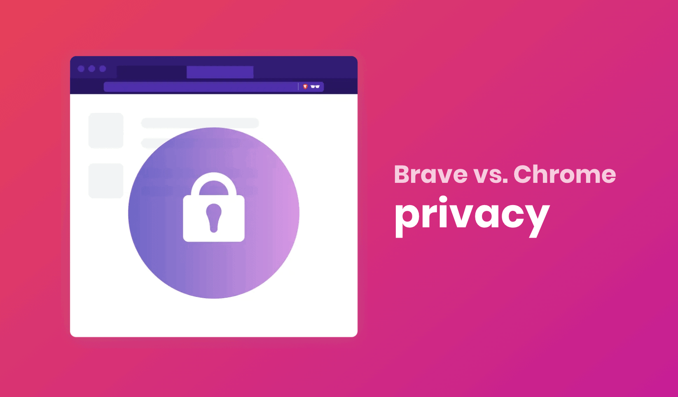
Browser Battle: Brave vs Chrome

Slide 3
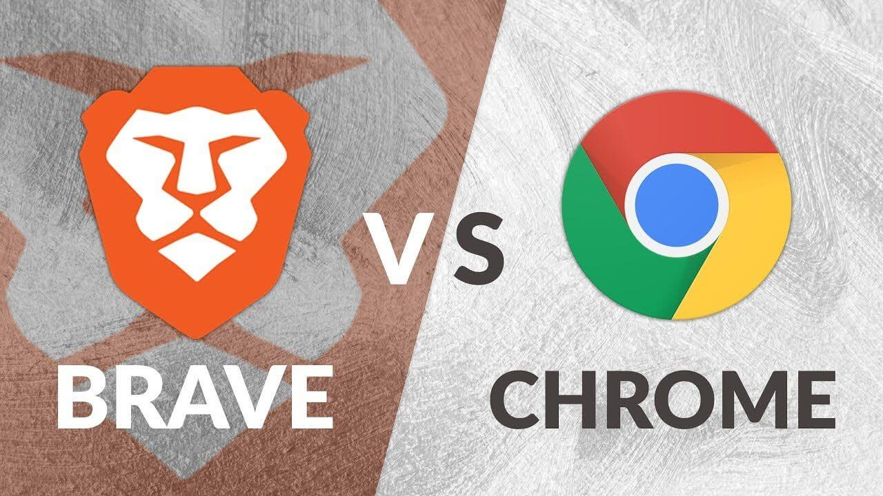
Overview
• Brave is a relatively new web browser that aims to offer a faster and more private browsing experience
• Chrome, on the other hand, is a well-established and widely-used browser developed by Google
• In this presentation, we will compare and contrast the key features and performance of both browsers

Slide 4
Privacy Features
• Brave blocks third-party trackers and ads by default, giving users more control over their online data
• Brave also has a built-in ad blocker, which can significantly improve page load times and reduce clutter
• Chrome does have some privacy features, such as Incognito mode, but it is more transparent about data collection

Slide 5
Speed and Performance
• Brave claims to be up to 3x faster than Chrome due to its innovative design and optimization techniques
• Brave also has a smaller codebase and fewer moving parts, which can result in a more stable browsing experience
• Chrome has many features and extensions, which can slow it down and make it more memory-intensive

Slide 6
User Interface
• Brave has a clean and minimalist interface that gets out of the way, allowing users to focus on their content
• Brave also has a focus on mobile users, with a simplified interface that is easy to navigate
• Chrome's interface is highly customizable, but it can also be cluttered and overwhelming

Slide 7
Security
• Brave uses the same advanced security features as Chrome, including sandboxing and SSL/TLS encryption
• Brave also has a built-in HTTPS Everywhere feature, which helps protect user data
• Chrome has a strong reputation for security, but has faced some vulnerabilities in the past

Slide 8
Extensions and Add-ons
• Brave has a limited selection of extensions and add-ons, but is constantly adding new ones
• Brave also has a built-in Rewards feature, which allows users to earn cryptocurrency for viewing ads or using Brave Search
• Chrome has a vast library of extensions and add-ons, but some may slow it down or compromise security

Slide 9
Platform Support
• Brave is available on desktop and mobile devices, including Windows, macOS, and Linux
• Brave also has a focus on emerging markets, with support for languages like Hindi and Spanish
• Chrome is also available on desktop and mobile devices, with a wider range of language options

Slide 10
Cost and Pricing
• Brave is completely free and open-source, with no hidden fees or subscription costs
• Brave also has a non-profit model, which aims to use revenue from Brave Search to fund development
• Chrome is also free, but has some optional premium features and subscriptions, such as Google Drive storage

Slide 11
Conclusion
• Brave and Chrome are two distinct browsers with different approaches to privacy, speed, and security
• Brave offers a unique combination of speed, privacy, and simplicity, but may lack the customization options of Chrome
• Ultimately, the choice between Brave and Chrome will depend on individual user needs and preferences

