Slide 2
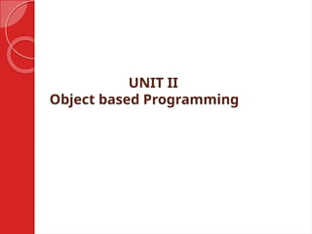
Introduction to C++
• C++ is a high-performance, compiled, general-purpose programming language
• It was developed by Bjarne Stroustrup as an extension of the C language
• C++ is used for developing operating systems, games, web browsers, and many other applications

Slide 3
C++ Syntax
• C++ is case-sensitive: uppercase and lowercase letters have different meanings
• Variables must be declared before they are used
• C++ supports procedural, object-oriented, and generic programming paradigms

Slide 4
C++ Variables
• Variables in C++ can be declared using the data type, such as int, float, char, etc.
• The scope of a variable is the region of the program where it can be accessed
• C++ supports various data types such as integer, floating-point, character, and Boolean

Slide 5
C++ Operators
• C++ supports various operators such as arithmetic, comparison, logical, and assignment operators
• Operators are used to perform operations on variables and values
• C++ also supports implicit type conversion and operator overloading

Slide 6
C++ Control Structures
• C++ supports various control structures such as if-else statements, switch statements, and loops
• The if-else statement is used to execute a block of code if a condition is true
• The switch statement is used to execute a block of code based on the value of an expression

Slide 7
C++ Functions
• Functions in C++ are blocks of code that can be called multiple times from different parts of the program
• Functions can take arguments and return values
• Functions can be used to reuse code and promote modularity in the program

Slide 8
C++ Classes and Objects
• Classes in C++ are user-defined data types that encapsulate data and functions
• Objects are instances of classes and have their own set of attributes and methods
• Classes and objects are the building blocks of object-oriented programming

Slide 9
C++ Constructors and Destructors
• Constructors in C++ are special member functions that are called when an object is created
• Destructors in C++ are special member functions that are called when an object is destroyed
• Constructors and destructors are used to initialize and cleanup objects

Slide 10
C++ Inheritance
• Inheritance in C++ is the mechanism of creating a new class from an existing class
• The new class is called the derived class, and the existing class is called the base class
• Inheritance allows code reuse and promotes modularity in the program

Slide 11
C++ Polymorphism
• Polymorphism in C++ is the ability of an object to take on multiple forms
• C++ supports polymorphism through method overriding and method overloading
• Polymorphism is used to write code that can work with objects of different classes

Slide 12
Conclusion
• C++ is a powerful and versatile programming language with a wide range of applications
• C++ is used to develop systems software, games, and web applications
• Mastering C++ requires practice and dedication, but it is a rewarding and challenging experience

