Slide 1

A3-PS015-TC554
Explainable Home and Last-Mile Connectivity Diagnosis
NERVE - Network Evidence, Reasoned Verification & Explanation
Pujan Sonani personal email ID-pujansonani1811@gmail.com
AIORI Hackathon 3
THREE MUSKETEERS

Slide 2

AIORI 3
Abstract
Problem Description
REAL-WORLD USER PAIN POINTS
CORE PROBLEM
Work & Study disruption:
  Remote workers face frozen video calls during household file transfers.
  Students see browser errors even though the computer shows "Connected".
Blind, trial-and-error fixes:
  Users waste time randomly restarting routers, swapping cables, or tweaking system settings without knowing if it helps.
  Speed tests only show symptoms, not the cause: Running a speed test tells you bandwidth is low or ping is high, but never explains where or why the issue is happening.
The "Blame Game" confusion: Everyday users cannot pinpoint which part of their network is failing:
  Is it their own Wi-Fi / local router?
  Is it a DNS issue stopping websites from loading?
  Is it packet loss on a specific path to one website?
  Is it network congestion because someone else is uploading or downloading?
SUPPORT & ISP CHALLENGES
  Vague customer complaints: Support engineers get tickets saying "internet is slow" or "Wi-Fi is down" instead of measurable evidence.
  No verifiable logs: Technicians lack timestamps, probe targets, and path metrics needed to quickly isolate and reproduce the problem.
  Guesswork over proof: Most existing diagnostic tools force a speculative guess instead of honestly stating when evidence is missing or inconclusive.
·
·
THREE MUSKETEERS
A3-PS015-TC554
October 12, 2026

Slide 3
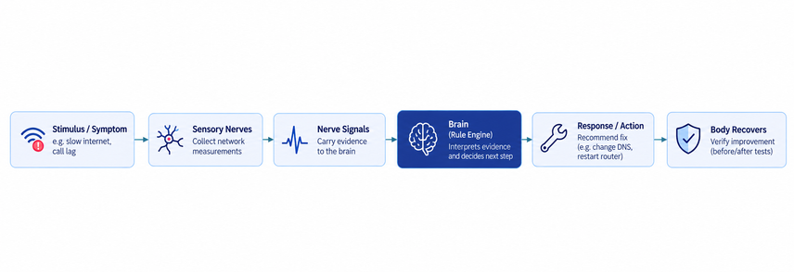
Background
The Problem: Users only know their call froze or a page failed. Traditional speed tests just give a raw Mbps number, with zero clue which part of the path choked.
The Problem: Tools run brute-force tests in a fixed order, or use black-box guesses that blame the ISP without proof
NERVE ⟶ Adaptive policy picks only the next-best probe to separate hypotheses; deterministic rules issue findings or honestly say Inconclusive.
NERVE ⟶ Lets user pick the symptom directly to focus initial checks
The Problem: Users try random reboots with zero follow-up or confirmation whether anything changed.
Endpoint Blindness
The Problem: device perceives sensations at the edge, not inside the ISP core or remote hardware.
The Problem: Tools run brute-force tests in a fixed order, or use black-box guesses that blame the ISP without proof.
NERVE ⟶ Suggests safe, consent-gated fixes and immediately re-tests the matched window to prove if the connection measurably improved.
NERVE ⟶ Reports what was measured, never an unsubstantiated "ISP fault".
NERVE ⟶ Adaptive policy picks only the next-best probe to separate hypotheses; deterministic rules issue findings or honestly say Inconclusive
THE BIGGER PROBLEM (Brute-Force Scans):
Standard tools run every heavy test in a fixed order regardless of results, wasting user time and data.
NERVE ⟶
Adapts to what it senses—picks only the probe that separates remaining explanations, stops when evidence is sufficient, and returns Inconclusive when it cannot prove the cause.

Slide 4
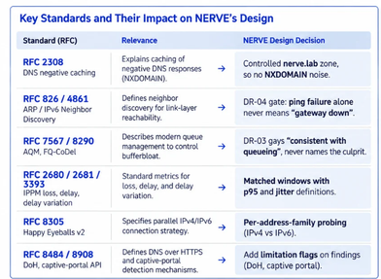
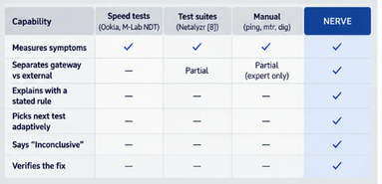
literature and RFC review
exisiting work and capability comparision
[1] RFC 2308 — DNS Negative Caching [2] RFC 826 — Address Resolution Protocol (ARP) [3] RFC 4861 — IPv6 Neighbor Discovery [4] RFC 7567 — Active Queue Management Recommendations
[5] RFC 8290 — FQ-CoDel Queue Management [6] RFC 2680 — One-Way Packet Loss Metric [7] RFC 2681 — Round-Trip Delay Metric [8] RFC 3393 — IP Packet Delay Variation [9] RFC 8305 — Happy Eyeballs Version 2 [10] RFC 8484 — DNS over HTTPS (DoH)
REFERENCES:
To our knowledge, none of these combine adaptive test selection, explicit inconclusive and verified remediation. That’s NERVE’S gap .

Slide 5
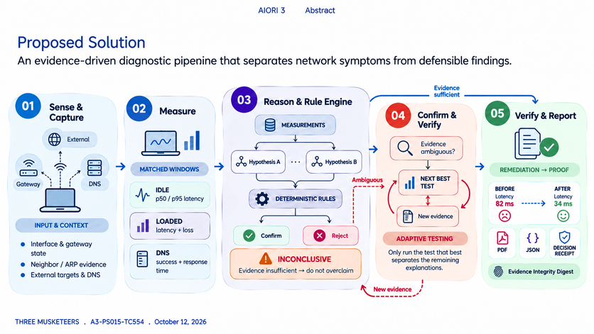
AIORI 3
Proposed Solution
Proposed Solution
An evidence-driven diagnostic pipeline that separates network symptoms from defensible findings.
·
·
THREE MUSKETEERS
A3-PS015-TC554
October 12, 2026

Slide 6
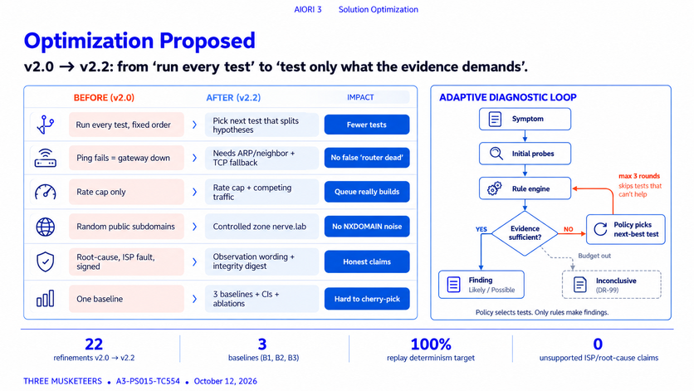
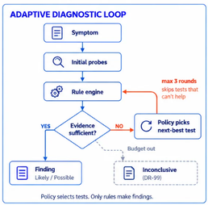

Slide 7
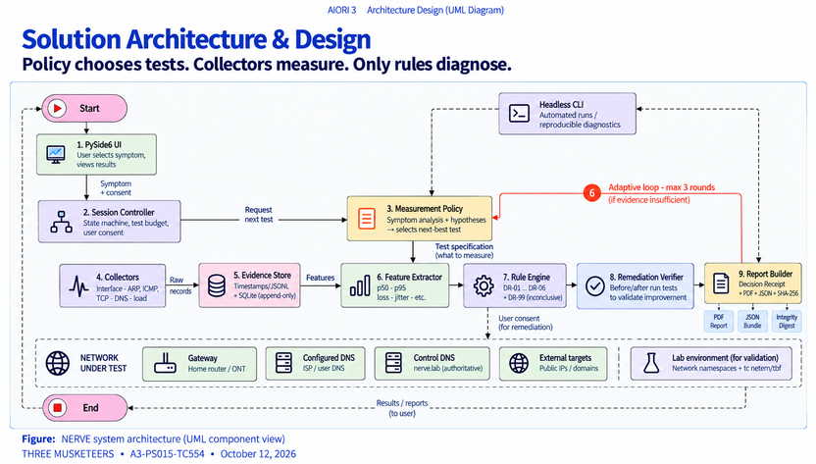

Slide 8
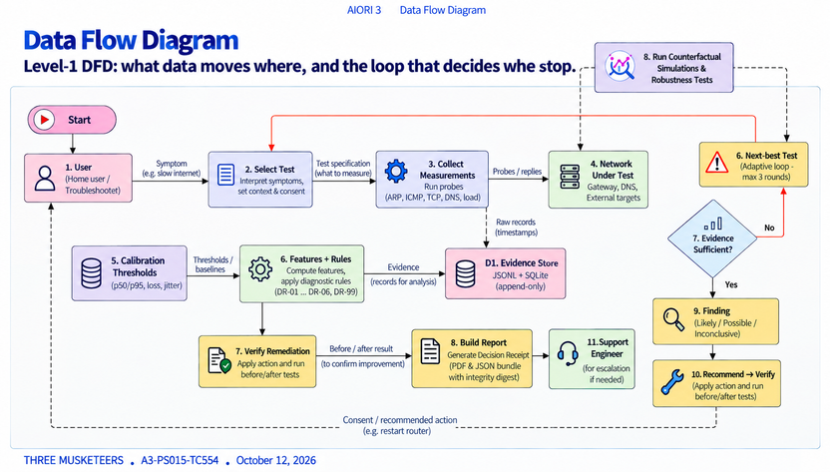

Slide 9
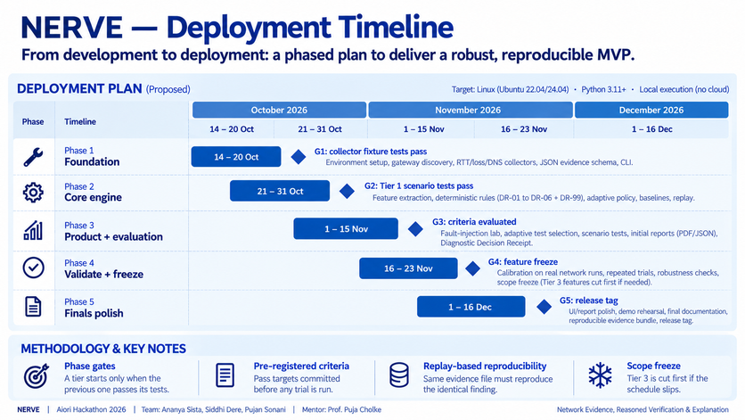

Slide 10
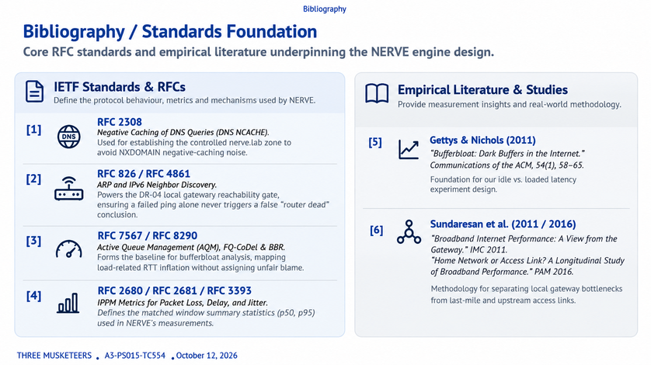

Slide 11


