Slide 1
Artificial Intelligence Project
Coloring Black and White Images
By using Deep Learning and Caffe
Siddhika Bejekar
MIS :111803136

Slide 2
Previous methods for image colorization either:
Was done manually and relied on significant human interaction.
Produced desaturated colorization
The approach I have used here today instead relies on deep learning. I used a Convolutional Neural Network capable of colorizing black and white images with best results.

Slide 3
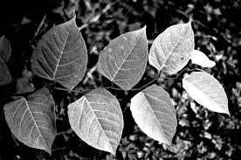
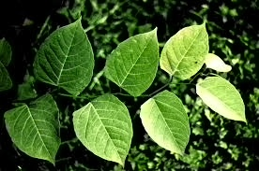
What this Project does?
Original
This is a Deep Learning Project where a black and white image is taken as input and a colorized image is produced. This is done using OpenCV DNN(deep neural network) architecture which is trained on ImageNet dataset.
Colorized

Slide 4
Technology Used:
Tech Stack used:
Python 3.8
Libraries used:
  OpenCV : cv2(for image processing)
  Matplotlib(for displaying i.e plotting the images)
  Numpy

Slide 5
Coloring greyscale images
Requirements:
colorization_release_v2.caffemodel : It is a pre-trained model stored in the Caffe framework’s format that can be used to predict new unseen data.
colorization_deploy_v2.prototxt : It consists of different parameters that define the network and it also helps in deploying the Caffe model.
pts_in_hull.npy : NumPy file.

Slide 6
Coloring greyscale images
Lab Color Space:
First image is converted from RGB color space to is converted to LAB color space. Like RGB, Lab is another color space. It is also three channel color space like RGB where the channels are:
L channel: This channel represents the Lightness
a channel: This channel represents green-red
b channel: This channel represents blue-yellow
Since the L channel encodes only the intensity, L channel is used as grayscale input to the network. From there the network learns to predict the a and b channels. Given the input L channel and the predicted ab channels we can then form our final output image.

Slide 7
Working:
The entire process can be summarized as:
Since BGR is default format for cv module, even though our image is black and white, first BGR color space is converted to proper Grayscale.
Then greyscale to RGB color space.
Then again from the RGB color space to the Lab color space.
Use the L channel as the input to the network and train the network to predict the ab channels.
Combine the input L channel with the predicted ab channels.
Convert the Lab image back to RGB.

Slide 8
Thank You!!

