Slide 1
Smart Train Ticket Verification System
Team Name: Social Workers
Team members:
SIDDHARTH B
YAZHINI G
REVANTHKUMAR S
PRAVEEN P
LOESGH KUMARAN D

Slide 2
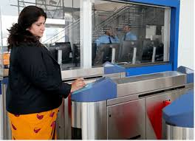
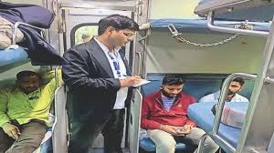
EXISTING SYSTEM
Manual Ticket Checking is slow, labor-intensive, and prone to human errors.
QR Code & RFID Systems require passengers to actively scan their tickets, causing congestion at entry points.
No Real-Time Tracking of passenger data, leading to inefficiencies in train occupancy management.
❌ Time-Consuming
❌ Prone to Fraud
❌ High Operational Costs
❌ Lack of Automation
❌ Limited Scalability

Slide 3
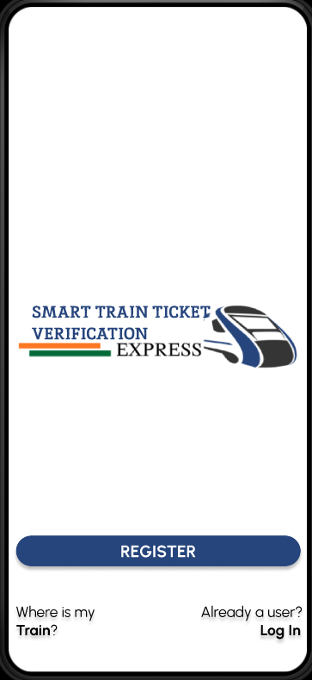
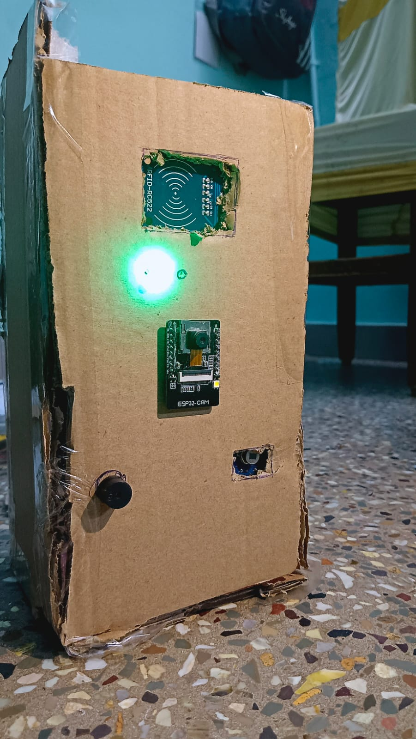
Automated Train Ticket Verification Process
The AI-powered Smart Train Ticket Verification System leverages NFC, deep sensors, ESP32 AI Thinker, and Firebase to automate ticket validation and passenger detection.
This system eliminates manual ticket checking, reduces fraud, and improves efficiency by using contactless NFC scanning and AI-driven human detection.
NFC-Based Ticket Validation
Deep Sensors for Passenger Detection
ESP32 AI Thinker for Image Recognition
Real-Time Database with Firebase
Automated Alerts & Reports
Energy-Efficient & Scalable

Slide 4
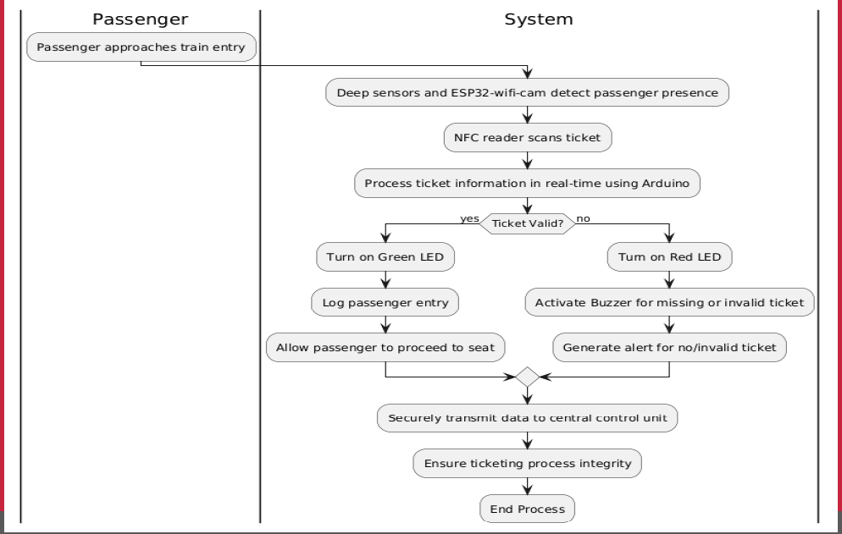

Slide 5
GENERAL BENIFITS
🔹 For Users:
Ease of Use: Contactless NFC ticketing simplifies boarding.
Better Experience: Eliminates long queues and manual ticket checking delays.
Convenience: Automated validation ensures a smooth and hassle-free journey.
🔹 For Businesses (Railway Operators & Transit Authorities):
Cost-Saving: Reduces labor costs by minimizing manual ticket checking.
Improved Efficiency: Real-time passenger tracking optimizes train operations.
Greater Customer Satisfaction: Faster ticket validation enhances the travel experience
🔹 Long-Term Impact:
Industry Innovation: Sets a benchmark for AI-driven ticketing in public transport.
Scalability & Future Growth: Adaptable for metro, bus, and high-speed rail systems.

Slide 6
AI FEATURES
Object Detection: To detect trains using the ESP32 Wi-Fi cam. By training a model to recognize specific shapes, sizes, or colors, the system can verify the presence of a train on the track.
Predictive Maintenance: By analyzing data from sensors over time, AI can predict when parts of the system (like RFID tags or components of the train) might fail, allowing for preemptive maintenance.
Threats Recognition: If your project involves verifying the identity of the train operator or passengers, AI can detect the person who are entering to the seats without scanning the tickets and capturing their photos.

Slide 7
PROJECT DETAILS
Harware & Completed prototype
https://drive.google.com/drive/folders/1f3xnLowx_outc9s_r_LYIQZoiu0Xd0Rn?usp=drive_link
Software & UI/UX design
https://drive.google.com/drive/folders/156S2nrJ1wXVWov3vX8VsOQzRs8z-h8fF?usp=drive_link
Abstract
https://drive.google.com/file/d/1a0v7FVH6UgpU2FyGbhFYe3VSnWMRD58s/view?usp=drive_link

