Slide 1
SMART TRAIN TICKET VERIFICATION SYSTEM
IoT-Based Smart Train Ticket Verification and Unauthorized Entry Prevention system designed to automate passenger authentication, reduce manual checks, and enhance security in rail transport.
Our system integrates NFC technology, Deep sensor, and IoT connectivity to verify passengers tickets in real time as they board trains.
Prototype is 90% complete, testing phase is ongoing.
Hardware : https://drive.google.com/drive/folders/149FsihxdhWgXt-yFUn_7yUrObHq0c_5Q?usp=sharing
Software : https://drive.google.com/drive/folders/156S2nrJ1wXVWov3vX8VsOQzRs8z-h8fF?usp=sharing
“Ensuring Secure, Smart, and Seamless Travel Experience”

Slide 2
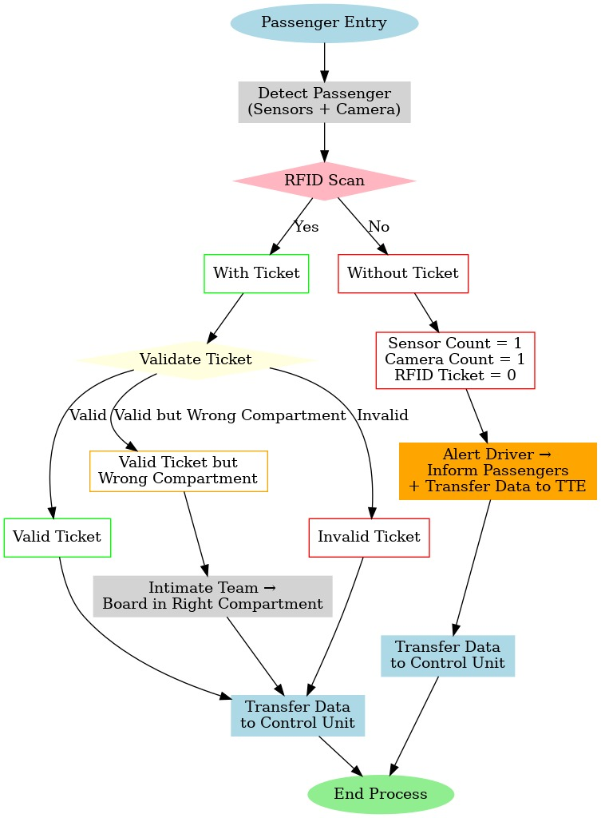
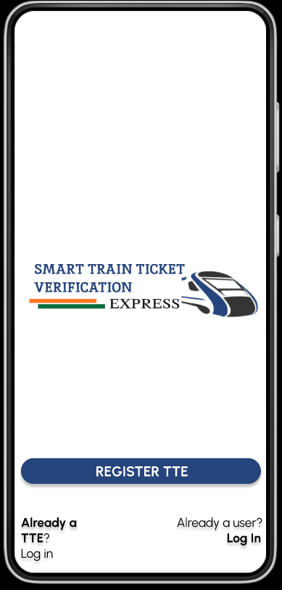
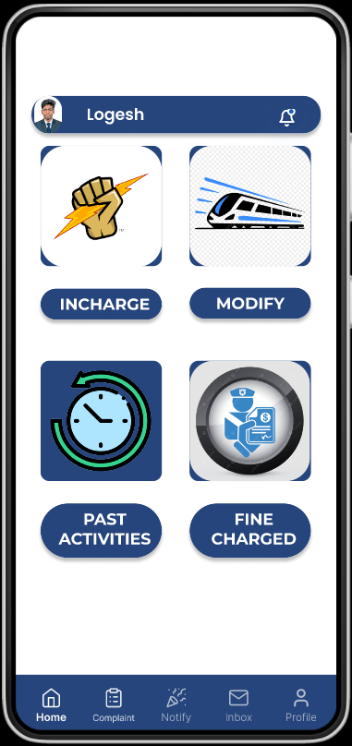
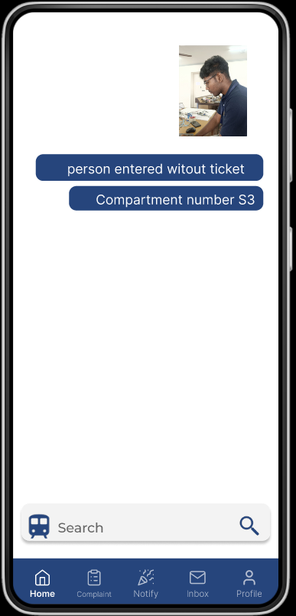
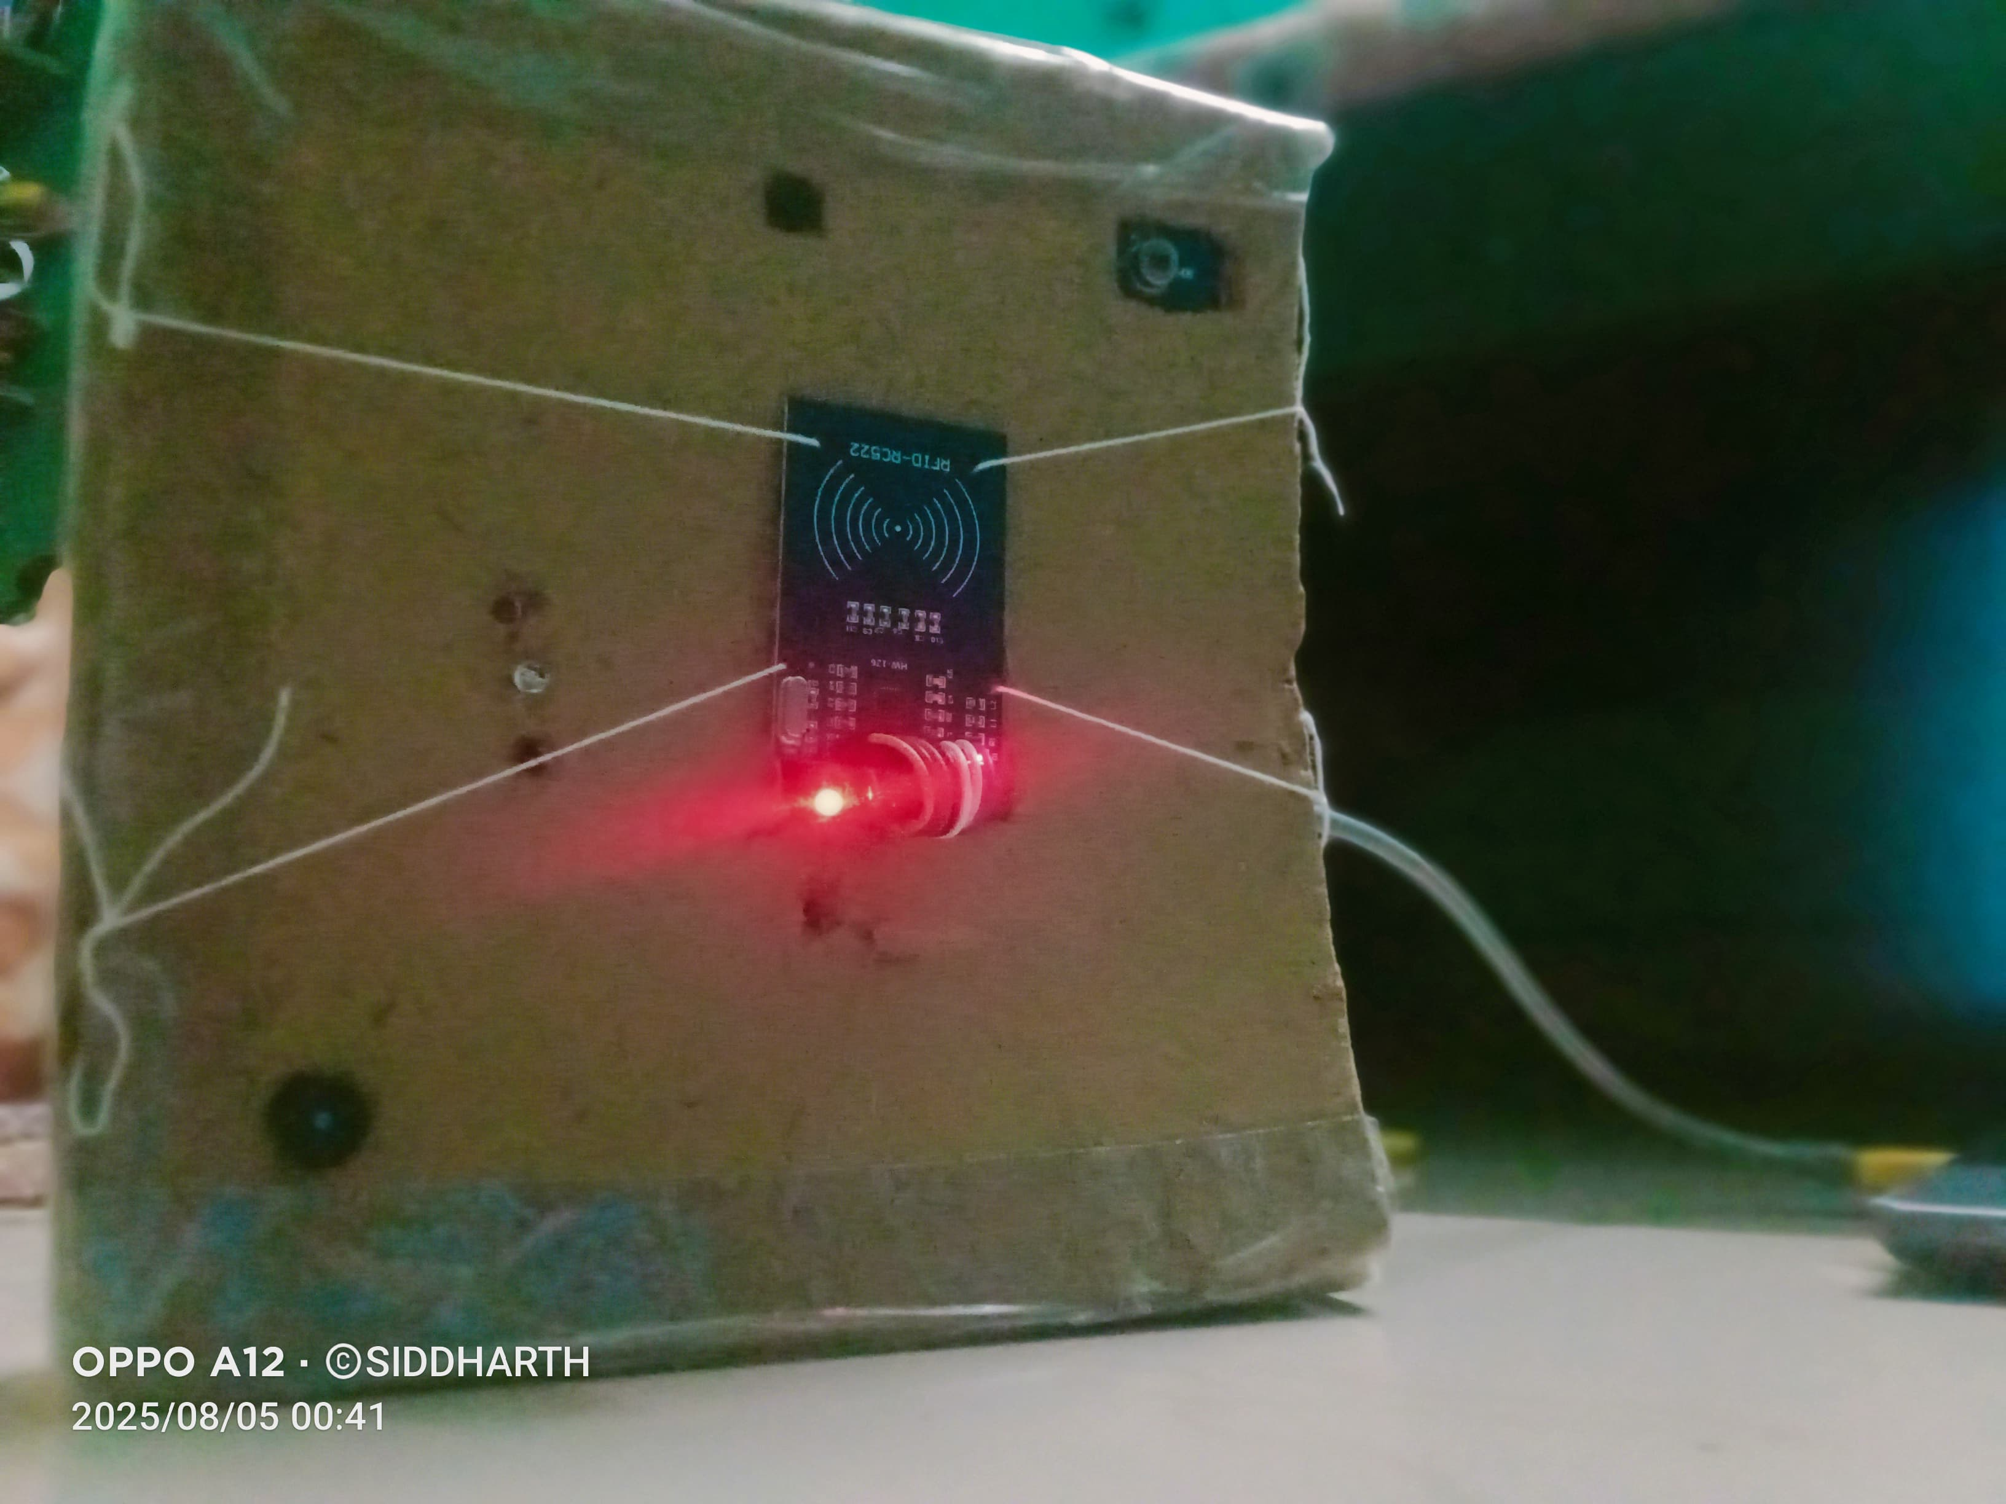
Social Workers
TECHNICAL APPROACH
Software:
Arduino IDE - Coding the Hardware.
NodeJs - For Hosting website.
Android Studio - For Mobile Application.
Figma - Designing the Application and
website.
Firebase - Authentication and Database.
Hardware:
Arduino UNO- Central Controller for hardware.
Deep sensor - Detecting the passengers.
ESP32-AI-Cam - Capturing the person without ticket.
ESP32 - Secure data transfer to TTE system.
Buzzers & LEDs - Intimation for the passengers
3

Slide 3
Social Workers
FEASIBILITY AND IMPACT
Technical Feasibility: Built using cost-effective hardware with firebase ensuring real-time validation and scalability.
Impact on Passengers & TTEs: Faster boarding, reduced waiting time, instant alerts, and improved safety through automated checks.
Enhanced Security: ESP32 - AI - Cam captures visual evidence of unauthorized entry, while the buzzer immediately alerts railway saff and passengers.
AI-Powered Monitoring: AI features like Object Detection & Treat Recognition help identify unauthorized passengers or anomalies, ensuring higher accuracy and safety.
Social, Economic & Environmental Benifits: Prevents revenue leakage from ticketless travel, ensures secure journeys, reduces manpoer dependency, and promotes eco-friendly digital ticketing.
4

Slide 4
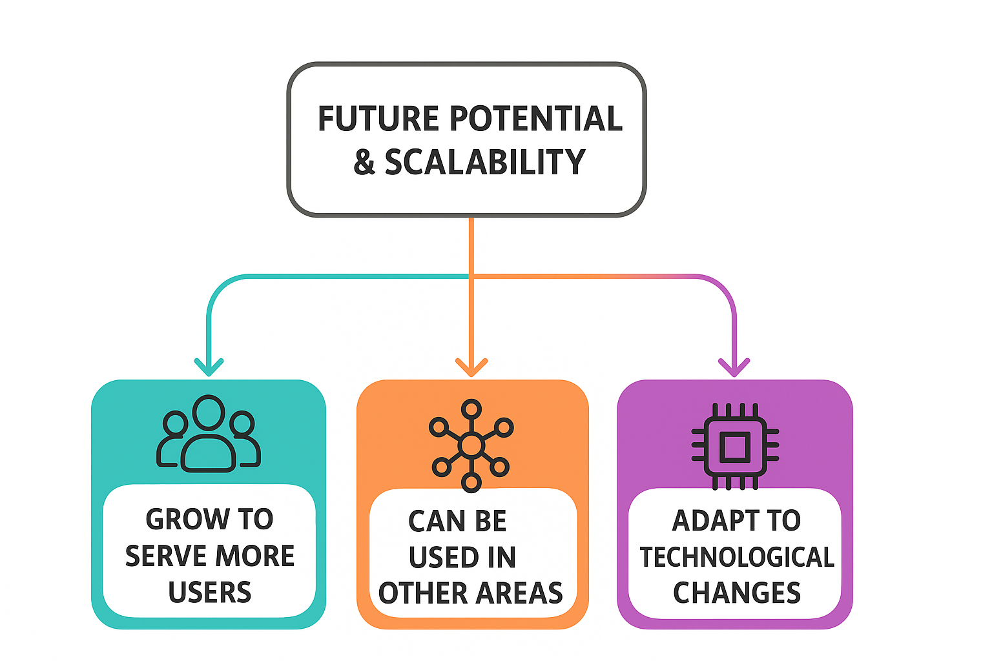
Social Workers
FUTURE POTENTIAL & SCALABILITY
Expansion: Scale from local communities to nationwide disaster management.
Application: Useful in mining, defence, healthcare & transport safety.
Tech Growth: Ready for AI, IoT & 5G integration to make alerts smarter.
Core Devices:
Buzzers -> Expand into multi-level emergency
alert systems and plays little psychology.(Intimates
passengers, person travelling without ticket).
ESP32 AI Cam -> Enables automated monitoring
& real-time visual evidence.
4

