Slide 1

AI-Powered Software Bug Tracking and Defect Management System
SOA Project Review-1
 | Under the Guidance of Dr. NEELIMA GOGINENI Assistant Professor, Department of Computer Science and Engineering, KLH CSE Bowrampet Campus
Team Members: B Sidharth Reddy 2420030600 T Devi Prasad 2420030165 M Sai Vinesh 2420030691

Slide 2
Outline of Project Work
Focus
Introduction
Literature Survey
Challenges
Research Objectives
Conclusion & Future Work
References
Publications Details

Slide 3
Problem Statement
Software development teams often face difficulties in efficiently managing a large number of reported defects. Manual bug classification, prioritization, assignment, and duplicate detection can consume significant time and may result in inconsistent decisions.
Existing defect tracking systems primarily focus on recording and monitoring bugs, while intelligent analysis and automated classification may be limited.
Therefore, there is a need for a secure, scalable, and AI-assisted defect management system that can automate important aspects of bug analysis while following modern SOA and microservices principles.

Slide 4
Objectives
To design and develop an AI-powered software bug tracking and defect management system.
To implement a microservices-based architecture for modularity, scalability, and independent service management.
To provide secure authentication and authorization using Spring Security and JWT.
To implement AI-assisted bug analysis for severity, priority, category classification, and duplicate-bug identification.
To integrate service discovery, API Gateway, and event-driven communication using Spring Cloud Eureka, Spring Cloud Gateway, and Apache Kafka.

Slide 5
Literature Survey
Authors | Title of the Paper | Methodology | Inferences | Limitation/Future work
Patil & Jadon (2022) | Auto-labelling of Bug Report using NLP | NLP, data transformation, deep neural network and ML techniques | Demonstrates the feasibility of automated similar-bug retrieval; reported 70% Recall@5 | Further improvement in retrieval/ranking and integration with broader defect-management workflows
Söylemez et al. (2022) | Challenges and Solution Directions of Microservice Architectures | Systematic literature review | Identifies major architectural, communication, data, deployment and testing challenges | Requires appropriate architectural and operational solutions
Billawa et al. (2022) | Security of Microservice Applications | Systematic study of practitioner literature | Microservices introduce distributed security challenges requiring specialized practices | Continued development and validation of practical security solutions

Slide 6
Problem Gap Identification
Based on the existing approaches considered for software defect management, the following gaps are identified:
Conventional defect tracking systems primarily focus on recording, assigning, and monitoring defects.
Manual severity and priority assignment can introduce inconsistency and additional effort.
Duplicate defect identification may require significant manual analysis when large numbers of reports are generated.
AI-based defect analysis is not always integrated with a complete microservices-based defect management architecture.
Security, service discovery, scalability, and automated testing need to be considered together in a distributed defect management system.
There is an opportunity to integrate AI-assisted defect analysis with secure and scalable microservices architecture.

Slide 7
Innovation, Creativity, and Novelty
The proposed system combines AI-assisted defect analysis with modern microservices architecture to provide an intelligent and scalable approach to software defect management.
Key Novelty
AI-assisted prediction of bug severity and priority.
AI-assisted bug category classification.
Potential duplicate-bug identification using textual similarity.
Integration of AI processing with a microservices-based defect management platform.
Secure access using JWT and role-based authorization.
Event-driven communication using Kafka.
Independent service databases for improved service autonomy.
Service discovery and dynamic routing using Eureka and Spring Cloud Gateway.

Slide 8
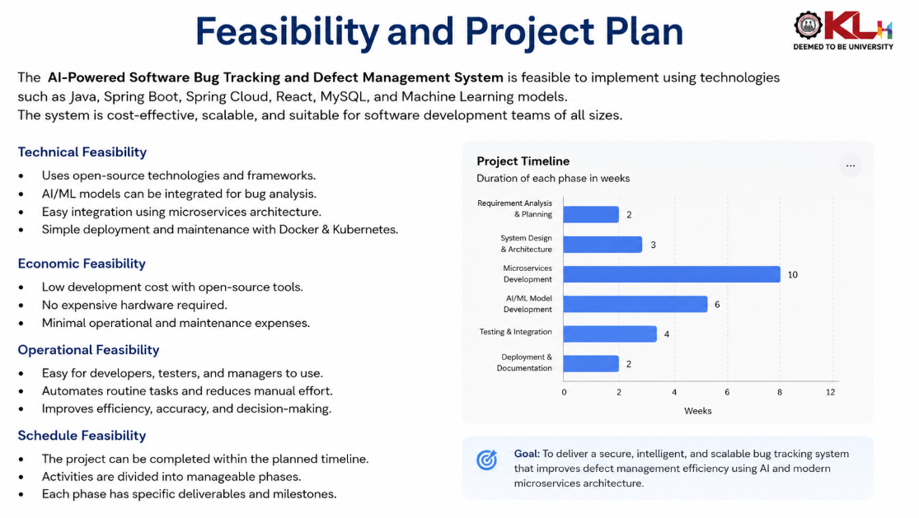
Feasibility and Project Plan
TIMELINE CHART FOR EACH PHASE OF YOUR PROJECT SHOULD BE THERE AFTER EXPLANATION

