Slide 1
Explaining Decisions
An IAP Practicum 2020
Vitali Petsuik, Julius Adebayo, Mirac Suzgun, Sebastian Gehrmann.

Slide 2
Overview of the lab
Pre-lab: You will get to play with a VGG-16 model and 3 gradient attribution maps. The goal here is to familiarize you with these methods for Lab 1 and 2.
Lab 1: RISE method on an image captioning example.
Lab 2: Saliency for NLP.

Slide 3
LAB LINKS
Pre-lab: http://tiny.cc/1teziz (10 mins, read)
Lab 1: http://tiny.cc/cveziz (20 mins)
Lab 2: http://tiny.cc/ibg0iz (25 mins)

Slide 4
Discussion & Wrap-Up

Slide 5
Lab Solutions
Lab 1: http://tiny.cc/ara0iz
Lab 2: http://tiny.cc/1na0iz

Slide 6
Takeaways from the lab
1: Several different methods and visualization schemes.
2: Data modality (i.e, NLP vs Vision) can lead to different challenges.
3: Model type (classification vs recurrent) can also affect how sensitivity is computed.

Slide 7
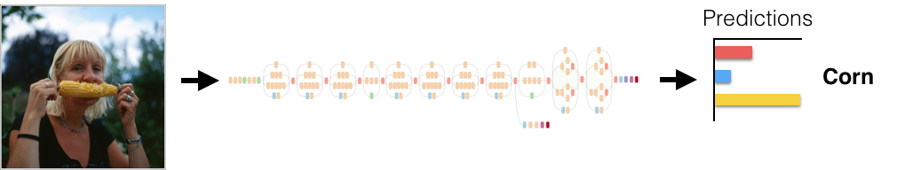
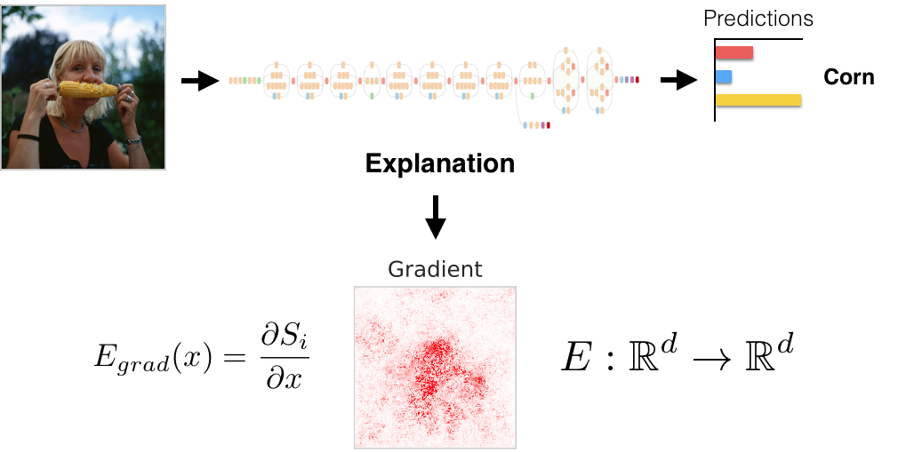
Explaining Decisions
The dominating characteristic of these class of methods is a focus on ‘explaining’ the prediction of a model for a single example.

Slide 8
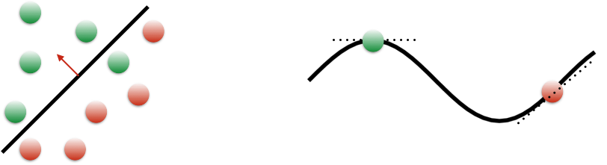
Why focus on a single example?
Functions linear in their parameters can be characterized globally by a single weight vector. For non-linear models, this is not the case, so local approximations around individual examples provide a reasonable inroad.

Slide 9
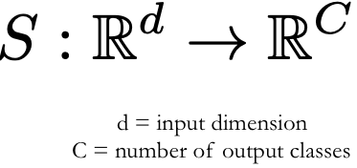
Attribution: Sensitivity Map
Given a model, an input, and the output of the model for the input in question, an attribution method returns the ‘relevance’ of each input dimension to the output.

Slide 10
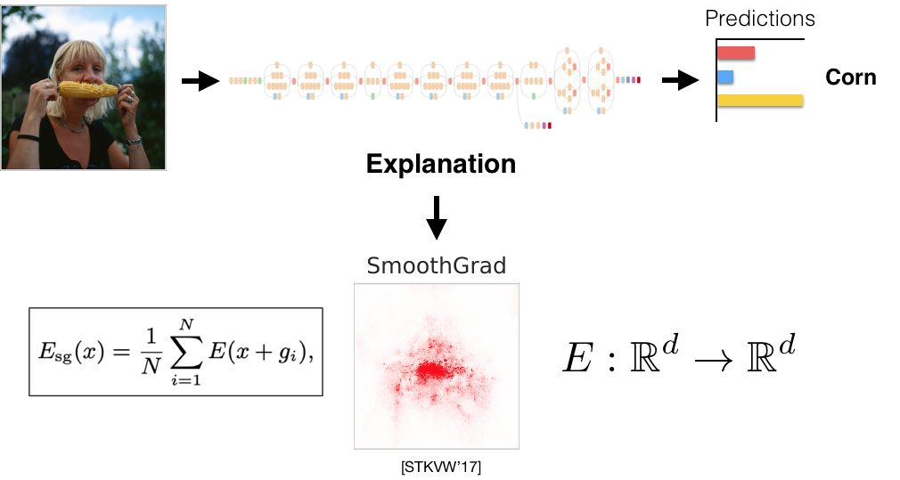
SmoothGrad
Average of noisy gradients.

Slide 11
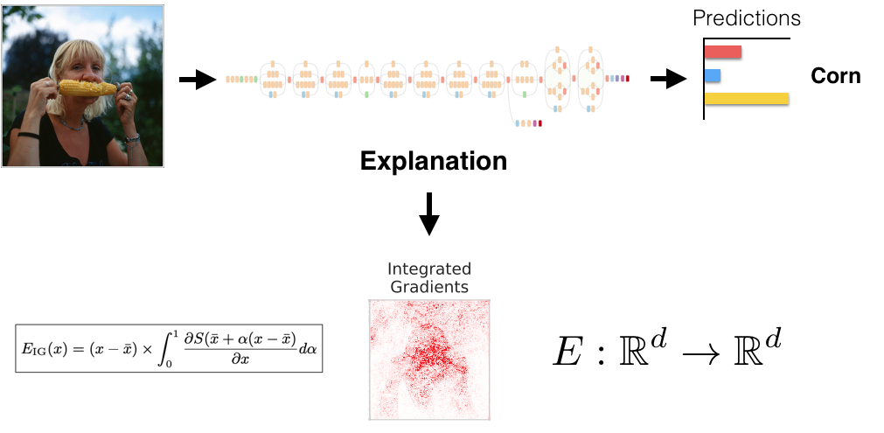
Integrated Gradients
Average of gradients over interpolations of the input.

Slide 12
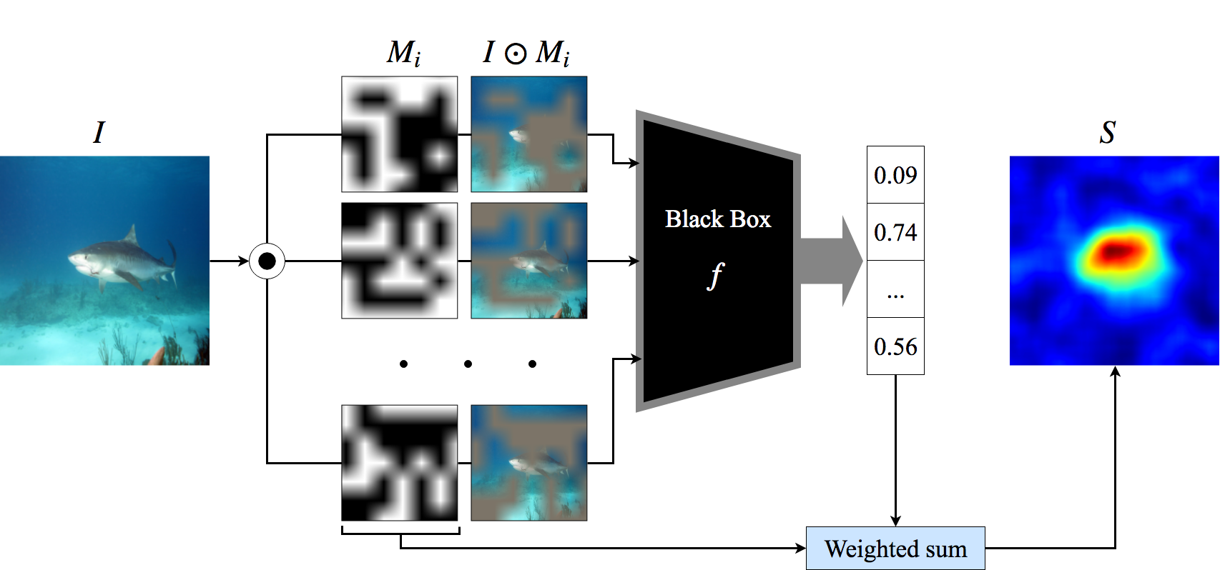
Perturbation Method: RISE
Probe model with masked inputs and weight results (Petsuik et. al.).

Slide 13
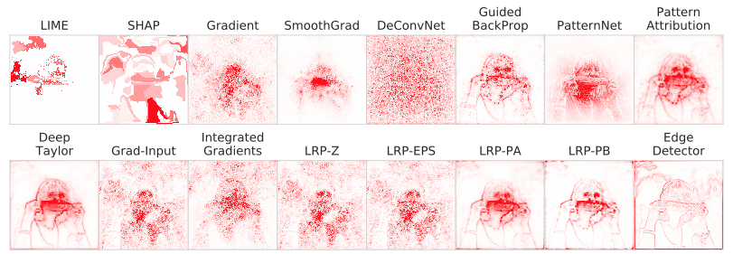
Several Others
The literature is vast!

Slide 14
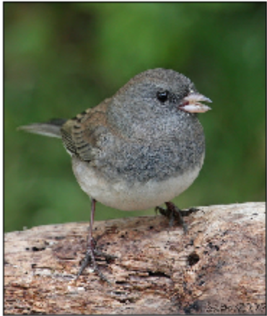
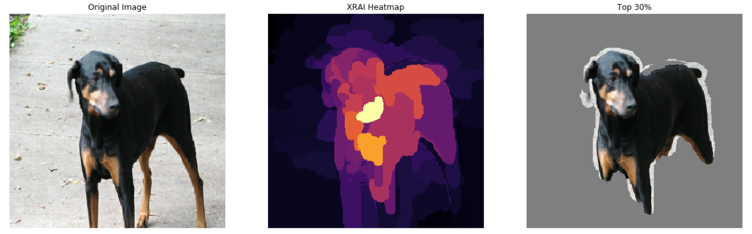
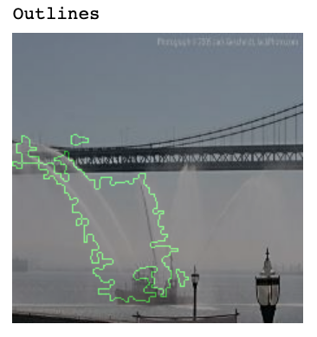
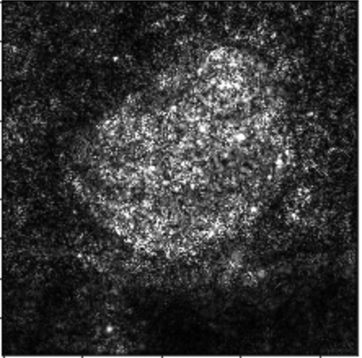
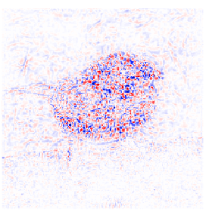

Visualization Scheme Matters
Segments
Source: Pair package by Smilkov et. al., 2017.
Vanilla Gradients: Positive Only
Integrated Gradients: Positive and Negative
Outlines
Source: Integrated Gradients by Taly et. al., 2017.

Slide 15
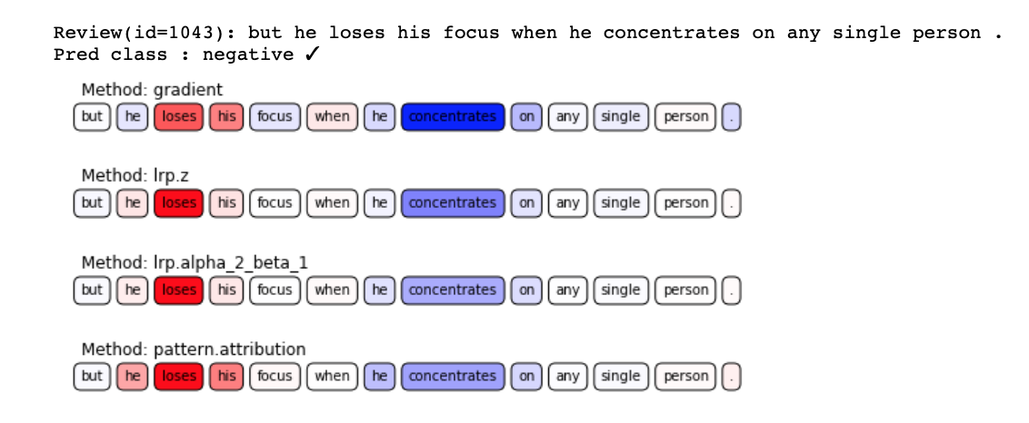
NLP: Sentiment Analysis on SST
Source: Innvestigate by Alber et. al., 2018.

Slide 16
Challenges
Insight about the model or representations beyond a single example.
The debugging perspective.
Interactivity.
Benchmarking and assessment.
Hyperparameters and choice of baseline input.
The data modality matters; gradient based methods are difficult to use with text.
Sequential nature.
Input-gradient and smoothgrad not readily applicable.
Can be difficult to capture compositionality.
Implementation challenge: backprop through an embedding lookup layer.
Notes:
Notes (Mirac):
Propagating through an embedding lookup layer in PyTorch and Tensorflow -- these platforms do not support such functionalities.
In CV, the input is static and one-time presented; whereas, in NLP, the input is sequential and highly-structured.
Capturing compositionality in languages is a challenging task.
Negations, context-dependent phrases, etc.
Saliency measures for text are not formally defined.
Some saliency measures in CV (e.g., input x gradient, smooth grad) cannot be immediately applied to text.
For example, how should you pick your baseline?
Would the baseline be a full sequence of zero vectors? Or should you randomly zero out the embedding vector of one word and leave the embedding vectors for other words untouched in a sentence?

Slide 17
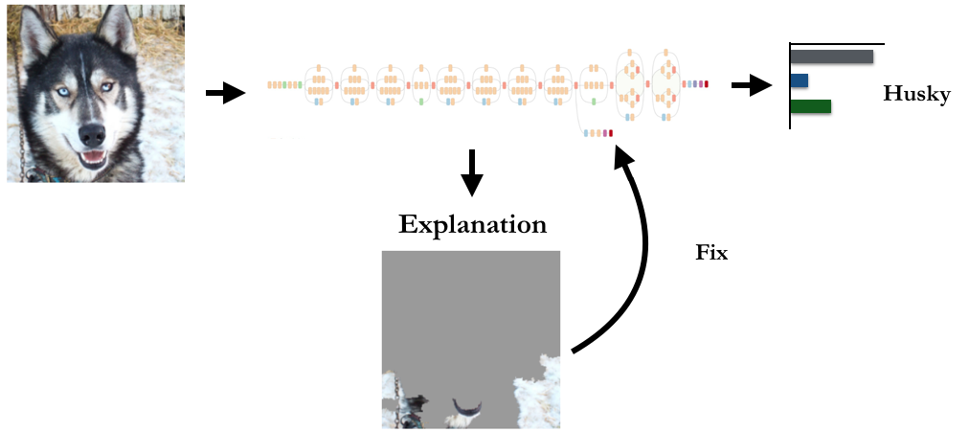
Model Debugging
What I cannot fix, I do not understand (Lazbnick et. al).
Source: Ribeiro et. al. 2016.

Slide 18
Wrap Up
We have seen a class of methods for interpreting DNNs. Attribution maps are increasingly popular in both vision and nlp settings.
However, these methods constitute one set of tools, amongst a potentially large class of methods for interpreting DNNs.
In future sessions, you will get to see these other perspectives.

Slide 19
End

