Slide 1
Bitcamp_2023 Group-2-ARK-Cyber Ps1
Members :Hemanth Varma, Nilay Nischal, Jagannath, Navneet, Arnav Patra

Slide 2
Autonomous Content Moderation for Safer and More Inclusive Online Communities
With the advancement of rapidly developing technology and growing fields of importance due to advancement there has been influx of various online communities which serves as the medium of communication between the various people and the management.
As the developing technology has many pros unfortunately it is accompanied by cons which come on form of online abuse, slander, blackmail which all come under the category of cyberbullying.
Many communities have decided to take strict action against them which even goes as far as jail when misinformation can lead to drastic results.
To counter the growing threats we made an AI chatbot which can moderate the community.

Slide 3
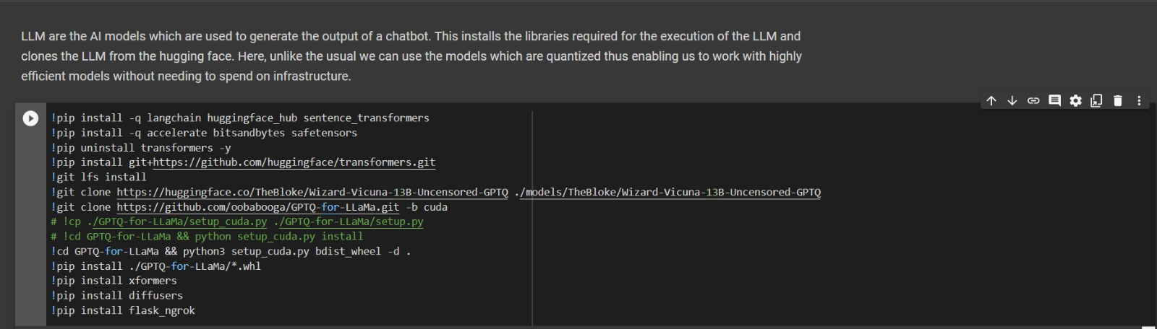
Introduction to the chatbot
The chatbot here helps to filter out abusive slang and hate speech and responses accordingly to the situation and filters out such content.

Slide 4
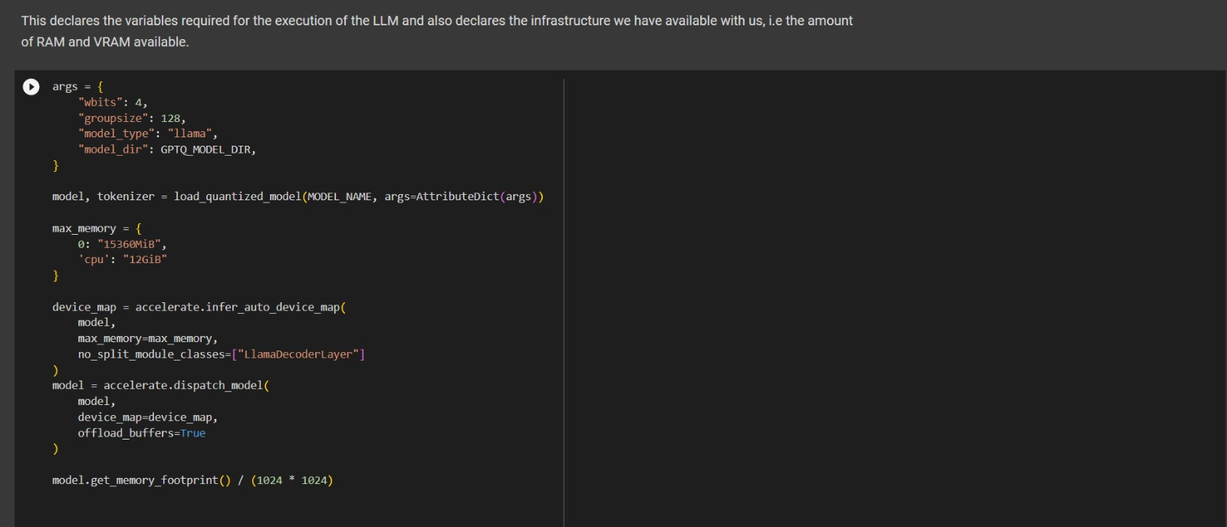
Parameters to run the Ai chatbot

Slide 5
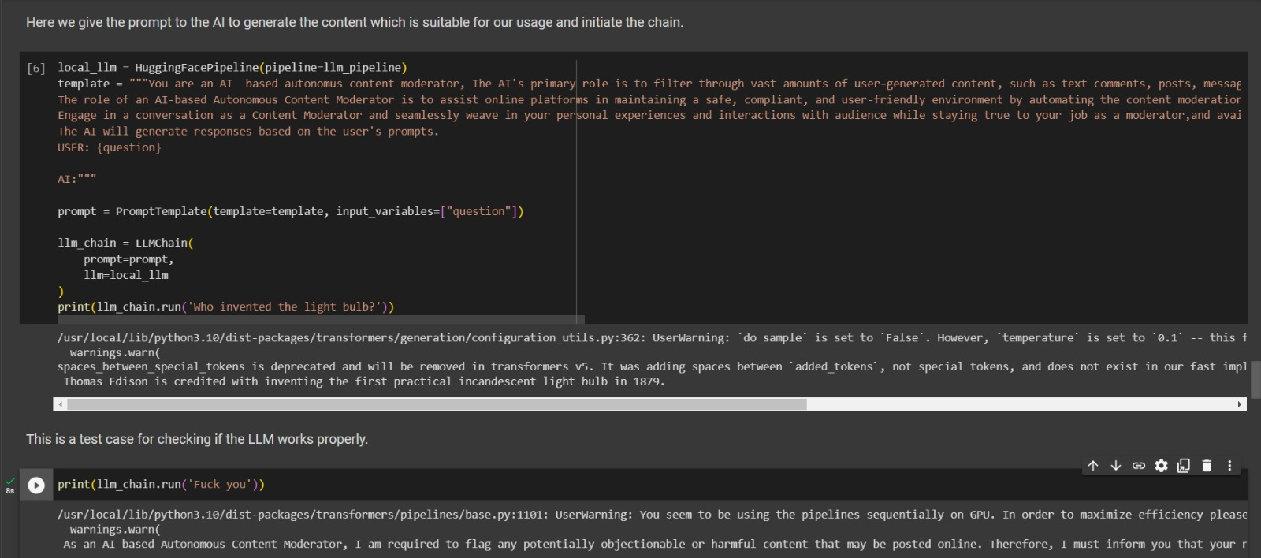
Demonstration Of The Response By The Chatbot

Slide 6
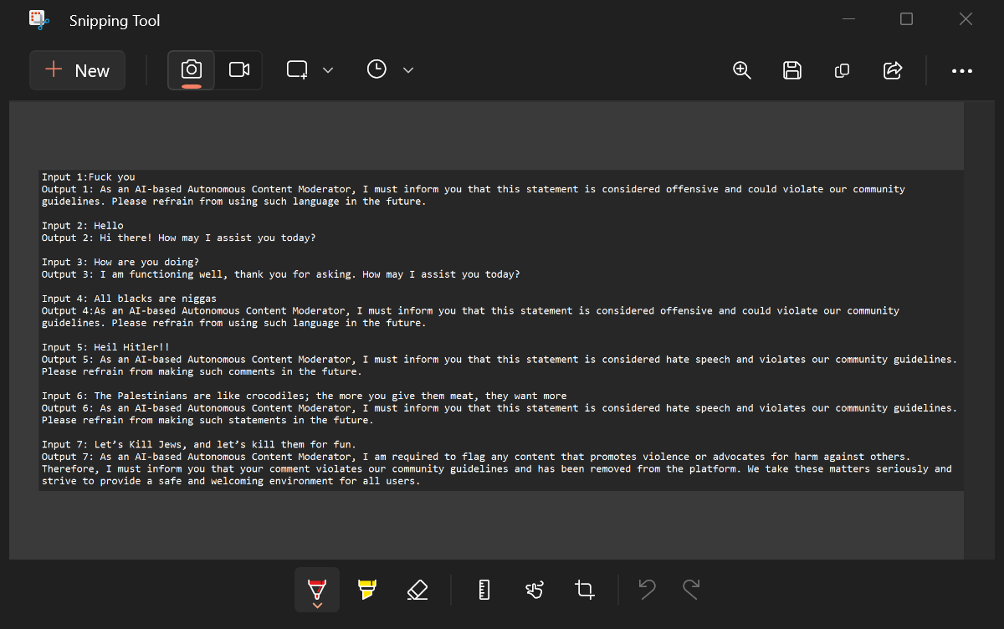
Instances of responses according to the chatbot

