Slide 1
Exploring Themes of Social Inequalities in Three Different Types of Statistics Courses Kim Druschel, Saint Louis University Mike May, Saint Louis University

Slide 2
I want to bring social justice data/statistics into my statistics (or math) course
What social justice topics am I particularly interested in addressing?
What datasets are available?
What is appropriate for the course given
Course content/difficulty
Students’ majors
Student demographics
Class structure
How do I keep the course positive?
How much do I weave a theme or a dataset into the course?

Slide 3
Types of courses:
STAT 1100: Freshman level consumer-based statistics for nursing and (some) healthcare majors
STAT 1300: Freshman level R-based statistics course. Mostly pre-med students.
STAT 3850: Junior level R-based statistics course. STEM majors. 2/3 engineering students.
Other courses where used data related to social justice
Calculus I
Topological data analysis

Slide 4
STAT 1100: A freshman level consumer-based statistics for nursing and (some) healthcare majors
Most relevant datasets used (explore in next slides):
Medicare’s hospital compare datasets: about 80 measurements of hospital care such as ER wait time, effective sepsis care rates, readmission rates, cost of care
Social justice and social and professional responsibility aspects.
Course structure: partially flipped course where students work on projects exploring the data and the hospital compare website and answer in-context questions related to covered course material
Also woven in as lecture examples and exam questions
Why appropriate: 1. Most students will encounter this dataset in their workplace or as healthcare consumers. 2. The Hospital Compare website allows students to see the public use of the data and course worksheets help them explore the data in the context of statistics.
Mapping Medicare Disparities

Slide 5
STAT 1100
A bit more:
Challenge for the course how to explore data without requiring many computations and no statistics software.
STAT 1100 Projects (worksheets and article reports) and course structure supported by client disciplines and now used in all STAT 1100 courses (about 10 per year)
Goal –replicate project and course structure for another consumer-based statistics course for general education where datasets are not centered on healthcare but are about social justice.

Slide 6
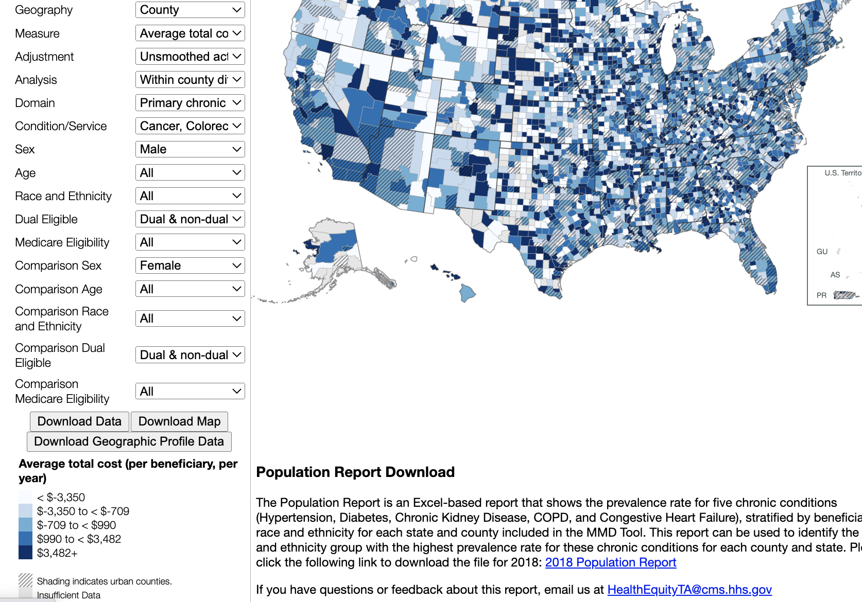
Stat 1100/Mapping Medicare Disparities
Many ways to compare different healthcare measures across different populations.
Used as illustrations of types of graphs. The website also has bar graphs and demographic information.
Worksheet questions ask students to explore and report on their findings.

Slide 7
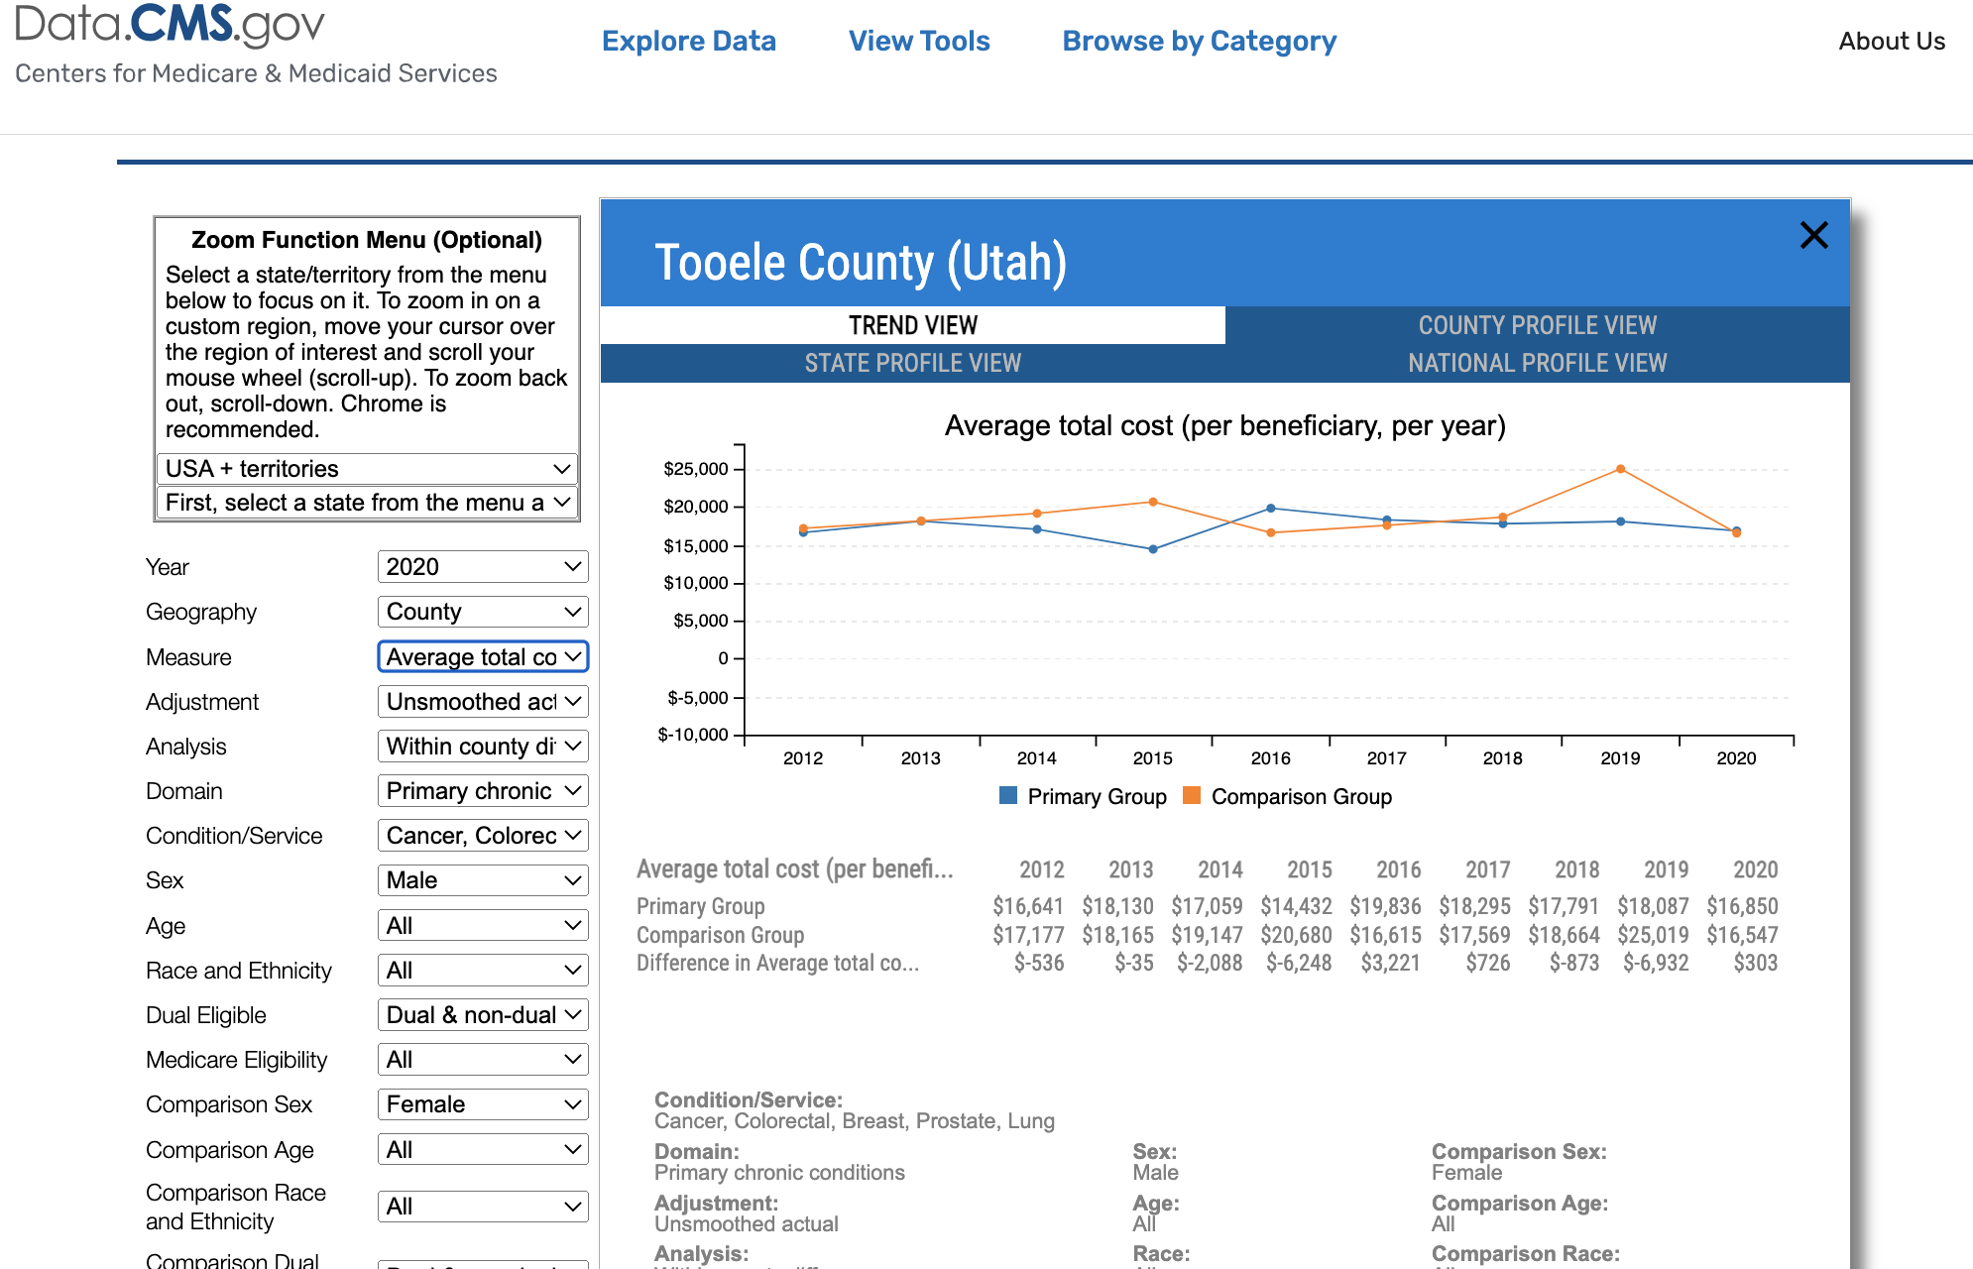
Stat 1100/Mapping Medicare Disparities
Many ways to compare different healthcare measures across different populations.
Used as illustrations of types of graphs. The website also has bar graphs and demographic information.
Worksheet questions ask students to explore and report on their findings.

Slide 8
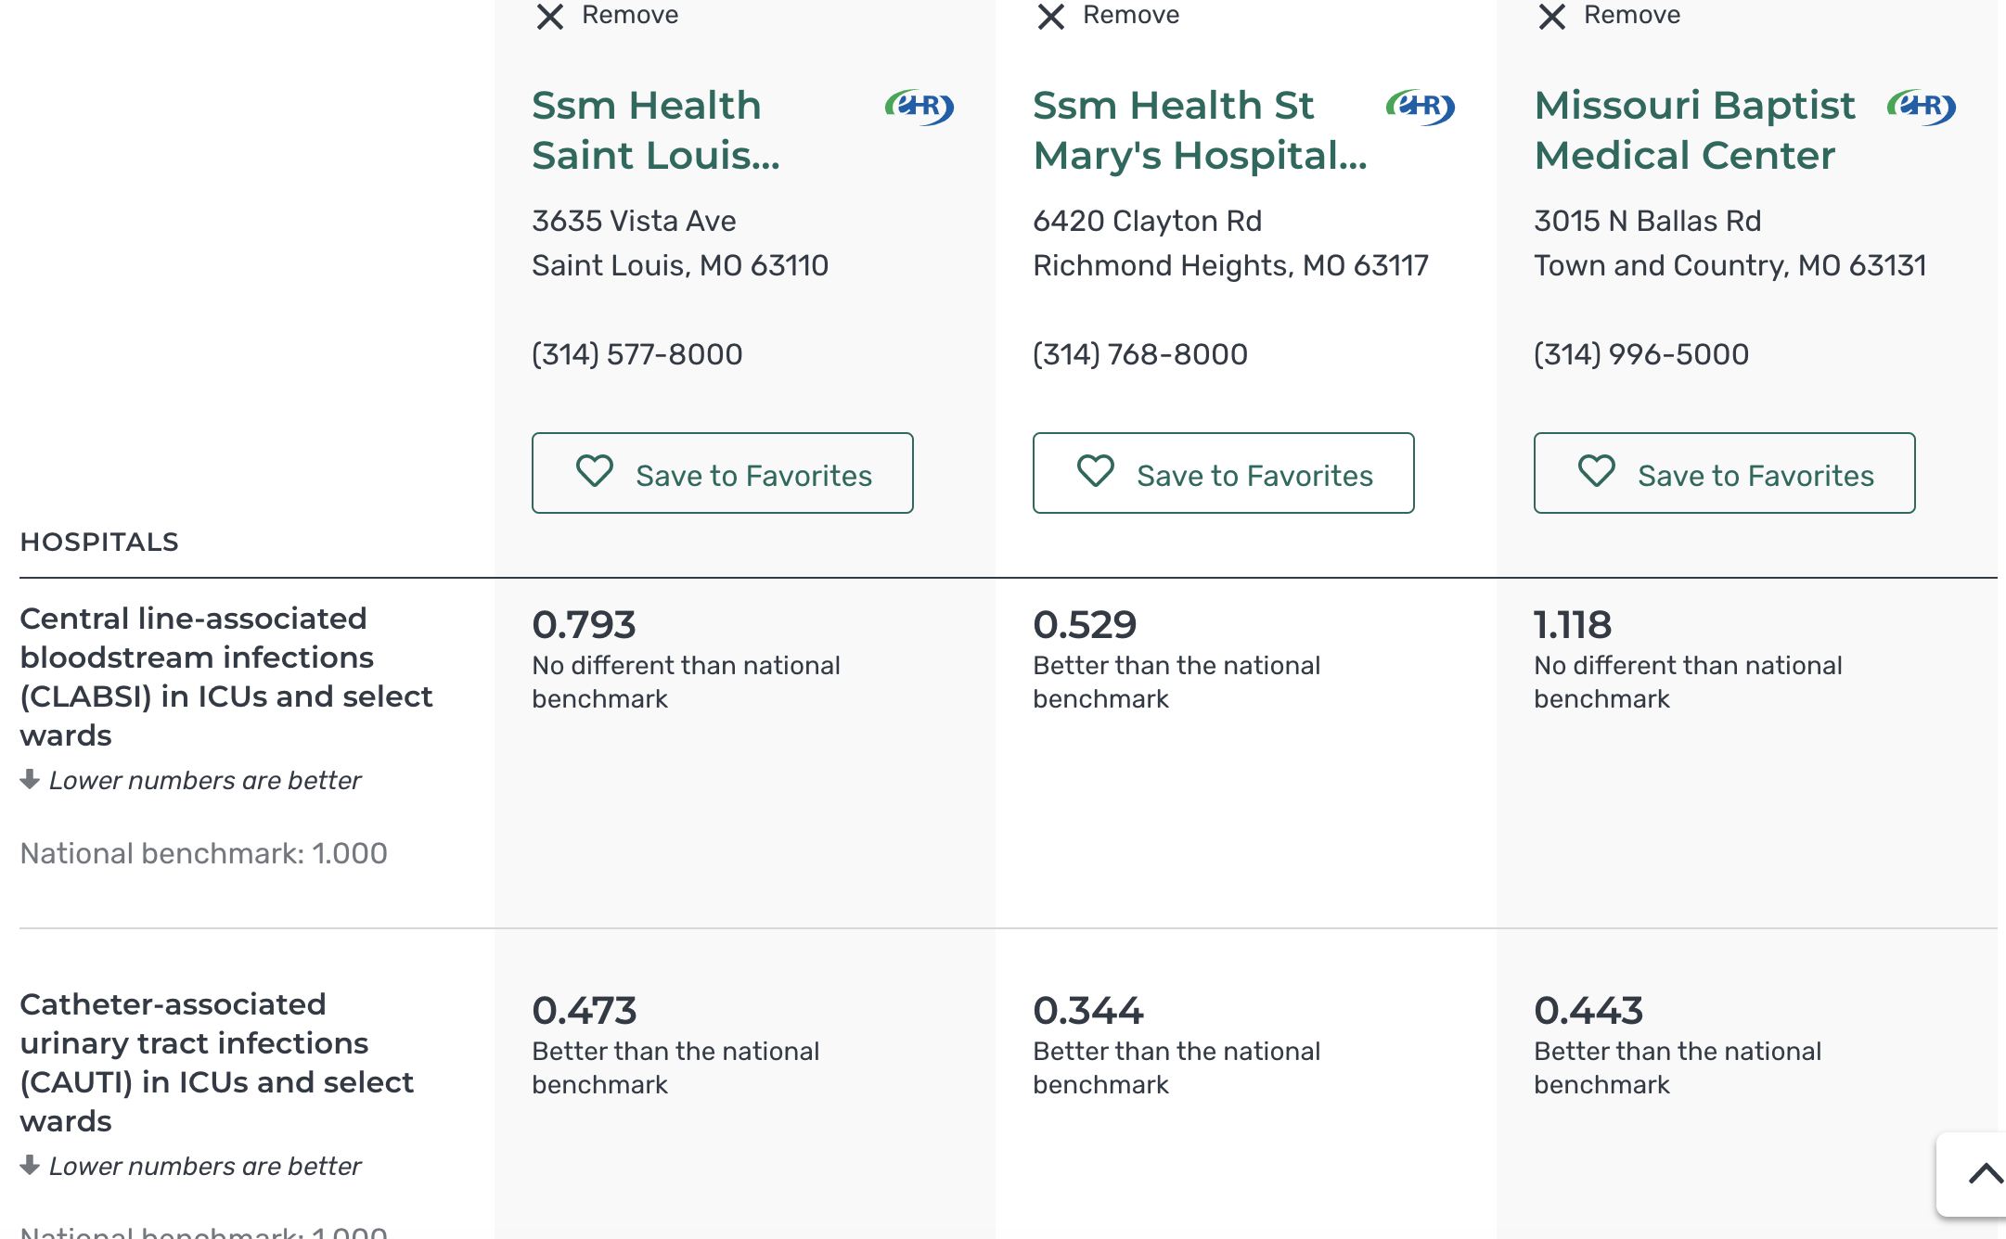
STAT 1100 –Using Hospital Compare website and data
Sample of what the consumer sees at the hospital compare webpage

Slide 9
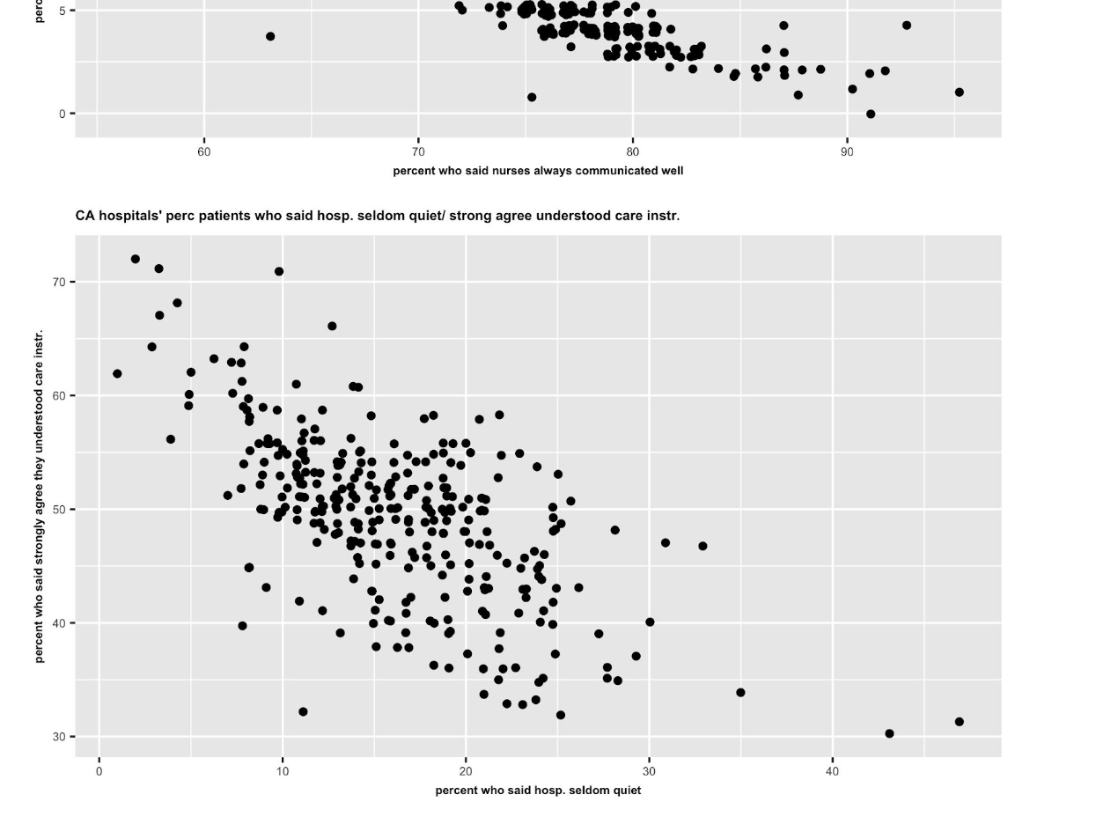
STAT 1100 –Using Hospital Compare website and data
Example of graphs created by KD from data and shared with students in worksheet on correlation
What is a hospital you would want to go to, or work at? Why?

Slide 10
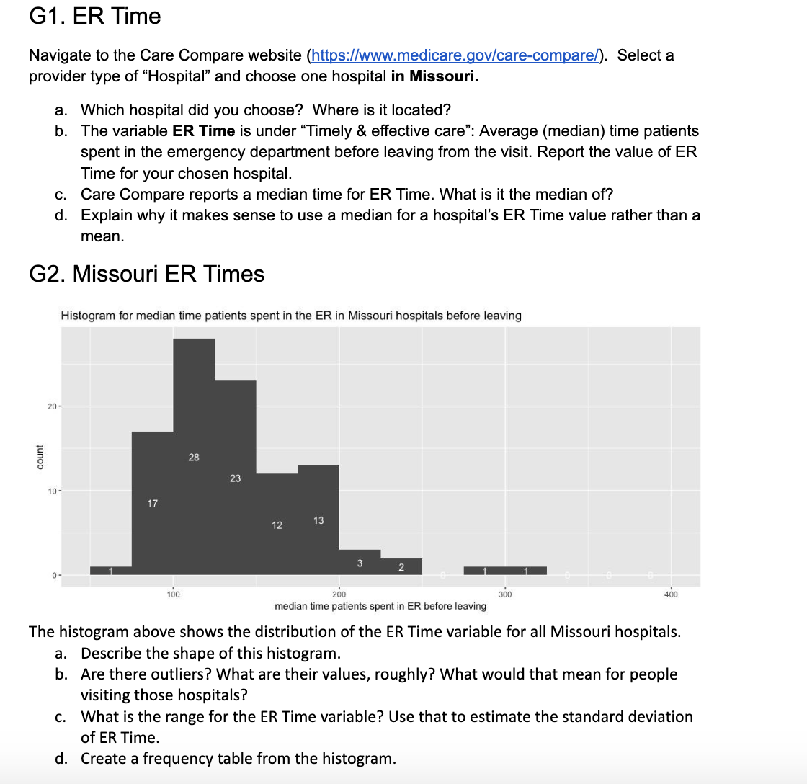
STAT 1100 –Using Hospital Compare website and data
Sample questions from worksheet

Slide 11
Stat 1300-Freshman level course-R based Mostly premed students
Unicef data-Excel dataset divided into books/categories such as Data includes mortality rates for children, sanitation/healthcare data, data on violence against children or women, data on child labor and education rates. Used in Rmarkdowns (R documents) which students complete during class time.
Course starts off with a NYT article which includes an effective visualization of data on the murder of women in the U.S. and an NPR article on childbirth problems in the U.S. Students are asked to identify some statistics in these articles and comment on what they notice or are surprised by.
Group projects where students take a book/category from the Unicef data and create an R dataset and an Rmarkdown analyzing/visualizing the data.
Additional project about women’s health/equity issues.
Additional datasets include the DOJ Campus Climate Pilot Study (sexual assault), Kaiser health data, the Hospital Compare data, Titanic data.

Slide 12
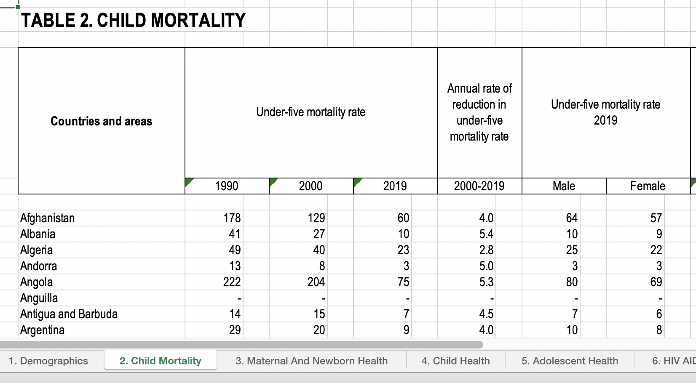
STAT 1300
Snapshots from projects/lectures/datasets
Portion of a page from the Unicef xslx dataset
Dataset lends itself to group projects and cross group collaborations/discussions.

Slide 13
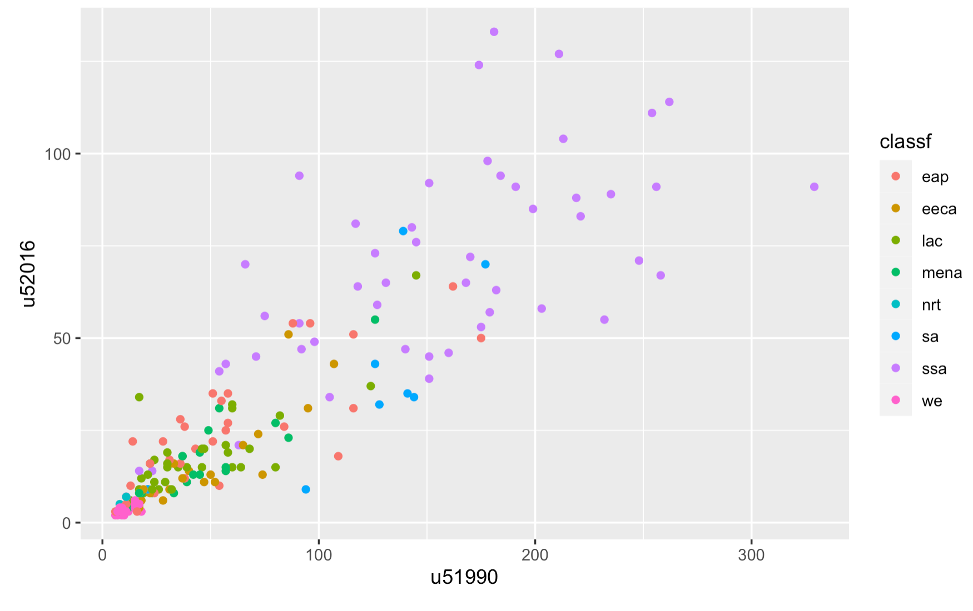
STAT 1300
Snapshots from projects/lectures/datasets
A graph of under5 mortality rates from an rmarkdown. What do students notice? What is hopeful here? Replicate this graph for another pair of Unicef variables. Discuss correlation issues. Create another set of graphs with one for each region.

Slide 14
Stat 3850
Junior level course
About 2/3 engineering majors; others are STEM or finance.
More in depth use of R as well as probability theory and inference.
Significant use of R simulation to motivate.
Continue to use Unicef data for examples and projects with more in depth assignments. Generally good response from students. Most groups eventually became adept at coding for projects and interpretation of their results, both in statistics terms and in context of social issues.
Projects and homework are significant part of grade.
Need to be mindful of the time student needs to put into the course, particularly someone who has no statistics or programming background while simultaneously using much of class time for practice.
Also used Hospital Compare data and data from DOJ Campus Climate Pilot Study
Student did honors project analyzing and commenting on Campus Climate Pilot Study.

Slide 15
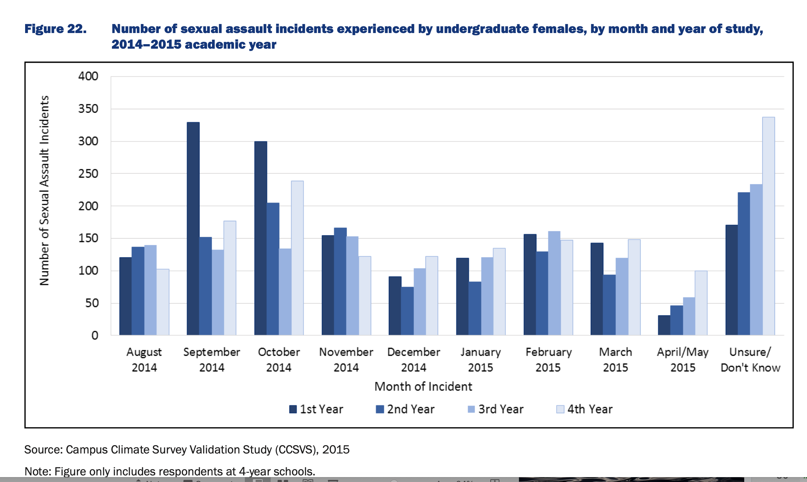
Illustration of grouped bar graph.
What is significant here? Why is the grouping of interest?

Slide 16
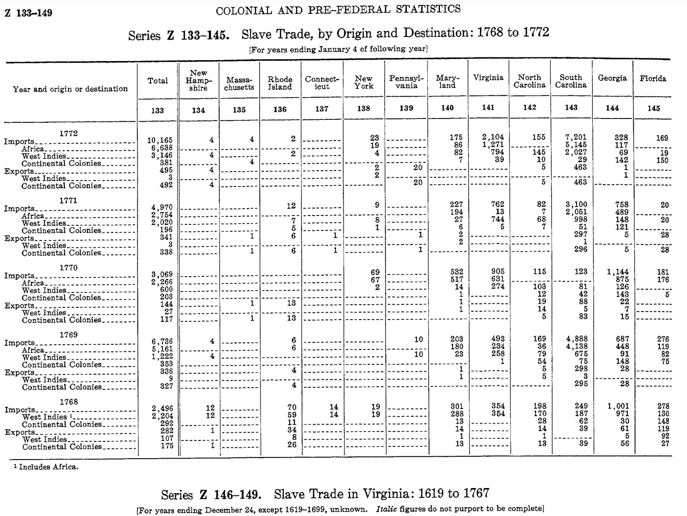
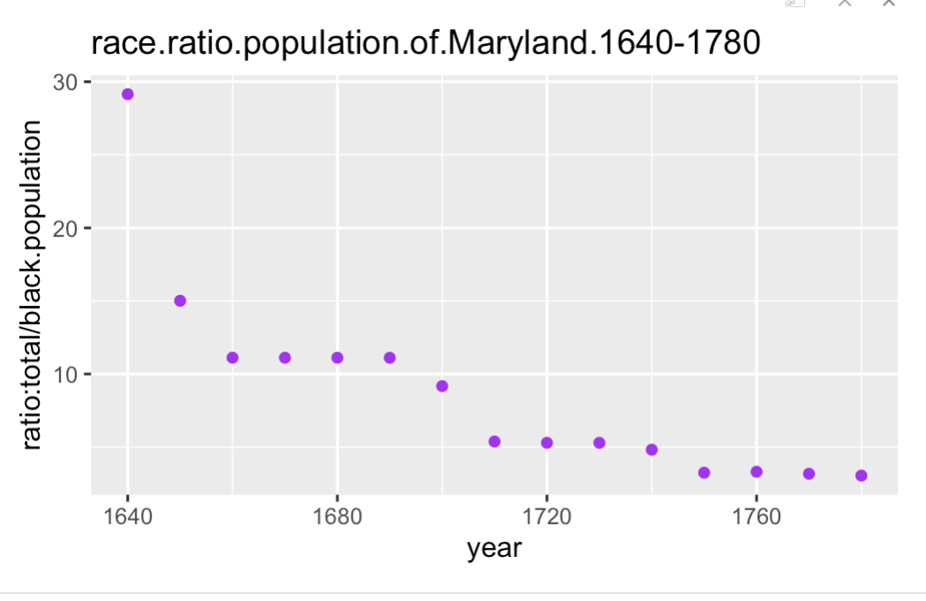
From a themed calculus course: One theme was colonial history
From calculus fitting a curve/ discussing concavity. Historical census data
Colonial census data on slave trade

Slide 17
STAT 1100 projects webpage:
https://sites.google.com/slu.edu/stat1100-projects-v2/home
STAT 1300 course webpage: Rmarkdowns, datasets, projects
https://sites.google.com/slu.edu/mathstat1300-fall19/home
Datasets/articles/webpages:
Primary:
Unicef https://data.unicef.org/resources/sowc-2021-dashboard-and-tables/
Hospital/Care Compare: https://www.medicare.gov/care-compare/?providerType=Hospital&redirect=true
Hospital compare data:https://data.cms.gov/provider-data/topics/hospitals
Mapping Medicare disparities https://data.cms.gov/tools/mapping-medicare-disparities-by-population
DOJ Campus climate study vc.ojp.gov/library/publications/campus-climate-survey-validation-study-ccsvs-final-technical-report
Article on childbirth in US https://www.npr.org/2017/12/22/572298802/nearly-dying-in-childbirth-why-preventable-complications-are-growing-in-u-s
Article on women murder data
Secondary:
Kaiser Family Foundation data https://www.kff.org/statedata/collection/abortion-health-coverage-access-for-families-children/
United Nations voting data https://dataverse.harvard.edu/dataset.xhtml?persistentId=doi:10.7910/DVN/LEJUQZ
Colonial census data https://www2.census.gov/prod2/statcomp/documents/CT1970p2-13.pdf

Slide 18
QUESTIONS?
THANK YOU!
Kimberly.Druschel@slu.edu. mike.may@slu.edu
Helpers: Bryan Clair, Elizabeth Blessing Gockel, Katie Radler, Sadita Salihovic, Lauren Miller, Mary Silverglate, Dal Yu

