Slide 1




Data Science: A Tool to Infuse Social Justice in STEM Learning
Team
R. N. Uma
NC Central University
Alade Tokuta NC Central University
Rebecca Zulli Lowe Cynosure Consulting
Adrienne Smith Cynosure Consulting
Acknowledgement
NSF Broadening Participation Research Project (HRD#1912408)

Slide 2
Rationale for using Social Justice
Persistent underrepresentation of minorities and women in STEM despite several efforts.

Slide 3
Rationale for using Social Justice
Minority Students more motivated by “Equity Ethic” than a big paycheck. [McGee & Bentley 2017]
Seek STEM careers that integrates STEM expertise with “social justice, empathy, and equity matters”.
Input on Efforts to Diversify the Workforce [North-East Scientific Training Retreat 2014 - Campbell, Skvirsky, Wortis, Thomas, Kawachi, & Hohmann 2014] – First of eight actionable items
To increase minority representation in STEM, “adapt STEM training to include or make room for a social justice component”.
To attract and retain a diverse STEM student body, connect STEM content to real-world problems [Gorman 2010, Kim & Song 2013, Larios-Sanz, Simmons, Bagnall & Rosell 2011]

Slide 4
Data Science for Social Justice (DSSJ)
Incorporated in a Freshman Seminar course.
Group project
Identify and explain a social problem/issue
Describe the issue
Why is it important to address the issue
(Your solutions or recommendations to address the issue)

Slide 5
Pre-DSSJ
Freshman Seminar
Prior Project – verbatim from a student-submitted report: “In 2010, there was an increase in the polices brutality cases. The increased of death was from 397 to 426 deaths. Black people were twenty four percent of people kill by cops. There are major racial disparities in how police officers use force on people.”

Slide 6
Pre-DSSJ
Freshman Seminar
Prior Project – verbatim from a student-submitted report: “In 2010, there was an increase in the polices brutality cases. The increased of death was from 397 to 426 deaths. Black people were twenty four percent of people kill by cops. There are major racial disparities in how police officers use force on people.”

Slide 7
DSSJ Example Data Set: Fatal shootings by police officers (downloaded on July 23, 2019 from https://github.com/washingtonpost/data-police-shootings)
name | date | manner_of_death | armed | age | gender | race | city | state | signs_of_mental_illness | threat_level | flee | body_camera
Patrick Wetter | 1/6/2015 | shot and Tasered | knife | 25 | M | W | Stockton | CA | FALSE | attack | Not fleeing | FALSE
Ron Sneed | 1/7/2015 | shot | gun | 31 | M | B | Freeport | TX | FALSE | attack | Not fleeing | FALSE
Hashim Hanif Ibn Abdul-Rasheed | 1/7/2015 | shot | knife | 41 | M | B | Columbus | OH | TRUE | other | Not fleeing | FALSE
Nicholas Ryan Brickman | 1/7/2015 | shot | gun | 30 | M | W | Des Moines | IA | FALSE | attack | Car | FALSE
Omarr Julian Maximillian Jackson | 1/7/2015 | shot | gun | 37 | M | B | New Orleans | LA | FALSE | attack | Foot | TRUE
Loren Simpson | 1/8/2015 | shot |  | 28 | M | W | Huntley | MT | FALSE | undetermined | Not fleeing | FALSE
James Dudley Barker | 1/8/2015 | shot | shovel | 42 | M | W | Salt Lake City | UT | FALSE | attack | Not fleeing | TRUE
Artago Damon Howard | 1/8/2015 | shot | unarmed | 36 | M | B | Strong | AR | FALSE | attack | Not fleeing | FALSE

Slide 8
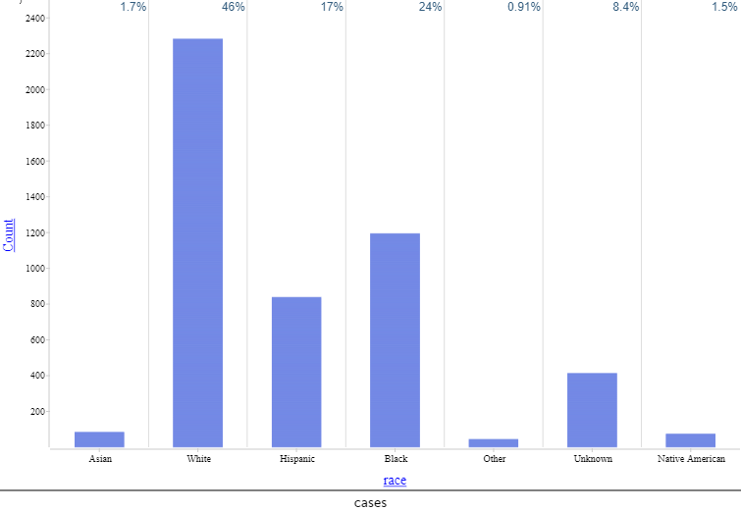
Freshman Seminar - DSSJ-Infused

Slide 9
DSSJ Example Data Set: Fatal shootings by police officers
Research Question: What has been the impact of the Black Lives Matter movement on police killings? Have police departments been using the data that is being collected?

Slide 10
DSSJ Example Data Set: Fatal shootings by police officers
Guiding Questions – Easy:
Create a summary statistics of the data to get a snapshot of the data - mean, median, standard deviation.
Create graphs of number of fatalities, by each race, gender, year, etc.
Create graphs to show distribution by race and by year within each race.
Repeat the previous item but with two other relevant variables of your choice.
Are whites or blacks more prone to dying as a result of police shooting because of mental health issues?
Guiding Questions – Intermediate:
Explore other visualizations that may be better suited to represent this data.
How do the demographics of the state impact the race of the victim?

Slide 11
DSSJ Example Data Set: Fatal shootings by police officers
Guiding Questions – Advanced:
Can you predict the outcome given the characteristics of a potential victim? Justify by building a predictive model to support your answer.
How do signs of mental illness affect the rates of police violence? When combining mental illness and race, are there correlations?

Slide 12
Challenges with this Approach
Instructors
Access to data sets
Ability to clean data sets as needed
Familiarity with necessary tools: CODAP, R, github
Ability to involve students from STEM and non-STEM background
Students
Ability to pick up programming concepts in R
Basic knowledge of statistics
Logical and critical thinking

Slide 13
DSSJ Module
Supplementary Materials
Input from
NCCU Students
Tutorials
Identify a Social Justice issue
Tools: CODAP, R
Data Acquisition
Research Question
Tools: Excel, WEKA
Data Cleaning &
Transformation
Curated Dataset
Anthology of Videos
Foundational Knowledge on Data Science
Data Dictionary
Differentiated
Guiding Questions
Resources
Legend
Completed
Detailed Lesson Plans
Statistics
In Progress

Slide 14
Curated Social Justice Data Collection
Police killings (2 data sets: shootings & all types)
Domestic Violence (NC)
Gun Violence
COVID-19
Sexual Assault (NC)
Environmental Pollution Data (2 data sets: by year & NC)
Cost of College Education
Child Abuse
LGBTQ+ Issues
Mental Health Issues
Social Media Effects
Immigration
. . .
curated datasets -
completed
under
development

Slide 15
Observations
Effectiveness study of the materials piloted:
Increase in students’ data science knowledge
Greater interest in learning about data science as a career option
Greater awareness of big data use across employment sectors
Increased desire to become more knowledgeable about data science
Analysis of qualitative data:
Students valued the use of CODAP as an analysis tool for data exploration.
Students described the exposure to data explorations as “powerful”.
Students and faculty found the topics to be relevant and interesting.

Slide 16
Hub and Spokes
Model
COVID-19
Domestic Violence
MATH
STATS
Police Killings
Sexual Assault
CS
Environmental Justice
. . .

Slide 17
Project Website
https://sites.google.com/view/dssj

