Slide 1
Statistics and Data Activities with R
Leon Kaganovskiy
Touro University,
Brooklyn, NY

Slide 2
New book – Introduction to Statistics with R (talking to Springer rep)
Statistics and data activities using R
My Open Math HW and exams
Research Projects with R

Slide 3
Proposal to Springer
Introductory Statistics with R
Applied approach to an Introductory Statistics course (teaching Statistics in various form for over 15 years)
Conceptual understanding and computational skills with R statistical package.
R is an organic part of the course (unlike most other textbooks, not an afterthought in the labs).
Avoids outdated tables and calculator-based computations
R - scripting language, step-by-step routines, students can see the results of every step
Computational approach allows to include ANOVA, Multiple and Logistic Regression
In what follows, we consider some examples of activities and homework with R.
There is also extra credit R project at the end of the course.

Slide 4
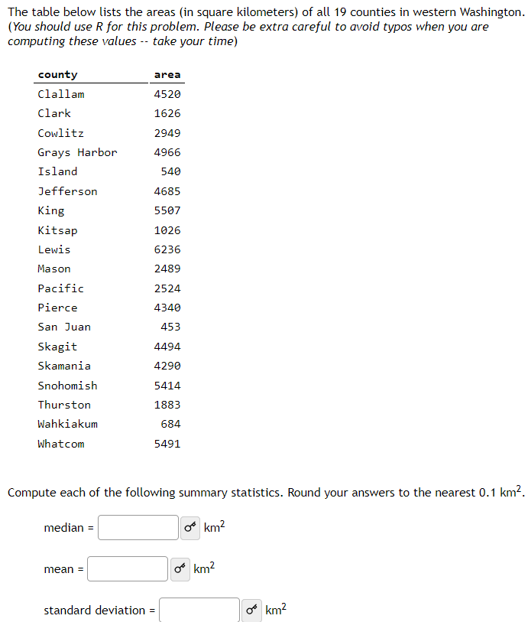
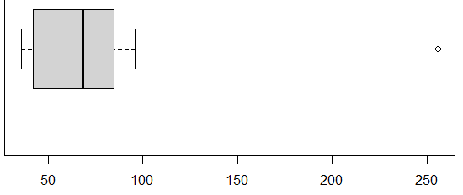
The student activities and homework are centered around randomized sets of problems from My Open Math (https://www.myopenmath.com/) web portal.
It is a unique free-of-charge source (full-length hypothesis testing problems randomized according to the results of test statistics and p-value).
The book starts with simple commands that computes mean, median, standard deviation, as well as graphical representation of histograms, boxplots, etc…
> x = c(256,36,89,78,96,85,42,36,68,48,75,69,36,45)
> n = length(x); n
[1] 14
> xbar = mean(x); xbar
[1] 75.64286
> xvar = var(x); xvar
[1] 3143.632
> xsd = sd(x); xsd
[1] 56.0681
> xmed = median(x); xmed
[1] 68.5
> CV = xsd/xbar*100; CV # coefficient of variation
[1] 74.12213
> sort(x)
[1] 36 36 36 42 45 48 68 69 75 78 85 89 96 256
> summary(x)
Min. 1st Qu. Median Mean 3rd Qu. Max.
36.00 42.75 68.50 75.64 83.25 256.00
> IQR(x)
[1] 40.5
> Q1 = quantile(x,0.25); Q1
42.75
> Q3 = quantile(x,0.75); Q3
83.25
> iqr = IQR(x); iqr
[1] 40.5
> upperwhisker = Q3 + 1.5*iqr; upperwhisker
75%
144
> lowerwhisker = Q1 - 1.5*iqr; lowerwhisker
25%
-18
> boxplot(x,horizontal = TRUE)
The initial goal is to
introduce students to the
simplicity of R commands.
Not a Computer Programming course

Slide 5
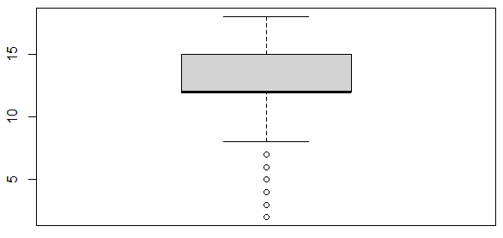
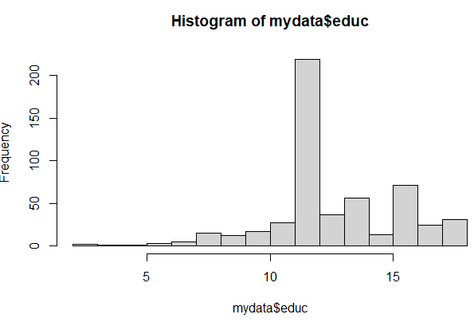
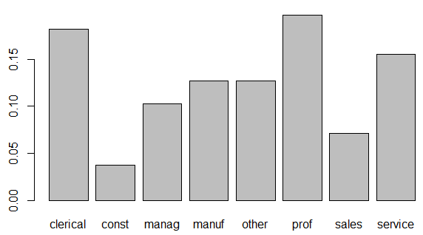
Students also learn how to work with files:
1st numerical variables
> library(mosaicData)
> mydata = CPS85
> mean(mydata$educ)
[1] 13.01873
> median(mydata$educ)
[1] 12
> var(mydata$educ)
[1] 6.840174
> sd(mydata$educ)
[1] 2.615373
> summary(mydata$educ)
Min. 1st Qu. Median Mean 3rd Qu. Max.
2.00 12.00 12.00 13.02 15.00 18.00
# create boxplot and histogram of educ
# remark about symmetry vs skewness and outliers
> boxplot(mydata$educ)
> hist(mydata$educ)
I stress the power of R to compute standard measures for larger files
2nd - categorical
> tableH = xtabs(~ sector, data=mydata); tableH
sector
clerical const manag manuf other prof sales service
97 20 55 68 68 105 38 83

Slide 6
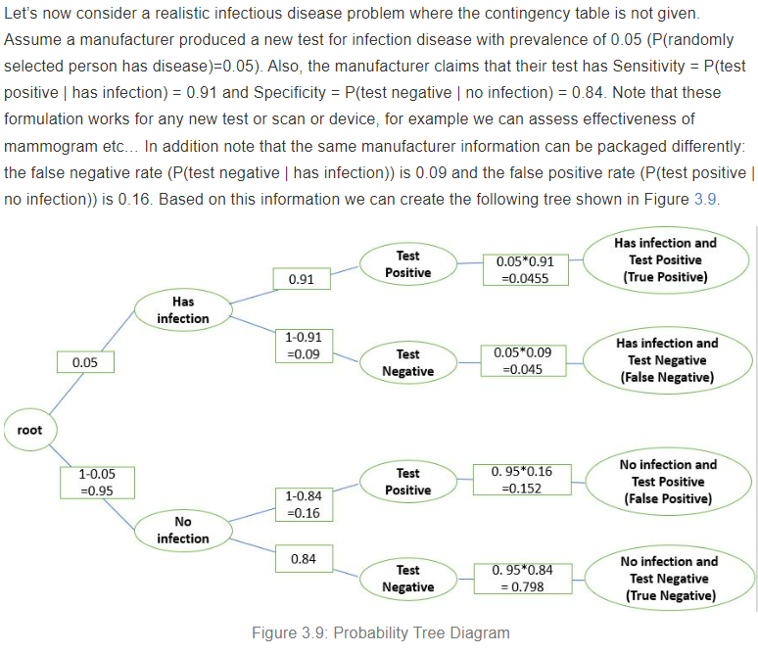
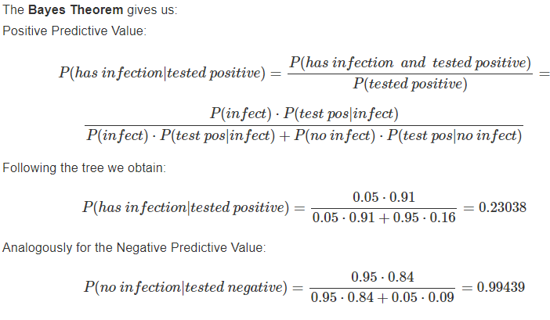
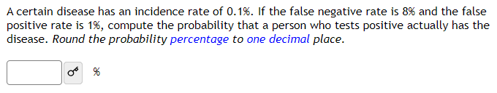
Probability chapter discusses standard topics like addition and multiplication laws, complement and conditional probabilities.
I introduce tree diagrams for conditional probabilities which leads to interesting activities.
Also, test terminology of positive/negative predictive as well as sensitivity/specificity is introduced
My Open Math randomized problem shown below.
There are also step by step problems

Slide 7
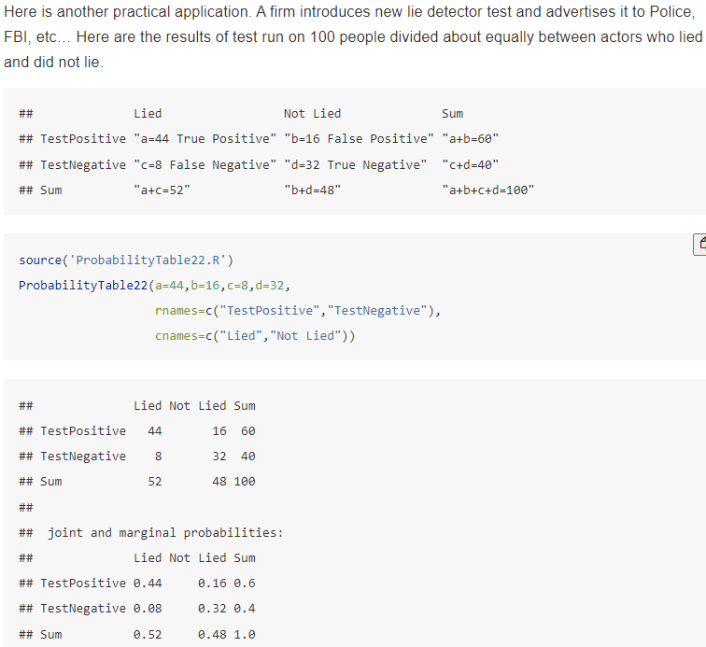
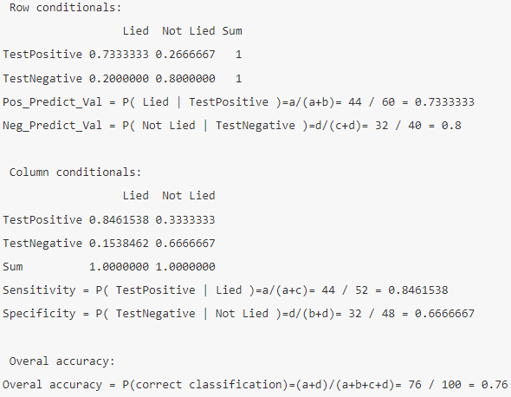
In addition, I created a convenient function to be sourced which computes all the positive/negative predictive, sensitivity/specificity, based on 2 by 2 contingency table.

Slide 8
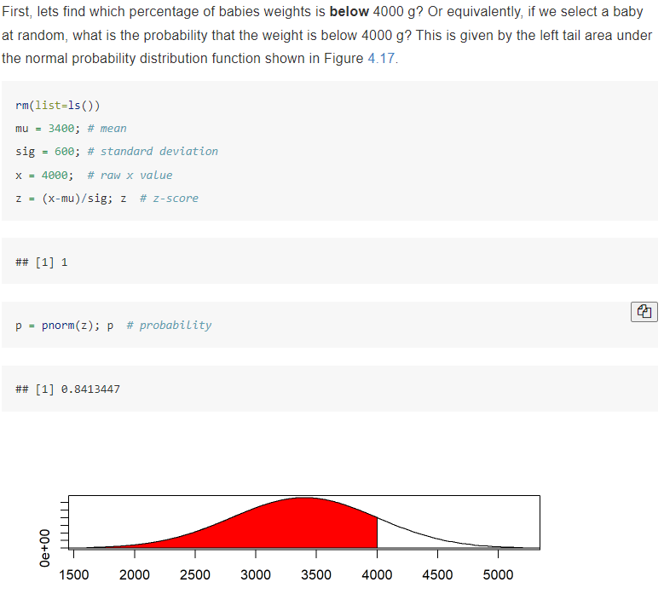
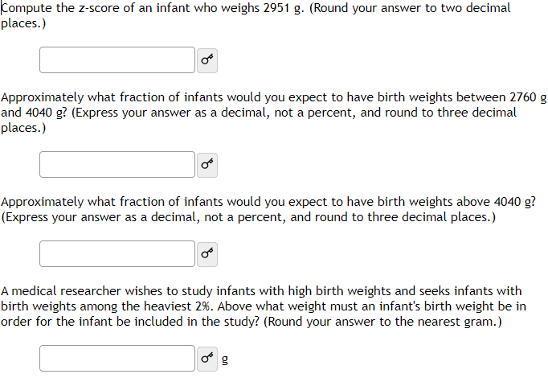
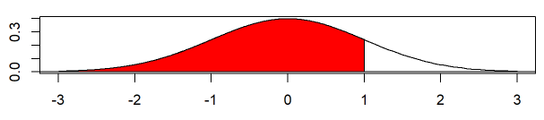
Normal Distribution
Here is a typical problem on My Open Math:
The birth weights of babies in US are approximately normal with mean μ = 3400 g and standard deviation σ = 600 g.
Easy computation and graphical
representation of areas under
Normal distribution

Slide 9
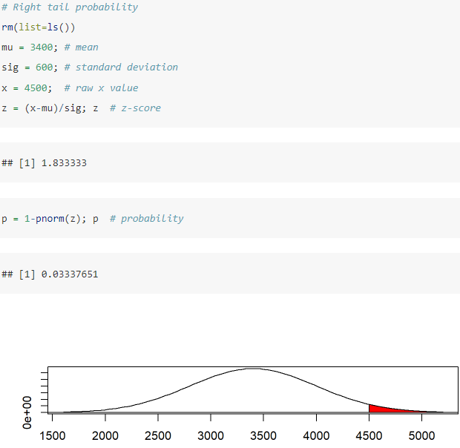
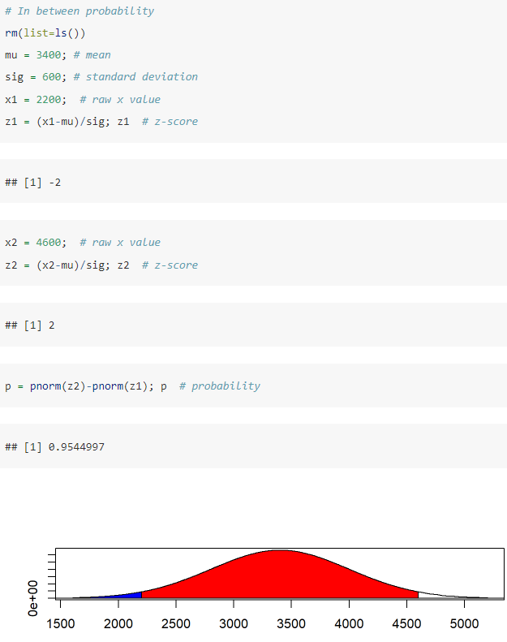
Normal Distribution (continue)

Slide 10
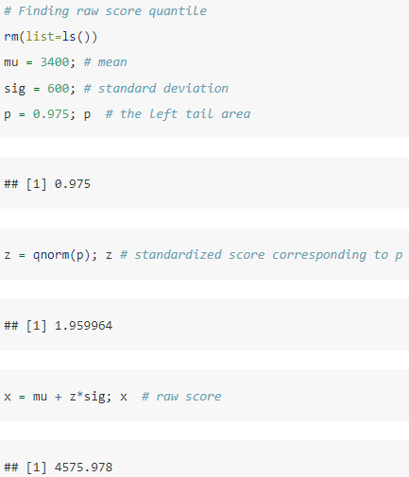
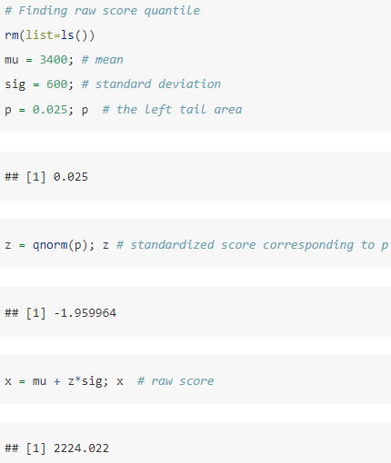
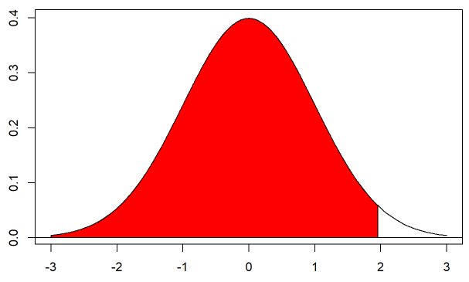
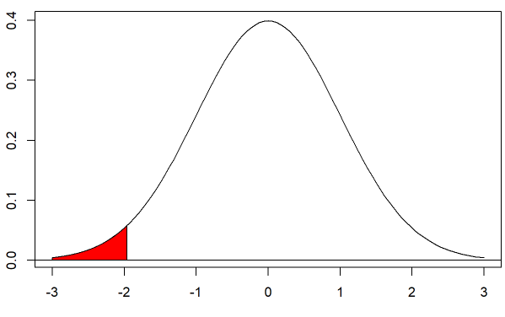
Normal Distribution (continue)

Slide 11
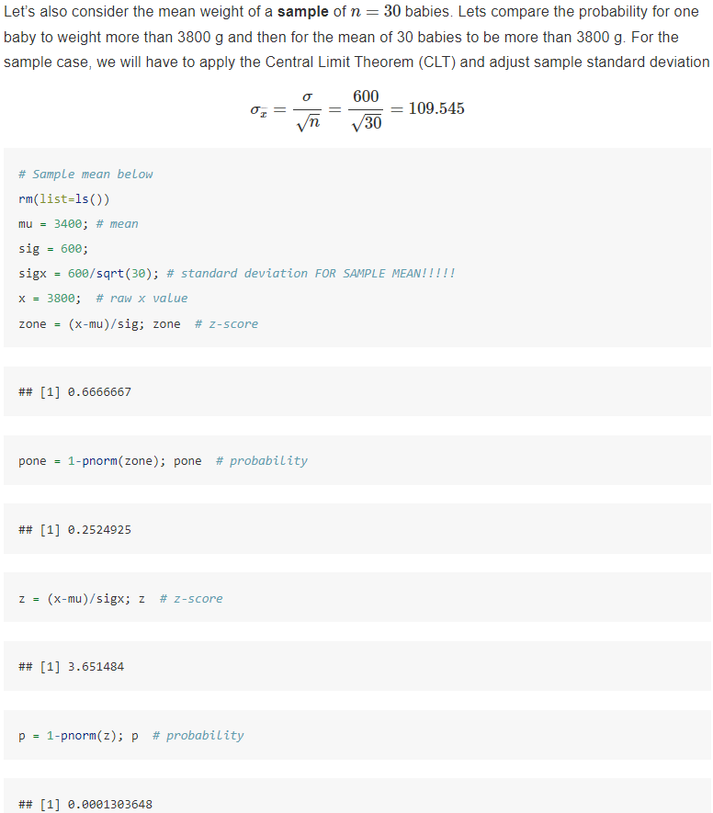
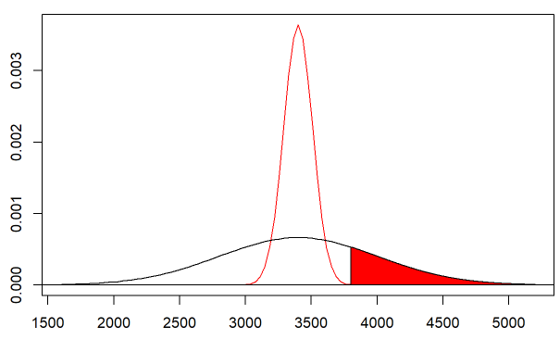
Normal Distribution
Sample of baby weights
vs. one baby weight
The graphical representation allows to show much tighter distribution of the distribution of sample means resulting in much smaller probability.

Slide 12
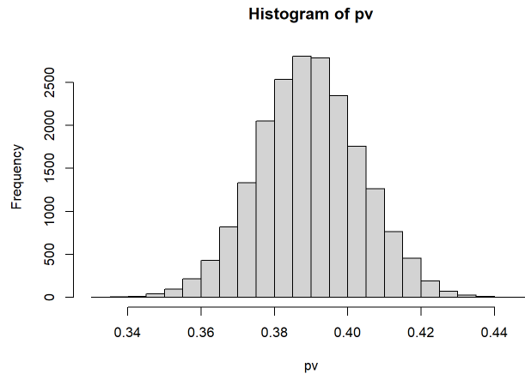
Central Limit Theorem (CLT) for Proportions
- Introduced via a simulation, but students are NOT responsible for code!
> # Simulation of Sample Proportions
> p = 0.39 # true population proportion
> N = 200000000; # population size
> n = 1200; # sample size
> numsamples = 20000 # number of samples in the simulation
> numYes = p*N; numYes
[1] 7.8e+07
> numNo = (1-p)*N; numNo
[1] 1.22e+08
> possible_entries <- c(rep(1,numYes), rep(0,numNo))
> pv = rep(0,numsamples) # sample proportions
> for ( j in 1:numsamples) {
+ # SIMPLE RANDOM SAMPLE:
+ onesample = sample(possible_entries, size=n)
+ pv[j] = sum(onesample == 1) / n
+ }
> hist(pv,breaks=30) # create histogram of sample proportions
> pvbar = mean(pv); pvbar # mean of sample proportions
[1] 0.3899257
> pvsd1 = sd(pv); pvsd1 # standard deviation of sample proportions
[1] 0.01408954
It is mostly done to show the amazing power of R computing simulating 20000 samples of size 1200 from population of 200 million

Slide 13
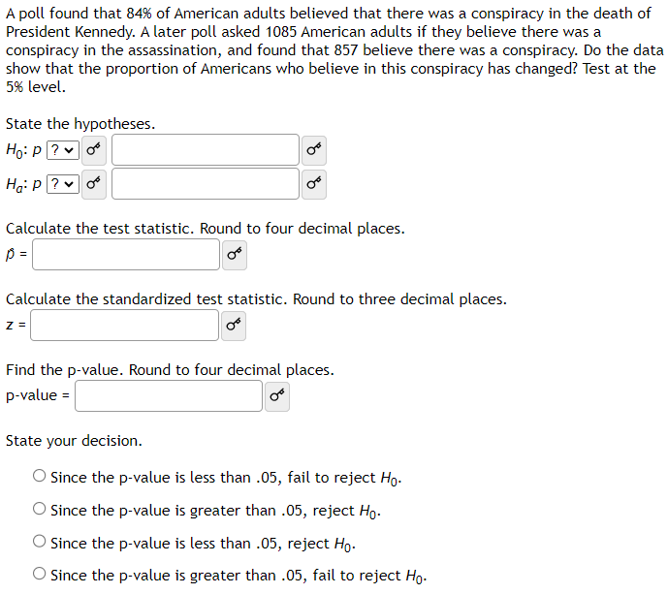
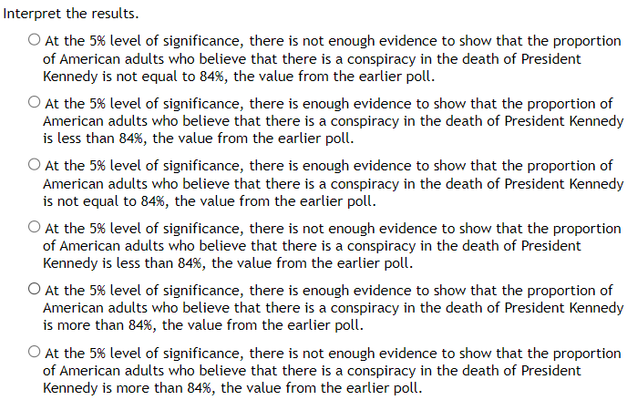
My Open Math Proportion Hypothesis Test

Slide 14

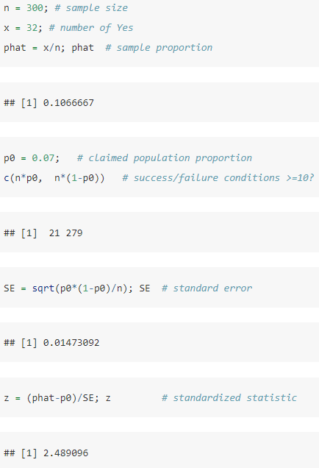
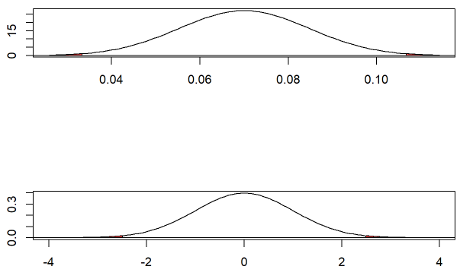
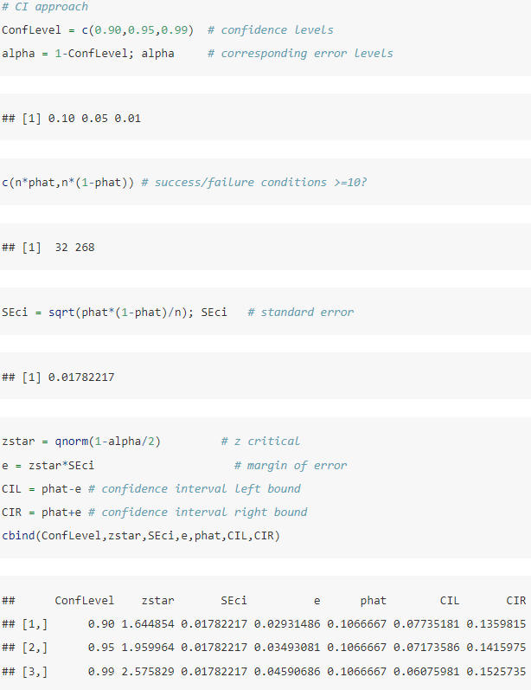
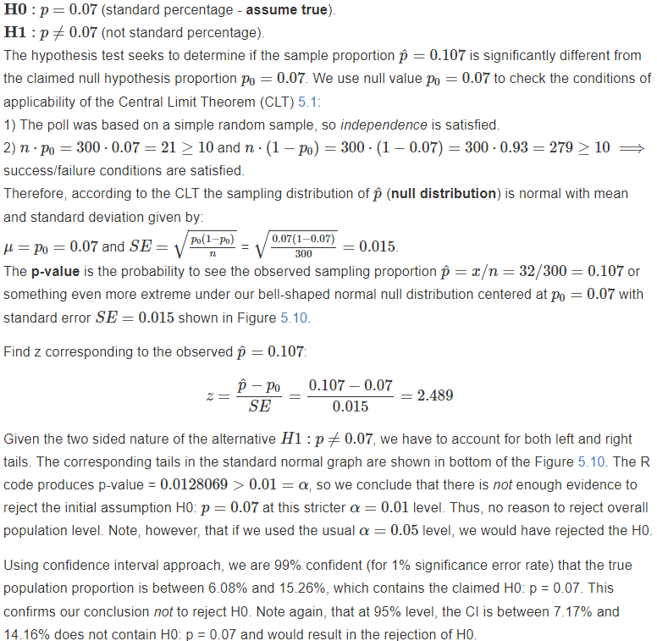
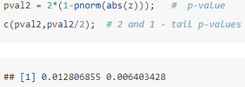
Proportion Hypothesis Test and Confidence Interval (CI)

Slide 15
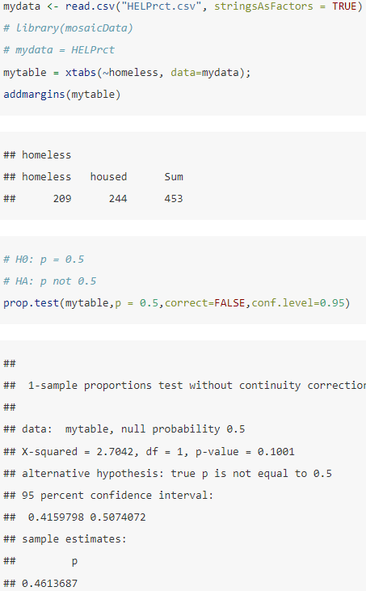
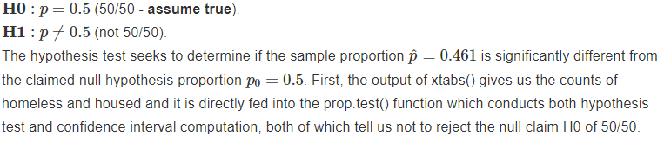
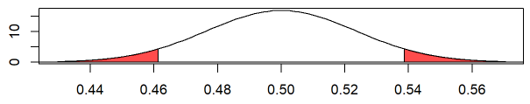
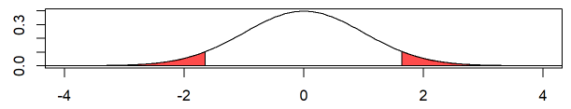
Proportion Hypothesis Test for a data file
In HELPrct.csv data file test if proportion of homeless vs housed in this sample is 50/50.
prop.test() is used but step by step solution is shown later as well

Slide 16
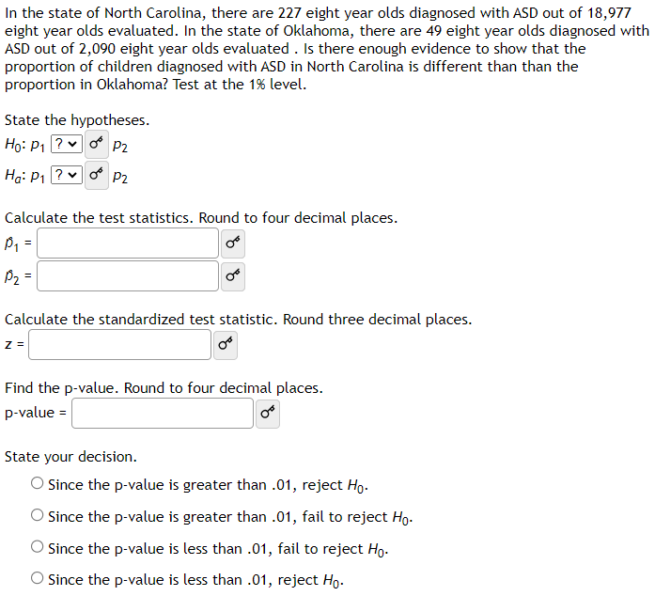
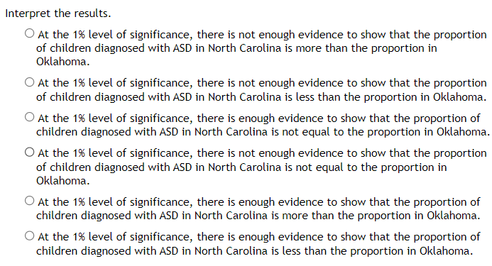
Two Proportion Hypothesis Test – MyOpenMath problem

Slide 17
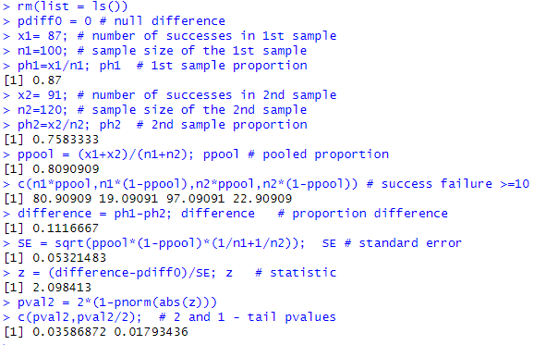
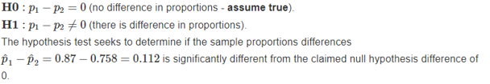
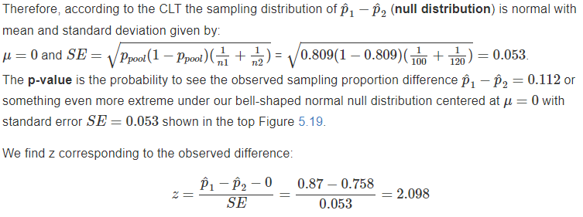
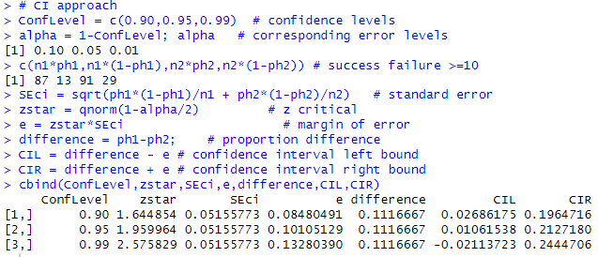
Two Proportion Hypothesis Test
Example: 87 out 100 students preparing with Barron’s passed the Medical admission test MCAT, while 91 out of 120 passed it with Princeton review. Is there a significant difference at the 1% level? How about 5% level?
Students are initially “spooked” by such longer code, but get used to it and appreciate that they don’t have to do it manually.
Also it is not a black box calculation of TI 84 calculator or Excel

Slide 18
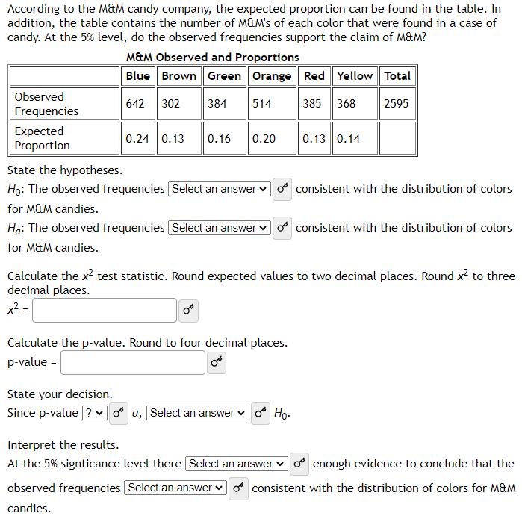
Goodness of Fit Test My Open Math problem

Slide 19
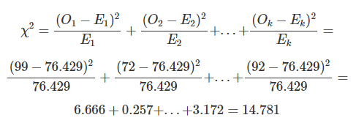
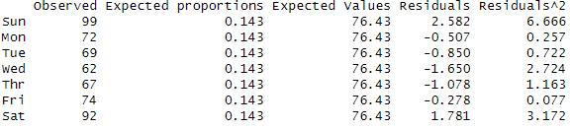
Goodness of Fit Test
Example: A hospital is reviewing staffing levels for their emergency medical response team to determine if the calls are uniformly distributed by day of the week. The data over past month is given as the first two columns in the table in the code below.
> O = c( 99, 72, 69, 62, 67, 74, 92) # observed
> p0 = rep(1/7,7) # c(1/7,1/7,1/7,1/7,1/7,1/7,1/7) # expected proportions
> Total = sum(O); Total
[1] 535
> E = Total*p0 # expeted values
> Residuals = (O-E)/sqrt(E)
> X2terms = Residuals^2;
> ChiTable = as.data.frame(as.matrix(cbind(O,round(p0,3),round(E,2),
+ round(Residuals,3),round(X2terms,3))))
> colnames(ChiTable) = c("Observed","Expected proportions","Expected Values",
+ "Residuals","Residuals^2")
> rownames(ChiTable) = c("Sun","Mon","Tue","Wed","Thr","Fri","Sat")
> print.data.frame(ChiTable)
> X2 = sum(X2terms); X2
[1] 14.78131
> df1 = length(O)-1; df1
[1] 6
> pvalue = 1-pchisq(X2,df=df1); pvalue
[1] 0.02202757
>
> chisq.test(O,p = p0, correct=FALSE)
Chi-squared test for given probabilities
data: O
X-squared = 14.781, df = 6, p-value = 0.02203

Slide 20
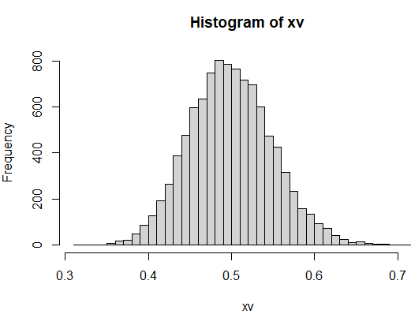
Central Limit Theorem (CLT) for Means
- Introduced via a simulation, but students are NOT responsible for code!
> # Simulation of CLT for Sample Means
> rm(list=ls())
> r = 2;
> n = 100; numsamples = 10000
> xv = rep(0,numsamples)
> for ( j in 1:numsamples) {
+ # sampling from exponential distribution (skewed):
+ onesample = rexp(n,rate = r )
+ xv[j] = mean( onesample )
+ }
> hist(xv,breaks=30)
> xbar = mean(xv); xbar
[1] 0.4989815
> mu = 1/r; mu
[1] 0.5
> SE = sd(xv); SE
[1] 0.04995003
> SE0 = (1/r)/sqrt(n); SE0
[1] 0.05

Slide 21
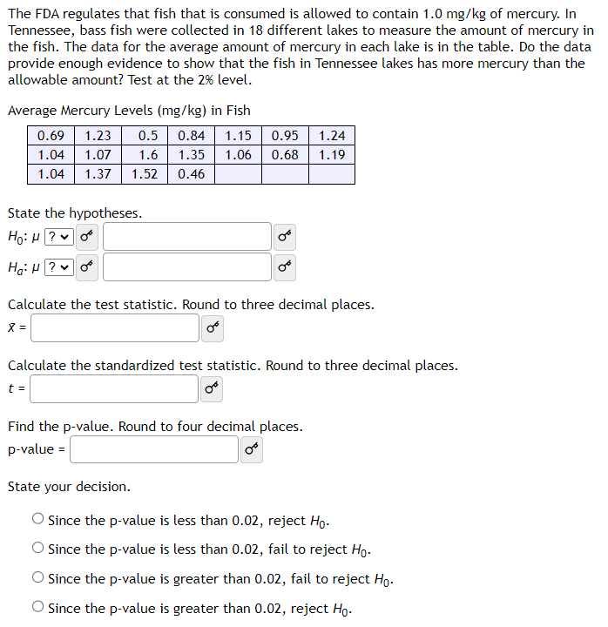

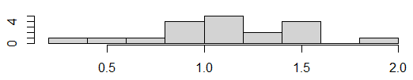
One Mean Hypothesis Test – MyOpenMath problem with data
> summary(x);
Min. 1st Qu. Median Mean 3rd Qu. Max.
0.380 0.900 1.060 1.107 1.365 1.850
> par(mfrow=c(2,1))
> boxplot(x,horizontal=TRUE)
> hist(x,main="")
> t.test(x, mu = 1, conf.level=0.95, alternative = "greater")
One Sample t-test
data: x
t = 1.2647, df = 18, p-value = 0.1111
alternative hypothesis: true mean is greater than 1
95 percent confidence interval:
0.9603484 Inf
sample estimates:
mean of x
1.106842

Slide 22
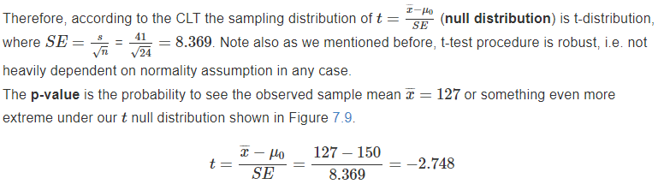

One Mean Hypothesis Test
> n = 24; # sample size
> xbar = 127; # sample mean
> s = 41; # sample standard deviation
> mu0 = 150; # claimed population mean
> c(xbar-2.5*s,xbar+2.5*s) # bounds to check min/max
[1] 24.5 229.5
> SE = s/sqrt(n); SE # standard error
[1] 8.36909
> t = (xbar-mu0)/SE; t # standardized test statistic
[1] -2.748208
> df1 = n-1; df1; # degree of freedom
[1] 23
> pval2 = 2*(1-pt(abs(t),df=df1)); # p-value
> c(pval2,pval2/2); # 2 and 1 - tail pvalues
[1] 0.011450910 0.005725455
>
> # CI approach
> ConfLevel = c(0.90,0.95,0.99) # confidence levels
> alpha = 1-ConfLevel; alpha # error (significance) levels
[1] 0.10 0.05 0.01
> tstar = qt(1-alpha/2,df=df1) # t critical
> e = tstar*SE # margin of error
> CIL = xbar-e # confidence interval left bound
> CIR = xbar+e # confidence interval right bound
> as.data.frame(cbind(ConfLevel,tstar,SE,e,xbar,CIL,CIR
Example: A consulting firm claims that its consultants earn on average 150/hour. In a random sample of 24 consultants, the average rate was 127/hour with standard deviation 41/hour (min 100, max 180). Conduct a hypothesis test at 5% level.

Slide 23
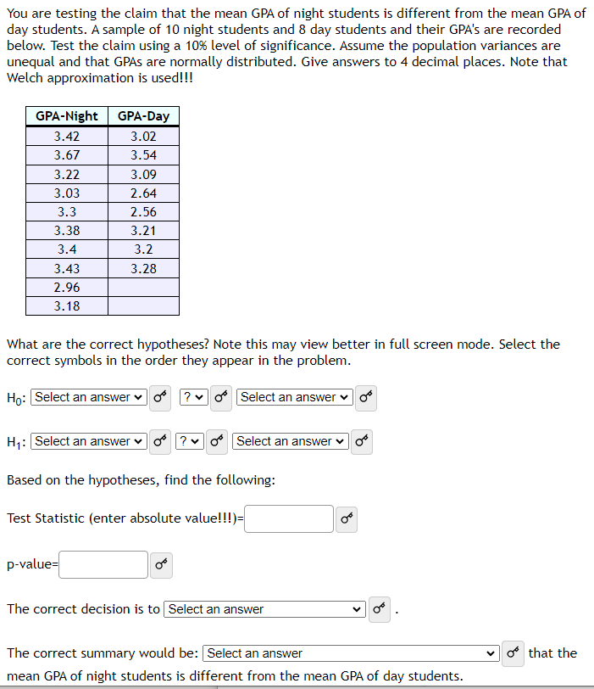
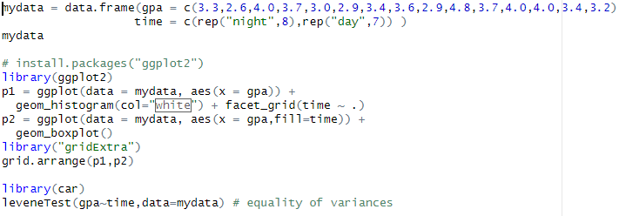
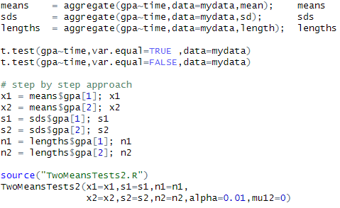
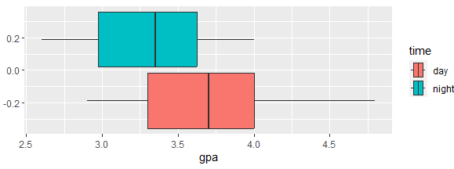
Two Means Hypothesis Test – MyOpenMath example with data

Slide 24

Two Means Hypothesis Test
Example: Two companies daily pay: sample sizes 20 and 25, means 240 and 220, standard deviations 26 and 12, respectively. Min and max for for 1st group 200 and 275, 2nd group 200 and 240. Is there a difference in daily pay between two companies is statistically significant at 1% level.
> # Two sample means test companies daily pay
> source("TwoMeansTests2.R")
> TwoMeansTests2(x1=240,s1=26,n1=20,
+ x2=220,s2=12,n2=25,alpha=0.01,mu12=0)
standard deviations ratios <2? = 2.166667
x1 +- 2.5s1 = 175 305
x2 +- 2.5s2 = 190 250
# 1st Pooled approach ##############################
pooled sp =sqrt( ((n1-1)*s1^2+(n2-1)*s2^2)/(n1+n2-2) = 19.46971
standard error = SE = sp*sqrt(1/n1+1/n2) = 5.840914
degree of freedom = df1 = n1+n2-2 = 43
sample means difference = x1-x2 = 20
standardized test statistic = t = (difference-mu12)/SE = 3.424121
2 and 1 - tail pvalues = 2*(1-pt(abs(t),df=df1)) = 0.001366515 0.0006832575
Confidence Interval:
t critical = tstar = qt(1-alpha/2,df=df1) = 2.695102
margin of error = e = tstar*SE = 15.74186
CI left and right bounds = difference +- e = 4.25814 35.74186
#######################################################
# 2nd UN-Pooled approach Welch Approximation###########
standard error = SE = sqrt(s1^2/n1+s2^2/n2) = 6.289674
Welch degree of freedom = df1 = 25.44257
standardized test statistic = t = (difference-mu12)/SE = 3.179815
2 and 1 - tail pvalues = 2*(1-pt(abs(t),df=df1)) = 0.003851167 0.001925584
#Confidence Interval:
t critical = tstar = qt(1-alpha/2,df=df1) = 2.783485
margin of error = e = tstar*SE = 17.50722
CI left and right bounds = difference +- e = 2.492784 37.50722

Slide 25

Correlation and Regression My Open Math Problem

Slide 26


Correlation and Regression
My Open Math problem with table

Slide 27




Correlation and Regression
Investigate correlation and regression for the data on Longevity and Smoking. Make prediction for several typical values.

Slide 28



Herbivory in the Malaysia Rain Forest Canopy, Penang Hill by M. Lowman, L. Kaganovskiy, and C. Haleyͨ -- submitted as a book chapter.
International “Expert Bio Blitz” on Penang Hill in October of 2017, a team of scientists and citizen scientists collected information on herbivory from canopy insect defoliators.
The observations were compared against a larger database of leaf samples (also measured by citizen scientists) from the Amazon rain forest canopies of Peru earlier in the year, and in the future, this will be integrated into a global database representing ten tropical rain forest regions.
Over 3000 data rows with on 16 variables were collected in Amazon and Penang Hill.
Mosaic package has a useful function
inspect() to summarize the data

Slide 29



ggplot can be effectively used to produce very informative mean and error comparisons for Genus and Species
ggplot(data1, aes(Genus, Percent_Eaten)) +
stat_summary(fun.y = mean, geom = "bar", position="dodge",alpha=0.4) +
stat_summary(fun.data = mean_cl_normal, geom = "errorbar",position=position_dodge(width=0.90), width = 0.5) +
coord_flip() + ggtitle("Mean and SE of Percentage Herbivory") + facet_wrap(~Location)
Anova can be used to compare percentage eaten vs location genus, species, etc…
Genus is significant, location is not

Slide 30
Rumain, B., Kaganovskiy, L. (Statistical Analysis), Geliebter, A., Schneiderman M. Incidence Rates and Relative Risk of Covid 19 Adolescents and Youth compared to Older Adults, Fall 2020. JAMA Netw Open. 2022;5(7):e2222126. doi:10.1001/jamanetworkopen.2022.22126
Rumain, B., Schneiderman, M., Kaganovskiy, L. (Statistical Analysis), & Geliebter, A. (2021). Students’ assessment of learning gains with a POGIL-based Experimental Psychology Laboratory curriculum. Scholarship of Teaching and Learning in Psychology. Advance online publication. https://doi.org/10.1037/stl0000275
R. Kidron, L. Kaganovskiy (Statistical Analysis), S. Baron-Cohen, “Empathizing-systemizing cognitive styles: Effects of sex and academic degree.”, 2018, PLoS ONE 13(3): e0194515. https://doi.org/10.1371/journal.pone.0194515

Slide 31

Joint Project with Professor R. Kidron from Psychology Department
Kidron, Kaganovskiy, Baron-Cohen Empathizing-systemizing cognitive styles: Effects of gender and academic degree. PLoS ONE 2018 13 (3): e0194515. https://doi.org/10.1371/journal.pone.0194515
How the drives to systemizing and to emphasizing measured by questionnaires interact with gender and academic major selection. The responses of 419 students from the humanities and the physical sciences were analyzed in line with the E-S theory predictions.
Found interaction between gender, major and the drive to empathizing relative to systemizing.
R allows to effectively summarize the data to find data entry errors and outliers:
We can see which variables are treated as numeric and which are categorical (factor) variables

Slide 32



2 by 2 Analysis of Variance (ANOVA) of difference vs Gender and Major.
The interaction is significant.
Interaction plot confirms interaction given non-parallel lines
Tukey test shows which individual groups are significantly different

Slide 33




ggplot package allows effective graphical representation:
Plot of means with confidence intervals for difference vs gender and major
quantile() breaks data into user specified
quantiles and regular loop and if-else techniques assign new categorical variables according to brain types: extreme empathizing, empathizing, balanced, systemizing, extreme systemizing:
Raw scores plots

Slide 34


This figure includes special “theme formatting” for article publication with clear type, larger fonts, etc...
The one below is automatic ggplot output

Slide 35




Aggregate() can by used to count the number of student of each brain type by gender and major
Prop.table() is used to find conditional proportions of each brain type by gender and major
Chi-squared test shows significant dependence
between gender-major groups and brain type.

Slide 36
Summary:
R is a very effective tool in teaching at lower and upper levels.
R allows to create step-by-step routines for teaching Introductory Statistics, which introduces students to computational science.
Extensive packages allow numerical and graphical representation.

Slide 37


Proportion Hypothesis Test and Confidence Interval (CI) as custom function
Let's assume that about 7% of certain population are left-handed. In a random sample of 300 children, 32 are left-handed. Do these data provide evidence that the 7% value is inaccurate for children? Use stricter 1% level of significance.
source('OneProportionTest.R’)
OneProportionTest(x=32,n=300,p0=0.07,ConfLevels=c(0.90,0.95,0.99))
One Proportion Test function
Number of successes x = 32
Sample size n = 300
Null hypothesis claimed proportion p0 = 0.07
Confidence Levels 0.9 0.95 0.99
H0: p = p0
H1: p not p0 or one-sided test
sample proportion phat = 32 / 300 = 0.1066667
Hypothesis Testing Approach:
success/failure conditions n*p0, n*(1-p0) <=10?? 21 279
Standard Error = SE =sqrt(p0*(1-p0)/n) = sqrt( 0.07 *( 1- 0.07 )/ 300 )= 0.01473092
Standardized statistic = z = (phat-p0)/SE = ( 0.1067 - 0.07 )/ 0.0147 = 2.489096
P-values, 2 sided and Left and Right = 0.01280686 0.9935966 0.006403428
Confidence Interval:
success/failure conditions n*phat, n*(1-phat) <=10?? 32 268
Standard Error = SEci =sqrt(phat*(1-phat)/n) = sqrt( 0.107 *( 1- 0.107 )/ 300 )= 0.01782217

