Slide 1
Student driven Data to illustrate statistical concepts across the curriculm
Dr. Ryad Ghanam

Slide 2
Problem
Data is needed to motivate interest in statistical applications.
Data is widely available on the internet.
Many datasets require domain level knowledge which the student/instructor may or may not know at a sufficient level.
If the dataset does not connect with the student then they lose interest.
Many datasets seem “manufactured”
Students can just read the slides on their own at a much faster pace so they can check TicTok until you get to the solution.

Slide 3
How to address this problem
Collect data from the students
Students can connect to data that comes from them.
They are already invested in the question.
Since the data comes from them they understand that the answer isn’t known and they need to participate in order to move the class forward.
They are often interested in the data from the other students and how theirs compare.
It can promote inclusion and discussion in the classroom as someone may need to explain their data.

Slide 4
Simple Example - Outliers
Ask the students how far they traveled to class that day.
Collect the data from the students on small piece of paper and collect them.
Write down the values on the board or input them into the computer.
Order the data to make it easy to create a boxplot.
Find Q₁, median and Q₃
Find the upper and lower fences.
Identify outliers. Invariably there is one outlier as one student came a long way to class that day.
Ask students what to do with the outlier. Suggest throwing it out.
Identify the student who is the outlier and ask them to leave class. (this shocks everyone)
Talk about the importance of including all measurements that are accurate whether or not we like the value.

Slide 5
Simple Example - Empirical Rule
Bring a roll of toilet paper and a small paper cup filled with water.
Unroll the toilet paper so that it spans the width of the desk and sit the cup at the open end (away from the roll).
Have the student roll the toilet paper towards them with the cup on it.
Record the time it takes to roll the paper across the table. If they spill water, they have to start over.
This takes two students at a time, one to roll, one to measure the time.

Slide 6
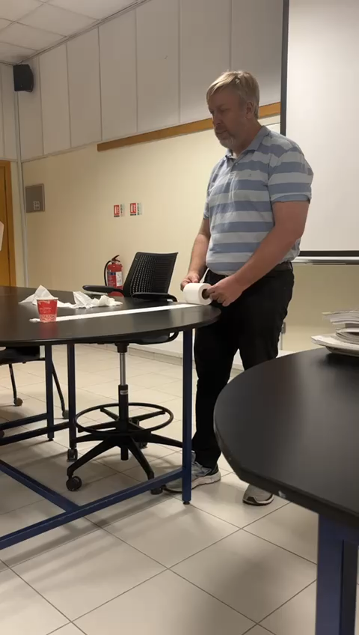
Simple Example – Empirical Rule

Slide 7
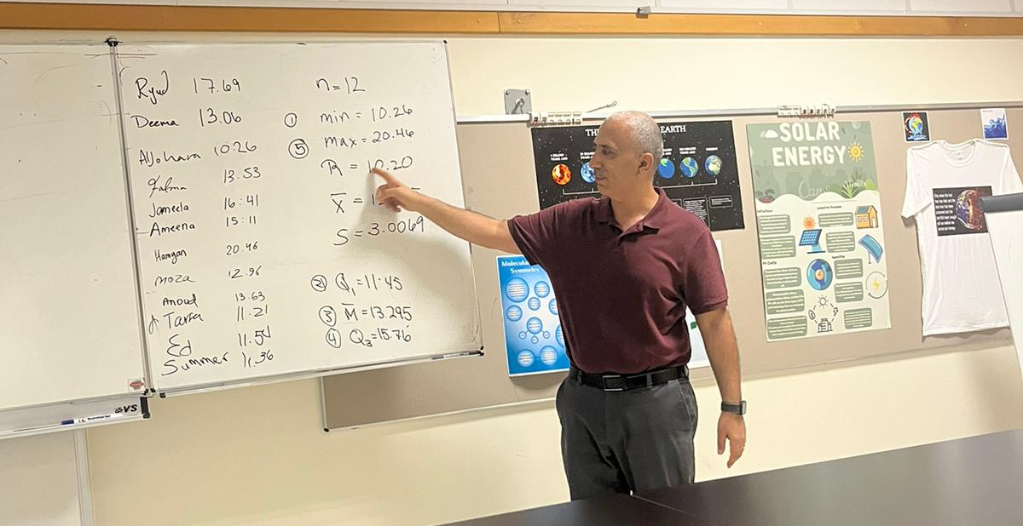
Simple Example – Empirical Rule
Student calculate:
Mean and SD
You can do others:
Range, min, max
Q₁, Median, Q₃

Slide 8
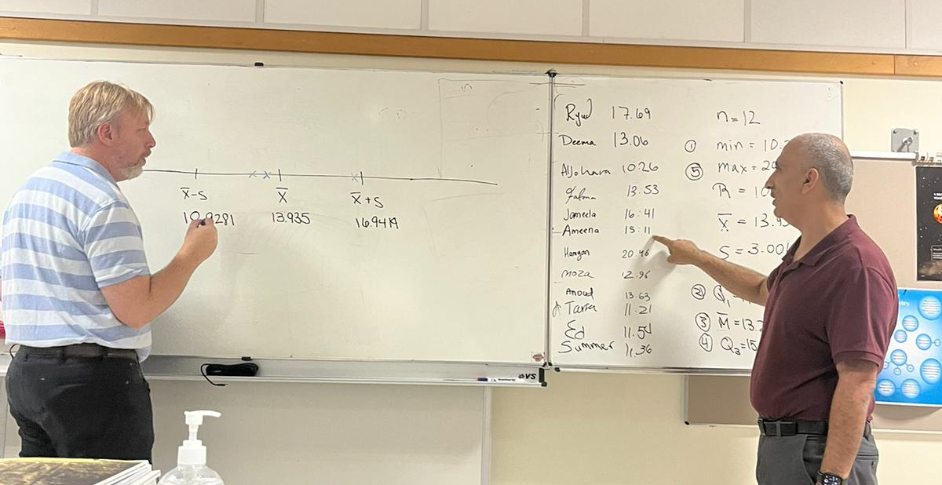
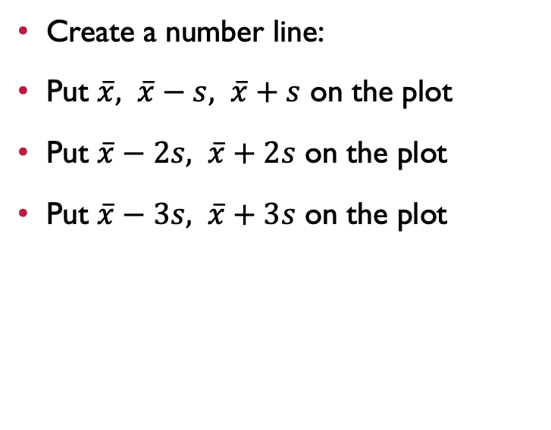
Simple Example – Empirical Rule
Create a number line:
Put $\overline{x}, \overline{x}−s, \overline{x}+s$ on the plot
Put $\overline{x}−2s, \overline{x}+2s$ on the plot
Put $\overline{x}−3s, \overline{x}+3s$ on the plot

Slide 9
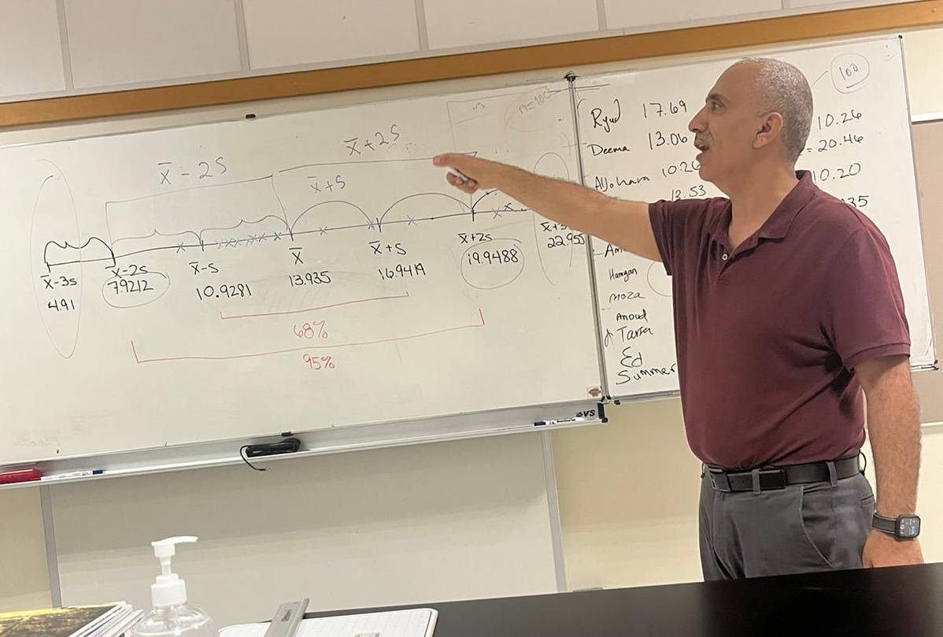
Simple Example – Empirical Rule
Note that 68% of observations are with in 1 standard deviation.
Note that 95% of observations are with in 2 standard deviations.
Note that 99% of observations are with in 3 standard deviations

Slide 10
Simple Example – Empirical Rule
Suggest values that lie outside the 3 standard deviation limits and ask if they are likely or unlikely to be observed.
Since they have all experienced the experiment they can connect to reasonable values that could be observed.

Slide 11
Advanced Example - Confidence Intervals
Confidence intervals is one of the most misunderstood concepts in statistics.
Saying that we are confident in the method (not the observed interval) is difficult to grasp.
At the beginning of the course have students install a “Fit” application on their phone that tracks the number of steps they take each day.
Create a google form create 10 questions all the same except the date.
Have each student enter the number of steps they took on the specified dates. Have them do this two lectures before the confidence interval activity lecture.

Slide 12
AdvanceD Example - Confidence Intervals
The day before the activity lecture grab all the data and calculate the overall mean (population mean).
Keep this number handy during the lecture.
Create new datasets of size 15 by randomly sampling the full dataset.
Put each dataset on an individual sheet so that it can be distributed to the students.
Have the students calculate the mean of their dataset.

Slide 13
Advanced Example – Confidence interval
Create a number line and have each student come up and place their sample mean on the number line.
Look at the distribution and constantly mention that this is the “Sampling Distribution of the Sample Mean”
Ask students why they didn’t all get the same value…. (Sampling variability).
Ask the students which of the sample means are right? (Right meaning that it is the true value in the population). Some will say... All of them. The truth… none of them.
How to do better?

Slide 14
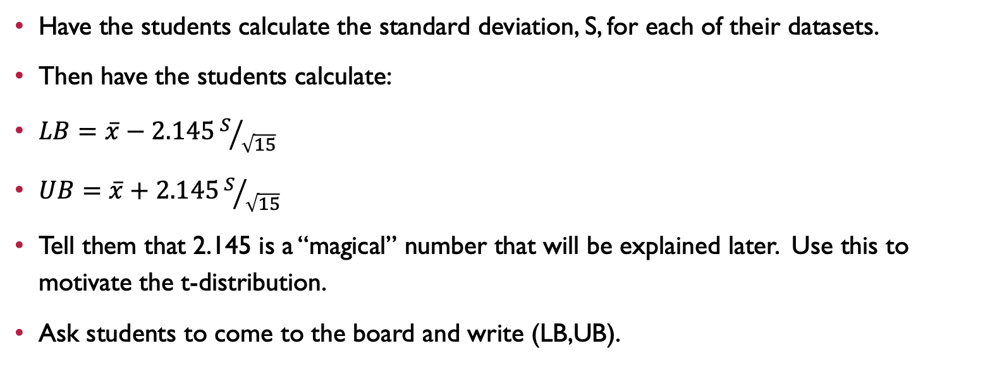
Advanced Example – Confidence Intervals
Have the students calculate the standard deviation, S, for each of their datasets.
Then have the students calculate:
$LB=\overline{x}−2.145S/{\sqrt{15}}$
$UB=\overline{x}+2.145S/{\sqrt{15}}$
Tell them that 2.145 is a “magical” number that will be explained later. Use this to motivate the t-distribution.
Ask students to come to the board and write (LB,UB).

Slide 15
Advanced Example – Confidence Intervals
Do not share the true population mean.
Go down the list and circle the ones that are correct and put a line through those that are incorrect.
Show that most are correct but not all.
Point estimates are (almost) always wrong. Who wants to be wrong all the time?
Interval estimates are correct quite often.
So we have confidence in the method we used to get the interval.

Slide 16
Advanced Example – Confidence Intervals
Mention that people speak in intervals so it is natural.
What time are you going to show up tonight?
Between 7 and 7:15
How much is a new computer?
$700 to $1200
Wider intervals mean more uncertainty about the true value of the mean.
Narrower intervals mean less uncertainty about the true value of the mean.

Slide 17
Advanced Example – Confidence intervals
Summarize the experiment and reiterate the points they observed and incorporate student comments.
We don’t know the true mean of the population.
We need to guess a value for the mean.
Problem with point estimates ( single value guess ) is that is almost always wrong.
Intervals are more likely to be correct.
Scientists typically don’t like intervals as they need a specific number to plug into their formulae.
Next lecture we will talk about how we can control how confident we are with the method.
Question to ponder??? Why does this work?

Slide 18

Hints:
Food helps!
Even if the lecture goes bad…
Students enjoy the food.

