Slide 1

SMART INDIA HACKATHON 2026
SecureMailScope
AI-Assisted Cryptographic Security
Posture Assessment for Secure
Email Communications
PROBLEM STATEMENT 26159
Blockchain & Cybersecurity / Software
Crypterpillars
Team ID: To be added
Notes:
SecureMailScope addresses SIH problem statement 26159: AI-Assisted Cryptographic Security Posture Assessment for Secure Email Communications. The target users are mail administrators, security operations teams and learners who need to understand whether captured email sessions used appropriate cryptographic protection. The prototype accepts packet captures, reconstructs supported sessions, evaluates observable evidence and explains what to fix. It is passive analysis: it does not actively attack mail servers or decrypt email messages. The presentation describes the implemented demonstration, not a certified forensic or compliance product. Team: Crypterpillars. The registered Team ID still needs to be supplied. Sources: project README.md, SecureMailScope.txt and the existing project submission PDF.

Slide 2
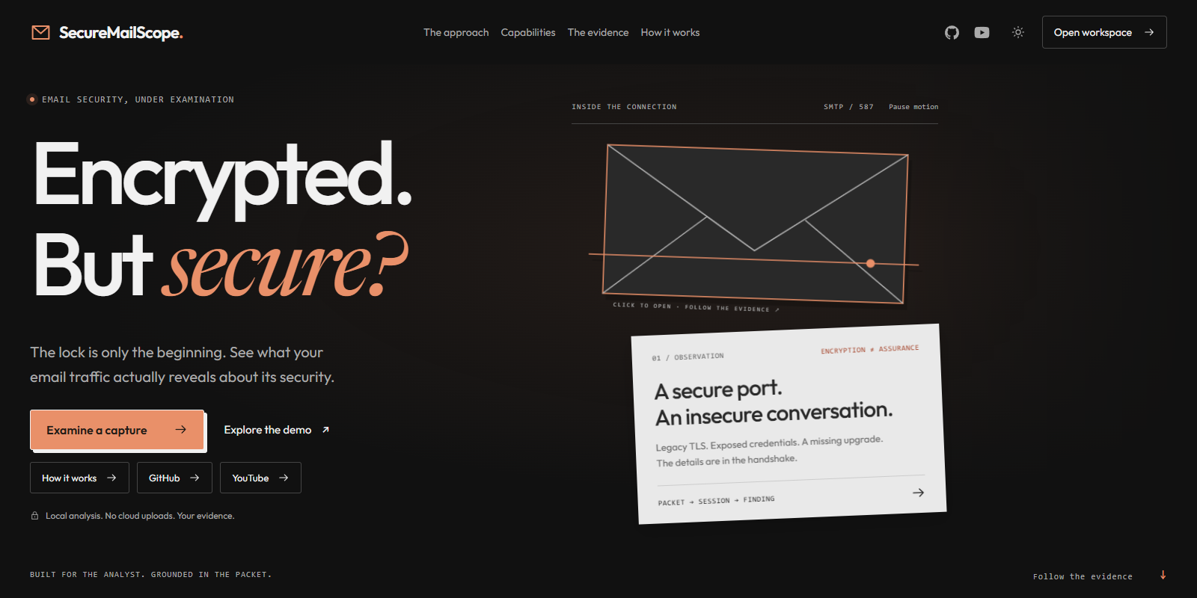
PROPOSED SOLUTION
Crypterpillars
The problem
A secure port does not prove a secure session.
Weak ciphers, failed STARTTLS upgrades and
plaintext logins need evidence-based review.
The solution
Upload PCAP/PCAPNG and reconstruct SMTP,
IMAP and POP3 sessions. Detect weak TLS,
certificate faults and exposed credentials.
Evidence behind every finding
Each finding shows severity, packet frame
and a fix. ML uses cryptographic features,
while missing evidence stays unknown.
Passive analysis / No email decryption
SecureMailScope / SIH 2026
2
Notes:
The problem is the gap between a connection appearing encrypted and evidence that its configuration is safe. Examples include negotiating an old TLS version, using a weak cipher, continuing plaintext authentication after STARTTLS failure, or presenting an expired or mismatched certificate. SecureMailScope turns captured packets into reconstructed SMTP, IMAP and POP3 sessions, then links findings to frames, timestamps and remediation. Deterministic rules are the primary evidence-based checks. Random Forest provides a separately labeled risk classification and Isolation Forest provides an anomaly signal using normalized cryptographic features rather than raw email content. These models assist the analyst and do not establish proof of compromise. The interface preserves unknowns instead of treating missing evidence as secure. Uploaded captures and the original synthetic browser simulation are separate workflows. In local mode, analysis makes no external API calls. Source: README.md and backend/app/core. Screenshot: tmp/video/landing.png.

Slide 3

TECHNICAL APPROACH
Crypterpillars
01 Capture intake
02 Reconstruction
03 Assessment
04 Analyst output
Validate up to 50 MB.
Extract with TShark/Scapy.
Retain SHA-256 to
identify uploaded evidence.
Order TCP segments.
Flag gaps/retransmissions.
Track email commands
and STARTTLS transitions.
Inspect TLS, ciphers and
visible X.509 certificates.
Run deterministic rules
and feature-based ML.
Score assessed sessions.
Explain deductions/fixes.
Export evidence in
JSON, HTML or PDF.
React + TypeScript / FastAPI + Python / TShark + Scapy / SQLite
Score: 100 minus rule and ML deductions. Incomplete sessions remain unscored.
SecureMailScope / SIH 2026
3
Notes:
Intake validates PCAP or PCAPNG and enforces the 50 MB upload limit. SHA-256 identifies the uploaded bytes. TShark is the primary packet extractor when available, with Scapy as the fallback. Reconstruction orders TCP segments and records retransmissions or gaps before protocol and TLS parsing. Supported email transitions include SMTP STARTTLS, IMAP STARTTLS and POP3 STLS. Assessment checks observable TLS versions, cipher properties, forward secrecy and X.509 certificate evidence, including validity at capture time and name/key checks. Rules attach packet evidence and a suggested fix. The ML path uses 11 normalized features. Random Forest classifies risk and Isolation Forest flags unusual combinations. Per-session scoring starts at 100 and subtracts deterministic-rule and separately recorded ML deductions, with a floor of zero. The overall score averages assessed sessions. Incomplete sessions have no score; no supported sessions does not imply a score of 100. Reports export as JSON, self-contained HTML or backend-generated PDF. Sources: README.md; backend/app/core/posture_score.py; rule_engine.py; pipeline.py. Workflow illustration is an AI-generated conceptual graphic, not measured evidence.

Slide 4
FEASIBILITY AND BENEFITS
Crypterpillars
01
02
03
Working prototype
Evidence limits
Expected benefits
Local analysis and reports
Encrypted or missing data
More focused remediation
Local capture processing with
saved history, session evidence
and downloadable reports.
TLS 1.3 encrypts certificates.
Partial captures omit evidence.
ML needs broader validation.
Help administrators and SOC
analysts prioritize weak TLS,
certificates and exposed auth.
Repeatable validation
Explicit uncertainty
Less manual packet review
Synthetic fixtures cover plaintext
auth, failed upgrades and expiry.
They use the same parser
as uploaded captures.
Keep unknowns visible and
incomplete sessions unscored.
Evaluate ML on representative
real traffic before deployment.
Connect findings to frames and
redact authentication arguments.
Measure review time and false
positives during future pilots.
SecureMailScope / SIH 2026
4
Notes:
Feasibility rests on an implemented React/TypeScript interface and Python/FastAPI backend, with local persistence and report generation. Constructed fixtures exercise cleartext authentication, TLS weaknesses, certificate faults, failed upgrades and partial captures. They validate known scenarios through the actual parser, but do not prove production coverage. TLS 1.3 encrypts certificates after ServerHello, and a passive capture cannot always establish identity, certificate validity or revocation status. Stream gaps can also prevent a complete assessment. The mitigation is to retain explicit uncertainty and exclude incomplete sessions from the overall score. Synthetic ML evaluation must not be advertised as real-world accuracy. Next validation should use authorized representative traffic, varied providers and configurations, and measurement of false positives and analyst review time. Expected benefits are faster prioritization and easier explanation of fixes; these are intended outcomes, not measured efficiency gains. Credentials and message content are redacted from exported evidence, but original packet captures still require appropriate access and retention controls. Sources: README.md Evidence boundaries and Validation.

Slide 5
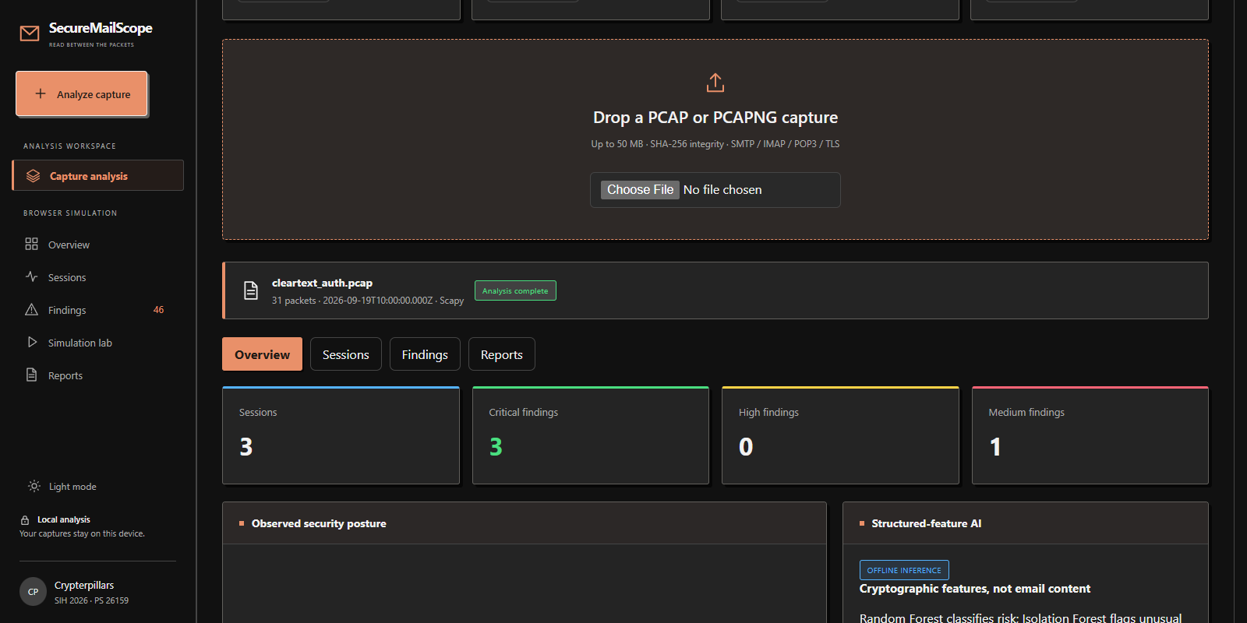
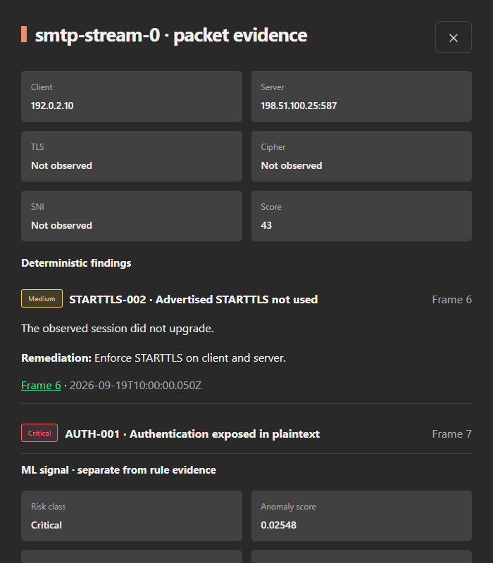
DEMONSTRATIVE WEB APP
Crypterpillars
01 Capture analysis overview
02 Evidence and remediation
Demo: cleartext authentication
1. Analyze the synthetic capture: 3 sessions, 3 critical findings.
2. Open SMTP: frame 7 identifies plaintext authentication.
3. Review STARTTLS remediation and export the report.
SecureMailScope / SIH 2026
5
Notes:
The screenshots show the actual web application with a constructed cleartext_auth.pcap fixture. First upload or select the demo capture. The overview reports three reconstructed sessions and three critical findings, representing the SMTP, IMAP and POP3 plaintext-authentication scenario. Open the SMTP session to inspect the evidence panel. STARTTLS-002 at frame 6 reports that advertised STARTTLS was not used. AUTH-001 at frame 7 reports authentication exposed in plaintext. The panel also offers the remediation to enforce STARTTLS on the client and server, alongside separately labeled ML risk and anomaly fields. The displayed SMTP score of 43 is an assessed-session posture score, not a probability of compromise or a claim about a real organization. Finally open Reports and export JSON, HTML or PDF so the evidence and recommendations can be reviewed outside the dashboard. The browser simulation and its simulated remediation remain distinct from actual uploaded-capture results. Sources: existing project screenshots tmp/video/workspace.png and tmp/video/session.png; README.md Demo flow.

