Slide 1

SMART INDIA HACKATHON 2026
SecureMailScope
AI-Assisted Cryptographic Security
Posture Assessment for Secure
Email Communications
PROBLEM STATEMENT 26159
Blockchain & Cybersecurity / Software
Crypterpillars
Team ID: To be added
Notes:
Source: SecureMailScope.txt and Crypterpillars_Software_SIH26159.pdf in the supplied project. Team ID was not present in supplied project materials.

Slide 2
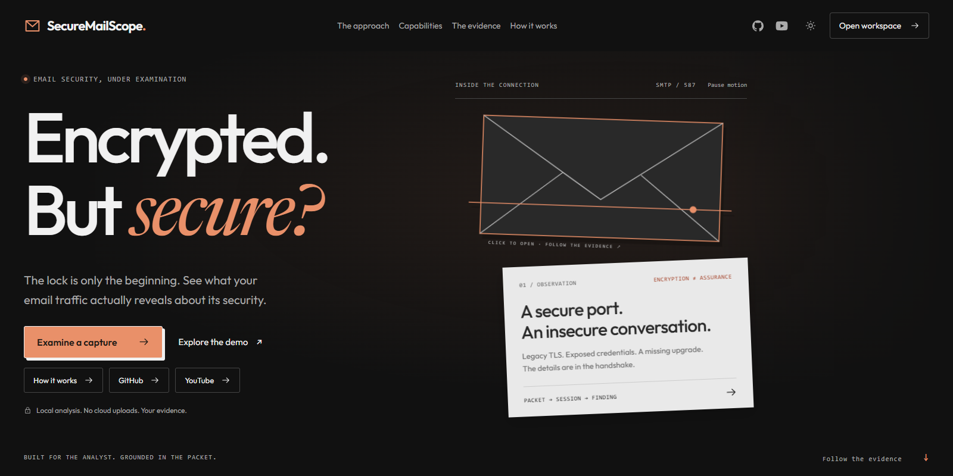
PROPOSED SOLUTION
Crypterpillars
The problem
Email services may use weak settings,
fail TLS upgrades or expose authentication.
Packet review takes expertise.
The solution
Upload a capture. Reconstruct email
sessions and assess the cryptographic
evidence in one analyst workspace.
Evidence behind every finding
Packet frames, prioritized fixes and
separately labeled ML signals.
SMTP / IMAP / POP3
SecureMailScope / SIH 2026
2
Notes:
Sources: README.md; backend/app/core/pipeline.py; backend/app/core/rule_engine.py. Passive demonstrative assessment. No email decryption or production forensic assurance.

Slide 3

TECHNICAL APPROACH
Crypterpillars
01 Capture intake
02 Reconstruction
03 Assessment
04 Analyst output
Validate PCAP/PCAPNG.
Extract packets and
retain the SHA-256.
Reassemble TCP.
Track SMTP, IMAP
and POP3 sessions.
Check TLS and certificates.
Apply rules and separate
ML risk signals.
Review frame evidence.
Export JSON, HTML
and PDF reports.
React + TypeScript / FastAPI + Python / TShark + Scapy / SQLite
Random Forest risk classification / Isolation Forest anomaly detection
SecureMailScope / SIH 2026
3
Notes:
Illustration generated using built-in ImageGen: four-stage navy/teal/copper workflow showing capture files, email reconstruction, security inspection and report. Source asset: tmp/ppt-build/workflow-illustration.png. Sources: README.md Architecture; backend/app/core; src/CaptureWorkspace.tsx. XGBoost exists as a challenger, not presented as the primary classifier.

Slide 4
FEASIBILITY AND BENEFITS
Crypterpillars
01
02
03
Working prototype
Evidence limits
Expected benefits
Local analysis and reports
Encrypted or missing data
More focused remediation
Upload captures, inspect findings
and download analyst reports.
TLS 1.3 hides certificates.
Partial captures leave gaps.
Help administrators and SOC
analysts prioritize fixes.
Repeatable validation
Explicit uncertainty
Less manual packet review
Synthetic fixtures exercise
cleartext auth, weak TLS
and certificate faults.
Mark unknowns and exclude
incomplete sessions. Validate
on representative real traffic.
Connect findings to frames
and redact credentials
in exported evidence.
SecureMailScope / SIH 2026
4
Notes:
Source: README.md Validation and Evidence boundaries. Benefits are expected, not measured. Synthetic ML evaluation does not establish real-world accuracy. Future validation should include representative real captures.

Slide 5
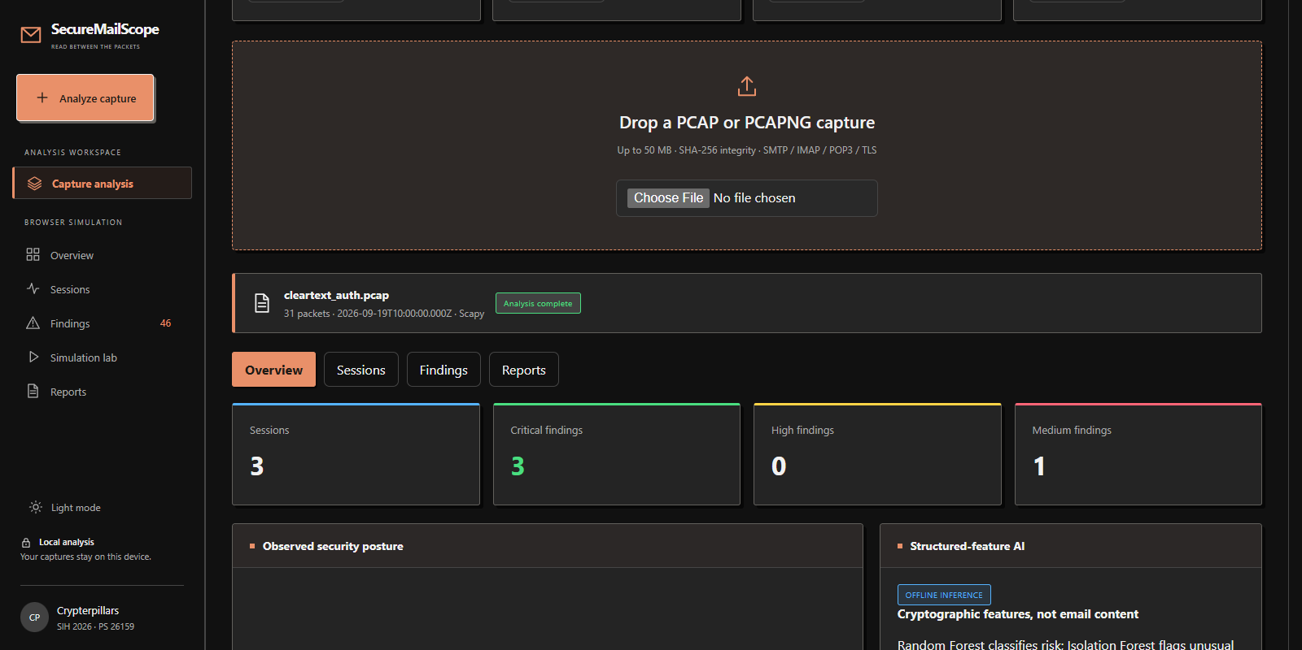
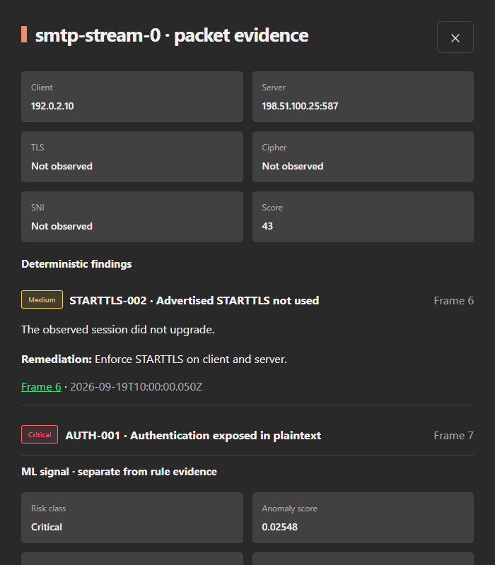
DEMONSTRATIVE WEB APP
Crypterpillars
01 Capture analysis overview
02 Evidence and remediation
Real app screens. Synthetic demo capture.
Frame evidence and separate ML signals in the same workflow.
SecureMailScope / SIH 2026
5
Notes:
Sources: existing project screenshots tmp/video/workspace.png and tmp/video/session.png. These show the constructed cleartext_auth.pcap fixture, not live production traffic.

