Slide 1

SMART INDIA HACKATHON 2026
SecureMailScope
AI-Assisted Cryptographic Security
Posture Assessment for Secure
Email Communications
Problem Statement ID: 26159
Theme: Blockchain & Cybersecurity
PS Category: Software
Team Name: Crypterpillars
Team ID: To be added
Notes:
Source: SecureMailScope.txt and Crypterpillars_Software_SIH26159.pdf in the supplied project. Team ID was not present in supplied project materials.

Slide 2
PROPOSED SOLUTION
Crypterpillars
The problem
Packet captures expose technical details, but assessing email encryption
and deciding which weaknesses to fix requires specialist effort.
The solution
Upload PCAP/PCAPNG to reconstruct SMTP, IMAP and POP3 sessions.
Inspect STARTTLS, TLS settings and observable certificate evidence.
What makes it useful
Each finding links to packet evidence and remediation. The dashboard
separates deterministic findings, ML signals and unknown evidence.
@SIH Idea submission- Template
2
Notes:
Sources: README.md; backend/app/core/pipeline.py; backend/app/core/rule_engine.py. Passive demonstrative assessment. No email decryption or production forensic assurance.

Slide 3
TECHNICAL APPROACH
Crypterpillars
01 Capture intake
Validate the file, retain its SHA-256 and extract packets.
02 Session reconstruction
Reassemble TCP streams and track email protocol transitions.
03 Security assessment
Check TLS, ciphers and certificates. Run rules and separate ML signals.
04 Analyst output
Show posture scores, frame evidence and JSON / HTML / PDF reports.
React + TypeScript / FastAPI + Python / TShark + Scapy / SQLite
Random Forest for risk classification / Isolation Forest for anomalies
@SIH Idea submission- Template
3
Notes:
Sources: README.md Architecture; backend/app/core; src/CaptureWorkspace.tsx. XGBoost exists as a challenger, not presented as the primary classifier.

Slide 4
FEASIBILITY AND BENEFITS
Crypterpillars
Feasibility
The working prototype analyzes uploads locally and exports reports.
Synthetic capture fixtures cover cleartext auth, weak TLS and certificate faults.
Challenges and response
TLS 1.3 hides certificate evidence. Partial captures leave gaps.
Mark unknowns explicitly, exclude incomplete sessions and validate on real traffic.
Expected impact
Help mail administrators and SOC analysts prioritize configuration fixes.
Redact credentials and reduce manual packet review with traceable findings.
@SIH Idea submission- Template
4
Notes:
Source: README.md Validation and Evidence boundaries. Benefits are expected, not measured. Synthetic ML evaluation does not establish real-world accuracy. Future validation should include representative real captures.

Slide 5
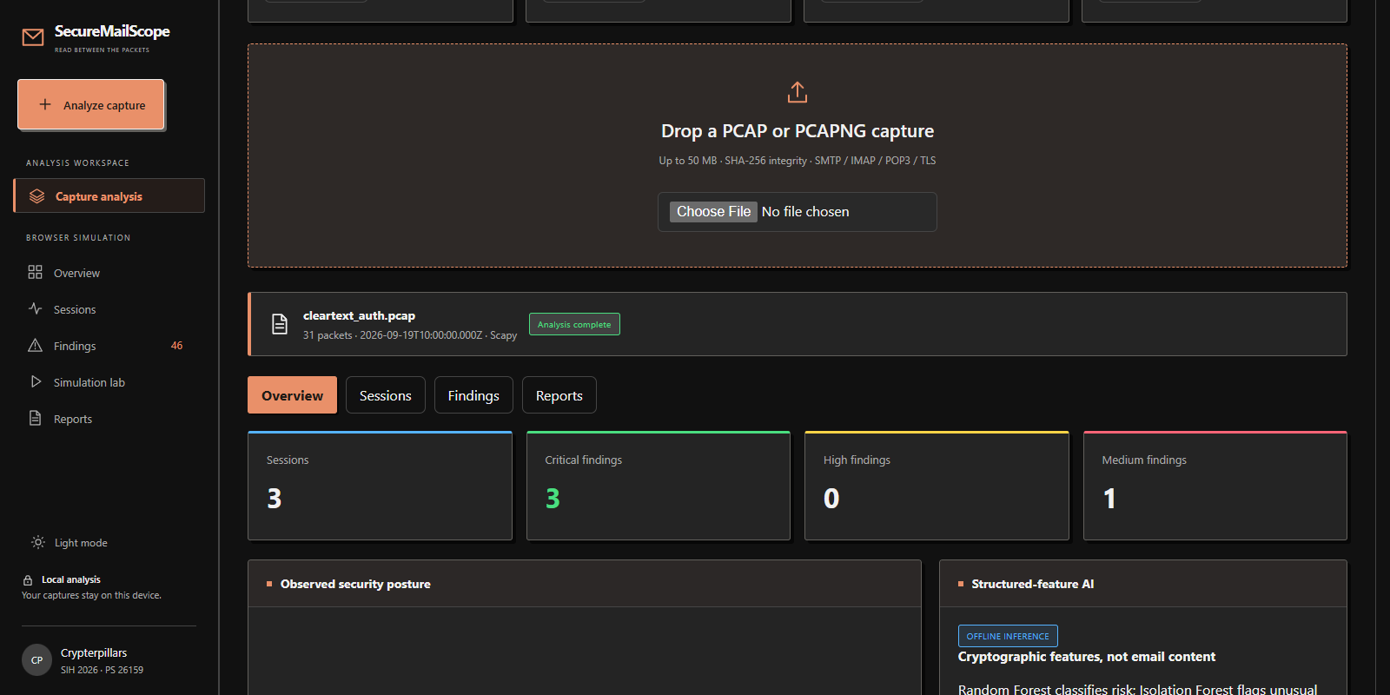
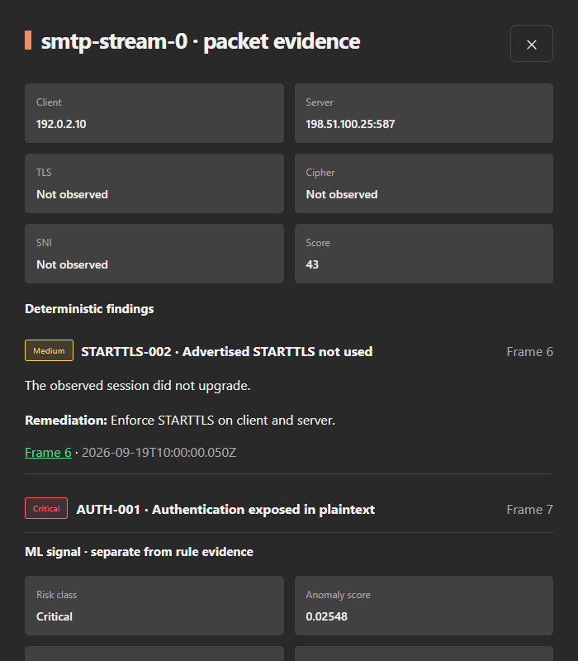
DEMONSTRATIVE WEB APP
Crypterpillars
Capture analysis overview
Packet evidence and remediation
Actual app screens using a synthetic demo capture.
Findings link to frames and keep ML signals separate.
@SIH Idea submission- Template
5
Notes:
Sources: existing project screenshots tmp/video/workspace.png and tmp/video/session.png. These show the constructed cleartext_auth.pcap fixture, not live production traffic.

