Slide 1

SMART INDIA HACKATHON 2026
TITLE PAGE
Problem Statement ID –SIH26001
Problem Statement Title-AI-Based Early Warning and Landslide Risk Monitoring System in NER
Theme-Disaster Management
PS Category- Software
Team ID- 21
Team Name- Problem Compilers

Slide 2
AI-Powered Predictive Landslide Intelligence Platform
Problem Compilers
Proposed Solution
WHAT IS OUR SOLUTION?
AI-Powered Landslide Intelligence Platform
An AI-powered platform integrating environmental, terrain, satellite, and field data to predict landslide risk and enable preventive action.
HOW DOES IT WORK?
Collect → Analyze → Predict → Assess Impact → Alert
A unified workflow that converts multi-source data into actionable early warnings.
WHAT MAKES IT UNIQUE?
Beyond Prediction → Impact-Based Decision Support
Combines landslide risk prediction with potential impact assessment to support proactive decision-making.
HOW DOES IT ADDRESS THE PROBLEM?
Early Risk Identification & Prevention
Identifies high-risk zones early, enabling authorities and communities to take timely preventive action.

Slide 3
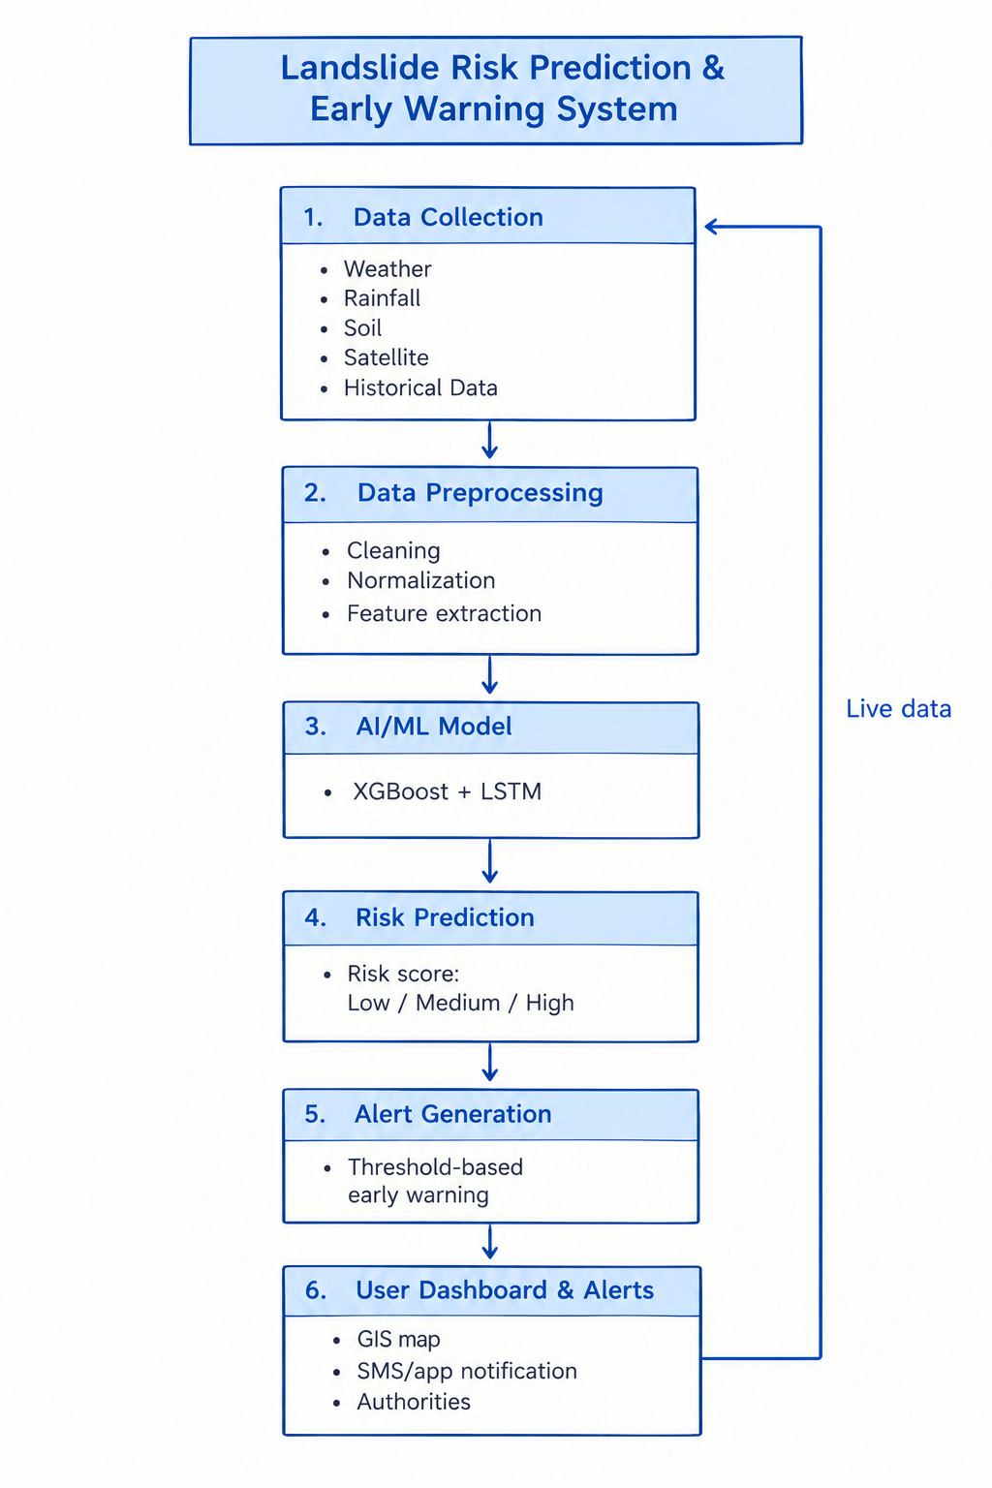
TECHNICAL APPROACH
Problem Compilers
Technologies Used
FRONTEND : React.js
BACKEND: FastAPI
AI / ML: Python ,Scikit-learn
DATA PROCESSING : Pandas ,NumPy
DATABASE : PostgreSQL
GIS & MAPPING: GIS ->Leaflet / Mapbox
DATA SOURCES : Satellite Data ,Weather APIs
DEPLOYMENT : Docker ,Cloud
2. Methodology / Implementation
Data Collection → Preprocessing → Feature Engineering → AI RiskPrediction → Multi-level Risk Classification → Early Warning →Dashboard & GIS Visualization → Continuous Monitoring

Slide 4
FEASIBILITY AND VIABILITY
Problem Compilers
FEASIBILITY
AI/ML: Predict landslide risk using rainfall, soil moisture, slope, terrain & historical data.
Real-Time Integration: Connect IMD weather APIs, IoT sensors, satellite & GIS data.
GIS Dashboard: Display live risk zones, roads, villages and infrastructure on maps.
Mobile + Cloud: Field officials can report geo-tagged cracks, slope movement and road blockages.
Offline Support: Store reports locally and sync automatically when connectivity returns.
Viability
Low Cost: Uses open-source AI/GIS tools and existing data sources.
Scalable: Pilot in high-risk districts → expand across the entire NER.
Easy Adoption: Multilingual alerts through SMS + mobile application.
Sustainable: Continuous learning from new sensor, weather and incident data.
High Value: Enables preventive action instead of reactive disaster management.

Slide 5
IMPACT AND BENEFITS
Problem Compilers
Social : Helps reduce Risk to life and improve community saftey
Impact on Target Audience
Higher Authorities: Faster identification of high-risk areas for timely action
Field & Rescue Teams: Better prioritization of inspections and emergency response
Local Communities: Early warnings with more time to take precautions
Key Benefits
Road & Infrastructure Authorities: Early identification of vulnerable roads and locations
Economic: Helps minimize damage to roads,buildings and other infrastructure
Environmental: Continuous monitoring of vulnerable slopes and terrain
Operational: Combines AI, GIS, weather, sensor and field data in one platform
Accessibility:Offline/low-network support for remote areas

Slide 6
RESEARCH AND REFERENCES
Problem Compilers
1. ISRO/NRSC – Landslide Atlas of India
https://www.isro.gov.in/Landslide_Atlas_India.html
2. NASA – LHASA Global Landslide Nowcast
http://gis.earthdata.nasa.gov/portal/home/item.html?id=9e65a60a305b458bba6330baa93c0238
3. ISRO – North-East India Applications
https://www.isro.gov.in/North-EastIndiaRegionSpecificApplications.html
4. ISRO – GIS/Landslide Research
ISRO uses GIS and satellite remote sensing to map and monitor landslide risks across vulnerable regions in India through the National Remote Sensing Centre (NRSC).
https://www.isro.gov.in/SpaceApplications.html
5. https://github.com/nasa/LHASA/tree/master/

