Slide 1
Problem Statement Track
01 / 07
PROBLEM STATEMENT TITLE
[ Paste the exact PS title + PS ID from the official portal — idea maps to themes on GNSS spoofing / assured sensor-information integrity ]
THEME
Aerospace & Defence · confirm against the official PS
PS CATEGORY
Software
TEAM ID
[ your Team ID ]
TEAM NAME
[ your Team Name ]
Fill Team ID, Team Name and the official PS title / ID exactly as on the portal before exporting.
TRUSTBATTLE — AI-Driven Battlefield Information Integrity & Trust Assessment Engine

Slide 2
Idea
02 / 07
PROJECT / IDEA NAME
TRUSTBATTLE — AI-Driven Battlefield Information Integrity & Trust Assessment Engine
“Don't just ask what the battlefield sensors are reporting — ask whether the information they report can be trusted.”
PROBLEM BEING ADDRESSED
PROPOSED SOLUTION
UAV, GNSS/IMU, visual and network data can be spoofed, replayed, injected, jammed or simply faulty — and a manipulated measurement can look perfectly legitimate. Operators see what sensors report, but not whether each individual observation is trustworthy right now.
An AI-assisted Information Integrity Layer between sensors and fusion. Every observation is scored 0–100 from five independent evidence streams — physical, temporal, cyber/network, cross-sensor and historical — suspicious sources are down-weighted in fusion, and the operator sees a plain-language evidence checklist.
KEY DIFFERENTIATORS
Explainable evidence
Checklist of passing / failing checks — not a black-box score
Dynamic trust
Drops during anomalies, recovers after — no permanent blacklisting
Trust-aware fusion
Suspicious sources automatically down-weighted in the estimate
Honest scope
Integrity assessment — never claims “hacked” without sufficient proof
TRUSTBATTLE — AI-Driven Battlefield Information Integrity & Trust Assessment Engine

Slide 3
Technical Approach
03 / 07
TECHNOLOGIES / TOOLS USED
SYSTEM ARCHITECTURE
FRONTEND & BACKEND
BATTLEFIELD SOURCES — GNSS · IMU · Visual · Telemetry/Network
• React + Vite · Leaflet/Mapbox · Recharts/Plotly (dashboard)
• Python FastAPI · REST + WebSocket real-time streaming
• PostgreSQL (SQLite in dev) via SQLAlchemy
FEATURE EXTRACTION
AI / ML LIBRARIES & MODELS
M1 · PHYSICAL
state consistency
M2 · TEMPORAL
replay / timing checks
M4 · CYBER
network anomaly scenarios
• scikit-learn Isolation Forest — primary anomaly detector
• One-Class SVM baseline · IF+OCSVM ensemble candidate
• pandas / NumPy pipelines · LSTM / autoencoder on roadmap
CLOUD & DEPLOYMENT TOOLS
EVIDENCE ENGINE
• Modular Python packages driven by shared configs/settings.yaml
• Deployable on any cloud VM / container platform (e.g. Docker)
OBSERVATION TRUST MODEL (0–100)
VERSION CONTROL & CI/CD
TRUSTED
→ robust fusion
SUSPICIOUS
→ verification alert
• Git / GitHub · per-module pytest suites (15 test files)
• Frozen data contracts + change-request workflow (docs/contracts)
EXPLAINABLE DASHBOARD (M5)
TRUSTBATTLE — AI-Driven Battlefield Information Integrity & Trust Assessment Engine

Slide 4
Feasibility & Viability
04 / 07
TECHNICAL FEASIBILITY
OPERATIONAL FEASIBILITY
ECONOMIC FEASIBILITY
• Fully open-source, mature stack — pipeline already runs end-to-end (integration/run_demo.py)
• No classified data: public GNSS spoofing datasets (TEXBAT) + synthetic attacks with known ground truth
• Unsupervised Isolation Forest — no large labelled dataset needed
• Adds one layer on top of existing sensor fusion — no sensor replacement, no workflow disruption
• Operator-friendly output: trust %, green/amber/red states, plain-English evidence checklist
• Alert thresholds are calibrated, tunable and explainable
• Zero licence cost — 100% open-source stack
• Lightweight tree models train in seconds — commodity hardware, no GPU farm
• Simulation-first evaluation avoids costly physical test ranges
SCALABILITY & SUSTAINABILITY
• Config-driven (YAML): thresholds, weights & check limits retunable without code changes
• Maintainable: strictly separated modules, frozen data contracts + change-request governance
• Expansion roadmap: V2 +Camera/EO → V3 +Radar → V4 multi-UAV → V5 edge deployment & real hardware
PROOF POINT (controlled simulation, M2 module): combined detector F1 = 1.00 across replay / telemetry-manipulation / network-anomaly scenarios, 0 false positives on 228 clean windows, detection latency ≤ 5 s (synthetic data — labelled as such).
TRUSTBATTLE — AI-Driven Battlefield Information Integrity & Trust Assessment Engine

Slide 5
Impact & Benefits
05 / 07
1
USER BENEFITS
2
SOCIAL IMPACT
3
ECONOMIC IMPACT
4
ENVIRONMENTAL IMPACT
5
EFFICIENCY & PRODUCTIVITY
• Instant answer: “can I trust this observation now?”
• 0–100 score + evidence + recommended action
• Crew & mission safety — decisions rest on verified information
• Relevant to GNSS spoofing seen in real conflicts
• Software-only layer over existing sensors
• Prevents costly corrupted-data decisions; near-zero running cost
• Simulation-first development — no physical test ranges
• Efficient models suit low-power edge hardware
• Automates sensor-veracity cross-checking
• ≤5 s detection limits corruption spread; auto trust recovery
IMPACT PATHWAY
PROBLEM
SOLUTION
IMMEDIATE IMPACT
LONG-TERM IMPACT
Unverifiable sensor data under spoofing / jamming / malfunction / deception
Multi-evidence integrity layer + dynamic trust + trust-aware fusion
Suspicious source down-weighted; evidence-backed alert; fusion stays accurate
Resilient, explainable information systems — transferable to AVs, drones, critical infrastructure
TRUSTBATTLE — AI-Driven Battlefield Information Integrity & Trust Assessment Engine

Slide 6
Research & References
06 / 07
RESEARCH / LITERATURE SURVEY
REFERENCES
Programs & doctrine
1. Liu, Ting & Zhou — “Isolation Forest”, IEEE ICDM, 2008.
2. Schölkopf et al. — “Estimating the Support of a High-Dimensional Distribution”, Neural Computation, 2001 (One-Class SVM).
3. Humphreys et al. — UT Austin Radionavigation Lab: GPS civil-spoofer studies & TEXBAT dataset, radionavlab.ae.utexas.edu.
4. U.S. Army SBIR topic: “Ensuring Sensor Data Security and Integrity”, armysbir.com.
5. Press Information Bureau — official releases on India's SANJAY Battlefield Surveillance System, pib.gov.in.
6. Official documentation: scikit-learn, FastAPI, React/Vite, Leaflet/Mapbox, Plotly/Recharts, WebSocket API.
• U.S. Army SBIR program: “Ensuring Sensor Data Security and Integrity” — protecting sensor data across its lifecycle
• India's SANJAY Battlefield Surveillance System — integrates ground/aerial sensors and confirms veracity before the common picture
Existing solutions & products
• Anti-jam GNSS receivers / GPS firewalls, network intrusion detection, Kalman-style fusion — each covers one fragment
• We combine physical + temporal + cyber + cross-sensor evidence into one observation-level trust score with explainability
Documented threats
• GNSS spoofing & jamming against UAVs in the Russia–Ukraine conflict
• Decoys / electronic deception produce “valid but wrong” sensor observations
Datasets used for training / testing
• UT Austin TEXBAT — public GPS spoofing test battery
• Our synthetic UAV telemetry with ground-truth-labelled attacks (spoof / replay / telemetry-manip / network anomaly) at 0–30% corruption levels
TRUSTBATTLE — AI-Driven Battlefield Information Integrity & Trust Assessment Engine

Slide 7
Important Instructions
07 / 07
✓
Use the real numbers, labelled honestly — quote F1 / FPR / latency as “controlled simulation results”, never as field-tested claims.
✓
Honesty guardrails — never claim “sensors are being hacked”, “nobody has solved this”, or “our AI proves the attack”.
✓
Diagrams over prose — layered architecture, trust drop/recovery curve (94% → 31% → 94%), M2 timeline graphs (appendix).
✓
One-line demo story — Normal (green, 94%) → spoofing injected → trust 31% + evidence → GNSS down-weighted → recovery to 94%.
✓
Consistent formatting — one font family, 2–3 colours, max ~6 bullets per slide, no decorative clip-art.
✓
Accuracy — Team ID, PS title/ID and team names must match the official portal before export.
✓
Concise & relevant — every bullet earns its place; cut anything that doesn't answer what / why / how / so what.
TRUSTBATTLE — AI-Driven Battlefield Information Integrity & Trust Assessment Engine

Slide 8
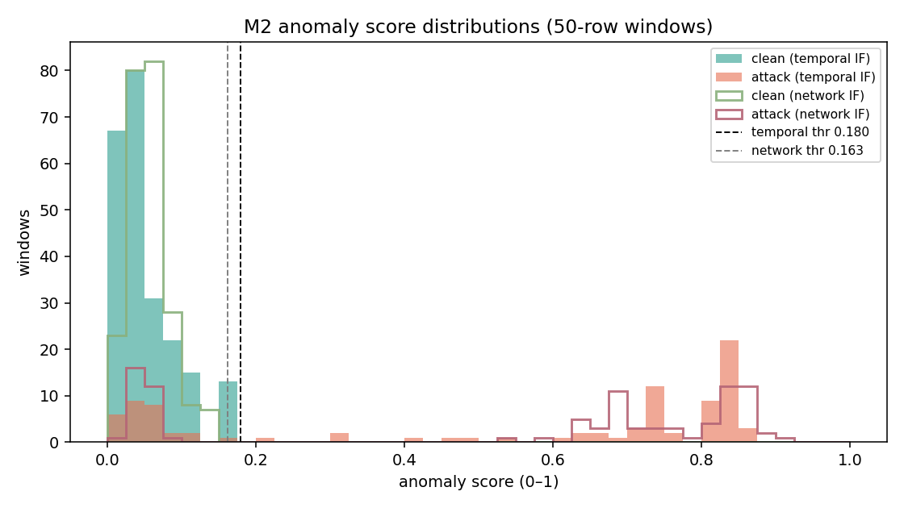
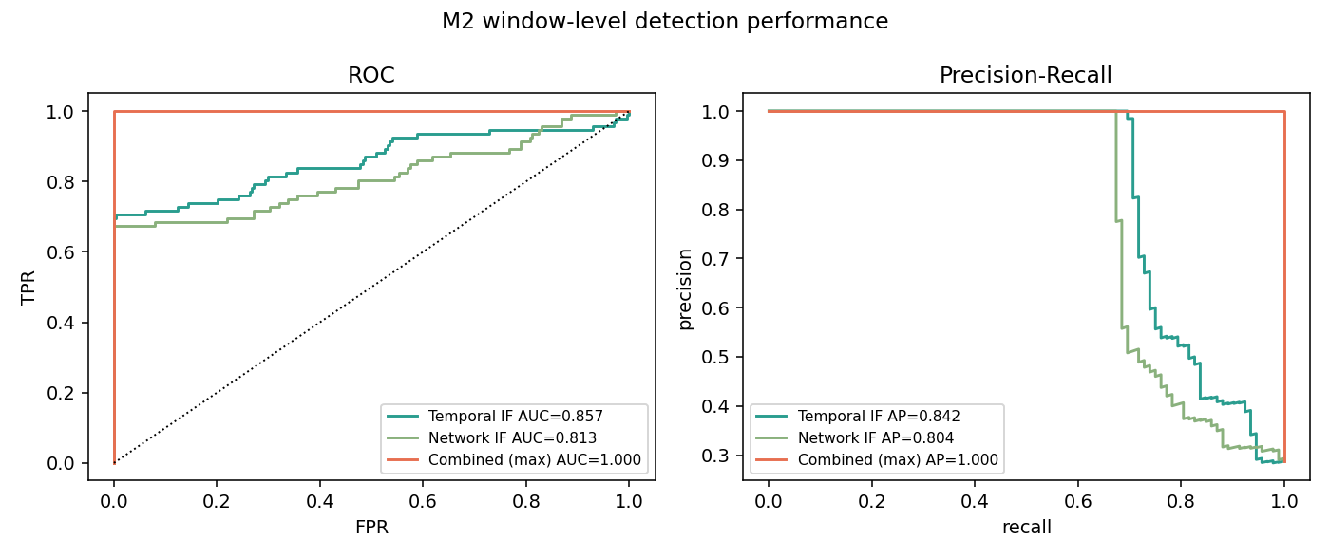
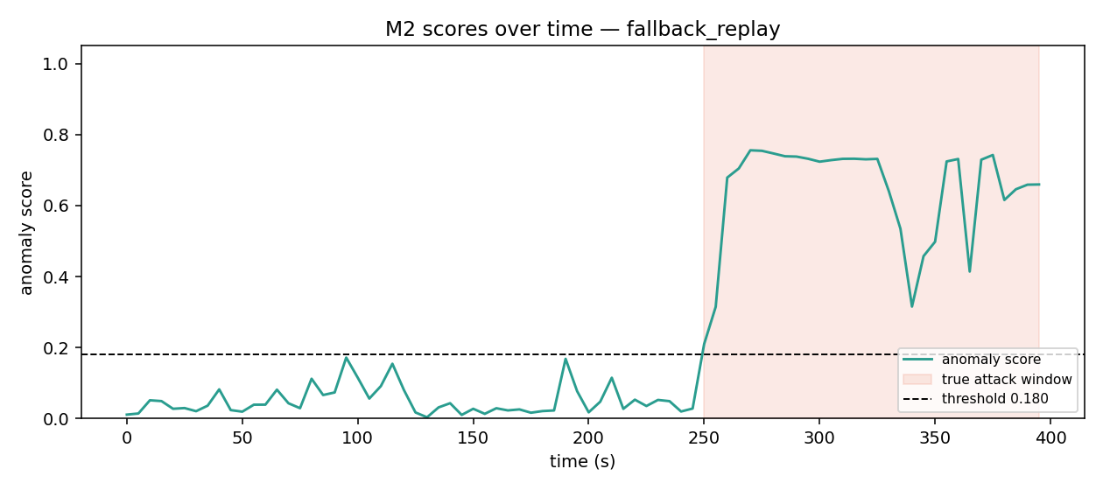
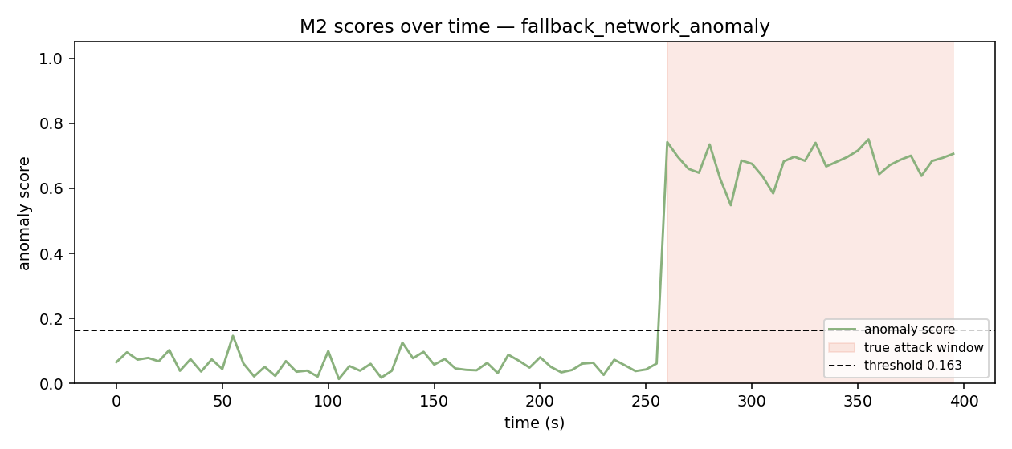
Appendix — M2 Evaluation Graphs
APPENDIX
Anomaly score distributions
ROC & precision-recall curves
Replay attack detection timeline
Network-anomaly detection timeline
Controlled-simulation results — regenerate with py -m member2_temporal.src.evaluate when real M4 scenario data lands.
TRUSTBATTLE — AI-Driven Battlefield Information Integrity & Trust Assessment Engine

