Slide 1



Technology Bucket – Software-Web App Development Category – Software
Ministry Name - Ministry of Women and Team Name - Invincible
Child Development Problem Code – AS124
Team Leader Name – Abhyudaya Mittal College Code - 1-3512387138
“Promoting holistic nutrition among women and children through/with the help of IT for Poshan Abhiyaan”
Idea Of Approach
Easier maintainence of beneficiary’s record.
Record of beneficiary who have not come for their dose.
Early reminder for beneficiary through sms.
Less tedious work for Anganwadi employees.
Data is stored permanently.
No chance of data loss.
Block Level
Add Beneficiary data to database
Maintain attendance of beneficiary
Send early notification to beneficiary
Contact beneficiary who are not regular
Child Development Project Officer(C.D.P.O.)
Register
Register
Mukhya Sevika
Cluster Level
Mukhya Sevika
Anganwadi workers
C.D.P.O.
(admin)
Login after selecting STATE, DISTRICT and BLOCK
Register
Habitation Level
Register
Anganwadi Worker
Mukhya Sevika
Android Studio
XML
JAVA
My SQL Lite 3
Technology Stack
Moblie Application
Front End
Backend
Database
VISUAL STUDIO
HTML,CSS
PHP
MY SQL
Web Application
Front End
Backend
Database

Slide 2
WORKFLOW
Start
Login
C.D.P.O.
(admin)
Anganwadi Worker
Select STATE, DISTRICT and BLOCK
Register Mukhya Sevika
Mukhya Sevika
Provide Login ID’s to Anganwadi Workers
Maintain Attendence
Add details of people(name,address,contact no.)
Send ALERT
Register Aaganwadi Worker
Provide Login ID’s to Mukhya Sevikas
All Present
NO
Notify Absenties
YES
End

Slide 3
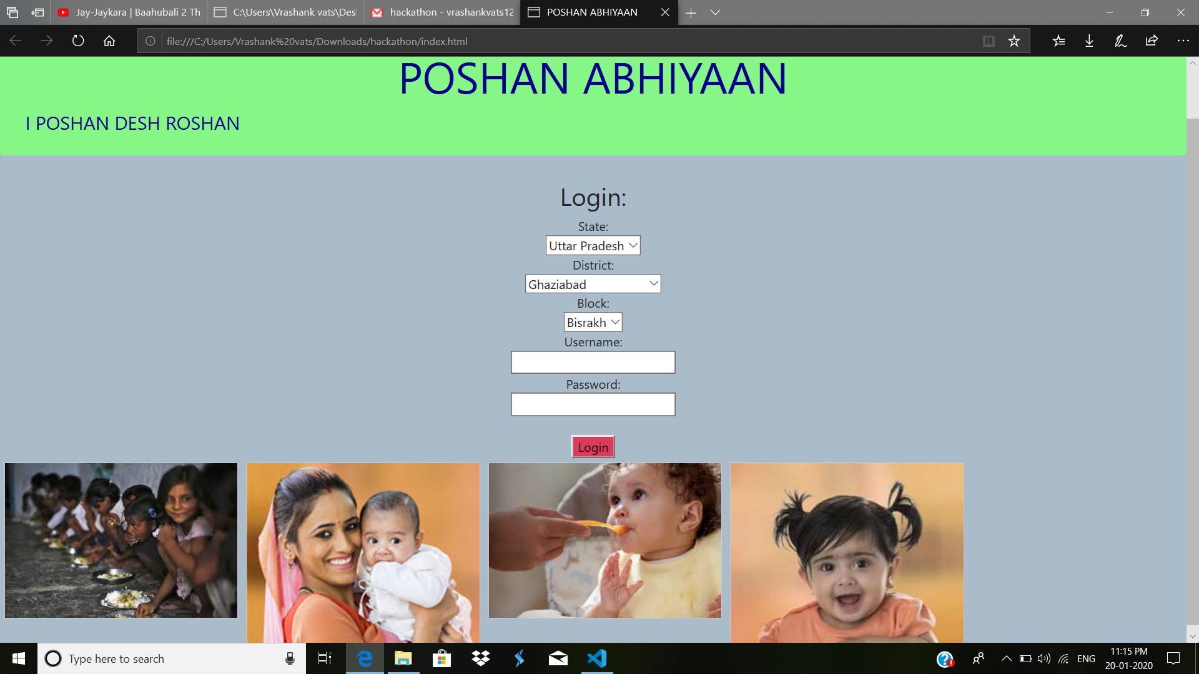
USE CASE DIAGRAM
Register all Mukhya sevikas
Registered
C.D.P.O
(admin)
Provide Mukhya Sevikas their Login ID’s
Register all Anganwadi workers
Registered
Provide Anganwadi Workers their Login ID’s
Mukhya Sevika
Add Name Address and contact number of new beneficiary
NOTE: All Login’s are after selecting State,District and Block of respective Member
Maintain attendance of all existing beneficiary
https://www.youtube.com/watch?v=ydPrIlQsy6g
Anganwadi Worker
Send early alerts to existing beneficiary about their upcoming dose
Contact those beneficiary who missed their dose
Dependencies:
The system must have active internet connection and Message pack in mobiles to send SMS alerts.

