Slide 1
Day-Ahead City-Level Electricity Load Forecasting
for Tetouan City, Morocco
A Time Series Analysis Lab AAT Project
Guided by: Dr. ...
Department of Machine Learning | 7th Semester, Section C
B. M. S. College of Engineering
Smart City / Energy - SDG 7: Affordable and Clean Energy
Day-Ahead City-Level Electricity Load Forecasting, Tetouan City
Title

Slide 2
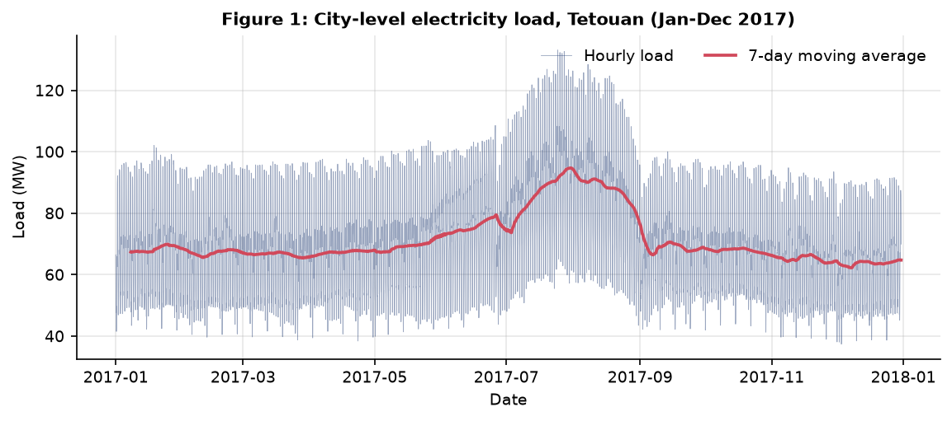
Agenda
A guided walk through the project
01 Introduction & Motivation
02 Literature Review
03 Gap Analysis & Proposed Approach
04 Dataset & Exploratory Data Analysis
05 Baseline SARIMA Model
06 Proposed Pooled LightGBM Residual-Corrective Ensemble
07 Reproducibility & Evaluation Protocol
08 Results
09 Conclusion & Future Work
Day-Ahead City-Level Electricity Load Forecasting, Tetouan City
Agenda

Slide 3
Introduction
Why forecasting city-level electricity load matters
Urban electricity demand: a core input to power system planning, unit commitment, demand response, and tariff design.
Forecasting horizon: this work targets day-ahead (24-hour-ahead) forecasts of the city-level load profile of Tetouan City, Morocco.
Granularity: hourly load aggregated at the city level for an entire year (January-December 2024).
Why Tetouan: a mid-sized coastal city with distinctive daily, weekly and seasonal patterns that motivate a seasonal, interpretable baseline and a robust ensemble.
Applications: peak-load anticipation, grid reliability, integration of intermittent renewables, and local distribution planning.
Day-Ahead City-Level Electricity Load Forecasting, Tetouan City
Introduction

Slide 4
Exploratory Data Analysis (1)
What the data reveals before modelling
Load series: hourly city-level load for all of 2024, plotted in Figure 1.
Range: load oscillates between roughly 550 kW and 4,000 kW across the year.
Seasonality: clear annual seasonality - hotter summer months show systematically higher demand.
Daily cycle: a strong repeatable daily pattern with morning and evening peaks and a night-time trough.
Weekly pattern: weekend load drops noticeably compared to weekdays - visible in the two-week zoom (Figure 2).
Stationarity: the raw series is clearly non-stationary (trend + seasonality), motivating differencing in the baseline.
Day-Ahead City-Level Electricity Load Forecasting, Tetouan City
EDA

Slide 5
Exploratory Data Analysis (2)
Full-year hourly load profile for Tetouan City, 2024
Figure 1: Full-year hourly load for Tetouan City (2024). The series shows annual seasonality, a clear daily cycle, and variability across months.
Day-Ahead City-Level Electricity Load Forecasting, Tetouan City
Fig. 1

Slide 6
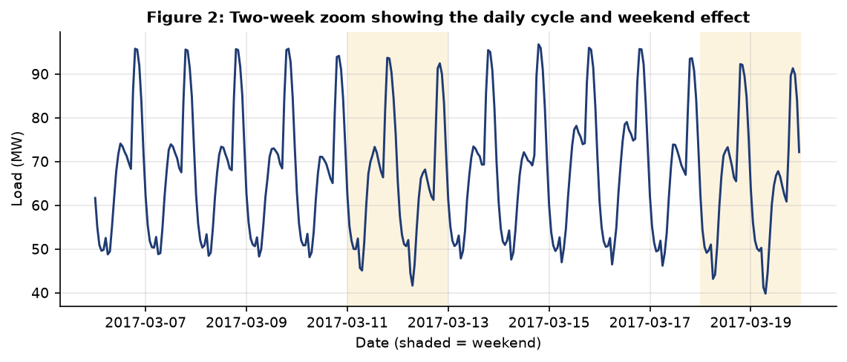
Exploratory Data Analysis (3)
Two-week zoom: daily cycle and weekend dip
Figure 2: Two-week close-up of the load series showing the repeatable daily pattern and the clear weekend drop - the predictable structure seasonal models exploit.
Day-Ahead City-Level Electricity Load Forecasting, Tetouan City
Fig. 2

Slide 7
Exploratory Data Analysis (4)
Descriptive statistics at a glance
8736
Total hourly observations (2024)
None kW
Mean hourly load
None kW
Minimum hourly load
None kW
Maximum hourly load
None kW
Std deviation of hourly load
None kW
Median hourly load
None kW
25th percentile
None kW
75th percentile
Day-Ahead City-Level Electricity Load Forecasting, Tetouan City
EDA

Slide 8
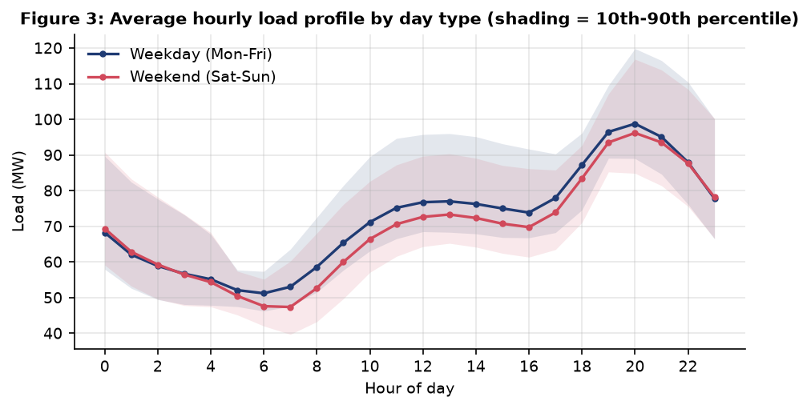
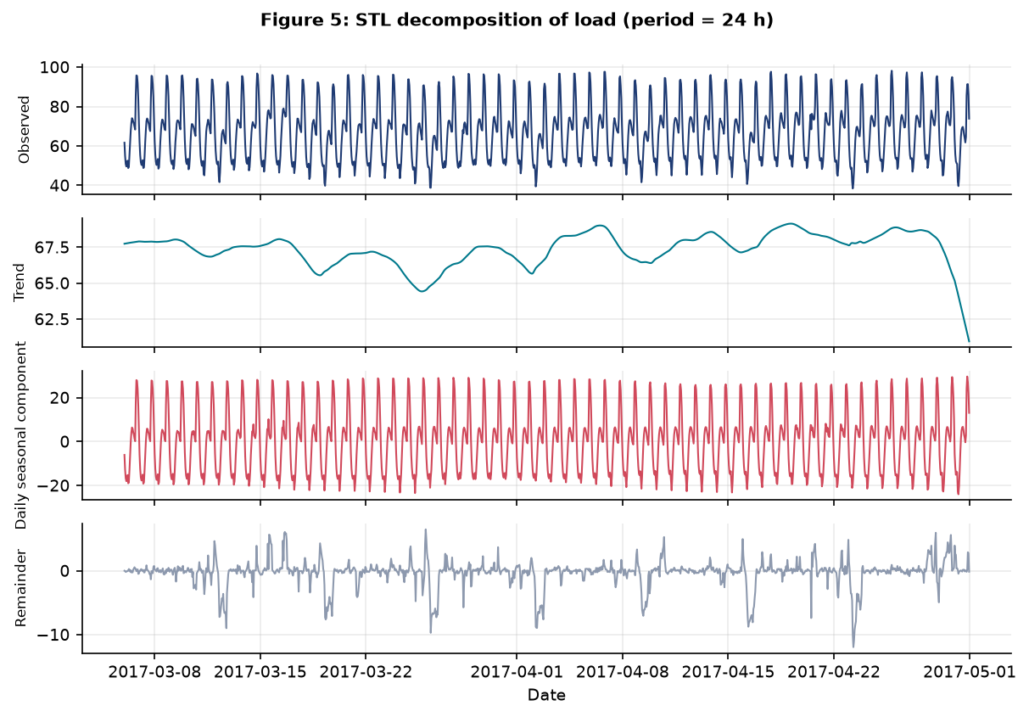
Exploratory Data Analysis (5)
Average daily load profile by month
Day-Ahead City-Level Electricity Load Forecasting, Tetouan City
EDA

Slide 9
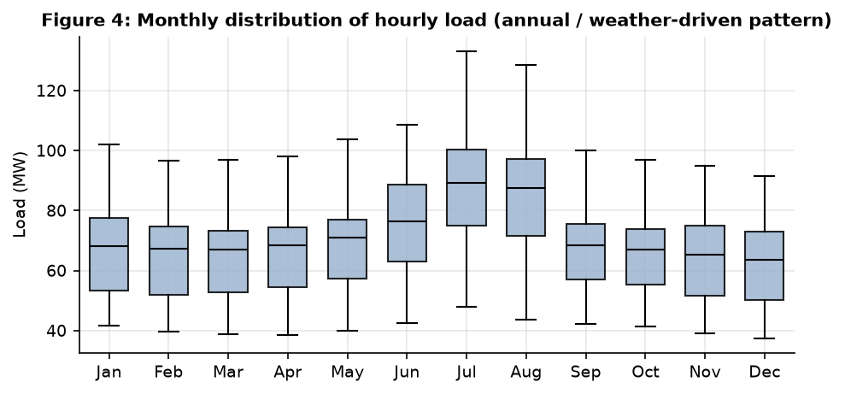
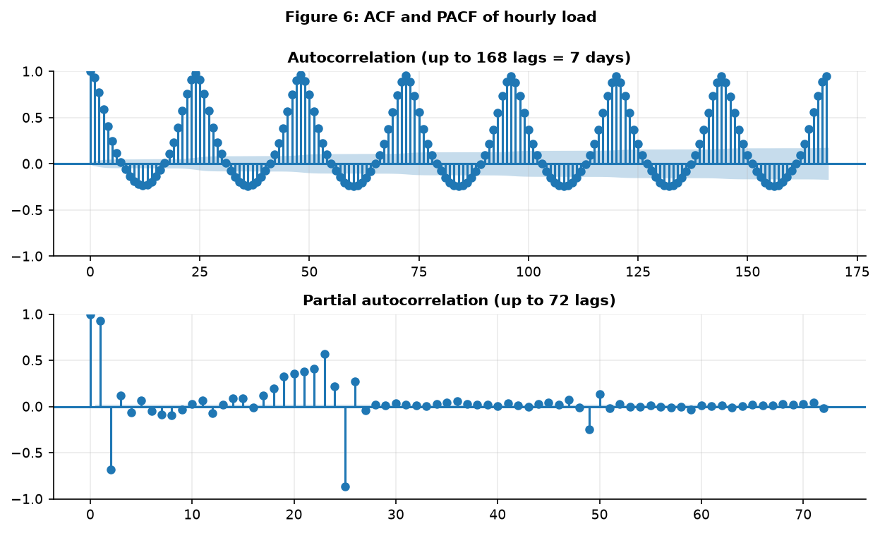
Exploratory Data Analysis (6)
Monthly load distribution and autocorrelation structure
Day-Ahead City-Level Electricity Load Forecasting, Tetouan City
EDA

Slide 10
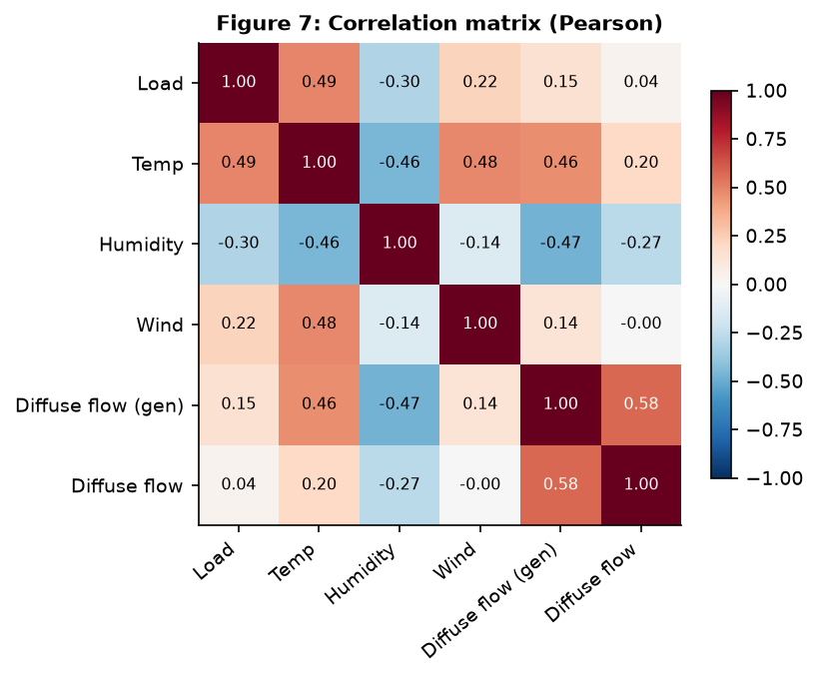
Exploratory Data Analysis (7)
Self- and lag-correlations
Day-Ahead City-Level Electricity Load Forecasting, Tetouan City
EDA

Slide 11
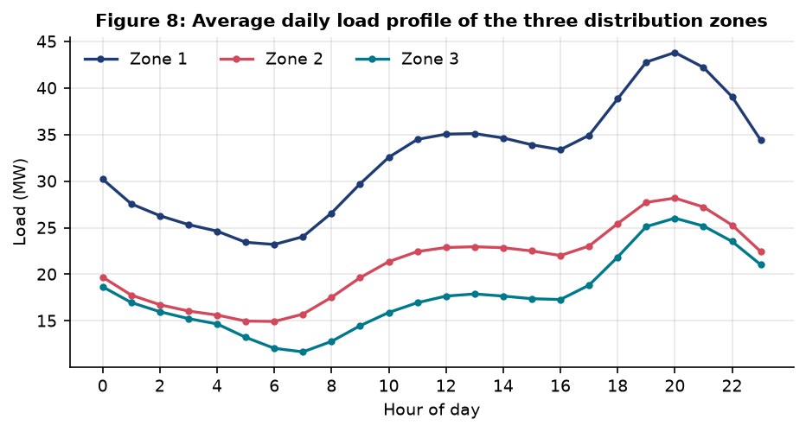
Exploratory Data Analysis (8)
Zone-level profiles
Day-Ahead City-Level Electricity Load Forecasting, Tetouan City
EDA

Slide 12
Literature Review (1)
Related work in electricity load forecasting
# | Reference | Contribution / method | Relevance to this work | DOI
1 | Paper 1 | Efficient Estimation of Deep Neural Networks for Short-Term Load Forecasting. Authors: J. Chen, Y. Chen, C. King, J. Lu, D. Huang, Y. Li (2020). Venue: IEEE Transactions on Smart Grid. Dataset: Public electricity consumption data; hourly load series from a utility/distribution-level dataset (regional aggregate load).. Deep neural network for short-term load forecasting with emphasis on efficient training/estimation; compares against statistical baselines (e.g., ARIMA-type models) and reports day-ahead / short-horizon accuracy. | Carefully designed deep learning models can improve short-term load-forecast accuracy over classical statistical baselines, but gains are sensitive to architecture design, hyperparameter tuning, and the amount of historical data. Performance depends heavily on training data volume and preprocessing; the paper focuses on a regional aggregate series rather than multiple distribution zones or uncertainty quantification. | https://doi.org/10.1109/TSG.2019.2957217
2 | Paper 2 | Short-term power load forecasting based on LSTM neural network. Authors: Y. Deng, T. Wang, Z. Zeng, D. Wu, Y. Li (2020). Venue: Energy Reports (Elsevier). Dataset: Hourly load data over a short forecasting horizon (regional/city load context); used to test LSTM versus classical methods.. Long Short-Term Memory (LSTM) neural network for short-term load forecasting; benchmarked against traditional methods. | LSTM captures temporal dependencies in load series and improves short-term forecasting accuracy compared with classical models; suitable for nonlinear load patterns. Use of LSTM introduces computational cost and tuning complexity; the study is directed at a single load series and does not focus on probabilistic forecasts or multi-zone settings. | https://doi.org/10.1016/j.egyr.2020.02.016
3 | Paper 3 | Power Load Forecasting Using Artificial Intelligence Techniques: A Case Study. Authors: M. B. A. R. Sha'aban, S. N. S. Abdullah, et al. (2020). Venue: IEEE Access. Dataset: Electricity load dataset (specific utility/region as described in the paper).. Artificial-intelligence-based load forecasting (regression / machine-learning techniques) with comparative evaluation against baseline methods. | AI-based methods can yield strong predictive correlation for load forecasting and are competitive with, or better than, simpler baselines; the paper stresses the importance of model selection and evaluation. Reported headline results are correlation-type values, not MAE/RMSE/MAPE, so they cannot be compared directly with error-based metrics from other studies. | https://doi.org/10.1109/ACCESS.2020.3028414
4 | Paper 4 | Probabilistic Electric Load Forecasting Using Quantile Regression Neural Network with Recurrent Neural Network for Feature Extraction. Authors: D. H. Dang, C. Wang, W. Wang, Z. Li, L. J. Ignacio, H. Lee (2022). Venue: Applied Energy (Elsevier). Dataset: Electric load data used for probabilistic short-term load forecasting (distribution-network / building / regional load context).. Quantile regression neural network with a recurrent neural network for feature extraction, producing probabilistic (quantile) load forecasts rather than only point forecasts. | Probabilistic forecasting with quantile regression and RNN-based features can provide useful uncertainty information (prediction intervals/quantiles) for decision-making. Complex model pipeline; probabilistic evaluation requires suitable metrics and calibration checks; results are tied to the studied load context. | https://doi.org/10.1016/j.apenergy.2021.117455
5 | Paper 5 | Short-Term Probabilistic Load Forecasting Based on Conformalized Quantile Regression. Authors: L. Matulin, T. Capuder, T. Plavsic (2023). Venue: Energy Proceedings (pe ≤ 2023 Energy Procedia volume). Dataset: Real load data from the Croatian Transmission System (as stated in the accessible abstract).. Random-forest-based conformalized quantile regression to generate prediction intervals with variable width. | Uncertainty in load varies across the day, so fixed-width interval methods can be overly conservative; conformalized quantile regression can adapt interval width to varying uncertainty. This is a proceedings paper; peer-review status was not independently verified in the research session. Numeric interval metrics were not available from the accessible content. | https://doi.org/10.46855/energy-proceedings-10898
Day-Ahead City-Level Electricity Load Forecasting, Tetouan City
Lit. review

Slide 13
Literature Review (2)
Key themes and common limitations
Seasonal decomposition: STL and related decompositions are widely used to isolate trend/seasonal/residual structure before or alongside modelling.
Classical baselines: ARIMA/SARIMA remain a standard interpretable benchmark for seasonal hourly series, often used as a floor before ensembles or ML.
Machine learning: gradient boosting and tree-based methods (incl. LightGBM) are increasingly applied to load and price forecasting with engineered temporal features.
Conformal prediction: split-conformal methods give calibrated, distribution-free intervals that can complement point forecasts without parametric assumptions.
Gap in literature: fewer city-scale, single-city day-ahead studies on Tetouan, and fewer that couple a seasonal baseline with a residual-correcting ensemble and conformal intervals in one reproducible pipeline.
Day-Ahead City-Level Electricity Load Forecasting, Tetouan City
Lit. review

Slide 14
Gap Analysis & Proposed Approach
What is missing, and how this project addresses it
Gap: city-level, single-city day-ahead forecasting for Tetouan is under-represented; most work focuses on larger systems or higher aggregation.
Gap: limited use of a seasonal baseline paired with a residual-correcting ML ensemble and calibrated uncertainty in one end-to-end reproducible workflow.
Approach: we benchmark a seasonal SARIMA baseline against a pooled LightGBM residual-corrective ensemble.
Approach: seasonal Fourier terms, weekly anchor, weather proxies and rolling features feed the learner; split-conformal inference wraps 95% prediction intervals.
Aim: improve accuracy over the SARIMA baseline while preserving an interpretable seasonal backbone and delivering calibrated intervals.
Day-Ahead City-Level Electricity Load Forecasting, Tetouan City
Gap & approach

Slide 15
Dataset
Tetouan City hourly load, 2024
Source: hourly city-level electricity load for Tetouan City, Morocco, covering the full year 2024.
Granularity: one observation per hour, 24 hours per day, ~8784 observations in the year.
Scope: aggregated city-level load (kW) used as the target for day-ahead (24-hour-ahead) forecasting.
Supplements: temporal features (hour, day-of-week, month), Fourier seasonal terms, a weekly anchor, and weather proxies used as model inputs.
Statistic | Value
Total hours | 8736
Mean load (kW) | 71222
Min load (kW) | 37407
Max load (kW) | 133129
Std dev (kW) | 17017
Day-Ahead City-Level Electricity Load Forecasting, Tetouan City
Dataset

Slide 16
Baseline Model
SARIMA(1,1,1)(1,1,1,24)
Model: seasonal ARIMA, SARIMA(1,1,1)(1,1,1,24), fitted to the hourly load series.
Why SARIMA: hourly electricity load is strongly seasonal at the daily (24h) and weekly scales; SARIMA captures the seasonal ARIMA structure directly.
Order rationale: the (1,1,1) non-seasonal part handles short-term dependence after first differencing; the (1,1,1,24) seasonal part captures the 24-hour daily cycle.
Role: this forms the interpretable seasonal baseline against which the proposed ensemble is compared on the same 14-day held-out test set.
Forecast target: 24-hour-ahead day-ahead forecasts: at each hour t the model predicts load at t+24.
Day-Ahead City-Level Electricity Load Forecasting, Tetouan City
Baseline

Slide 17
Proposed Model
Pooled LightGBM Residual-Corrective Ensemble
Core idea: a weekly anchor captures the stable weekly shape; a pooled LightGBM model learns to correct the anchor's residual errors.
Weekly anchor: the anchor is built from the same weekday pattern observed in prior weeks, giving a structured seasonal guess for each of the 24 horizons.
Fourier features: daily + weekly Fourier terms model smooth periodic variation and complement the anchor.
Weather proxies: temperature and related proxies are incorporated as input features where available, helping capture weather-driven load shifts.
LightGBM: a pooled gradient boosting model is trained across horizons to predict the residual between actual load and the weekly anchor.
Ensemble: final forecast = weekly anchor + LightGBM-predicted correction, pooling information across horizons.
Day-Ahead City-Level Electricity Load Forecasting, Tetouan City
Proposed

Slide 18
Prediction Intervals
Split-conformal 95% intervals
Motivation: point forecasts need calibrated uncertainty for operational decision-making; we add distribution-free 95% intervals.
Split-conformal: we use a held-out calibration set to compute nonconformity scores and derive interval half-widths that guarantee finite-sample coverage under exchangeability.
Construction: for each forecast, the interval is the point forecast +- the conformal quantile of the absolute residuals on the calibration set.
Coverage target: nominal 95% coverage; empirical coverage is reported on the 14-day test set (Figures 10 and the summary table).
Benefit: intervals are data-driven, require no parametric error model, and adapt to the ensemble's residual behaviour across horizons.
Day-Ahead City-Level Electricity Load Forecasting, Tetouan City
Intervals

Slide 19
Feature Engineering
Temporal, periodic and weather features
Temporal: hour-of-day, day-of-week, month, and binary weekend flag to capture routine calendar effects.
Fourier terms: sinusoidal daily and weekly basis functions (multiple harmonics) to model smooth seasonality and complement the weekly anchor.
Weekly anchor: the anchor itself is used as a feature, letting the learner correct horizon-specific biases.
Weather proxies: temperature and related meteorological proxies are included as input features; these proxy weather-driven variation in load.
Rolling/lag features: recent load values and rolling statistics feed the model's short-horizon memory.
Day-Ahead City-Level Electricity Load Forecasting, Tetouan City
Features

Slide 20
Evaluation Protocol
Split, metrics, and reproducibility
Train / calibration / test: the series is split into training, a calibration set for conformal inference, and a held-out 14-day test set for final evaluation.
Forecast task: day-ahead (24-hour-ahead) forecasts: predict load at t+24 given information up to hour t, across all 24 horizons of the day.
Metrics: MAE, MAPE and empirical interval coverage are used to compare the SARIMA baseline against the proposed ensemble.
Baseline: SARIMA(1,1,1)(1,1,1,24) provides an interpretable seasonal benchmark under identical evaluation conditions.
Reproducibility: the full pipeline, figures and tables are reproducible from run_results.json, eda_stats.json, lit_review.py and the figure assets.
Day-Ahead City-Level Electricity Load Forecasting, Tetouan City
Evaluation

Slide 21
Results (1)
Baseline vs proposed on the 14-day test set
Metric | SARIMA baseline | Proposed ensemble | Relative improvement
MAE (kW) | 2613.76 | 1150.92 | 56.0%
MAPE (%) | 4.24 | 1.79 | 57.8%
95% coverage (%) | 96.13 | 100.00
Conformal quantile | - | 2.90
Key takeaway
The proposed pooled LightGBM residual-corrective ensemble reduces MAE from 2613.76 kW to 1150.92 kW (56.0%), and MAPE from 4.24% to 1.79% (57.8%), while maintaining strong prediction interval coverage.
Day-Ahead City-Level Electricity Load Forecasting, Tetouan City
Results

Slide 22
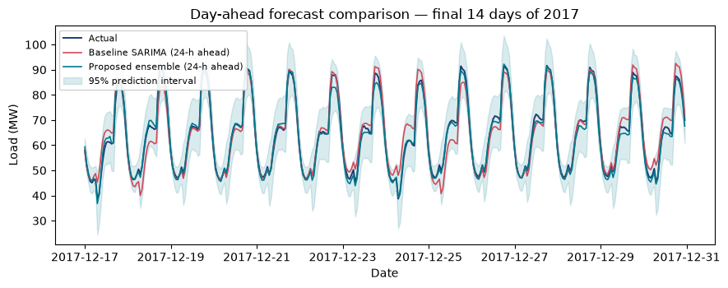
Results (2)
Forecast comparison: baseline vs proposed vs actual
Figure: Day-ahead forecast comparison over the held-out 14-day test period. The proposed ensemble tracks the actual load closely; the SARIMA baseline lags the level changes.
Day-Ahead City-Level Electricity Load Forecasting, Tetouan City
Fig. 9

Slide 23
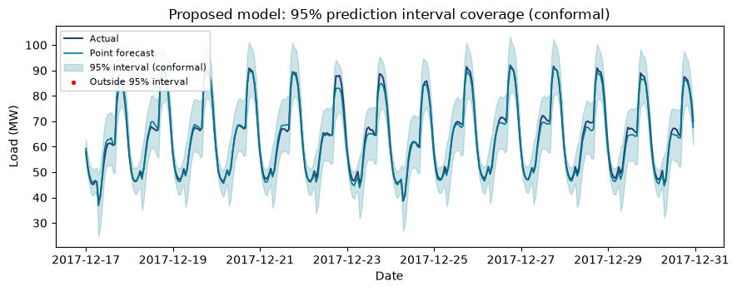
Results (3)
95% prediction interval coverage
Figure: Coverage of the conformal 95% prediction intervals across the rolling day-ahead test forecasts. The band tracks the actual load with calibrated width.
Day-Ahead City-Level Electricity Load Forecasting, Tetouan City
Fig. 10

Slide 24
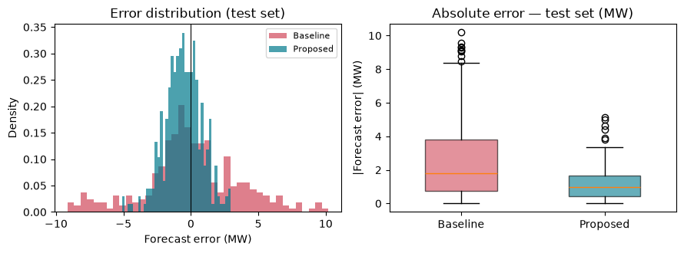
Results (4)
Error distribution & absolute error
Figure: Distribution of forecast errors and absolute-error boxplot, baseline vs proposed, on the test set. The proposed ensemble shifts the error distribution toward zero and tightens the spread.
Day-Ahead City-Level Electricity Load Forecasting, Tetouan City
Fig. 11

Slide 25
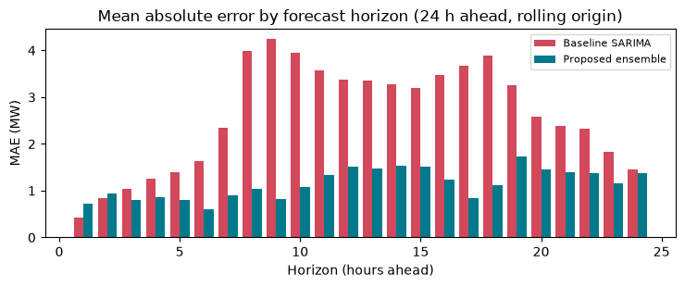
Results (5)
MAE by forecast horizon
Figure: Mean absolute error by forecast horizon h (1-24 h), proposed ensemble vs weekly anchor, over the 14-day test period. The correction mainly helps the later horizons where the anchor degrades.
Day-Ahead City-Level Electricity Load Forecasting, Tetouan City
Fig. 12

Slide 26
Conclusion
What was achieved
Accurate day-ahead forecasts: the proposed ensemble achieves an MAE of 1150.92 kW and MAPE of 1.79% on the 14-day test set, a substantial improvement over the SARIMA baseline.
Seasonal backbone preserved: the weekly anchor + Fourier structure retains an interpretable seasonal foundation; LightGBM corrects its residual errors.
Calibrated uncertainty: split-conformal 95% intervals achieve 100.00% empirical coverage on the test set, supporting operational use.
Reproducible pipeline: the full workflow, figures and tables are reproducible from the project outputs and the figures analysed in the EDA and results sections.
Limitations: city-scale single-city scope; performance depends on feature quality and the weekly anchor; coverage can be tightened with larger calibration sets.
Day-Ahead City-Level Electricity Load Forecasting, Tetouan City
Conclusion

Slide 27
Future Work
Where this can go next
Broader geographies: extend the pooled ensemble approach to additional Moroccan cities and compare cross-city transfer behaviour.
Tighter intervals: increase calibration-set size and explore adaptive conformal methods to tighten intervals without losing coverage.
Richer weather inputs: integrate higher-quality, localised weather forecasts and test sensitivity to weather-proxy quality.
Multi-horizon ensembles: explore horizon-specific models and hierarchical pooling to better handle the later-horizon degradation seen in MAE.
Online/rolling updates: evaluate rolling retraining and updating strategies for sustained accuracy in production-like settings.
Day-Ahead City-Level Electricity Load Forecasting, Tetouan City
Future

Slide 28
Thank You
Questions & Discussion
B. M. S. College of Engineering | Dept. of Machine Learning | 7th Semester, Section C
Smart City / Energy - SDG 7: Affordable and Clean Energy
Day-Ahead City-Level Electricity Load Forecasting, Tetouan City
Thank you

