Slide 1
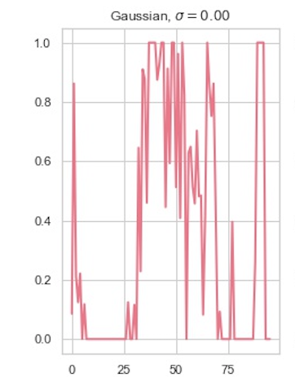
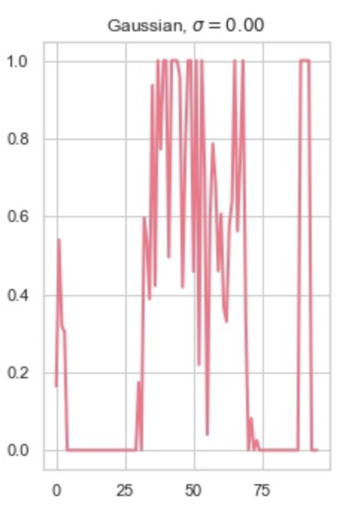
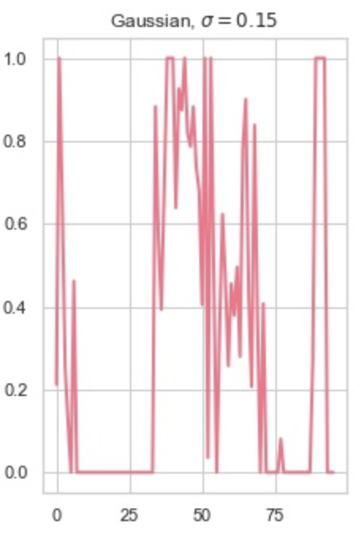
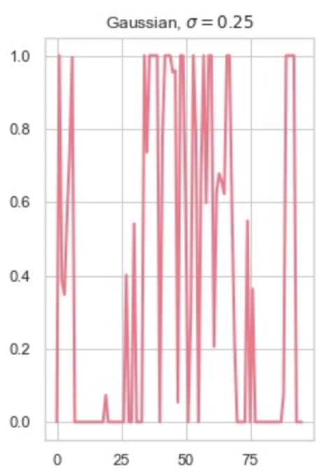
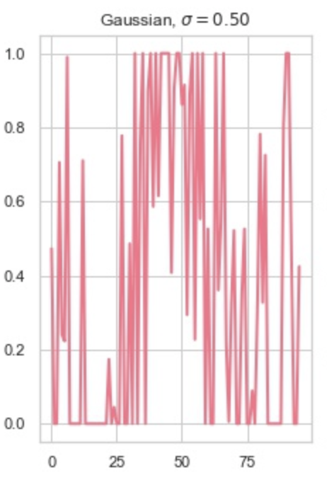
Randomized Smoothing
Original Label: 1
Generate Noisy Copies of X
1
Custom Trained Classifier
0
Output Label:1
Majority Rules
1
Input Data : X
Certified Radius
1

Slide 2
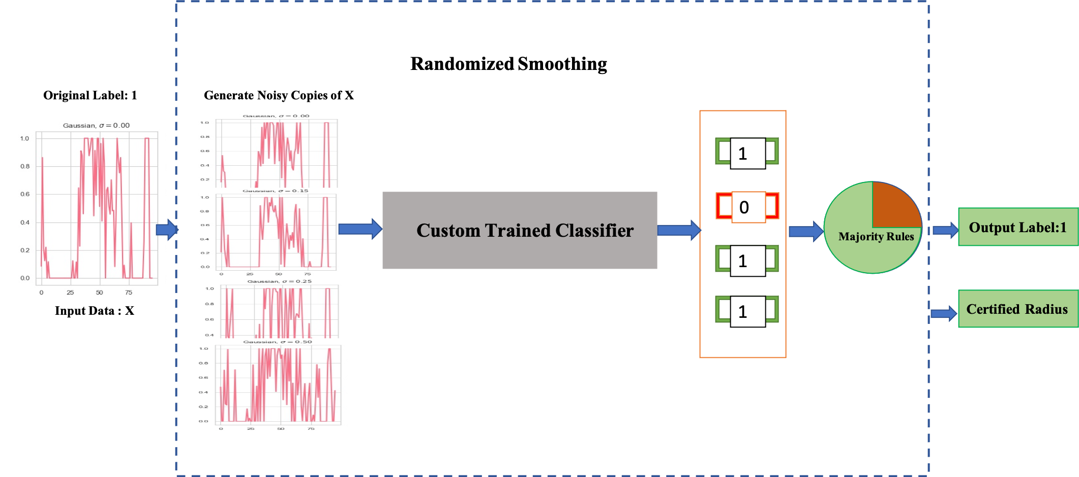
Ford A
L₂ Radius | .25 | .5 | .75 | 1.0
Certified Accuracy | 56 (91.6:Original accuracy) | 5 | 15 | 13
Certify radius for Ford A: 0.25 (l2)

Slide 3
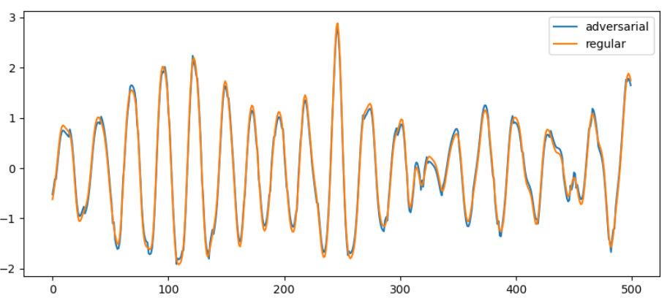
PGD attack on Ford-A dataset

Slide 4
