Slide 1



Nova Workshop
06/04/2026

Slide 2
What is a Cluster?
High-Performance Computing (HPC) Cluster:
Networked group of computers (nodes) pooling processing power and memory
Used for calculations too large, slow, memory intensive for a local computer
Shared hardware for many users
Access Controlled via login node

Slide 3
Local vs. Cluster Nodes
Local
Cluster
Good for:
Editing files
Making plots
Very cheap calculations
Drawbacks:
Limited CPU core
Limited Memory
Not suggesting for most calculations
Good for:
Long and expensive calculations
Many CPUs/GPUs available
Drawbacks:
Requires login ID
Requires resource management
Powerful, but has learning curve

Slide 4
Cluster: Home vs. Work Directories
Home
Work
This is the login node:
/home/<UserID>
Has same restrictions as Local
Little memory, not for calculations
Important:
Login nodes are a shared resource
Limited Memory
Do NOT run calculations in home directory
Work directory accesses compute nodes:
/work/simcodes/<UserID>
For calculations
Plenty of CPUs/GPUs, plenty of memory
Important:
This is where you run calculations

Slide 5
Before Login
Required:
Nova username (NetID)
Cluster address (nova.its.iastate.edu)
Password
MFA access (Authenticator/Duo)

Slide 6

Nova OnDemand
Provides access to a command line session
Access to full graphical Linux desktop
All within the web browser https://nova-ondemand.its.iastate.edu

Slide 7

Nova OnDemand
First Time Login:
https://research.it.iastate.edu/accessing-clusters#with-ssh

Slide 8
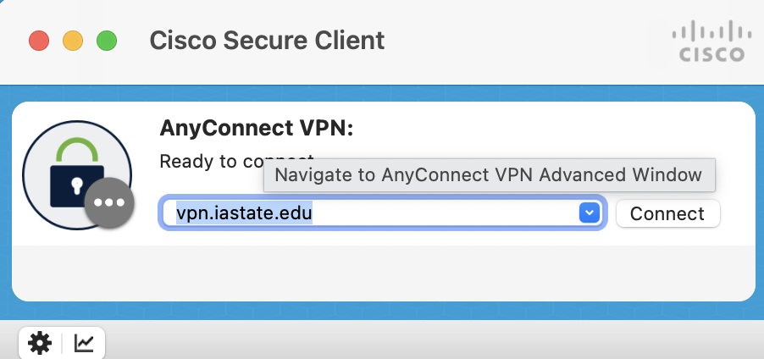
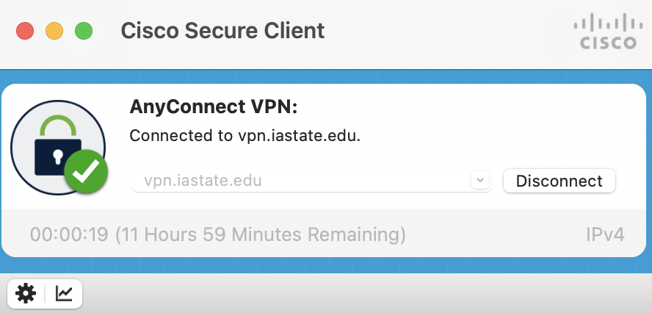

VPN to IASTATE via Cisco AnyConnect
If off campus, login to the university VPN to access Nova

Slide 9
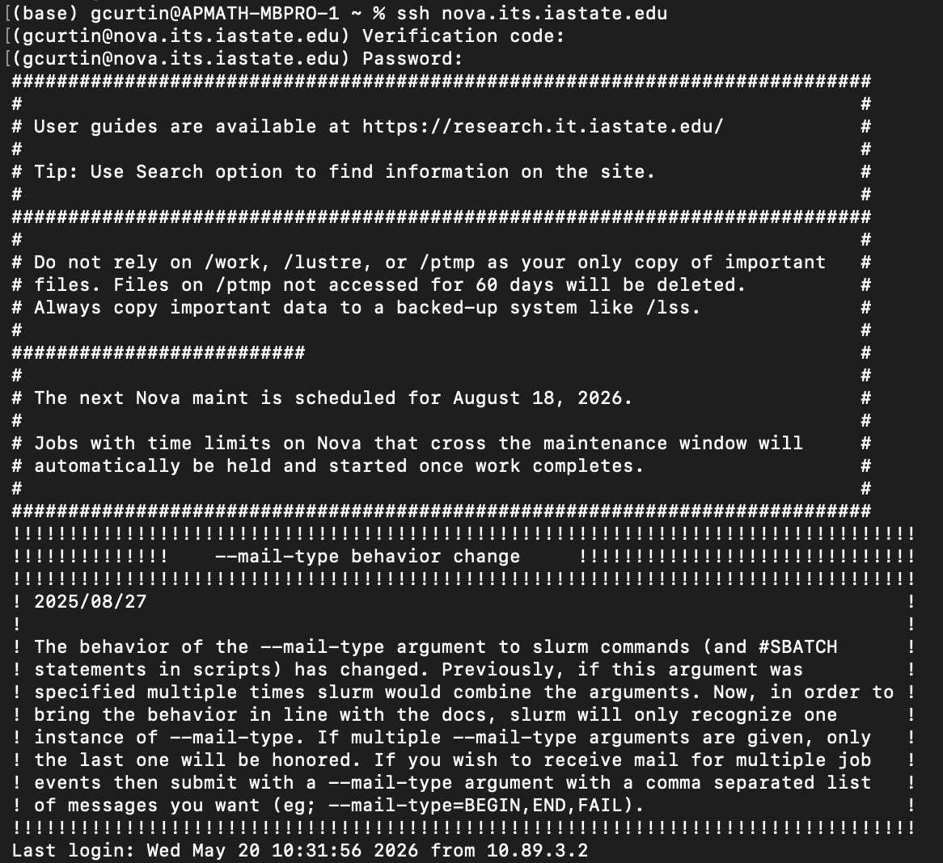
1. Logging in MacOS
Open terminal
Type: ssh username@cluster.address.edu
Type MFA code into Verification code
Type password into Password
First login may have additional questions
Authenticity of host (answer: yes)

Slide 10
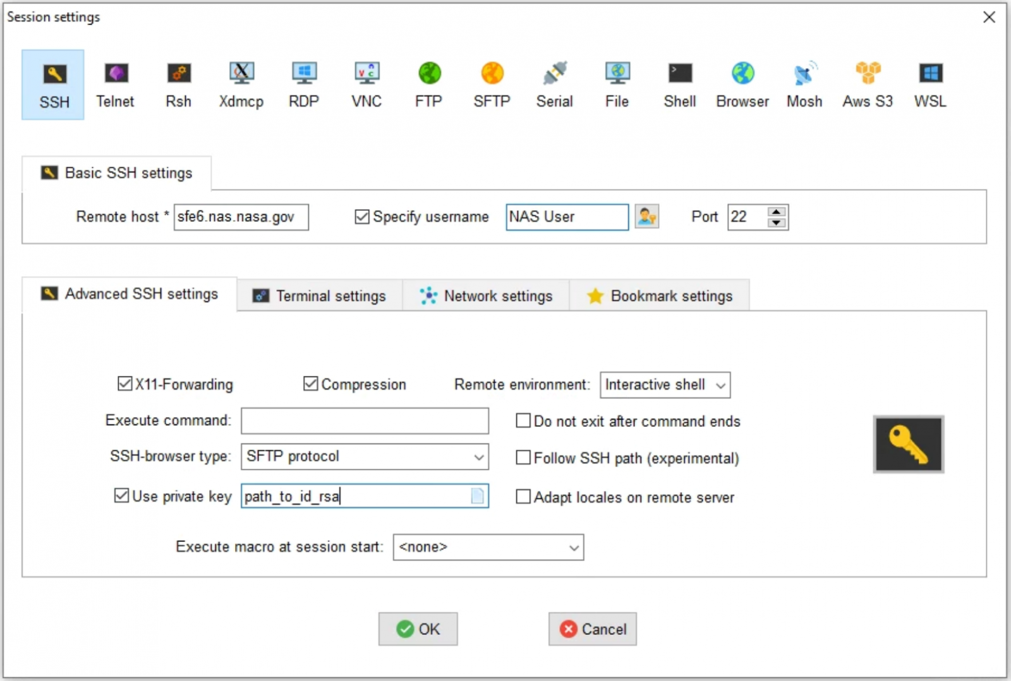
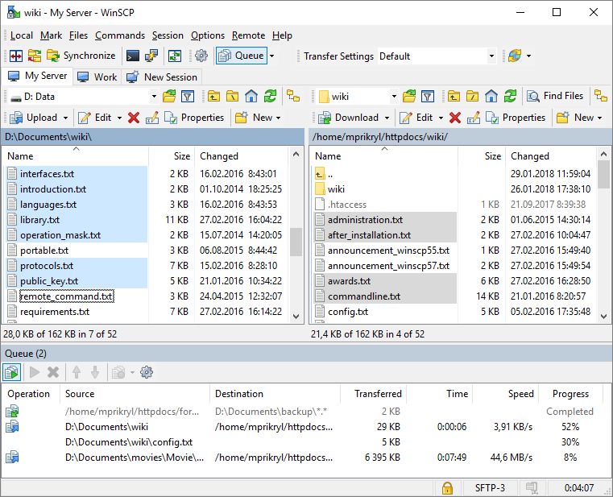
1. Logging in WindowOS
More Complicated (requires remote manager)
Recommended: MobaXterm
Alternative: PuTTY/Bitvise + winscp

Slide 11
Overview: Running a Calculation
Login via SSH (Secure Shell)
Change directory to /work directory
Upload/Create input files
Upload/Create submission script
Submit Job
Monitor Job
Check output
Data processing

Slide 12
Command Line Basics
pwd: print current working directory (cwd)
ls: list files (ls –lh to list detailed version)
cd: change directory (<folder_name>, .., ../<folder_name>)
. means current directory
.. means parent directory
~ means your home directory
mkdir: make directory
clear: clear screen
Note:
Avoid spaces in file names
Opt for underscore instead (folder_name)

Slide 13

Paths: Setting Up Your Work Directory
Start:
cd /work/simcodes
pwd
/work/simcodes
Make your personal directory:
mkdir <UserID>
cd <UserID>
pwd
/work/simcodes/<UserID>
Good habits for file management:
One project, one folder
One folder per calculation
Keep input, submission script, and output together in the same directory

Slide 14
Making Directories, Moving Files
cp old.inp new.inp: copy contents of old.inp into new.inp
mv old new: move/rename old into new
rm file.txt: remove file.txt
rm –r folder_name: remove folder_name
Note: There is no storage for removed files
Once its removed, its lost completely
Glob to batch files:
ls *.out: list all .out files in directory
rm –r *.out: list all .out files in directory

Slide 15
Moving Files Continued: From local to cluster and back
Local to cluster:
scp input.inp username@cluster.address.edu:/path/to/remote/folder/
Cluster to local:
scp username@cluster.address.edu:/path/to/remote/output.out .
Notes:
Run scp from your local terminal
Alternative SCP file transfer (WindowsOS)
Filezilla for MacOS

Slide 16
scp vs rsync file transfer
scp: move selected files on a one-time basis
rsync: moving files are folders recursively -- sync local+cluster
Local to cluster:
rsync -avz my_folder/ username@cluster.address.edu:/path/to/remote/my_folder/
Cluster to local:
rsync -avz username@cluster.address.edu:/path/to/remote/my_folder/ ./my_folder/
Be very careful with trailing slashes:
folder/ copies the contents
folder copies the folder itself

Slide 17
Search/View File Contents
Print whole file:
cat file.txt
Page through a file
less file.txt
Show start/end of file
head file.txt
tail file.txt
Search a word:
grep error output.out
grep -i error output.out (case insensitive)
Search Recursively
grep -R -i "terminated normally" .

Slide 18
vi Editor
Common in-terminal editors:
Nano, vi/vim, emacs
vi Cheatsheet:
Open/make file
vi input.inp
Insert/Edit mode
i
Esc back to normal mode
Quit and Save:
:wq
Search
/<word>

Slide 19

SLURM Job Scheduler
Decides:
Job order on Queue (shared resource)
Which compute node to run on
Based on:
CPU/GPU and memory requirements
Wall time requirements
Consistent way to run calculations
Benefits you and other users

Slide 20
Job Script
#!/bin/bash
#SBATCH --job-name=test
#SBATCH --nodes=1
#SBATCH --cpus-per-task=8
#SBATCH --time=01:00:00
#SBATCH --partition=nova
#SBATCH --output=slurm-%j.out
hostname
date
echo "Job started"
program input.inp > output.out
echo "Job finished"
date
Number of CPU/GPU nodes (Pick 1 unless directed otherwise)
Wall time requested max (scale to size of calculation)
Queue (interactive, scavenger, and nova)
Actual task/job submitted

Slide 21
Modules and Environments
Conda Environments
Modules
Software might not be available in default environment
HPCs use environment modules
See all modules:
module avail
Load software:
module load <program_name>
ml <program_name>
Check loaded modules
module list
Build from custom environments
GitHub, built environments, etc.
Activate environment
conda activate <env_name>
Common mistake:
Job fails in SLURM because the environment was not activated in the job script

Slide 22
Submit via SLURM, Check Queue, Canceling Jobs.
Submit a job to slurm
sbatch job.sh Expected output: Submitted batch job 123456
Check jobs
squeue -u <UserID>
Canceling Jobs
scancel <jobID>
scancel –u <UserID>
Checking finished jobs
sacct -j jobid --format=JobID,JobName,State,Elapsed,MaxRSS,ExitCode

Slide 23
Have a Look at a Researcher’s Directories

Slide 24
Try This!
From the work directory:
Create a folder called cluster_practice and move into it
Create a file called hello.sh.
Add this script:
#!/bin/bash
echo "Hello from the Cluster"
hostname
date
Check the file contents, make it executable (chmod +x hello.sh), then try to run it. (./hello.sh)
Bonus: Turn it into a SLURM script at submit it that way. View the output file.

Slide 25


