Slide 1
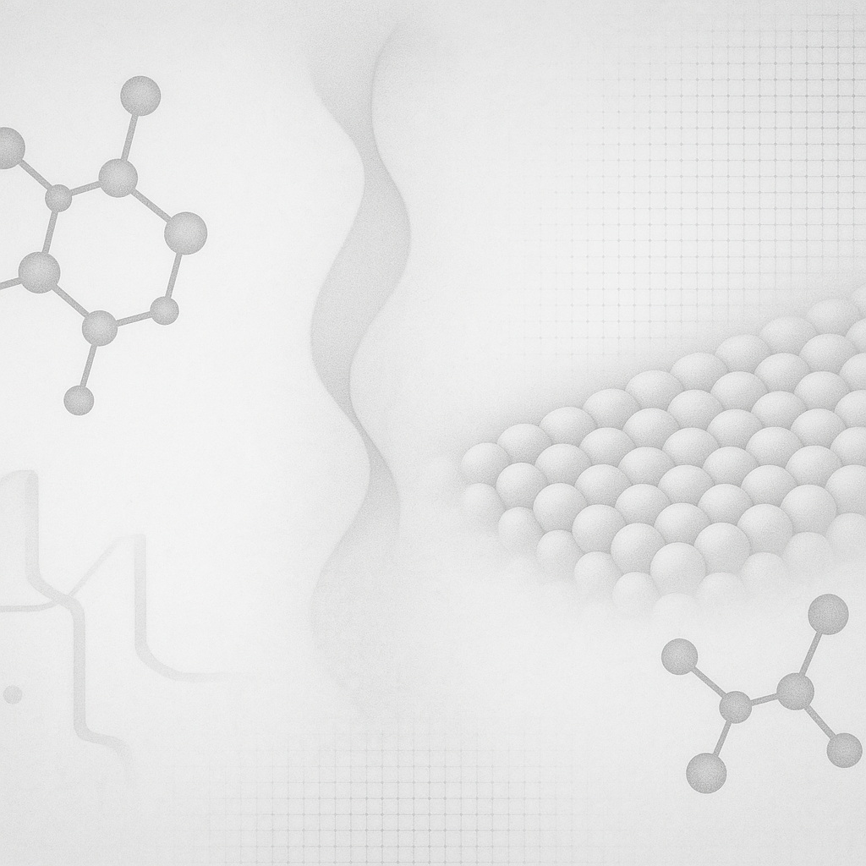


Quantum Chemistry
06/05/2026

Slide 2
What is Computational Chemistry
Branch of chemistry using computer simulations/mathematical algorithms
Calculation of molecular structure, energies, reaction pathways, etc.
Every calculation is a model
Every model has assumptions
Structure, charge, multiplicity, method, basis-set, solvent, temperature, etc.
Goal of lecture:
Give students a baseline understanding of quantum mechanics calculations

Slide 3
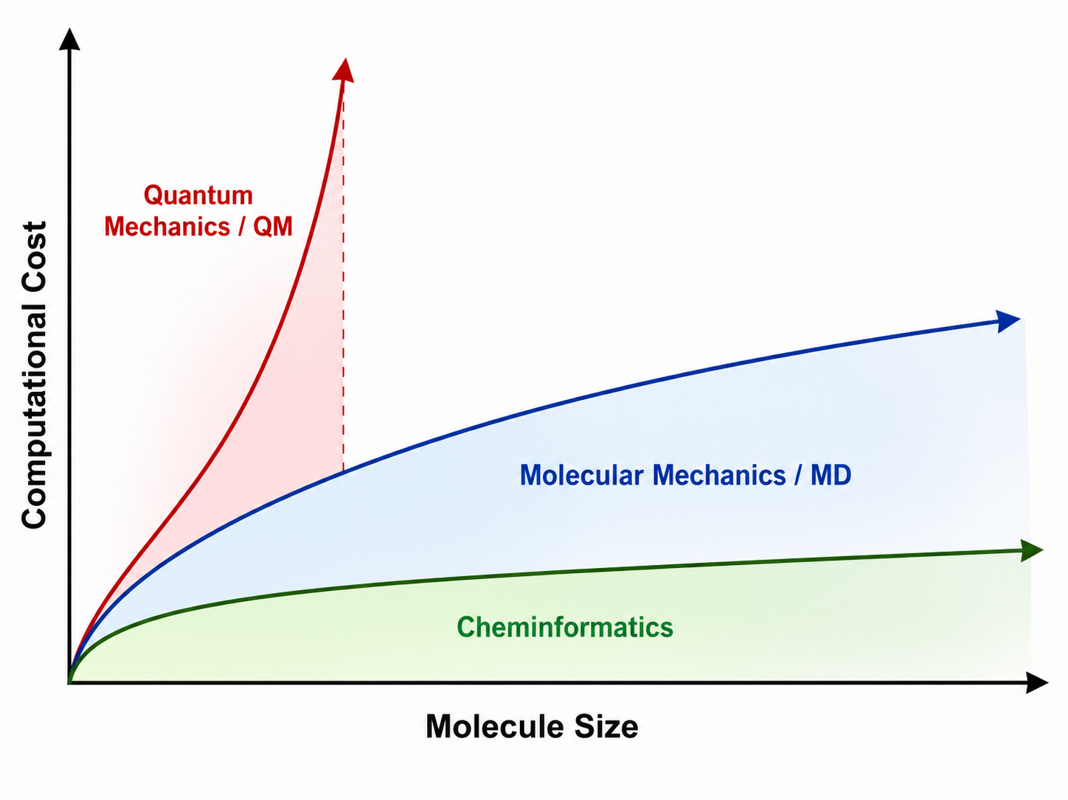
Modeling Options/Scaling
Modeling Methods:
Cheminformatics:
Molecular Graphs, descriptors, databases
Quick screening of molecules
Molecular Mechanics/Dynamics:
Ball-and-spring model
For large systems
Cannot describe electronic structure
Ex. Bond forming/breaking
Quantum Mechanics/Dynamics
Models electronic structure
Bonding, spectroscopy, reactions, charge transfer, etc.
More chemically detailed approximations
More expensive

Slide 4
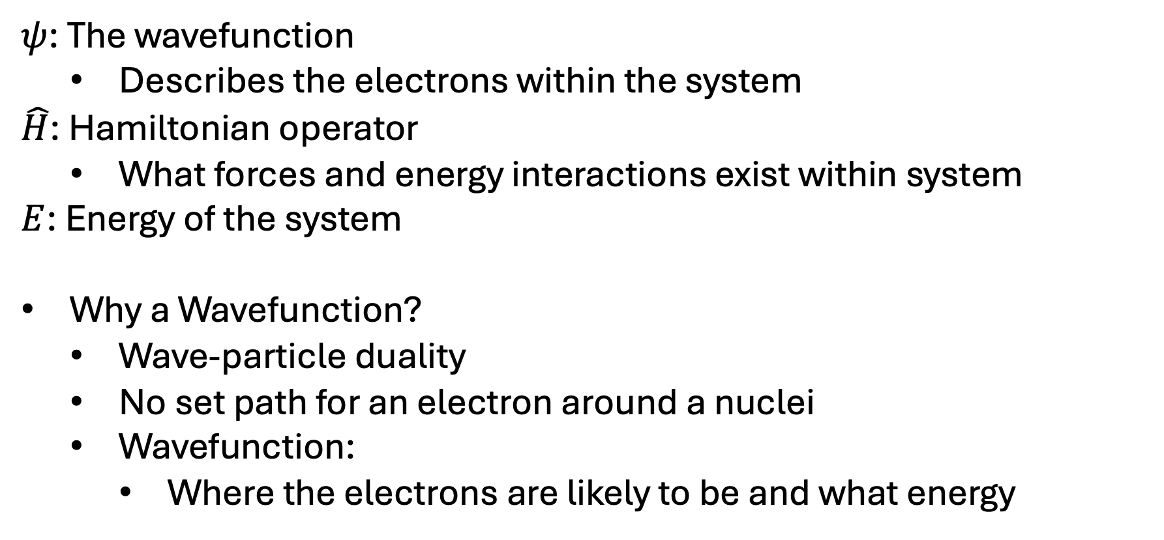
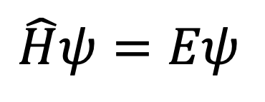
Schrödinger's Equation
$$\hat{H}ψ=Eψ$$
$ψ$: The wavefunction
Describes the electrons within the system
$\hat{H}$: Hamiltonian operator
What forces and energy interactions exist within system
$E$: Energy of the system
Why a Wavefunction?
Wave-particle duality
No set path for an electron around a nuclei
Wavefunction:
Where the electrons are likely to be and what energy

Slide 5
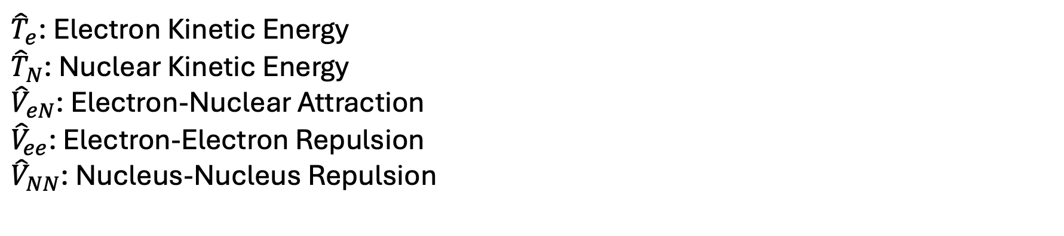
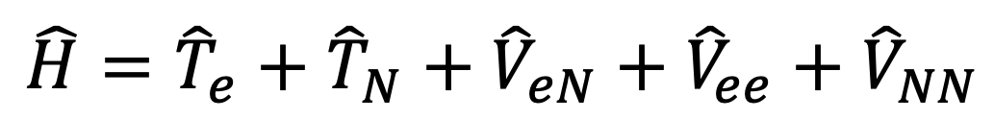
Hamiltonian Operator
$$\hat{H}={\hat{T}}_{e}+{\hat{T}}_{N}+{\hat{V}}_{eN}+{\hat{V}}_{ee}+{\hat{V}}_{NN}$$
${\hat{T}}_{e}$: Electron Kinetic Energy
${\hat{T}}_{N}$: Nuclear Kinetic Energy
${\hat{V}}_{eN}$: Electron-Nuclear Attraction
${\hat{V}}_{ee}$: Electron-Electron Repulsion
${\hat{V}}_{NN}$: Nucleus-Nucleus Repulsion

Slide 6
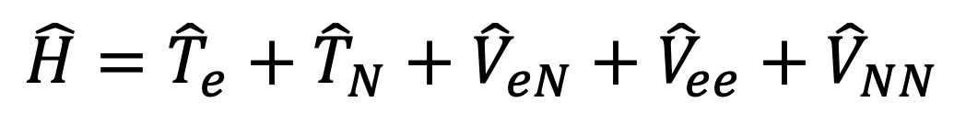
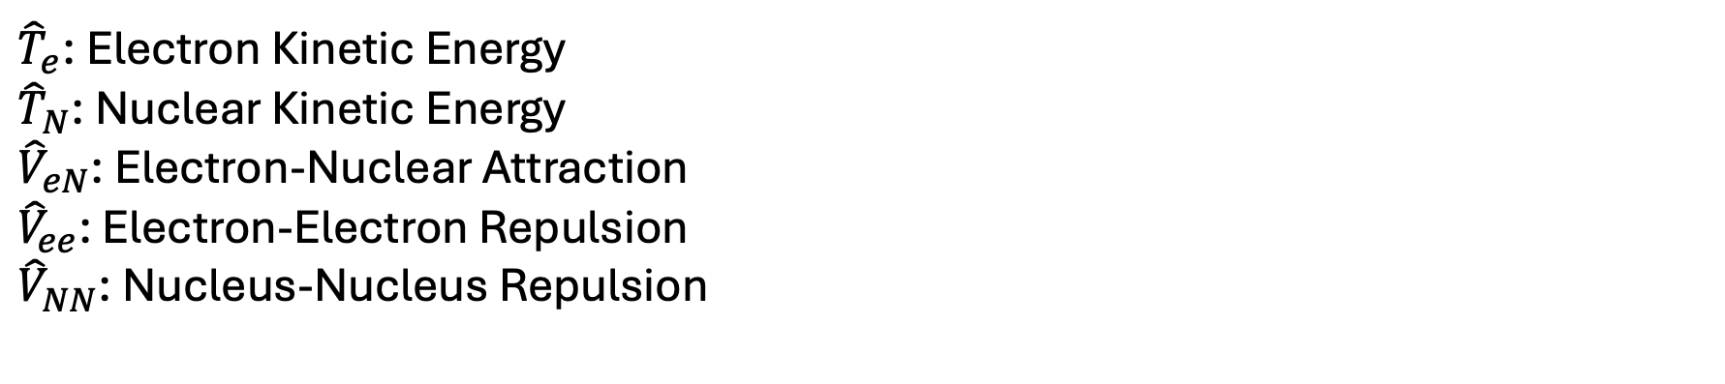
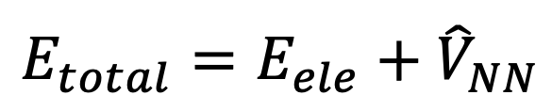
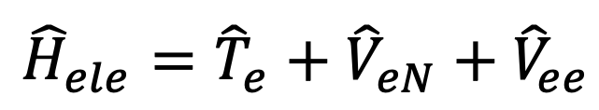
Born-Oppenheimer Approximation
Nuclei are ~1800x Heavier than electrons: Treat nuclei as fixed
$$\hat{H}={\hat{T}}_{e}+{\hat{T}}_{N}+{\hat{V}}_{eN}+{\hat{V}}_{ee}+{\hat{V}}_{NN}$$
0
Constant
${\hat{T}}_{e}$: Electron Kinetic Energy
${\hat{T}}_{N}$: Nuclear Kinetic Energy
${\hat{V}}_{eN}$: Electron-Nuclear Attraction
${\hat{V}}_{ee}$: Electron-Electron Repulsion
${\hat{V}}_{NN}$: Nucleus-Nucleus Repulsion
$${\hat{H}}_{ele}={\hat{T}}_{e}+{\hat{V}}_{eN}+{\hat{V}}_{ee}$$
$$E_{total}=E_{ele}+{\hat{V}}_{NN}$$

Slide 7
Quantum Mechanics Methods: Hartree-Fock (HF)
Foundational ab initio QM approach
Mean-Field approximation:
Electron interactions as a static average field of all other electrons
Variational Principle:
Restricts wavefunction to a single Slater determinant
“What set of molecular orbitals gives the lowest possible energy for this single-determinant model?”
Self-Consistent Field (SCF):
Guess/Receive initial set of orbitals
Calculate potential energy
Solve for new set of orbitals
Repeat process until orbitals/energy is converged (unchanging)
Not usually accurate enough for final models (missing electron correlation term)

Slide 8
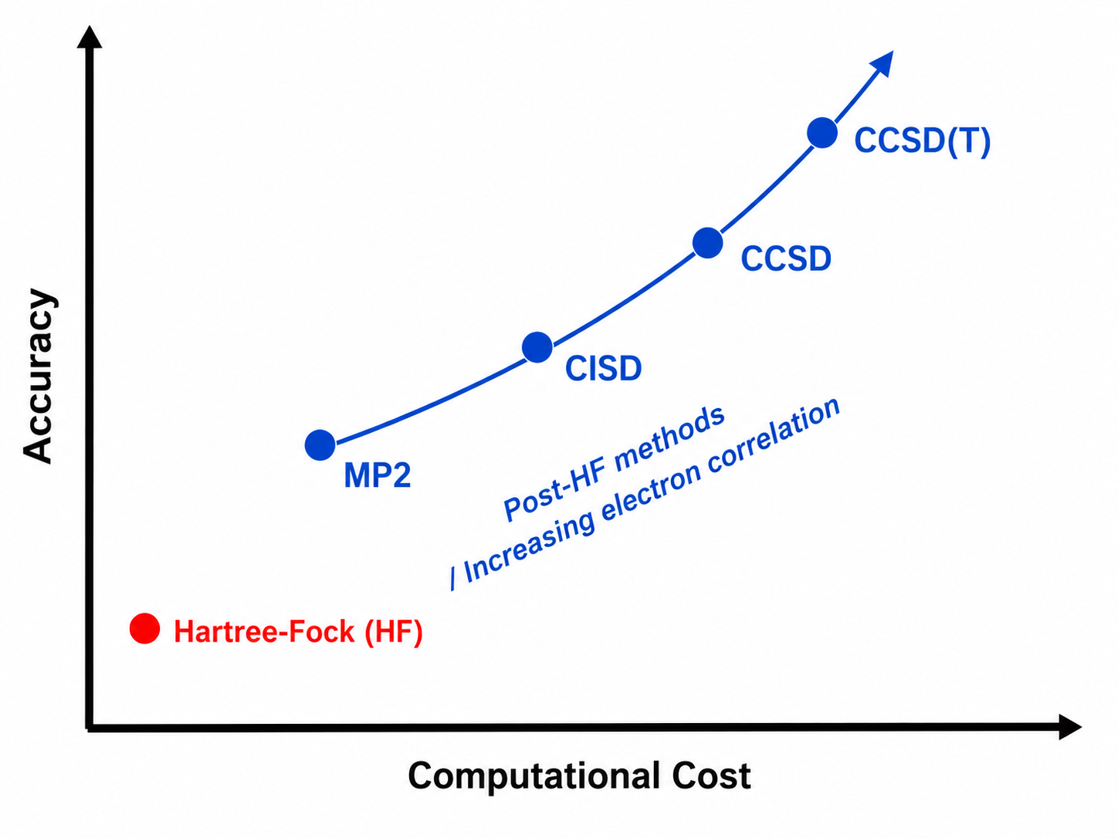
Quantum Mechanics Methods: Post-HF (ab initio)
Advanced methods built from HF
Electron Correlation terms added to HF
Electron motions are NOT independent, motions are linked
Adding Correlation term Provides:
Better relative energies, reaction energies, better described weak interactions (H-bonding), etc.
More accurate, but more expensive
MP2, CC, CI, CASSCF, etc

Slide 9
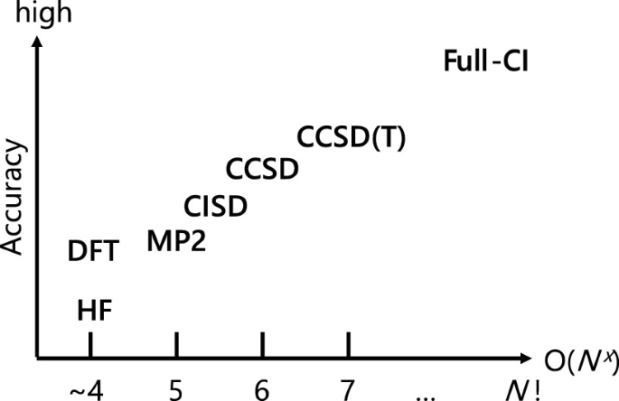
Quantum Mechanics Methods: Density Functional Theory (DFT)
HF/Post-HF methods solve Schrodinger equation
Cost scales exponentially with # of electrons
Density Functional Theory
Utilizing Electron density to describe system as a probability an electron at any point in space
Balance between accuracy and cost
Additional Considerations:
Functionals
Different functional, different approximation
Nakata, A., Morikawa, Y. (2024). Density Functional Theory Calculations for Materials with Complex Structures. In: Hayashi, K. (eds) Hyperordered Structures in Materials. The Materials Research Society Series. Springer, Singapore.

Slide 10
Model Chemistry: Basis Sets
Toolkit used to approximate/describe orbitals
Smaller basis-set:
Faster, less flexible orbital description, less accurate
Larger basis-set:
More flexible orbital description, more accurate, slower
Polarization functions:
Allow orbitals to distort, hybridize during bonding
Important for reaction chemistry/bonding
Diffuse functions:
Allow electron density to spread outwards
Important to weak interactions, long-range effects, excited states, etc.

Slide 11
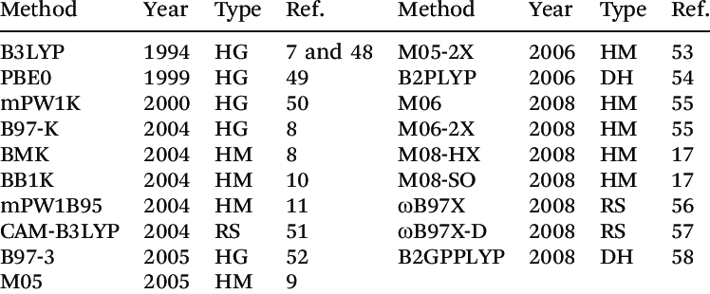
Model Chemistry: Basis Sets and Density Functionals
Basis-set family | Example basis set
Minimal basis sets | STO-3G
Pople basis sets | 6-31G(d)
Ahlrichs/Karlsruhe basis sets | def2-TZVP
Dunning correlation-consistent basis sets | cc-pVDZ
Sapporo basis sets | Sapporo-DZP
Effective core potential basis sets | LANL2DZ
Phys. Chem. Chem. Phys., 2014,16, 26769-26778

Slide 12
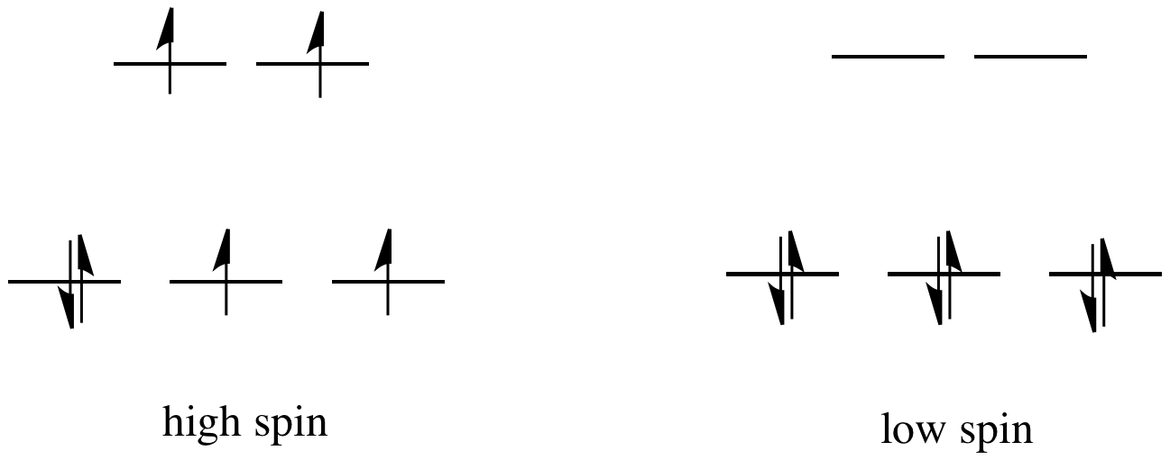
Charge and Multiplicity
Charge: Net molecular charge determines total number of electrons
Multiplicity: How many unpaired electrons are there.
Always important, Especially for:
Metal complexes and radicals
Ex. d⁶ transition metal (Fe²⁺, Co³⁺, etc)

Slide 13
Effective Core Potentials (ECPs)
All-Electron model
ECP model
Valence e⁻
Valence e⁻
Core e⁻
Core ECP
All-electron models treat core and valence electrons (e⁻) equally
ECPs replace core e⁻ with a potential (approximation)
ECPs focus on the Valence e⁻
Reduces computational cost of heavier atoms (ex. metals)

Slide 14
Solvent Effects: Explicit Vs. Implicit Solvation
Gas Phase
Explicit Solvation
Implicit Solvation
Simplest model: Gas Phase/ Vacuum
Chemistry not often in vacuum
Solvent can affect: Geometry, charge distribution, energy barriers, spectra, binding energies, etc.
Explicit Solvent: Includes solvent molecules
Good for hydrogen bonding, coordination
Expensive

Slide 15
Solvent Effects: Explicit Vs. Implicit Solvation
Gas Phase
Explicit Solvation
Implicit Solvation
Simplest model: Gas Phase/ Vacuum
Chemistry not often in vacuum
Solvent can affect: Geometry, charge distribution, energy barriers, spectra, binding energies, etc.
Implicit Solvent: Treat solvent as a continuous medium (PCM, SMD)
Captures bulk solvent effects
Inexpensive

Slide 16
Potential Energy Surface Model
Potential Energy Surface (PES):
Ground State PES (S₀)
Energy changes as a function of geometry
Minima: energy wells
Global vs. Local Minima
Transition State (TS):
Maxima between two minima
Example is a 2D PES
Molecules have 3N-6 Dimensionality
N = # of atoms
S₀
TS
Global
Min.
Local
Min.

Slide 17
Single Point Energy Calculation
Computes energy at fixed geometry
Answers:
“What is the energy at this exact molecular conformation”
Comparatively cheap
Molecules have 3N-6 Dimensionality
Increase N
Increased dimensionality
Increased # of conformers
S₀
Structure #2
Structure #1
Structure #3

Slide 18
Geometry Optimization, Energy Minimzation
Change Molecular Conformation to achieve lower energies
Descend shape of PES
Stop when optimization reaches an energy minimum
Finds a minimum energy
Global Minimum not guarenteed
S₀
Structure #2
Structure #1
Structure #3
Local
Min.
Global
Min.

Slide 19
Frequency/Hessian Calculations
Compute vibrational frequencies
Second derivatives of molecular energy with respect to atomic coordinates
Builds a Hessian matrix
Curvature of the PES
“If I move atoms, what happens to energy?”
From minima: raise energy
From TS: 1 mode lowers energy
Other modes raise energy
Imaginary frequencies: Negative values
0 imaginary freqs: Minimum
1 imaginary freq: TS
>1 imaginary freqs: Neither Min or TS
TS
1 Imaginary Freqs
>1 Imaginary Freqs
Min.
0 Imaginary Freqs
Min.
0 Imaginary Freqs

Slide 20
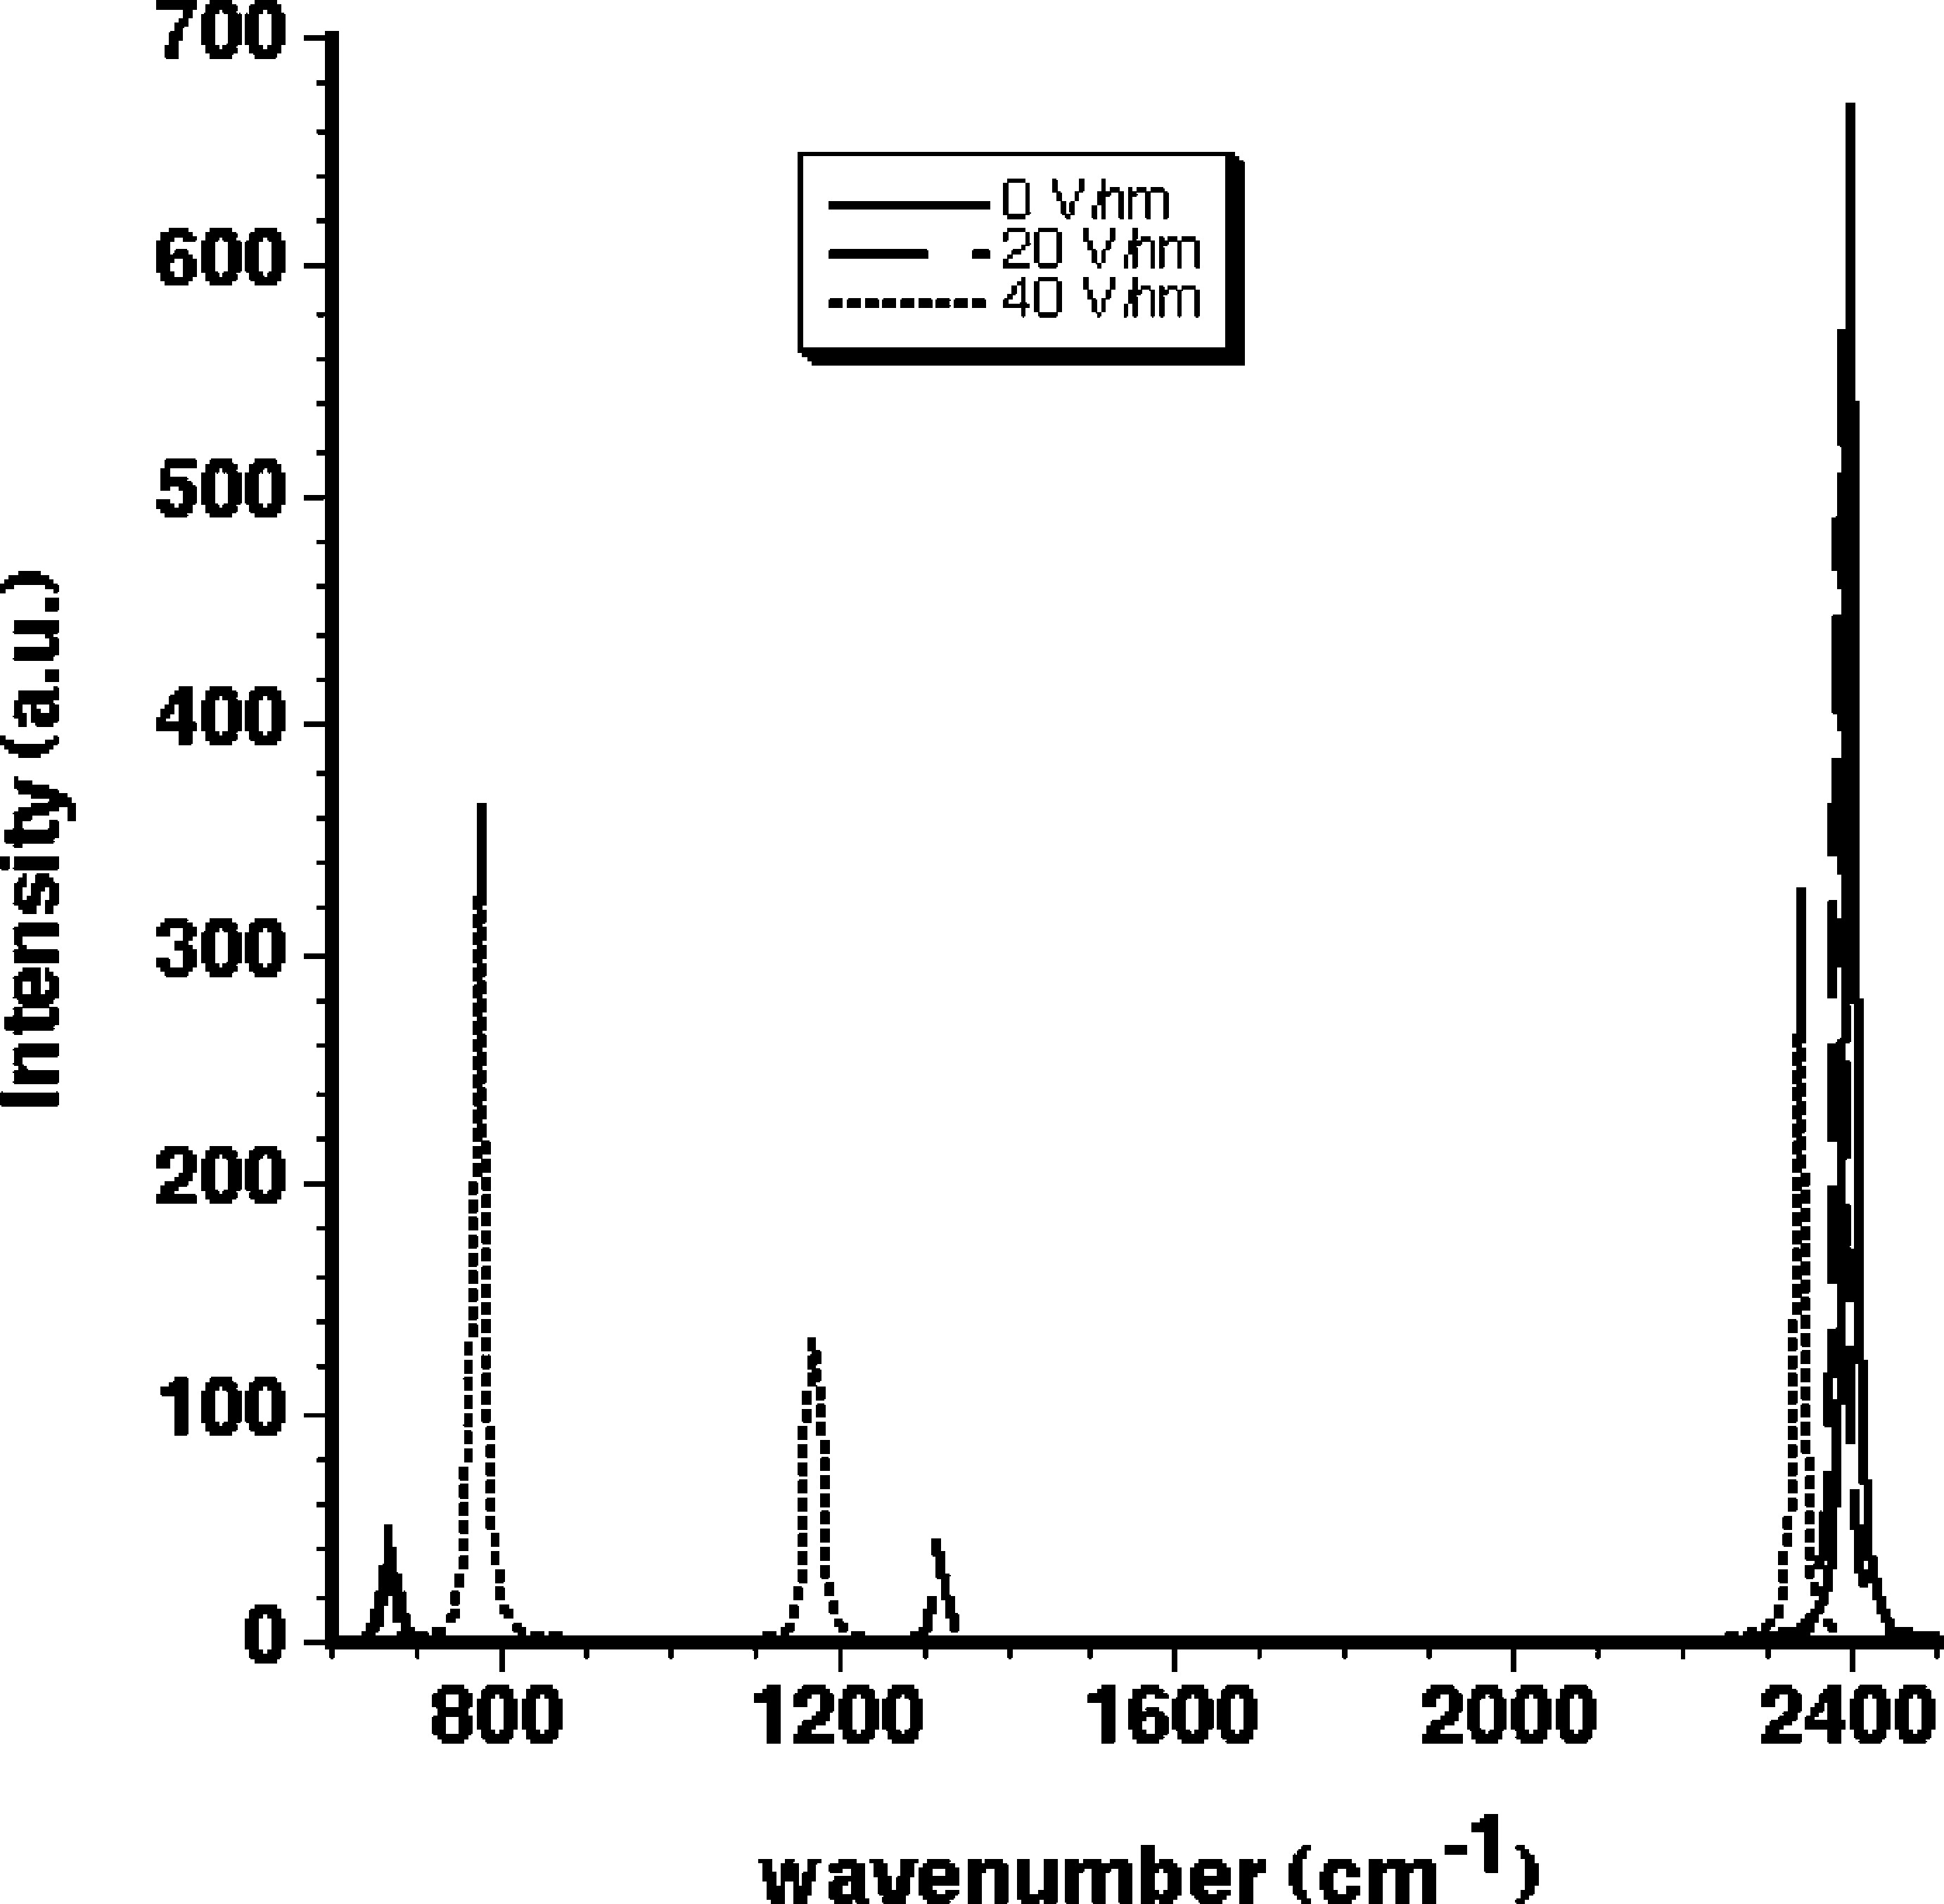
Frequency/Hessian Calculations
Compute vibrational frequencies
Compute molecules normal modes of vibration
Stretches
Bending
Torsion
Linear combination of motions
Approximate IR spectra
Changes with vibrational change in dipole moment
J. Phys. Chem. Lett. 2010, 1, 22, 3256-3260

Slide 21
Thermochemistry
“What can be obtained through frequencies?”
Zero-point energy:
Lowest energy a QM system can possess
Even a 0 K, there is quantum mechanical vibration
Thermal Corrections:
Temperature-dependent corrections to energy
Entropy (S), Enthalpy (H), Gibbs Free Energy (G)
Compare
reactions,
isomers,
binding

Slide 22
Chemical Model
Metal states and spin treatment
Protonation and pH
Metal | d count | Spin/Multiplicity | Notes
Co²⁺ | d7 | quartet | High spin with peptide donors
Ni²⁺ | d8 | Triplet or singlet | Octahedral/tetrahedral (triplet); square planer (singlet)
Cu²⁺ | d9 | doublet | Jahn-Teller distortion
Zn²⁺ | d10 | singlet | Closed-shell
Near-neutral pH
Peptide protonation assigned accordingly
No explicit counter ions (yet)
Binding reaction
Solvation
$${\left[M{\left(H_{2}O\right)}_{6}\right]}^{2+}+{\left[L\right]}^{Z−}⟺M\left[L\right]{{\left[H_{2}O\right]}_{Y}^{\left(2−Z\right)}}_{}+XH_{2}O$$
Explicit water for the coordination sphere
PCM for implicit solvation
Y depends on how much of the coordination sphere is occupied by the peptide

Slide 23
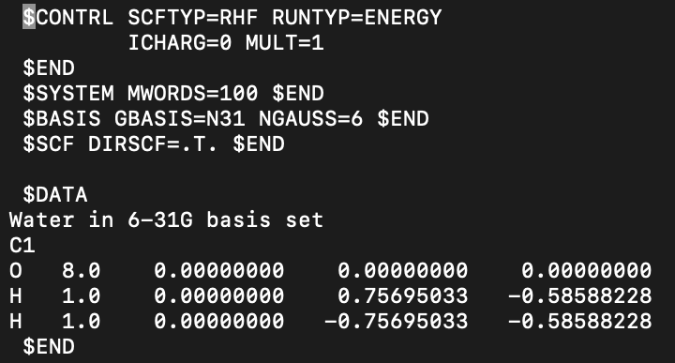
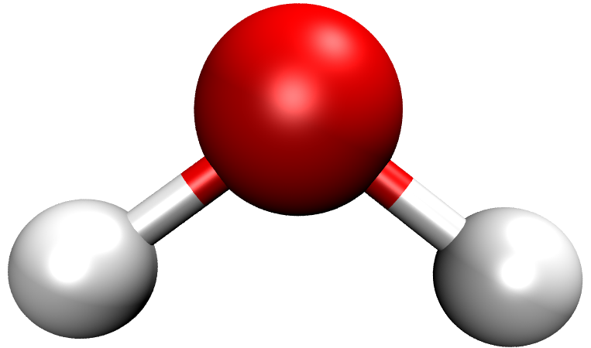
GAMESS Sample Input
https://www.msg.chem.iastate.edu/gamess/GAMESS_Manual/docs-input.txt
Level of Theory: HF/6-31g

Slide 24
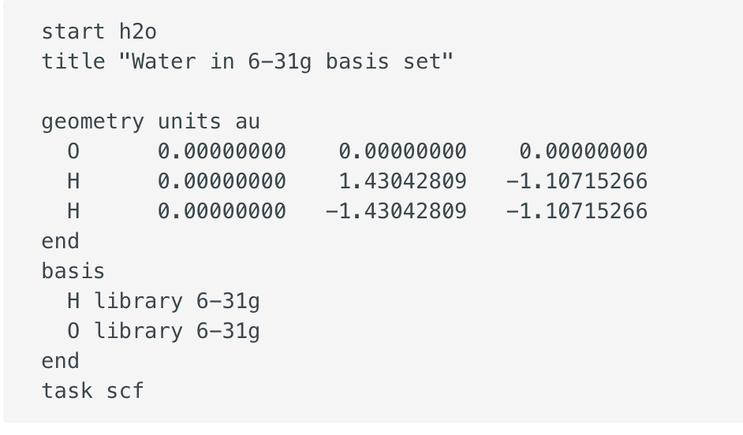
NWChem Sample input
https://nwchemgit.github.io/
Water at HF/6-31g
Level of Theory: HF/6-31g

Slide 25
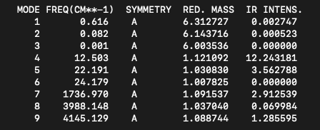
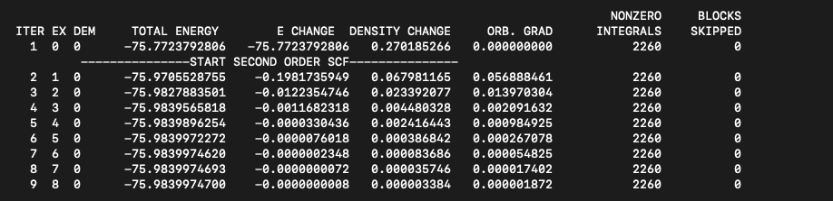
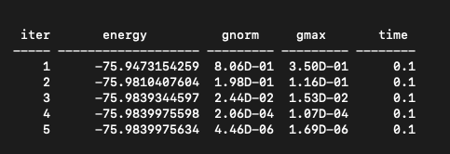
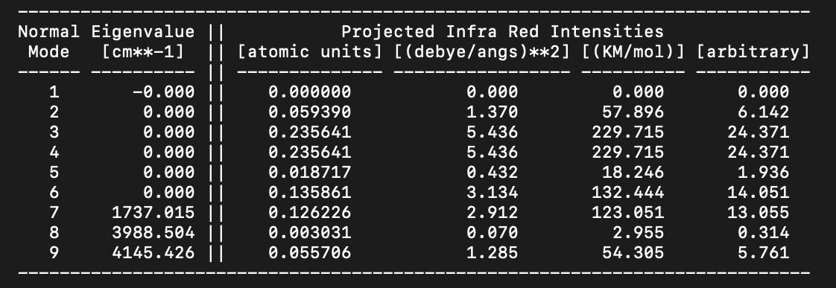
GAMESS
SCF Iteration
Optimization
Vibrational Frequencies
NWChem
SCF Iteration
Optimization
Vibrational Frequencies

Slide 26
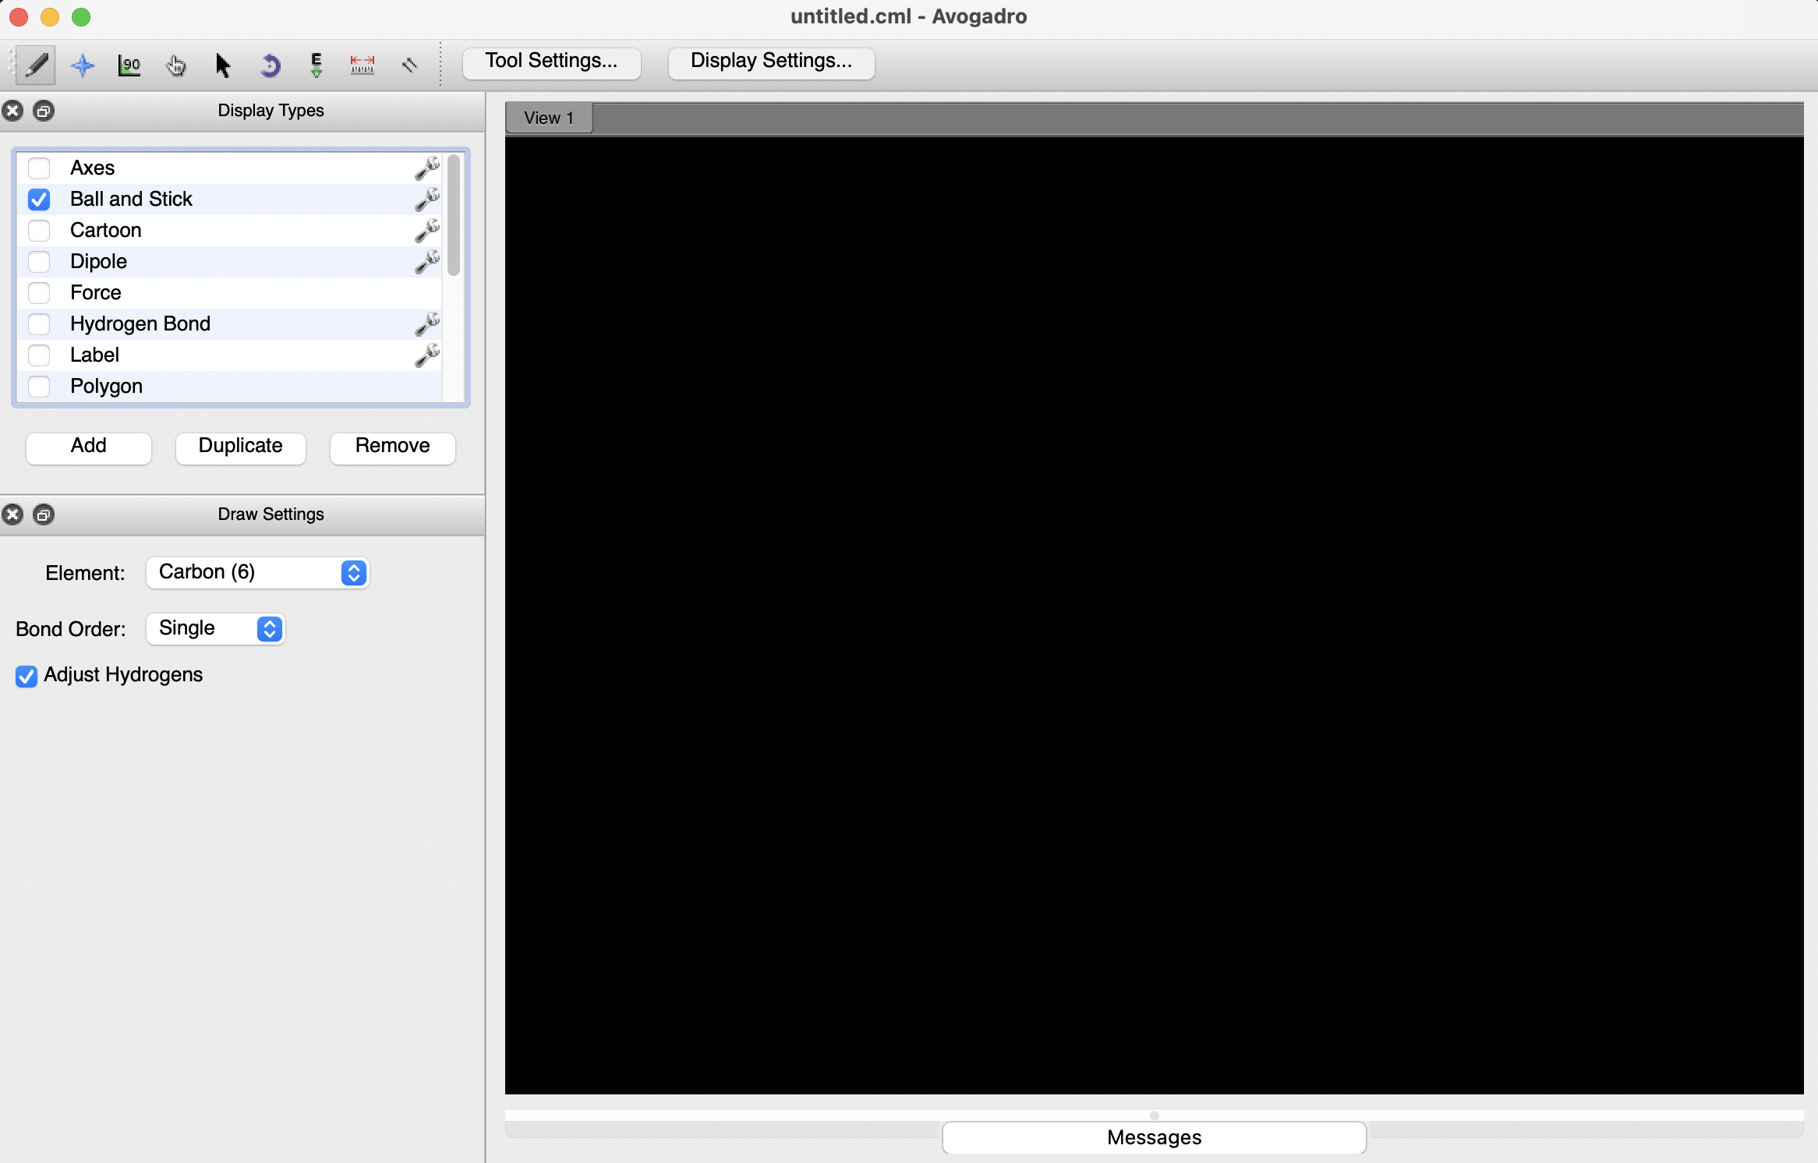
Building Molecules
Draw and edit molecules in 3D
Measure bond lengths, angles and dihedrals
Visualize:
geometry
orbitals
vibrations
surfaces
Export structures to GAMESS and NWChem

Slide 27


