Slide 1
SIMCODES 2026 Midterm Presentation
by Aspen & Bushman

Slide 2
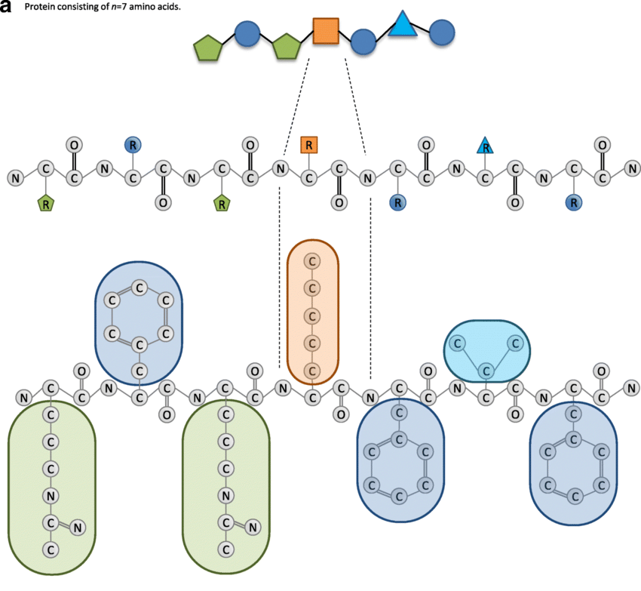
Background
Each atom in an amino acid in a protein has a Cartesian coordinate (x, y, z) in space
There are 20 amino acids that we care about in this project
Mrzic, Aida & Meysman, Pieter & Bittremieux, Wout & Moris, Pieter & Cule, Boris & Goethals, Bart & Laukens, Kris. (2018). Grasping frequent subgraph mining for bioinformatics applications. BioData Mining. 11. 10.1186/s13040-018-0181-9.

Slide 3
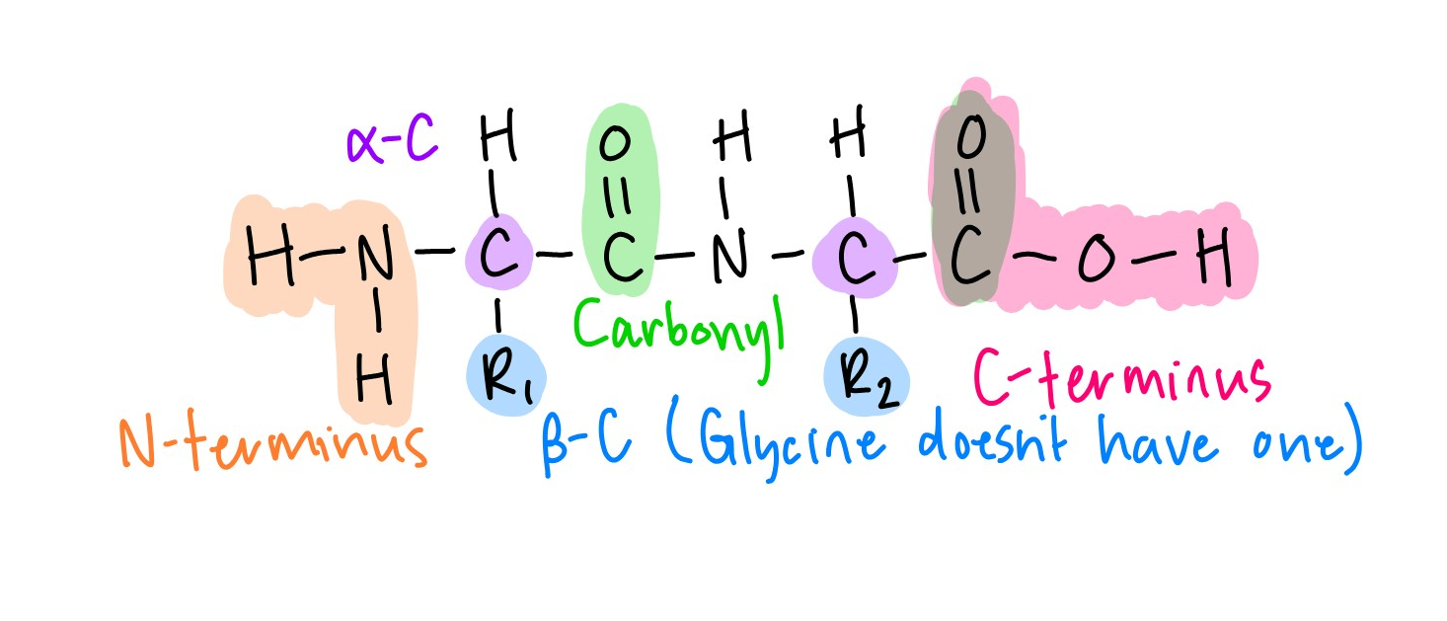
Relevant Chemistry Refresh
The α-carbon is the carbon connected to the R-group
The β-carbon is the first carbon in the sidechain, immediately off the α-C
  Glycine doesn’t have a β-C
A carbonyl is a carbon double bonded to an oxygen
N-terminus is the start of a protein/peptide
C-terminus is the end of a protein/peptide

Slide 4
Purpose of the Project
To create a python library (atom2seq) that can transform the XYZ-coordinates of atoms in a protein into a string of amino acids that make it up (the Primary Structure) with a single function call.
This is useful since proteins are very large
Most software working with protein structure requires the primary structure, but many papers only publish XYZ-coordinates.

Slide 5
Research & Roles
Aspen
Main Programmer
  Design & Implementation of:
    Algorithms
    Class Structures
    Testing Suite
  Debugging :(
Bushman
Computing optimized amino acid molecular geometry using Nova
  Useful for testing data
Writing pseudocode and turning some of it into actual code
  Helpful in brainstorming/ developing efficient ways to write the code, and in my learning!
Assisting with chemistry questions

Slide 6
Structure & Algorithm

Slide 7
Class Structure
IndexedObject
IndexedGraph
Atom
Cluster
FxnalGroup
Mol

Slide 8
Algorithms
File
Parser
Verifier 1
Bonder
AA ID’er
Backbone
Verifier 2
Merger

Slide 9
Amino Acid Identifier
Find N-term
Find α-carbon,
delete N-cluster
& note carbonyl
Note β-carbon’s
index & delete
α-carbon
We are done!
Find N-cluster of
next AA & delete
carbonyl
Delete Carbonyl &
find N-cluster of
next AA
Split β-carbon’s
submolecule
Add to output
ID β-carbon’s
sidechain

Slide 10
What I’ve Learned (Aspen Edition)
Better Software Development Practices
I do not want to go into solely Software Development
  I enjoy the process, but I would like to do other things as well.
    E.g. if I need a program for some mathematical objects in my research
Having someone to yap with makes me more productive

Slide 11
What I’ve Learned (Bushman Edition)
I’m bolstering my “figure it out” skills
I’ve become a lot more comfortable with being uncomfortable
  Developed some skills surrounding Python, Git, GitHub, and VSCode
Computational chemistry is an interesting, important, resource-saving, and growing field
  Development of these skills (i.e. using AI/ML and writing code) is important
I do not wish to specialize this heavily in compchem in my career
I prefer working at the lab bench

Slide 12
Goals for the Remaining Weeks
Finish the rework of my algorithms with the new class structure
Once it’s working, identify and optimize slow algorithms
Get this project to a point where it’s ready to put on PyPI
Start investigating how ML can be helpful in this project

Slide 13
Acknowledgements
SIMCODES & The National Science Foundation Grant No. 2348724 for providing funding
Dr. Ryan Richard for guiding us through software development
Our Cohortmates for being up for fun adventures like going to Des Moines and the Farmer’s Market
Our families for being willing to listen to our yapping about the project (even though they don’t understand)
CyRide drivers

Slide 14
Acknowledgements (cont.)
Aspen
Bushman for helping with chemistry questions
  And for being a great roommate and conversation partner
Bushman
Advisor/mentor at Loras, Adam Moser
Aspen

Slide 15
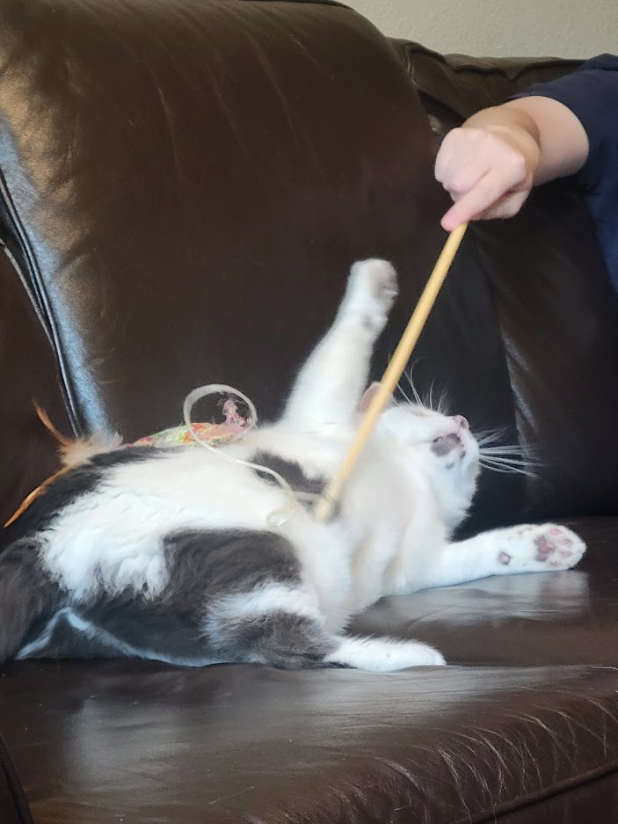
Aspen’s Silly Acknowledgements
Pastspen (past Aspen) for not adequately commenting their code
  And leaving the writing of docstrings for later
Tesla (cat) (cosigned by Bushman)
Misery Business by Paramore
  For being stuck in my head for multiple weeks

Slide 16
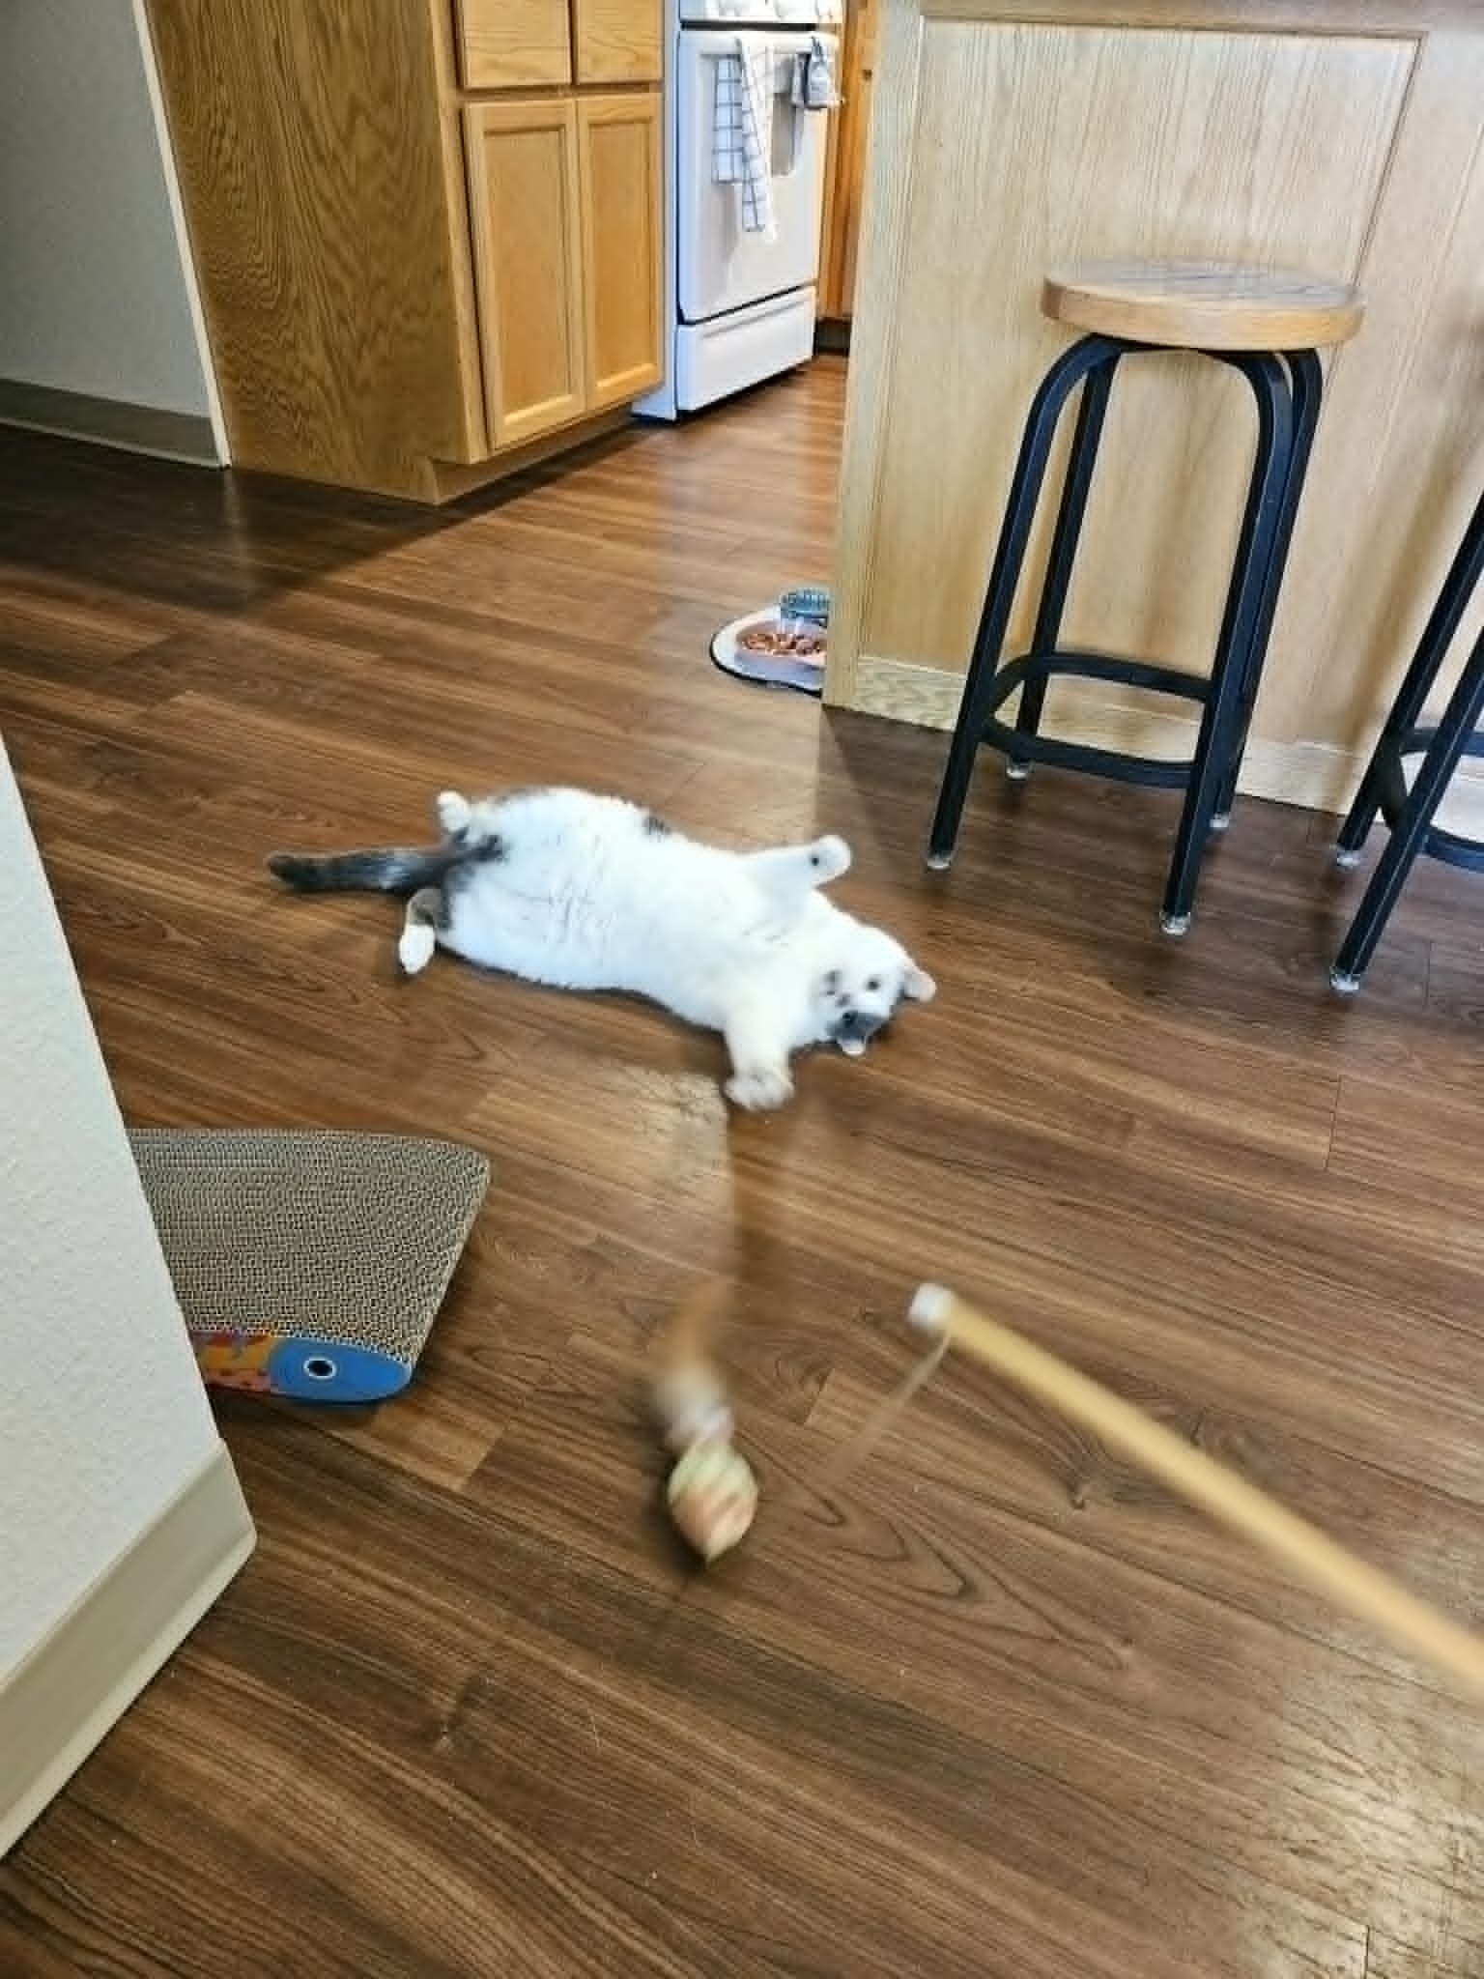
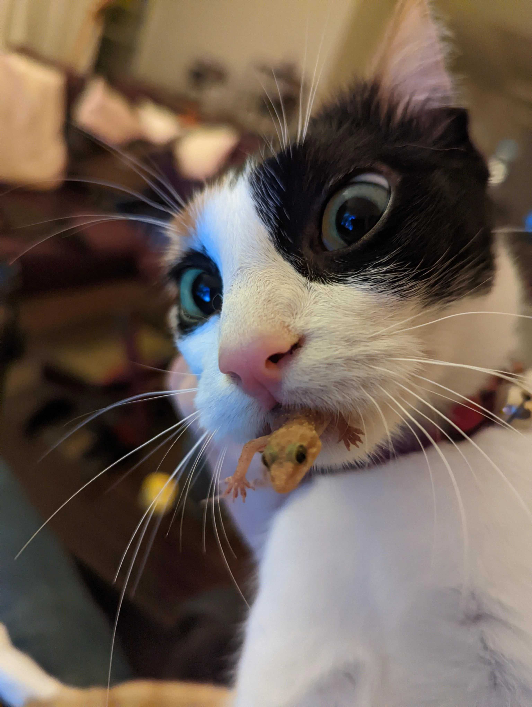

Bushman’s Silly Acknowledgements
Tesla (cat)
Reddit lizard cat
Puzzles
  Deeply serious
Proline
  All my homies hate proline
(All cosigned by Aspen)

