Slide 1
Why are Reactions Important?
Everything
is made by
chemical reactions
Understanding basic chemical reactions allow us to make
new materials and reproducibly make known substances
Notes:
We don't have to understand every reaction
Start with reactions that occur in water

Slide 2
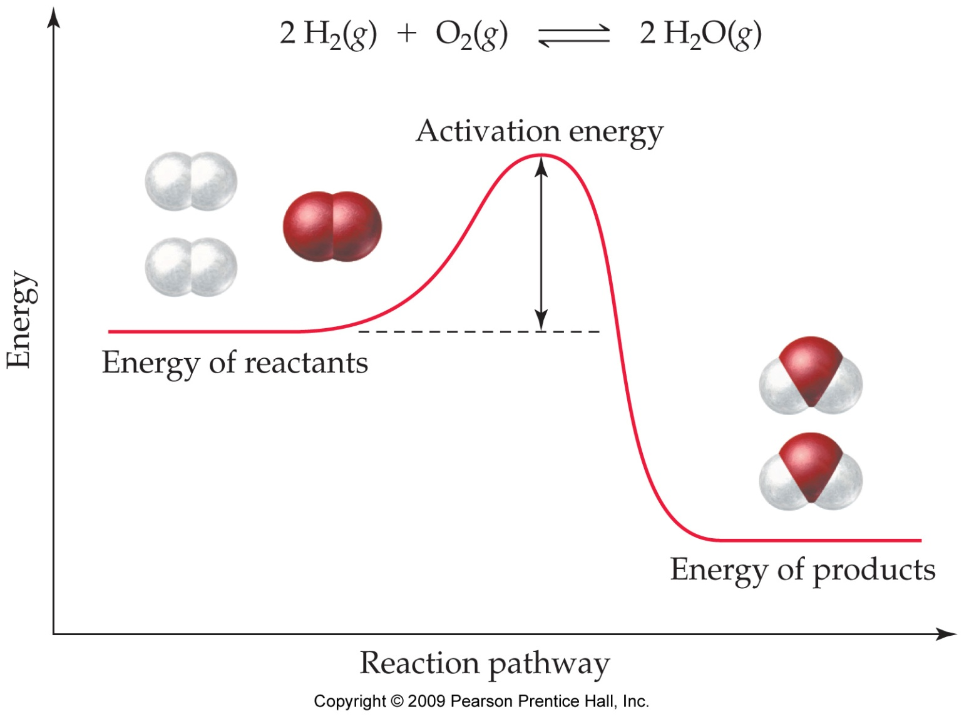
How do reactions happen?
minimum amount of energy for the reaction to even start: kinetics
energy released upon reaction:
thermodynamics
note: sometimes reactions do absorb energy

Slide 3
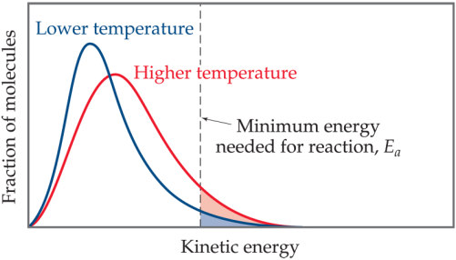
How do reactions happen?
Breaking bonds always takes energy
1) Molecules are always in motion
The key is Energy
2) Add energy – heat, light for example

Slide 4
What is a Chemical Reaction?
In a chemical reaction, one or more substances are converted into different substances.
The starting substance is a reactant.
The resulting substance is a product.
We represent chemical reaction using a Chemical Equation as shown below.
A(g) + B(l) → C(s) + D(g)
In writing chemical reaction, it is important to show the physical states of each reactants and products.
Of course the chemical reaction has to be completely balanced (number of atoms on either side the equation should be equal) – conservation of matter.

Slide 5
Symbols Used in Chemical Equations
Symbols used to indicate state after chemical.
(g) = gas; (l) = liquid; (s) = solid.
(aq) = aqueous = dissolved in water.
Energy symbols used above the arrow for decomposition reactions.
Δ = heat.
hν = light.
shock = mechanical.
elec = electrical.

Slide 6
In a chemical reaction, any of the following process could take place.
Atoms of different elements can combine to make new compounds.
Molecules can combine to make bigger molecules.
Molecules can decompose into smaller molecules or atoms.
Atoms can be exchanged between molecules or transferred to another molecule.
Atoms can gain or lose electrons, turning them into ions.
Or changing the charge on ions that are already there.
But, remember this…. Elements are not transmuted during a reaction. (in other words, nothing happens to the nucleus in a chemical reaction!).

Slide 7
Balancing Chemical Equations
Count the number of atoms of each element on each side of the equation. Determine which need to be balanced.
Polyatomic ions may often be counted as if they are one “element”. Example, CO₃²⁻, SO₄²⁻, NO₃⁻ etc
Pick an element to balance.
Usually start with an atom in the most complicated molecule.
If an element is found in only one compound on both sides, balance it first.
Metals before nonmetals.
Leave elements (like O₂ and H₂) until last.
Put coefficients in front of the formula to bring the elements into balance. Never change a subscript in a compound.

Slide 8
4. Move on to next element and balance. Repeat as necessary.
Make sure that all coefficients are whole numbers. If not, multiply all coefficients by the same number on both sides of the equation so that all the coefficients will be a whole number.
Fractions are acceptable, but not recommended: you can write ½, but not 0.5 in front of a species.
You can master this only if you practice.

Slide 9
H₂(g) + O₂(g) → H₂O(g)

Slide 10
Example: Combustion of Methane
Methane gas burns to produce carbon dioxide gas and gaseous water.
Whenever something burns it combines with O₂(g).
CH₄(g) + O₂(g) → CO₂(g) + H₂O(g)
This equation reads “1 molecule of CH₄ gas combines with 1 molecule of O₂ gas to make 1 molecule of CO₂ gas and 1 molecule of H₂O gas”. The chemical equation is NOT balanced as you can see.
On the left side (Reactant side): 1 C, 4 H and 2 O
On the right side (Product side): 1 C, 2 H and 3 O

Slide 11
CH₄(g) + O₂(g) → CO₂(g) + H₂O(g)
The carbon atoms are already balanced. Oxygen exists in two compounds, so skip for now. Try to balance H.
Put 2 as coefficient for water on the right.
Now, C and H are balanced, so focus on oxygen. To make oxygen even on both sides, put 2 in-front of O₂(g) on the reactant side.
Recheck:
On the left (reactant side): 1 C, 4 H and 4 O
On the right (product side): 1 C, 4 H and 4 O
CH₄(g) + O₂(g) → CO₂(g) + 2H₂O(g)
CH₄(g) + 2O₂(g) → CO₂(g) + 2H₂O(g)

Slide 12
How do reactions happen? Thermochemistry

Slide 13
Remember: chemical reactions involve:
Reactant bonds breaking – requires energy
Product bonds forming – releases energy
Electrolysis of water:
NaOH (aq) + HCl(aq) → H₂O(l) + NaCl(aq)

Slide 14
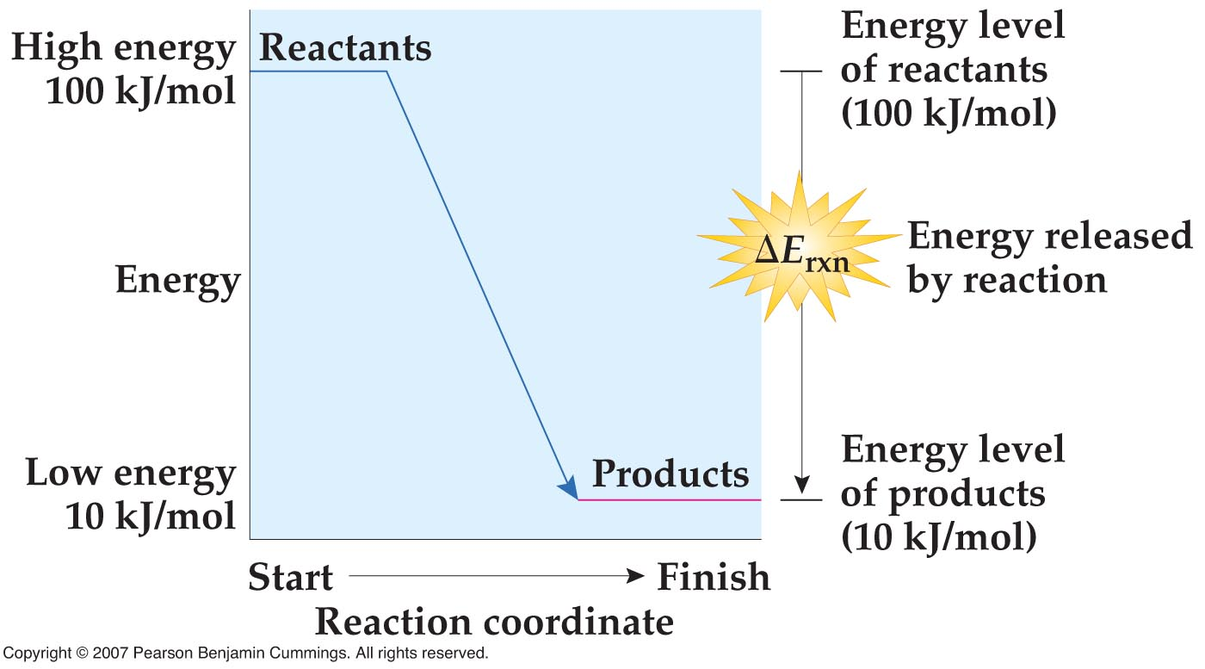
Energetics of reactions: 1
Reactions which release energy are called exothermic reactions.
ΔE = E_{products} – E_{reactants} < 0

Slide 15
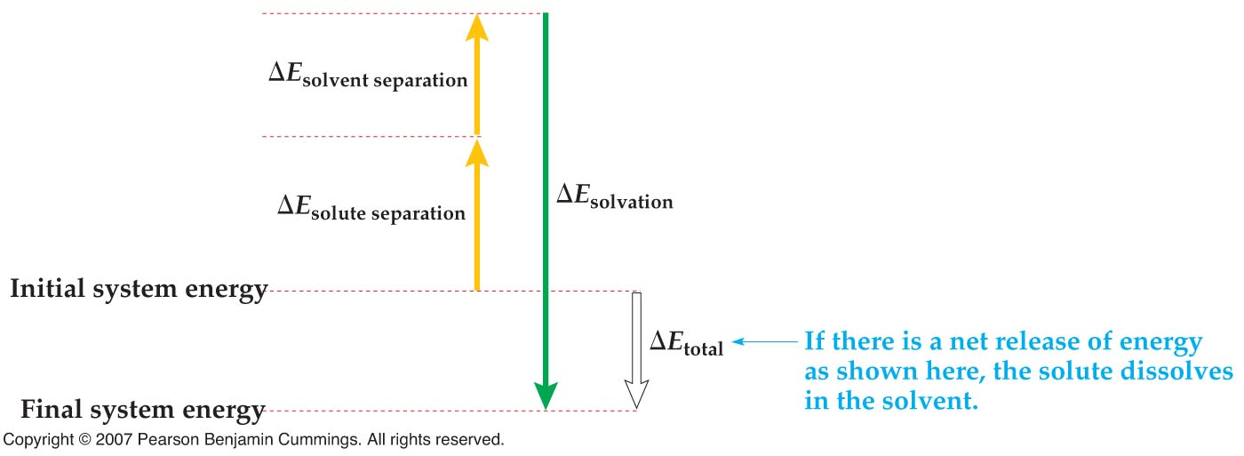
Will it dissolve?
If ΔE_{total} < 0 (is negative), the substance will dissolve and the solution forms, the reaction is exothermic
Solution will also get warmer

Slide 16
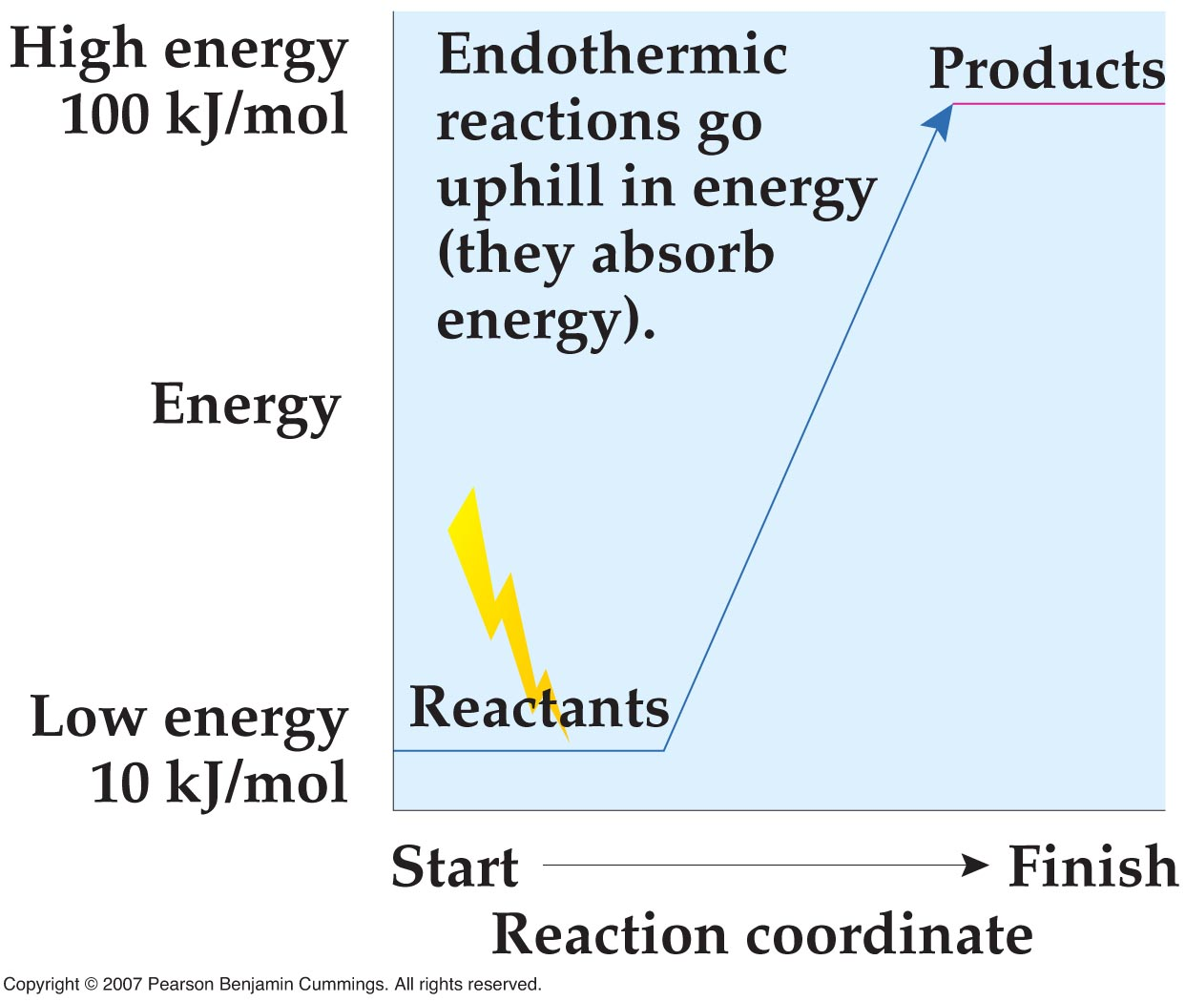
Energetics of reactions: 2
Reactions which absorb energy are called endothermic reactions.
ΔE = E_{products} – E_{reactants} > 0

Slide 17
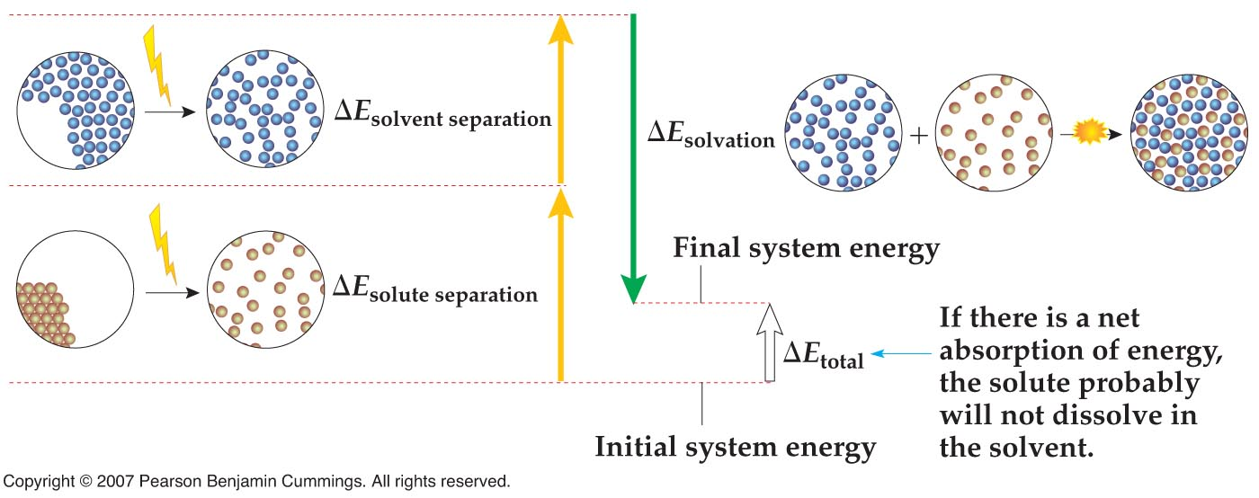
Will it dissolve?
If ΔE_{total} > 0 (is positive), the substance will probably not dissolve, the reaction is endothermic
Solution will also get colder if the substance dissolves

Slide 18
Energetics of reactions: 3
Reactions where the reactants and products are at the same energy are energy neutral or thermal neutral reactions.
Very rare!!!
ΔE = E_{products} – E_{reactants} = 0

Slide 19
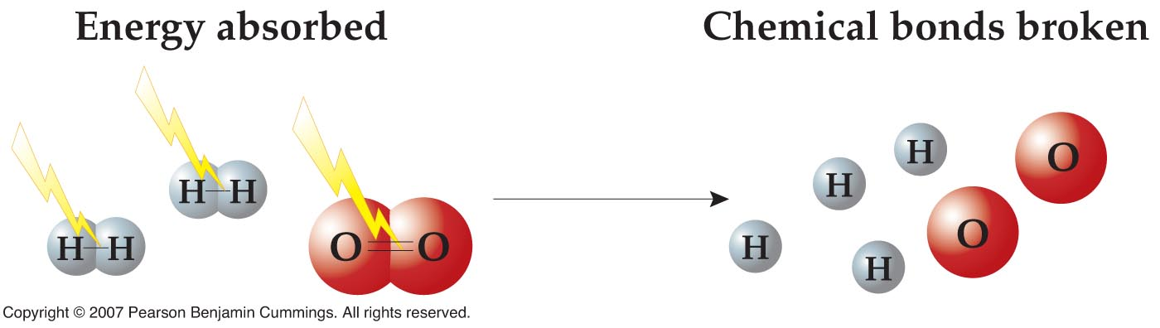
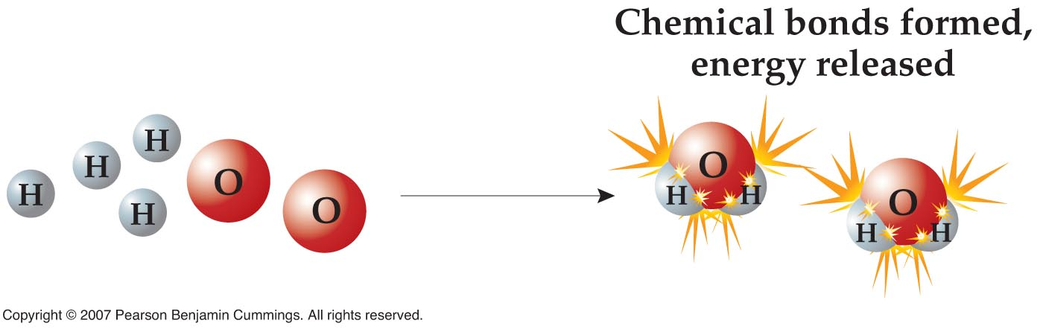
Another “hypothetical” reaction

Slide 20
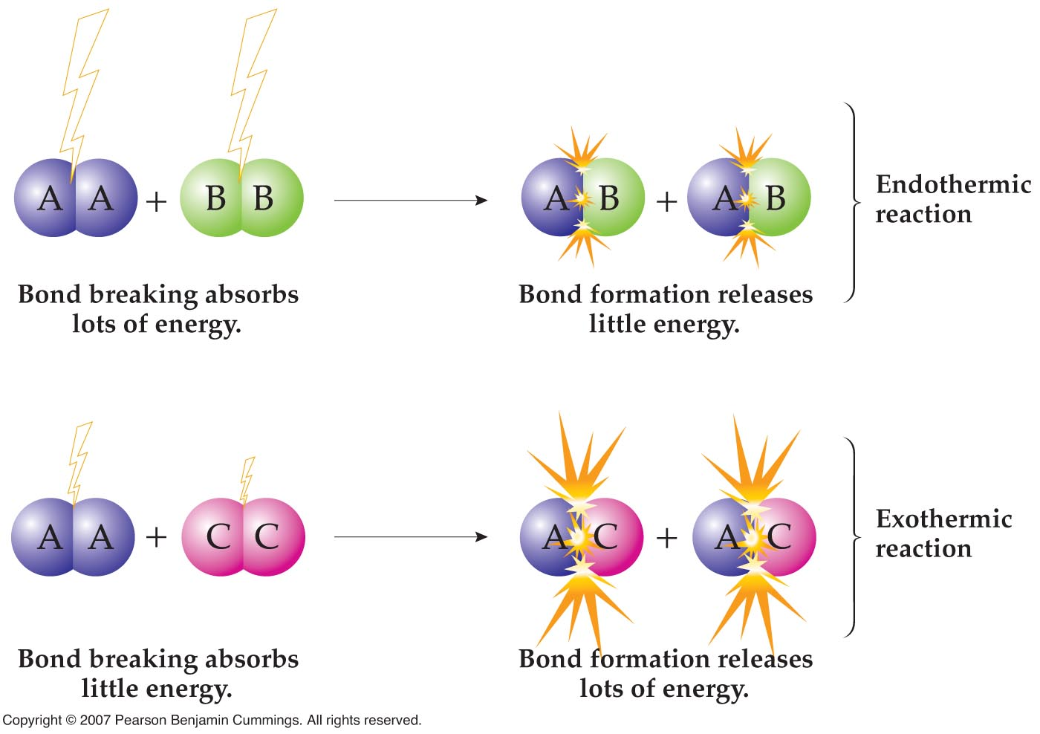

Slide 21
Another example
140 kJ/mol
Energy
20 kJ/mol
Reaction coordinate
ΔE_{forward} = – ΔE_{reverse}

Slide 22
Is ice melting endothermic or exothermic?
Is water boiling endothermic or exothermic?
Notes:
pose the question to the class?

Slide 23
All of this still doesn’t tell us how fast a reaction happens!!!
Exothermic reactions can be fast!
Exothermic reactions can be slow!
Endothermic reactions can be fast!
Endothermic reactions can be slow!

Slide 24
Chemical kinetics
Why do some reactions happen quickly?
Why do some reactions happen slowly?
Chemical kinetics is the study of chemical reaction rates and how they change.

Slide 25
Macroscopic factors that affect the rate of a reaction
Physical state – gases tend to react faster than liquids
Concentration of reactants
Temperature
Catalyst

Slide 26
Multiple reaction steps
A reaction rarely involves only one step
student in dorm room → student in lecture hall
This process is not a single step,
but is the net overall change from a series of steps:
student in dorm room → student at 1st bus stop
student at 1st bus stop → student at 2nd bus stop
student at 2nd bus stop → student in lecture hall

Slide 27
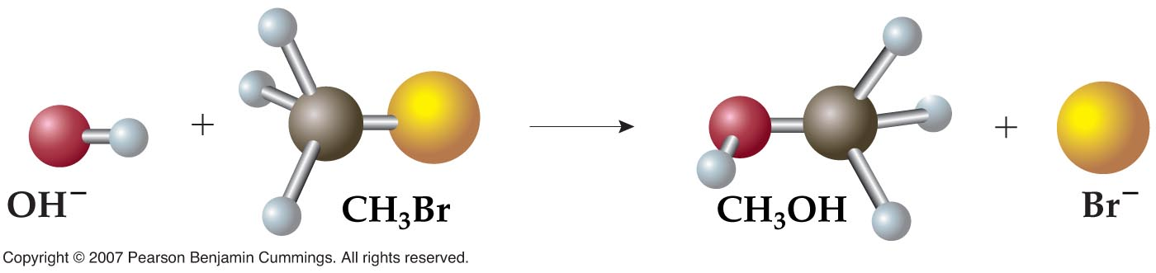
Chemical kinetics
A reaction mechanism is the detailed series of reactions steps that represents how reactants move from reactants to products.
C₆H₁₂O₆(s) + 6 O₂(g) → 6 CO₂(g) + 6 H₂O(l)
Substitution reaction
How do we figure out the reaction mechanism?

Slide 28
What determines the rate of a reaction (microscopic)?
E_{a}

Slide 29
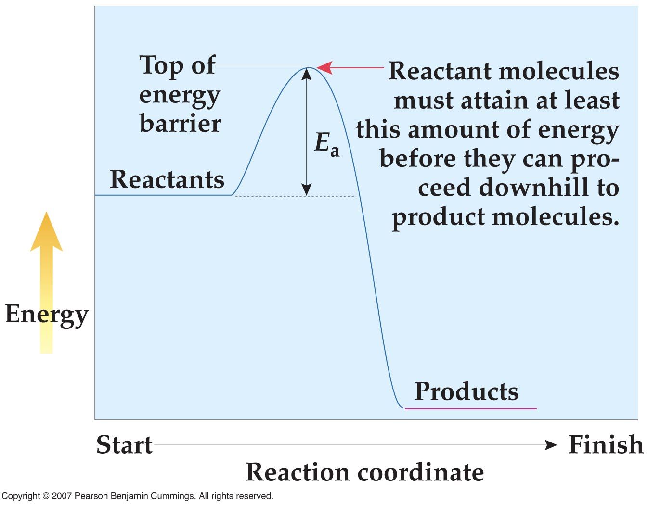

Slide 30
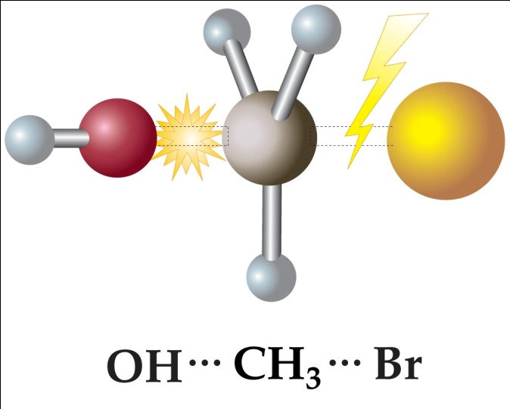
Transition state
The transition state is the high energy, unstable state of the molecules at the top of the barrier.

Slide 31
Reaction rate depends on E_{a}
The higher the activation barrier, the slower the reaction!
Large E_{a} → slower reaction
Small E_{a} → faster reaction

Slide 32
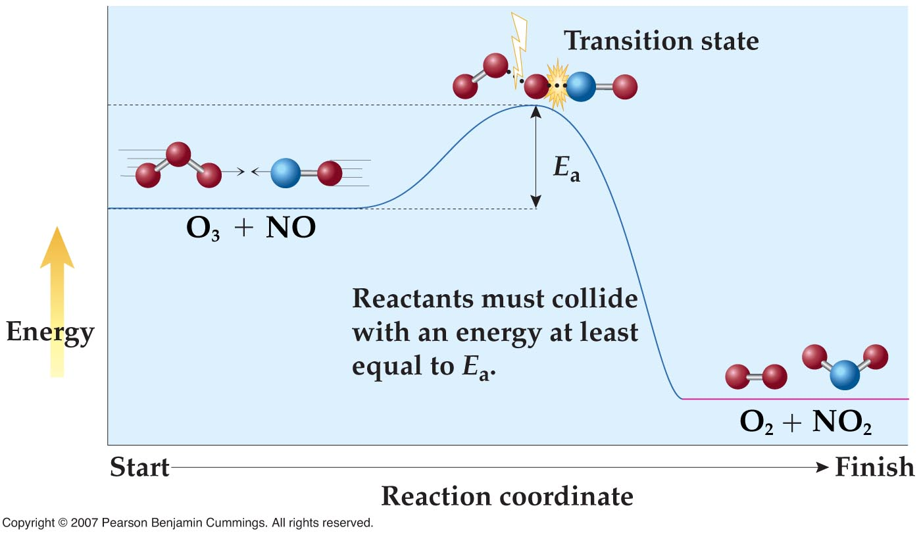
Orientation matters

Slide 33
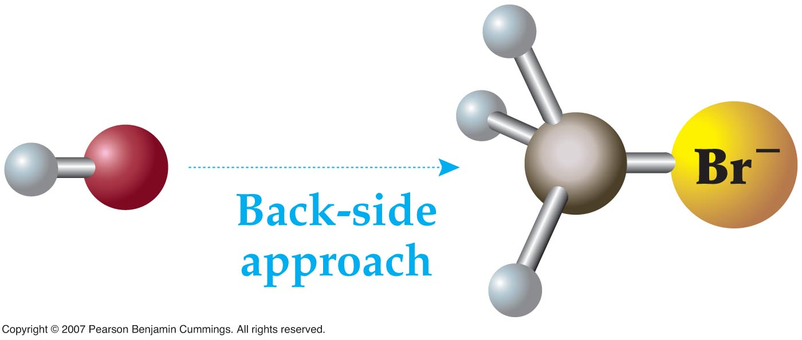

Orientation matters

Slide 34
Higher Temperature, higher reaction rate
Rule of thumb: for every increase of 10 ̊C, double reaction rate

Slide 35
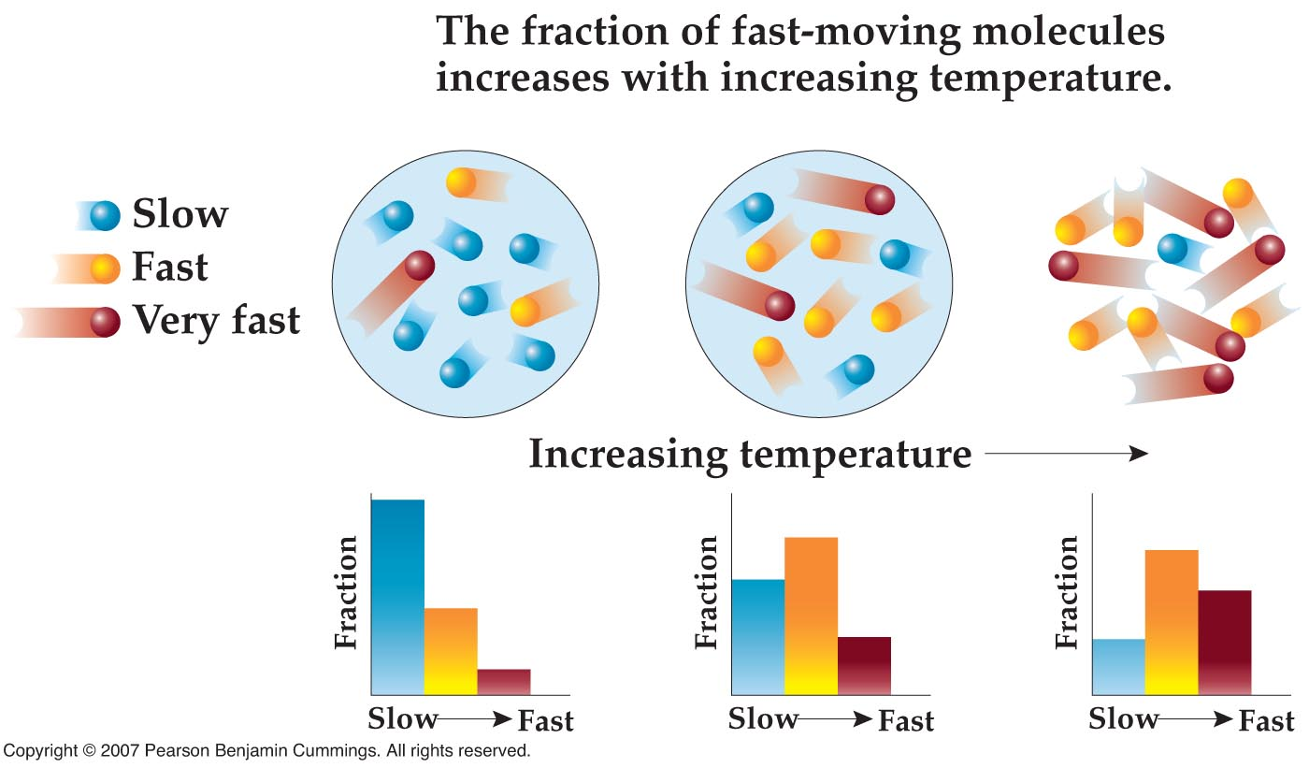
Higher Temperature, higher reaction rate

Slide 36
Reaction rates
Any collision that is sufficiently energetic and properly oriented such that it leads to the formation of product is called an effective collision.
Number of collisions per unit time with energy equal to or greater than E_{a}
Fraction of collisions in which molecules have proper orientation
Reaction rate =
X
Energy factor
Orientation factor

Slide 37
Reaction rates
Number of collisions per unit time with energy equal to or greater than E_{a}
Fraction of collisions in which molecules have proper orientation
Reaction rate =
X
Molecules formed per second or Moles formed per second
Orientation factor – between 0 and 1
Usually in collisions/s

Slide 38
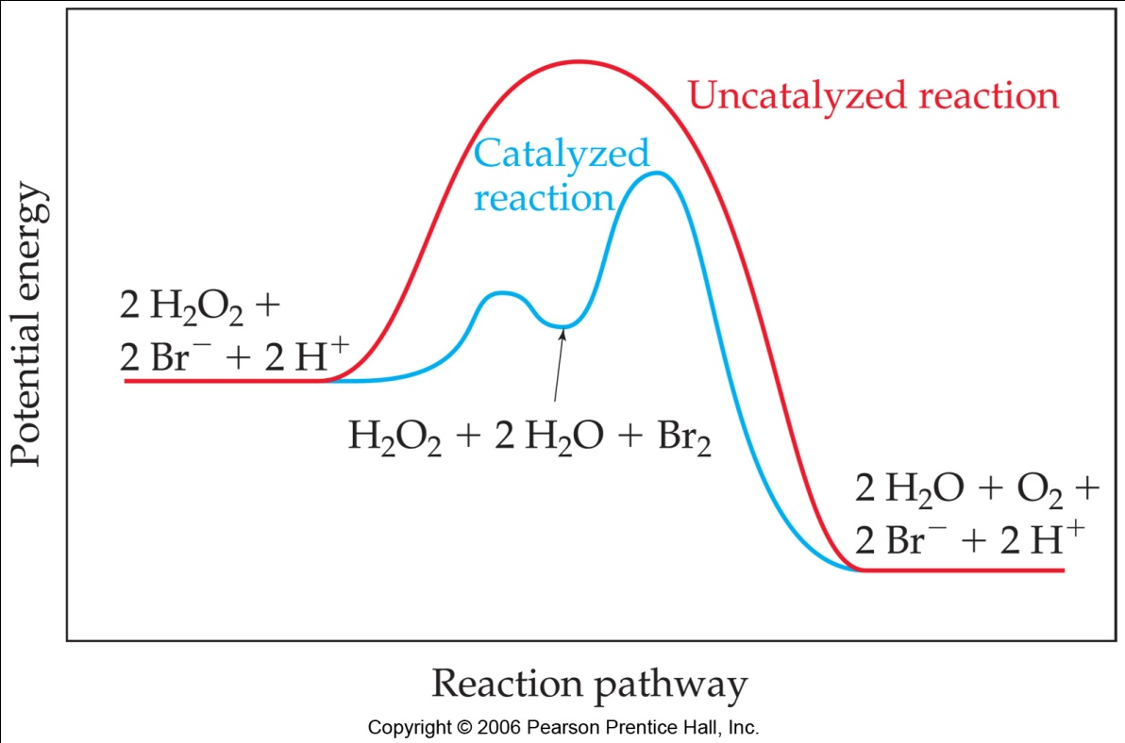
Is there another way to make the reaction go faster?
A catalyst is a substance that changes (modifies) the rate of a reaction but does not undergo any permanent change.
Usually changes both E_{a} and the orientation factor
The overall exothermicity and endothermicity of a chemical reaction is unaffected by the presence of a catalyst.

Slide 39
Catalyst example
student in dorm room → student in lecture hall
student in dorm room → student at 1st bus stop
student at 1st bus stop → student at 2nd bus stop
student at 2nd bus stop → student in lecture hall
student in dorm room → student at 1st bus stop
Bus +student at 1st bus stop → student at 2nd bus stop + Bus
student at 2nd bus stop → student in lecture hall

Slide 40
Catalyst example
Tl⁺(aq) + 2 Ce⁴⁺(aq) → Tl³⁺(aq) + 2 Ce³⁺(aq)
Catalyzed by Ag⁺
k₁
Ag⁺(aq) + Ce⁴⁺(aq) Ag²⁺(aq) + Ce³⁺(aq) (fast)
k₋₁
Tl⁺(aq) + Ag²⁺(aq) Tl²⁺(aq) + Ag⁺(aq) (slow)
Tl²⁺(aq) + Ce⁴⁺(aq) Tl³⁺(aq) + Ce³⁺(aq) (fast)
Identifying catalyst and intermediates

Slide 41
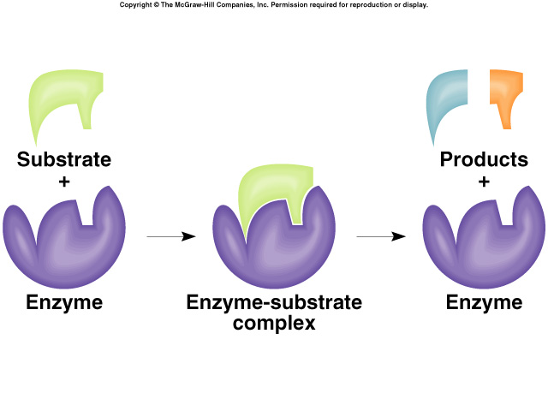
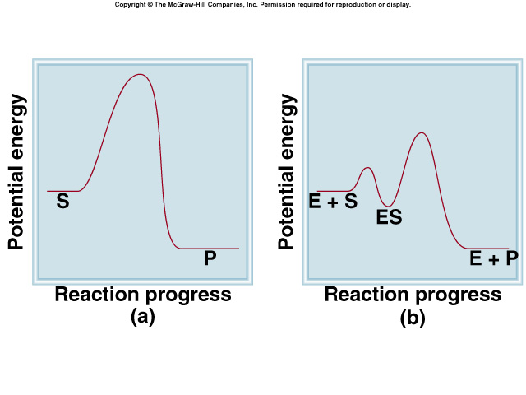
Another catalysis example - enzymes
Lock and key mechanism

Slide 42
Reaction rates
Number of collisions per unit time with energy equal to or greater than E_{a}
Fraction of collisions in which molecules have proper orientation
Reaction rate =
X
Fraction of collisions with energy equal to or greater than E_{a}
Reaction rate =
Number of collisions per unit time
Fraction of collisions in which molecules have proper orientation
X
X

Slide 43
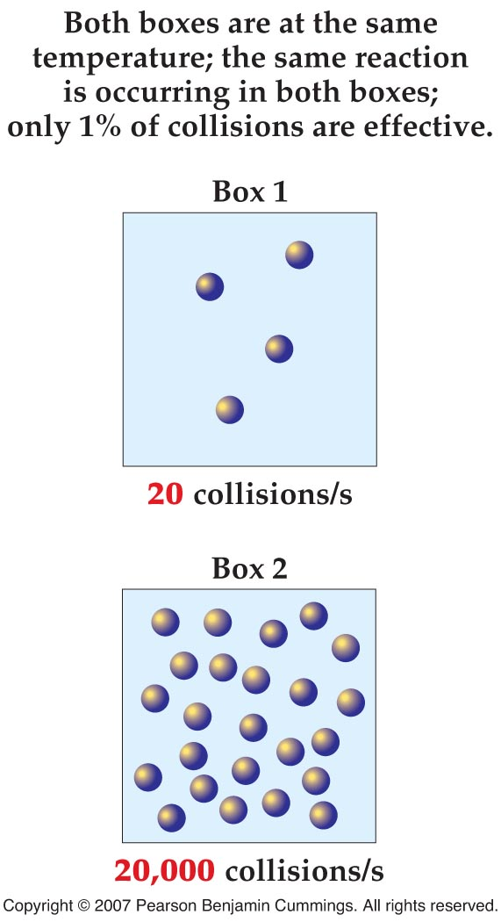
Dependence on concentration
The greater the concentration of reactants, the greater the total number of collisions per second and thus the higher the reaction rate.

Slide 44
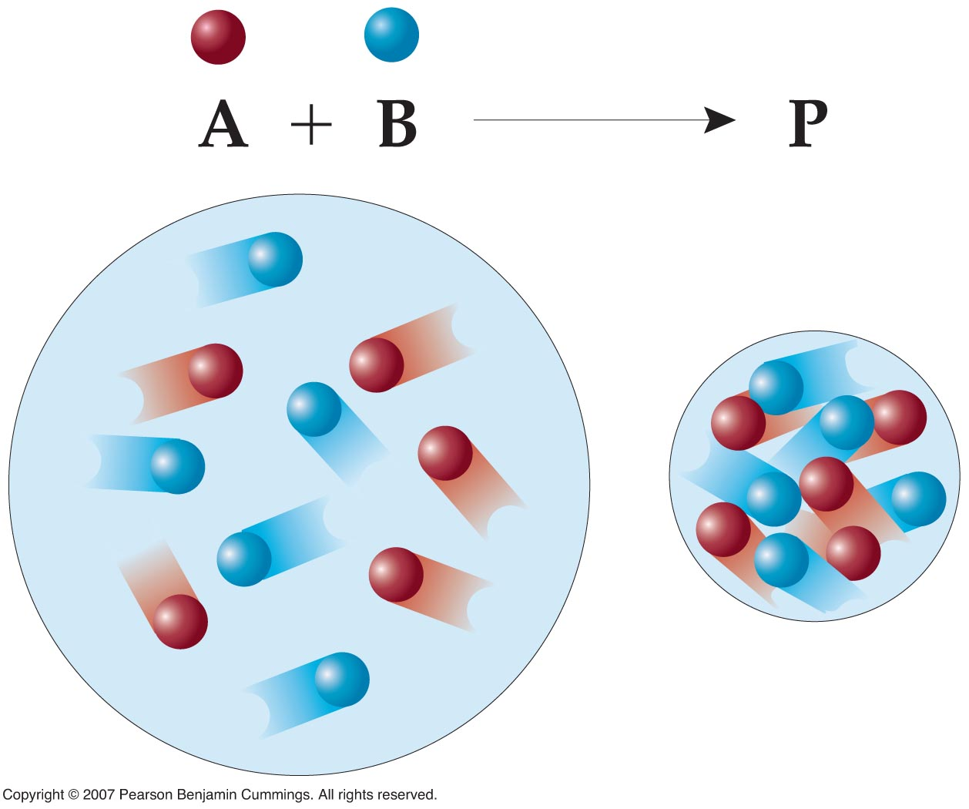
Dependence on concentration
The number of collisions is proportional to the concentration – if the concentration increases, the number of collisions increase or if the concentration decreases, the number of collisions decrease

Slide 45
Reaction rates
Fraction of collisions with energy equal to or greater than E_{a}
Reaction rate =
Number of collisions per unit time
Fraction of collisions in which molecules have proper orientation
X
X
Reaction rate =
Number of collisions per unit time
X
k
Rate constant – independent of concentration
k is still dependent on temperature!!

Slide 46
Rate law or expression
MUST be determined experimentally!!
The rate law/expression gives the relationship between the concentration of the reactants and the rate of the reaction.
aA + bB → cC + dD
Orders – ALWAYS experimentally determined
Rate constant
rate = k [A]^{m} [B]^{n}
Molar concentration of reactants

Slide 47
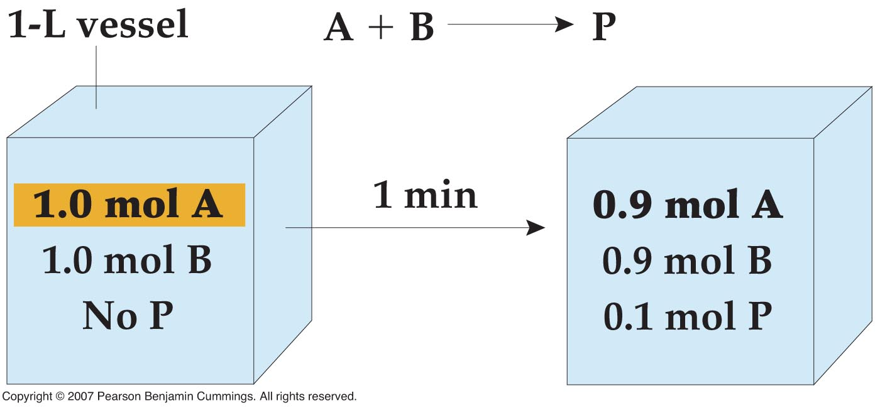
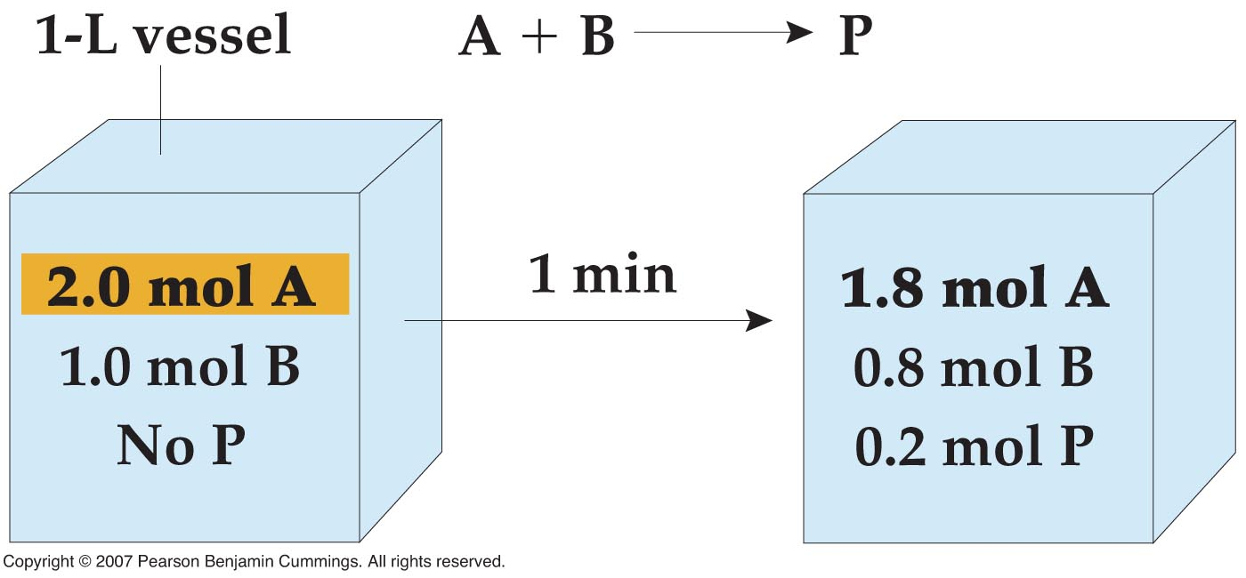
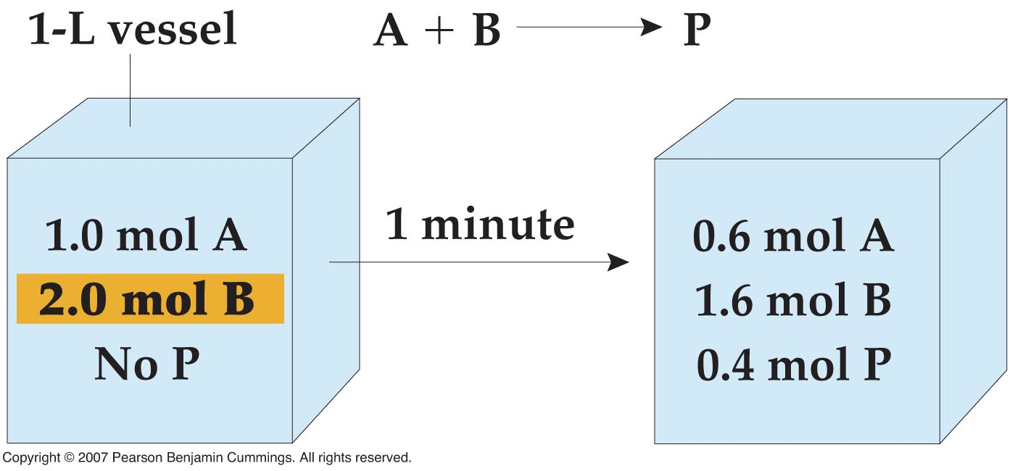
How do we find the orders?
Look at initial reaction rate
rate = k [A]^{m} [B]^{n}

Slide 48
Reaction orders
A₂ + B → AB + A
Zeroth order: For example Rate = k [A₂]⁰ [B]^{m} = k [B]^{m}
If reactant concentration doubles or triples, rate doesn’t change and product concentration doesn’t change
First order: For example Rate = k [A₂]¹ [B]^{m} = k [A₂] [B]^{m}
If reactant concentration doubles, rate doubles and product concentration doubles
If reactant concentration triples, rate triples and product concentration triples
Second order: For example Rate = k [A₂]² [B]^{m}
If reactant concentration doubles, rate quadruples and product concentration quadruples
If reactant concentration triples, rate and product concentration increase by 9-fold

Slide 49
Overall order of reaction
Third order: For example Rate = k [A]²[B₂]¹
2 + 1 = 3
More generally: Rate = k [A]^{m} [B]^{n} [C]^{p}
m + n + p = overall order
Remember the reaction rate and orders MUST BE determined experimentally

Slide 50
For example
2 NO(g) + 2 H₂(g) → N₂(g) + 2 H₂O(l)
Experiment | [NO]_{init} | [H₂]_{init} | Initial Rate
1 | 5.0 x 10^{–3} M | 2.0 x 10^{–3} M | 1.25 x 10^{–5} M/s
2 | 1.0 x 10^{–2} M | 2.0 x 10^{–3} M | 5.00 x 10^{–5} M/s
3 | 1.0 x 10^{–2} M | 4.0 x 10^{–3} M | 1.00 x 10^{–4} M/s

Slide 51
Summary of important rate law points
Rate laws or expressions must be experimentally determined.
Method of initial rates can be used to determine rate laws.
The rate constant is independent of concentration of products.
Once the rate law or expression has been determined, it can be used to calculate the rate of the reaction under different concentrations

Slide 52
Reaction Mechanisms
A reaction rarely involves only one step
A reaction mechanism is the detailed series of steps involved in a chemical reaction.
Mechanisms are theoretical, cannot be directly observed, therefore cannot be proven. Although computational methods can now give important insight into these mechanisms
Mechanisms are inferred from kinetics data
Balanced reaction equations give the overall reaction or the net result of the reaction mechanism

Slide 53
Elementary reactions
An elementary reaction or elementary process refers to a single step in a reaction mechanism.
Represents the actual collision or decomposition happening
For an elementary reaction, the reactant orders in the rate law are determined by the stoichiometry of the balanced elementary reaction

Slide 54
Elementary reactions
Unimolecular elementary reaction: only 1 reactant (no collision)
A → product
rate = k [A]
Remember: ONLY for an elementary reaction, the reactant orders in the rate law are determined by the stoichiometry of the balanced elementary reaction

Slide 55
Elementary reactions
Bimolecular elementary reaction: 2 molecules collide
A + B → product
rate = k [A][B]
2 A → product
A + A → product
rate = k [A][A] = k [A]²
Remember: ONLY for an elementary reaction, the reactant orders in the rate law are determined by the stoichiometry of the balanced elementary reaction

Slide 56
Elementary reactions
Termolecular elementary reaction: 3 molecules collide
RARE!
A + B + C → product
rate = k [A][B][C]
2 A + B → product
rate = k [A][A][B] = k [A]²[B]
Remember: ONLY for an elementary reaction, the reactant orders in the rate law are determined by the stoichiometry of the balanced elementary reaction

Slide 57
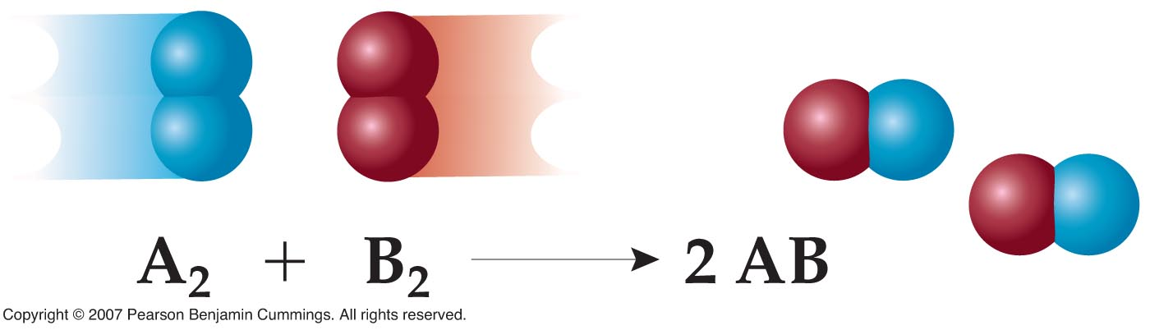
Multistep reactions
Consider the reaction A₂ + B₂ → 2 AB
And suppose that kinetics experiments show the rate law to be
Rate = k [A₂]²
Is the following elementary mechanism correct?

Slide 58
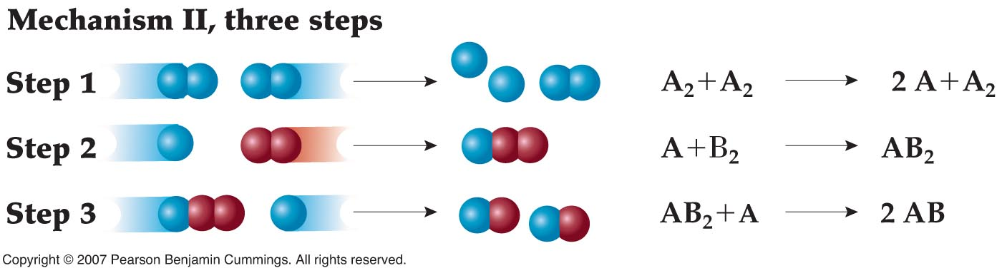
Multistep reactions
Consider the reaction A₂ + B₂ → 2 AB
Rate = k [A₂]²
Is the following multistep mechanism correct?
A and AB₂ are reaction intermediates
Maybe, if Step 1 is a rate limiting step

Slide 59
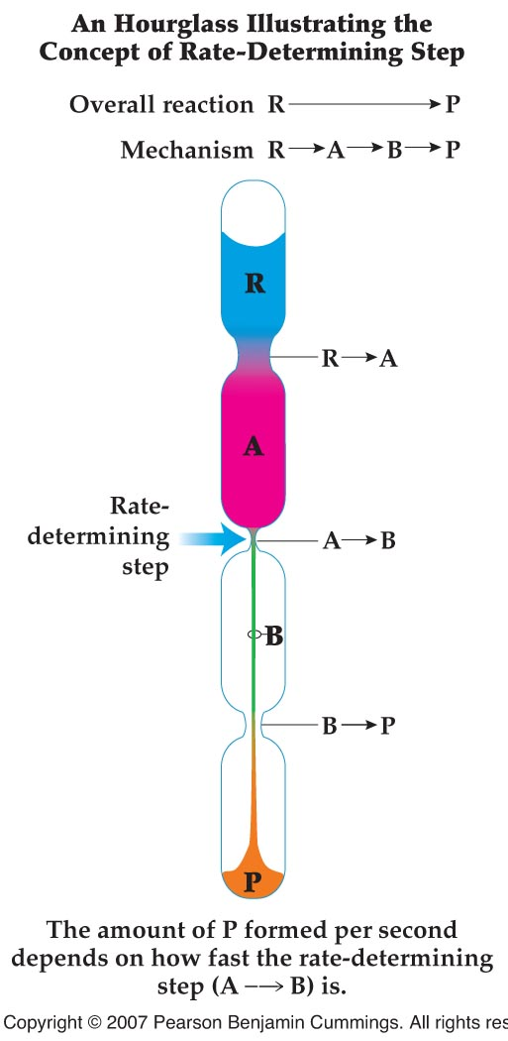
Rate limiting or rate determining step
The rate limiting step is one step in a multistep reaction mechanism that is much slower than the others.

Slide 60
Multistep reactions
Consider the reaction A₂ + B₂ → 2 AB
Rate = k [A₂]²
Is the following multistep mechanism correct?
Maybe, if Step 1 is a rate limiting step

Slide 61
Another multistep mechanism
Consider the proposed mechanism
(i) Cl₂ 2 Cl
(ii) Cl + CHCl₃ HCl + CCl₃
(iii) CCl₃ + Cl CCl₄
What is the overall reaction equation?
Cl₂ + Cl + CHCl₃ + CCl₃ + Cl → 2 Cl + HCl + CCl₃ + CCl₄
Cl₂ + CHCl₃ → HCl + CCl₄

Slide 62
Another multistep mechanism
Consider the proposed mechanism
(i) Cl₂ 2 Cl
(ii) Cl + CHCl₃ HCl + CCl₃
(iii) CCl₃ + Cl CCl₄
If the experimentally determined rate law is 1st order in Cl₂ and the concentration of CHCl₃ has no effect on the rate of the reaction, which step is the rate limiting step?

Slide 63
Summary of important rate law points
Elementary steps should never have more than 2 species colliding simultaneously. Termolecular or 3-body collisions are extremely rare.
The sum of the elementary steps must yield the overall balanced reaction equation for the mechanism to be valid.
The mechanism must predict the experimentally observed rate law for it to be valid.
If a mechanism is consistent with the experimental rate law, the mechanism is possibly correct. The mechanism is theoretical: it can’t be proven but it can be disproven.

Slide 64
Extra materials

Slide 65
Balance the following reactions
When magnesium metal burns in air, it produces a white, powdery compound magnesium oxide.
When aluminum metal burns in air, it produces a white, powdery compound aluminum oxide.

Slide 66
Practice more examples
When ethyl alcohol (C₂H₅OH – the liquor) is burnt in air, it produces carbon dioxide and water.
Combustion of liquid butane (C₄H₁₀) produces carbon dioxide and steam in a lighter.
Practice on end-of chapter problems: 8.26 through 8.42

Slide 67
Practice more examples
When methanol (CH₃OH) is burnt in air, it produces carbon dioxide and water.
Practice on end-of chapter problems: 8.26 through 8.42

Slide 68
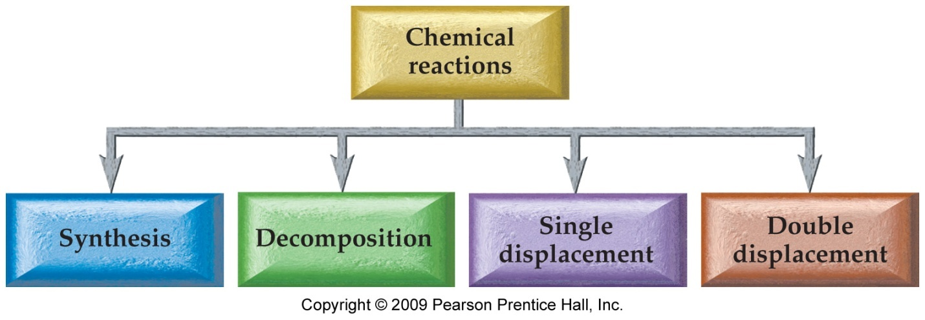
Types of Reactions
One way of classifying the chemical reactions is by looking at what the atoms do.
Type of reaction | General equation | What atoms do?
Composition (synthesis) | A + B → AB | Atoms combine
Decomposition | AB → A + B | Atoms separate
Single Displacement | A + BC → AC + B | Single atoms exchange
Double displacement | AB + CD → AD + CB | Two atoms exchange

Slide 69
Combination Reactions
Also known as composition or synthesis reactions.
Two (or more) reactants combine together to make one product.
Simpler substances combining together.
2 CO + O₂ → 2 CO₂
2 Mg + O₂ → 2 MgO
4 Al + 3 O₂ → 2Al₂O₃

Slide 70
Decomposition Reactions
A large molecule is broken apart into smaller molecules or its elements.
Caused by addition of energy into the molecule.
Electrolysis of water:
Function of Air-bags (decomposition of sodium azide, NaN₃):
Decomposition of Ozone:
Note: the reverse of a combination reaction is a decomposition reaction and vice versa.

Slide 71
Single Displacement (or Replacement) Reactions
Reactions that involve one atom displacing another and replacing it in a compound.
In the reaction,
Zn(s) + 2 HCl(aq) → ZnCl₂(aq) + H₂(g),
the atom Zn displaces H from the compound.
Other examples of single displacement reactions are:
Fe₂O₃(s) + Al(s) → Fe(s) + Al₂O₃(s)
Mg(s) + H₂SO₄(aq) → 2 MgSO₄(s) + H₂(g)
2 AgNO₃(aq) + Zn(s) → 2 Ag(s) + Zn(NO₃)₂(aq)

Slide 72
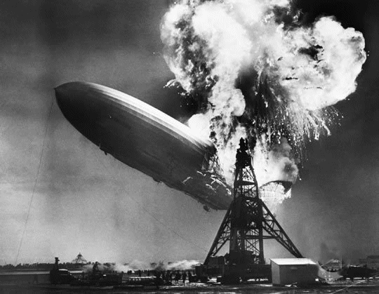
Thermite reaction
2 Al + Fe₂O₃ → 2 Fe + Al₂O₃
Hindenburg disaster May 6, 1937

Slide 73
Double Displacement (or Replacement) Reactions
Elements in two compounds exchange their places.
XY(aq) + AB (aq) → XB + AY
Precipitation, acid–base, and gas evolving reactions are some examples of double displacement reactions.
CaCl₂(aq) + Na₂CO₃(aq) → CaCO₃(s) + 2 NaCl(aq)
NaOH (aq) + HCl(aq) → H₂O(l) + NaCl(aq)
Ba(OH)₂(s) + 2 HNO₃(aq) → Ba(NO₃)₂(aq) + 2 H₂O(l)
Li₂CO₃(aq) + 2 HCl(aq) → 2 LiCl(aq) + CO₂(g) + H₂O(l)

Slide 74
Practice—Classify the Following Reactions as Combination, Decomposition, Single Displacement, or Double Displacement.
3 Mg(s) + 2 FeCl₃(aq) → 3 MgCl₂(aq) + 2 Fe(s)
CO₂(g) + H₂O(l) → H₂CO₃(aq)
3 KOH(aq) + H₃PO₄(aq) → K₃PO₄(aq) + 3 H₂O(l)

Slide 75
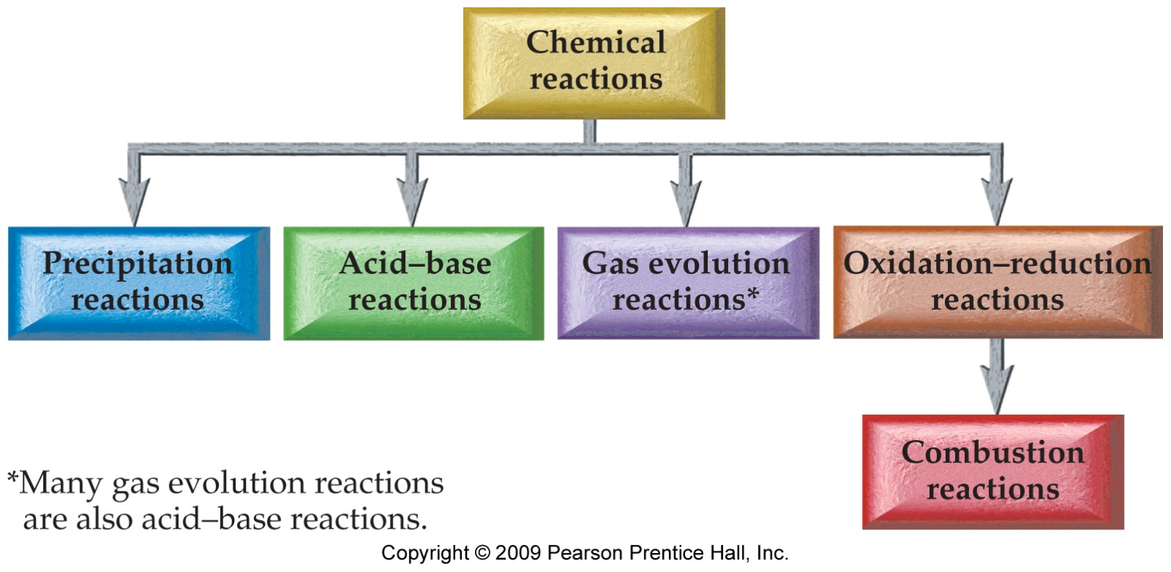
Type of Reactions – Cont…
Another way of classifying chemical reactions is based on the process that happens in a chemical reaction.
Precipitation, neutralization, formation of a gas, or transfer of electrons.

Slide 76
Combustion Reactions
Reactions in which O₂ is consumed by combining with another substance are called combustion reactions.
Always release heat and/or other forms of energy.
Produce one or more oxygen-containing compounds.
In general, compounds containing only C, H and O in their composition produces CO₂ and H₂O as the only products in a combustion reaction.
Examples: see previous balancing equation slides
Respiration (reaction of glucose in our body):
Try to balance this equation!

Slide 77
Solubility and Precipitation Reactions
Reactions in Aqueous Solutions
Many times, the chemicals we are reacting together are dissolved in water.
Mixtures of a chemical dissolved in water are called aqueous solutions.
Dissolving the chemicals in water helps them to react faster.
The water (aqueous medium) separates the chemicals into individual molecules or ions.
The separate, free-floating particles come in contact more frequently so the reaction speeds up.

Slide 78
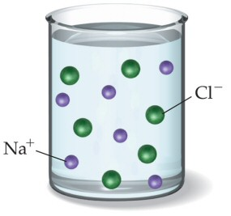
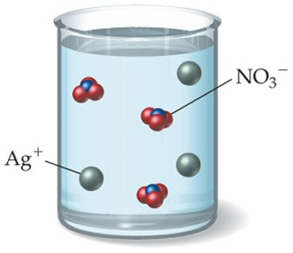
When ionic compounds dissolve in water, the anions and cations are separated from each other. This is called dissociation.
However, not all ionic compounds are soluble in water! (see following slides)
When compounds containing polyatomic ions dissociate, the polyatomic group stays together as one ion.

Slide 79
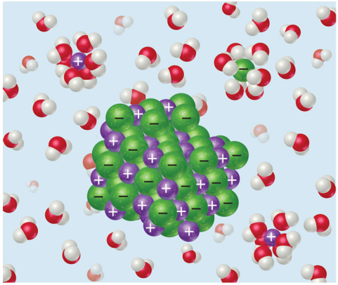
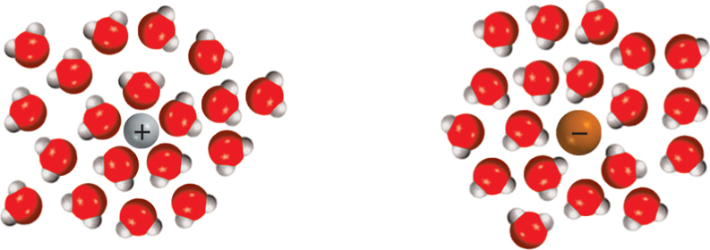
Why do ionic compounds dissociate in water?

Slide 80
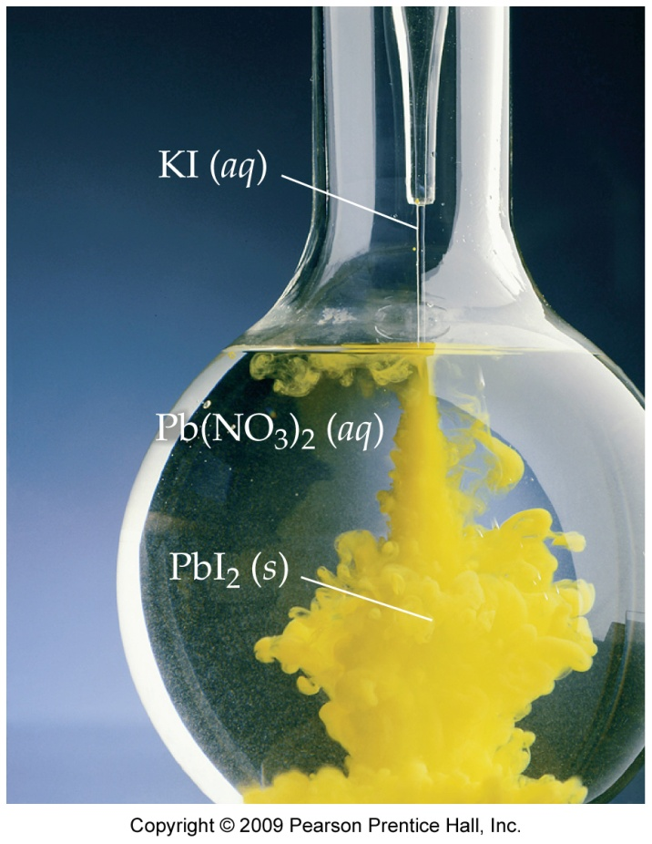
Precipitation Reactions
Many precipitation reactions are done by mixing aqueous solutions of ionic compounds together.
When this is done, often a reaction will take place from the cations and anions in the two solutions that are exchanging.
If the ion exchange results in forming a compound that is insoluble in water, it will come out of solution as a precipitate.
2 KI(aq) + Pb(NO₃)₂(aq) → 2 KNO₃(aq) + PbI₂(s)
(precipitate)

Slide 81
Acids and Bases
Acids in water give H⁺
HA_{(aq)}
H⁺_{(aq)} + A–_{(aq)}
HCl_{(aq)}: A– is Cl–
"general formula for acid"
aqueous = dissolved
in water
Bases in water give OH–
MOH_{(aq)}
M⁺_{(aq)} + OH–_{(aq)}
NaOH_{(aq)}: M⁺ is Na⁺
"general formula for base"

Slide 82
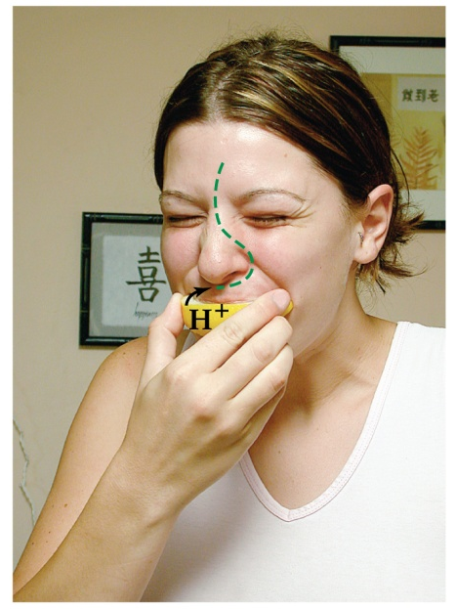
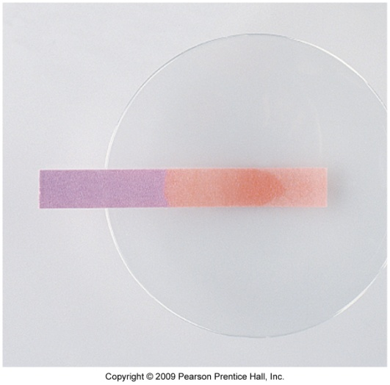
Introduction to Acid-Base Reactions
Facts about Acids:
Any substance that produce H⁺ ions
Sour taste and changes the color of vegetable dyes.
React with “active” metals.
i.e., Al, Zn, Fe
Zn + 2 HCl → ZnCl₂ + H₂
Very corrosive.
React with carbonates, producing CO₂.
Marble, baking soda, chalk, limestone.
CaCO₃ + 2 HCl → CaCl₂ + CO₂ + H₂O
React with bases to form ionic salts.
And often water (neutralization)

Slide 83
Some Common Acids

Slide 84
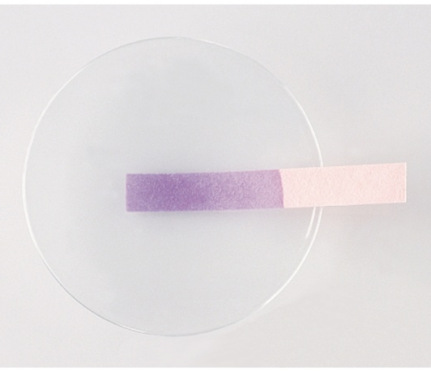
Facts about Bases:
Any substance that produce OH⁻ ions.
A.k.a. alkalis.
Taste bitter and feel slippery.
Change color of vegetable dyes.
Different color than acid.
Litmus = blue.
React with acids to form ionic salts.
And often water and the reaction is referred to as Neutralization Reaction.

Slide 85
Some Common Bases
Note that a lot of the cations are metals!!!

