Slide 1
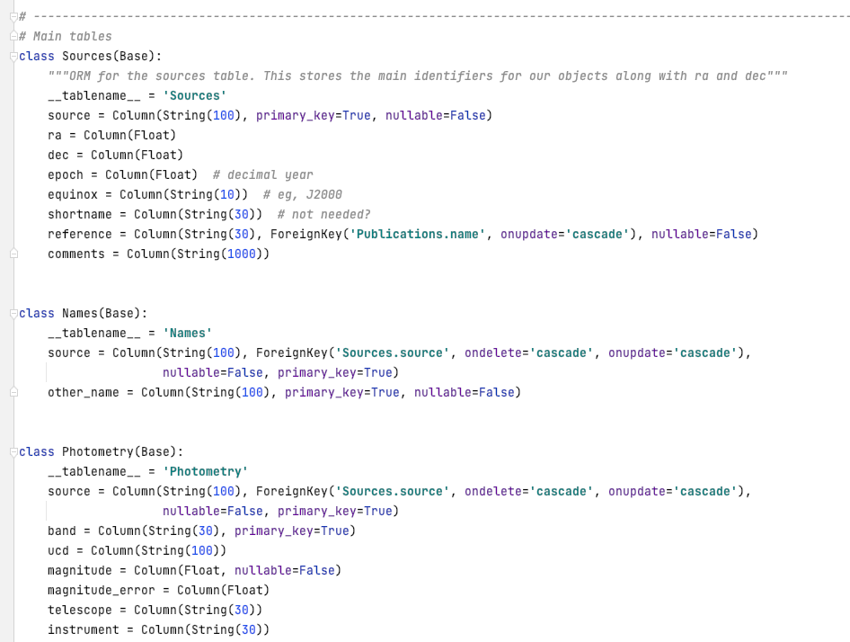
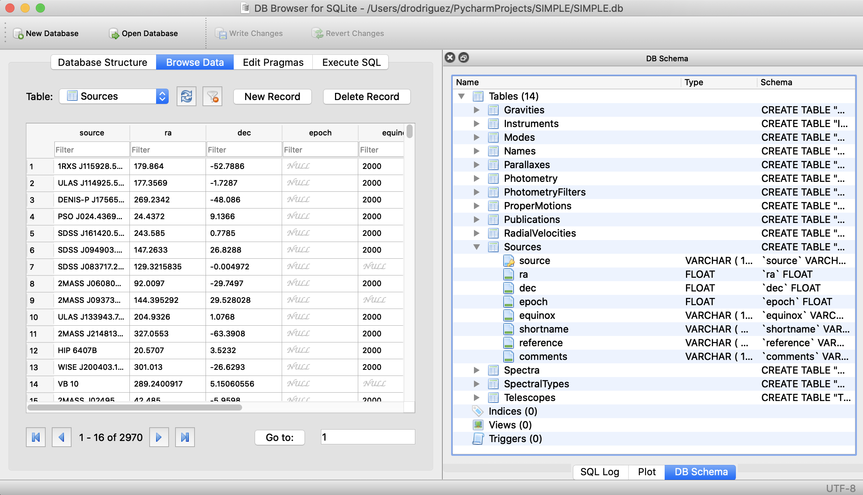
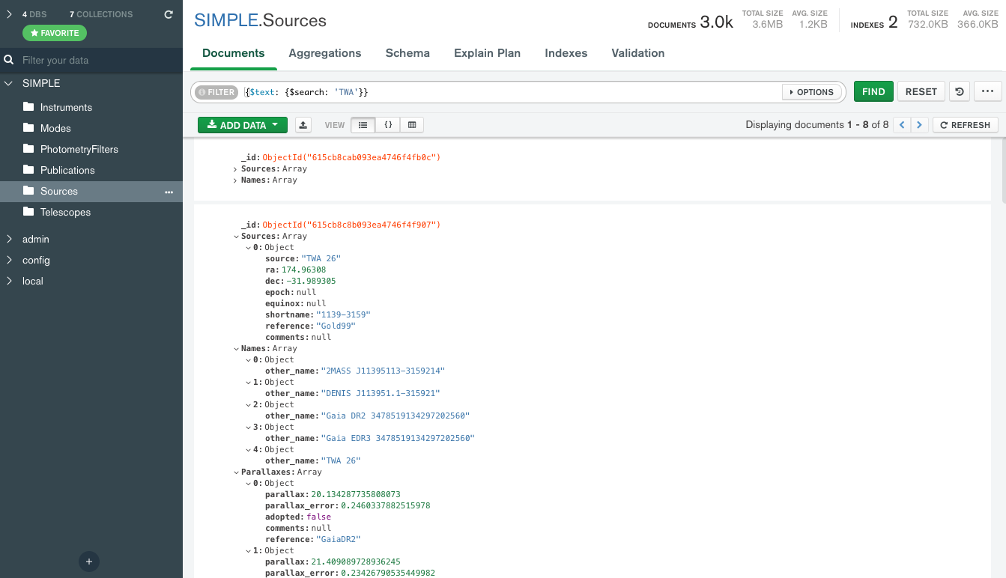
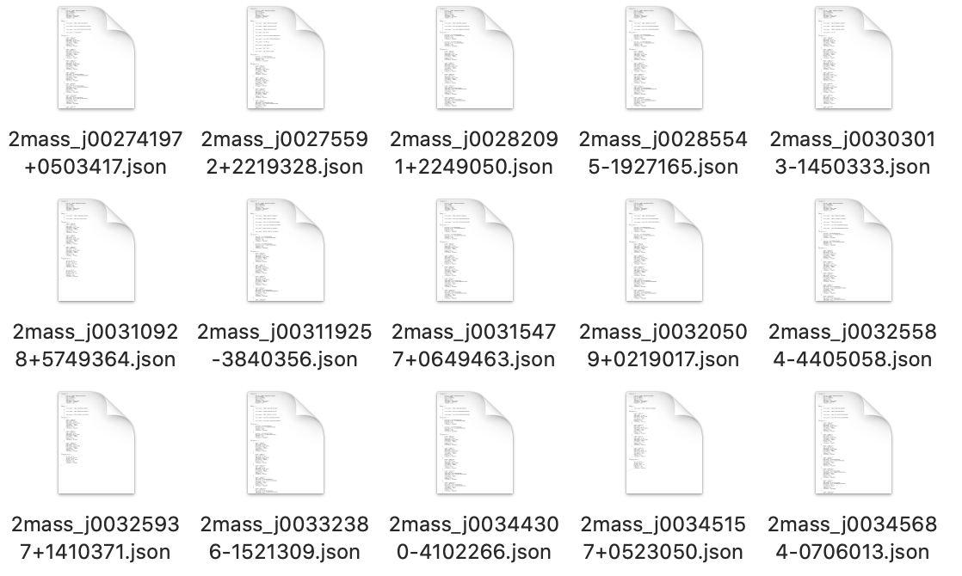
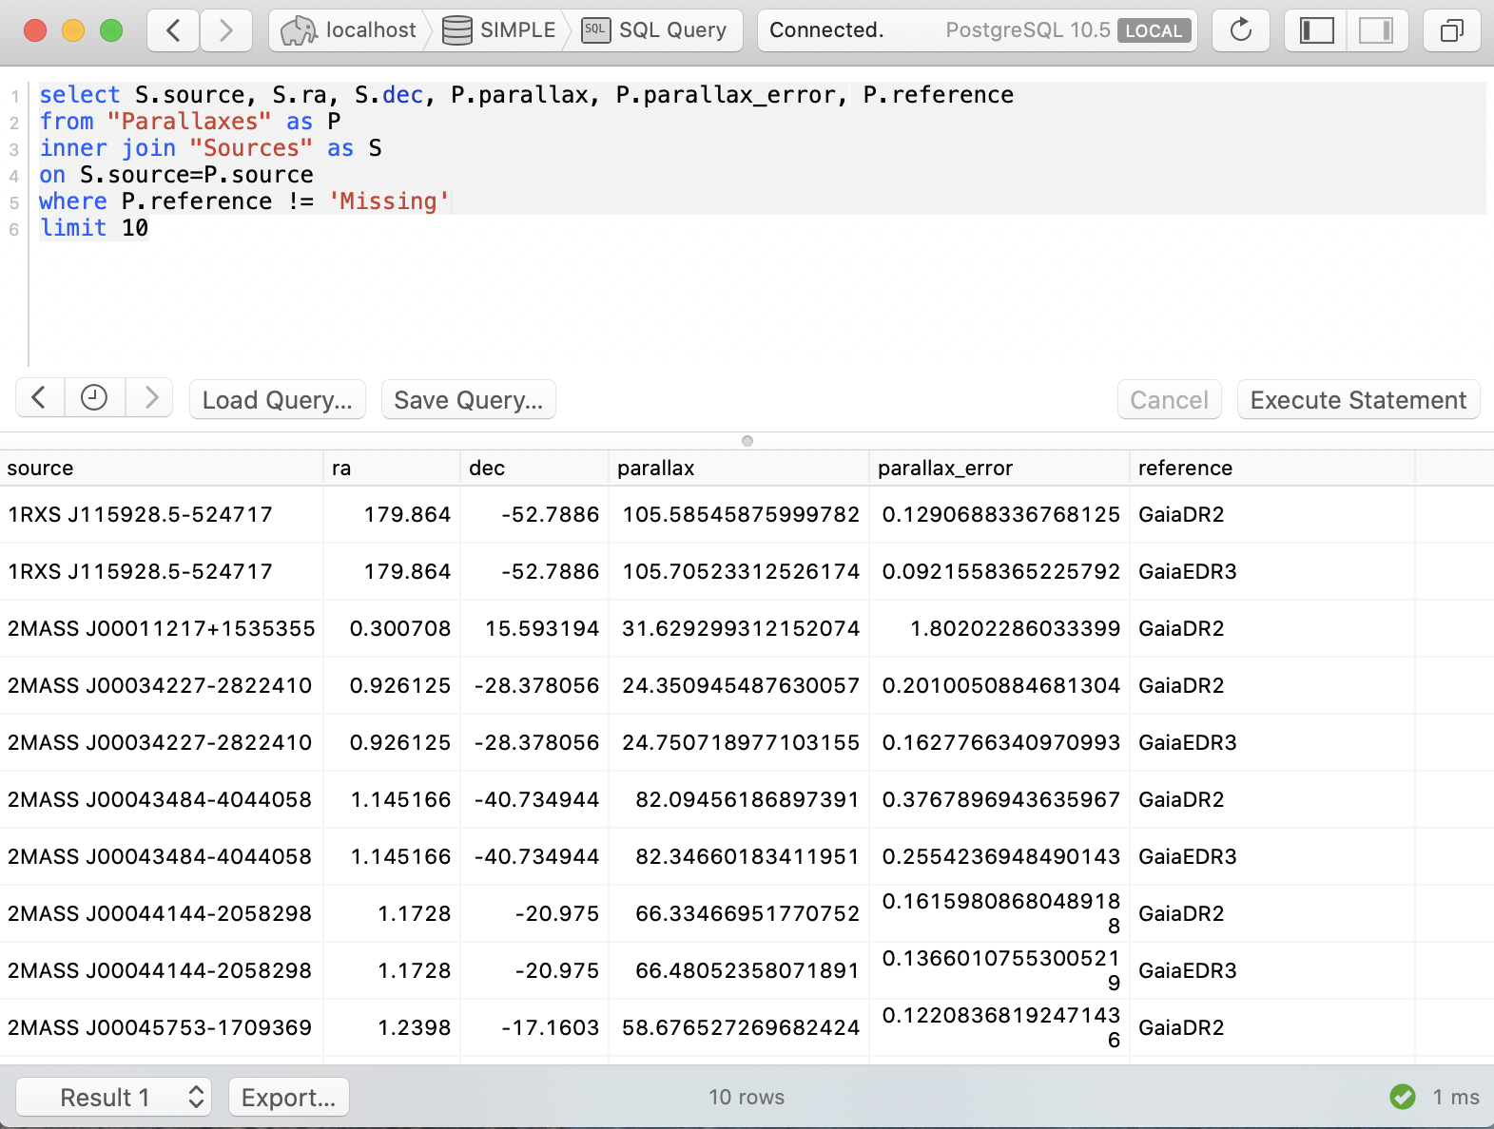
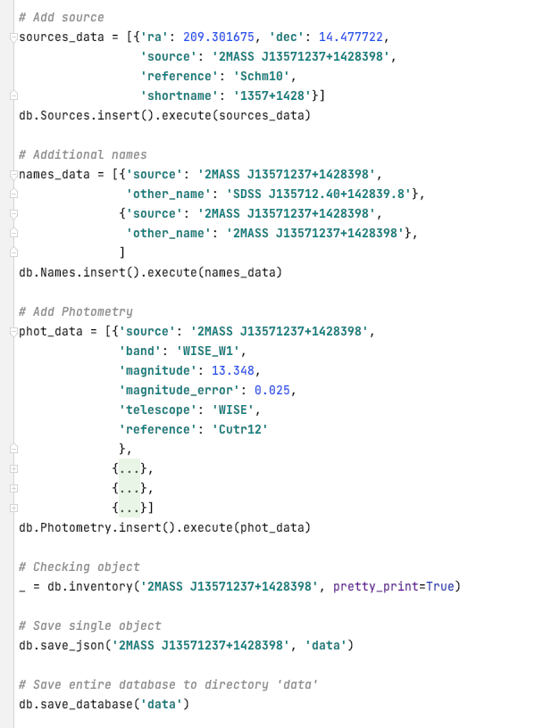
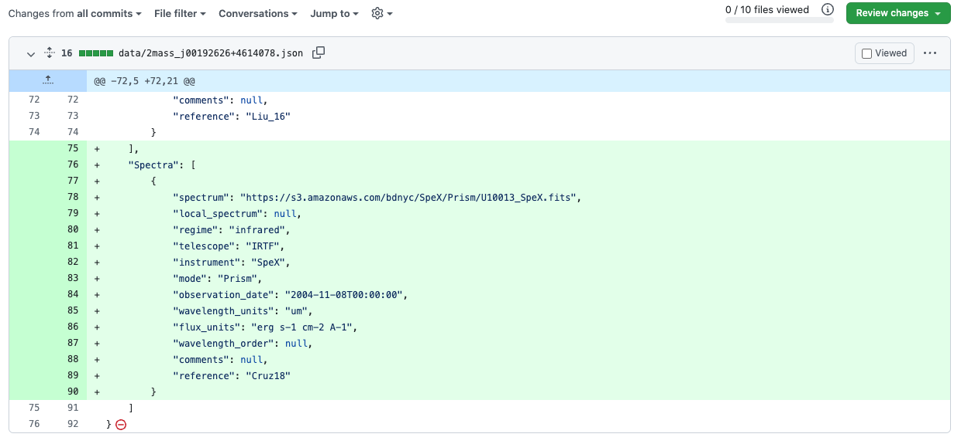
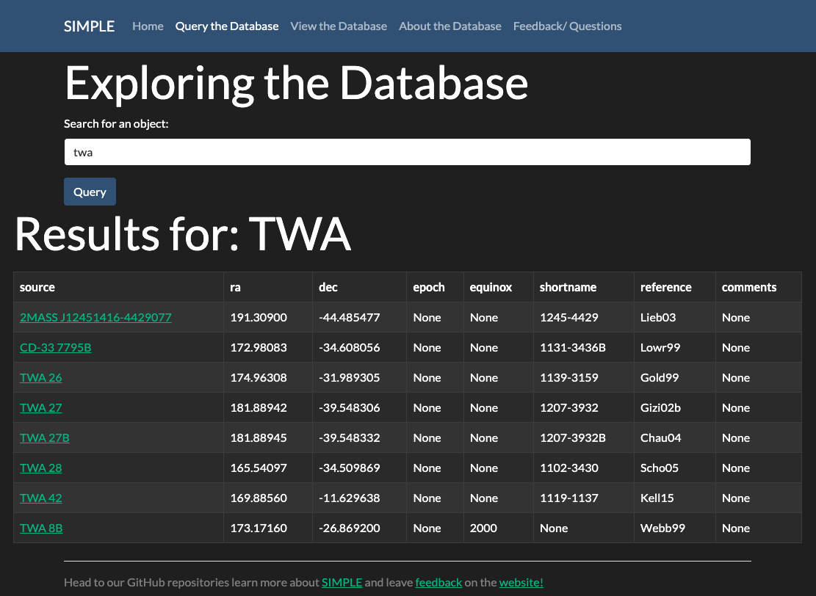
The SIMPLE Archive
David R. Rodriguez (STScI), Kelle Cruz (CUNY Hunter College), Will Cooper (University of Hertfordshire), Niall Whiteford (University of Edinburgh), Clemence Fontanive (CSH, University of Bern), Ella Hort (Pomona College), Sherelyn Alejandro (Hunter College), Robert Blackwell (Flatiron Institute), Daniel Terach (Pace University)
We present the SIMPLE Archive alongside its database management tool, AstrodbKit2. SIMPLE is an archive of low mass stars, brown dwarfs, and exoplanets driven by community curation and review using GitHub. SIMPLE relies on AstrodbKit2 to convert back and forth from a document-store model of the database, to a more standard relational database that can be used with established packages like SQLAlchemy. In this poster, we present the architecture of the SIMPLE database and how using AstrodbKit2 facilitates a git workflow for reviewing and approving database modifications.
SIMPLE is available at https://github.com/SIMPLE-AstroDB/SIMPLE-db
AstrodbKit2 is available at https://github.com/dr-rodriguez/AstrodbKit2
AstrodbKit2 is a Python package that uses SQLAlchemy to create and connect to a variety of relational databases (eg, SQLite, Postgres, MSSQL, etc). Tables in AstrodbKit2 are organized into two types: Object tables, which have one-to-many relationships to a single primary object table (ie, Sources in the SIMPLE database); and Reference Tables, which have many-to-many relationships against the object tables and are used to store lookup information like publications, telescopes, or instruments. The SIMPLE Archive gathers measurements for low mass objects into a variety of tables all associated to the primary Sources table by their source name, as can be seen below.
Sources
Photometry
Spectra
Parallaxes
Proper Motions
Radial Velocities
Names
Spectral Types
Gravities
Reference Tables
Telescopes
Instruments
Publications
Modes
Photometry Filters
Snippet of SIMPLE schema as defined with SQLAlchemy
Schematic representation of the SIMPLE database as split between Object and Reference tables
Using AstrodbKit2, we can convert the SIMPLE database from a document store mode, where individual Sources are stored as JSON files (which can in turn be loaded into NoSQL databases like MongoDB), to a relational database such as SQLite or Postgres that can be accessed with standard tools. JSON files serve as the definitive copy of the database for purposes of version control.
Relational Database
Document Store
Examples of handling SIMPLE as a document store
Examples of handling SIMPLE as a relational database
By exporting a database to a JSON document store, we can use git and GitHub to handle version control for our database as well as curate commits via pull requests. The chart below illustrates the workflow from inserting new data to a local database instance via Python, review of database modifications in GitHub, and then pushing changes to external uses of the database, such as a GUI.
Develop
Work on local instance
Export to JSON
Review
Run validation tests
Merge changes
Publish
Commit to branch
Issue pull request
Run GitHub actions
Load DB from JSON
Deploy to website

Slide 2
Develop
Work on local instance
Export to JSON
Commit to branch

Slide 3
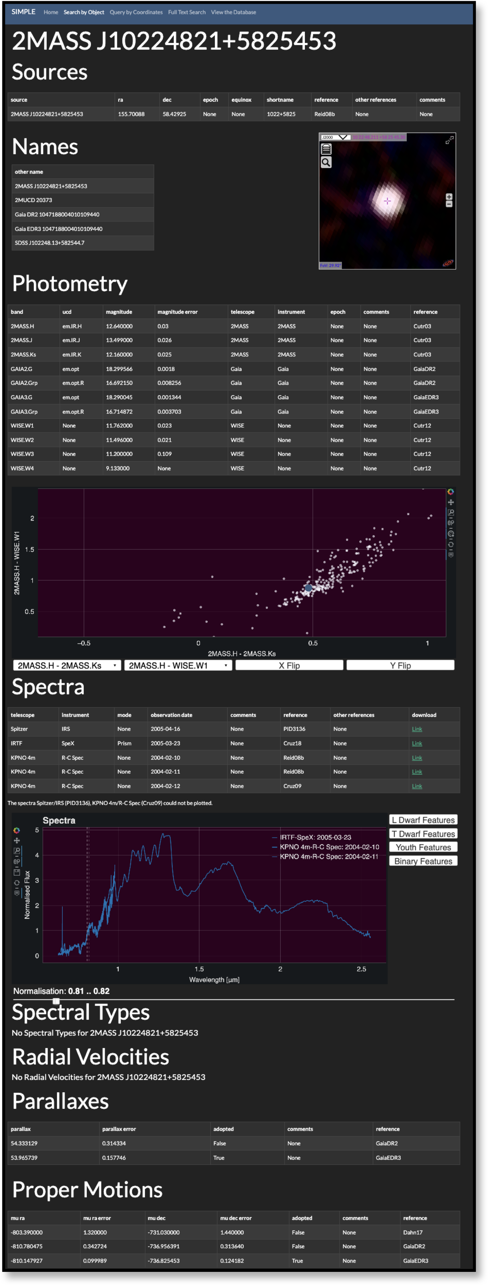

Slide 4
