Slide 1
VisualVoice: CaptivateAI
AI Tool to generate catchy captions based on user provided images

Slide 2
TASK
Create an AI tool that creates captions based on the image provided by the user. Should also have the option to generate multiple captions based on the image.
Provide an interface where the user can come and upload images and get AI generated captions.
Captions should be catchy, exciting, innovative, captivating, creative and engaging instead of just a description of the picture.

Slide 3
MY APPROACH
SCENCE PREDICTION
MobileNetV2
The model has been pre-trained on the ImageNet dataset and is used for object recognition.
LANGUAGE MODEL
Chat GPT3
The tool then takes in the scene predicted and prompts Chat GPT- 3 to generate catchy and creative captions
INTERACTIVE USER INTERFACE
GUI
The UI has option to browse images, display image, and generate captions multiple times.
The model predicts and returns the scenes recognized in the image
It has the option to select tone of the caption to be generated such as Happy, Sad, Motivating ,etc.
It returns the captions to display to the user. You can also specify to create hashtags along with captions

Slide 4
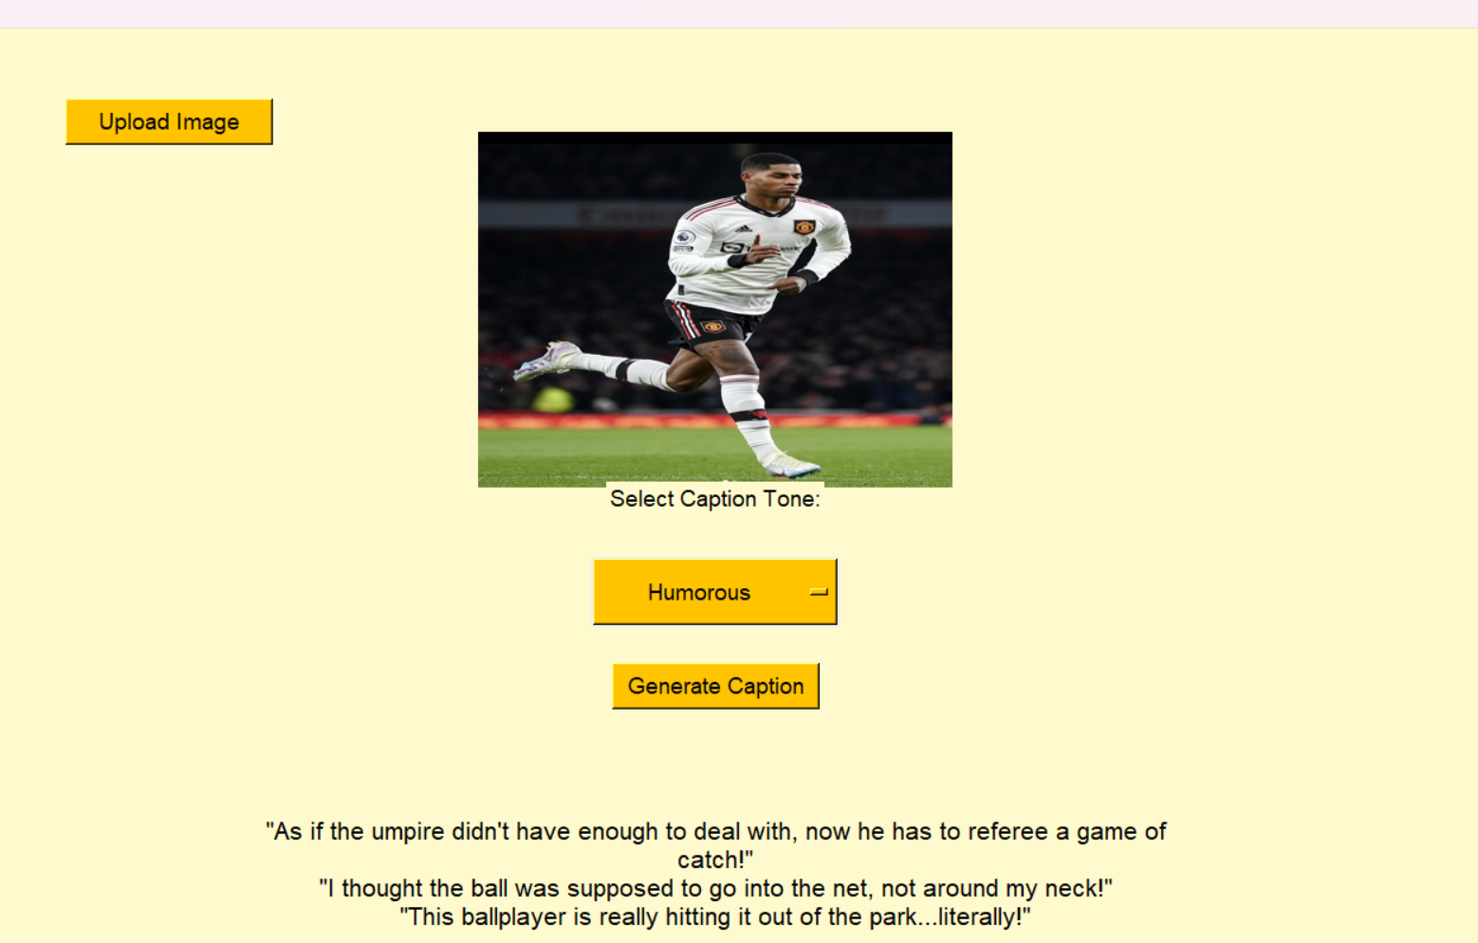
RESULT

Slide 5
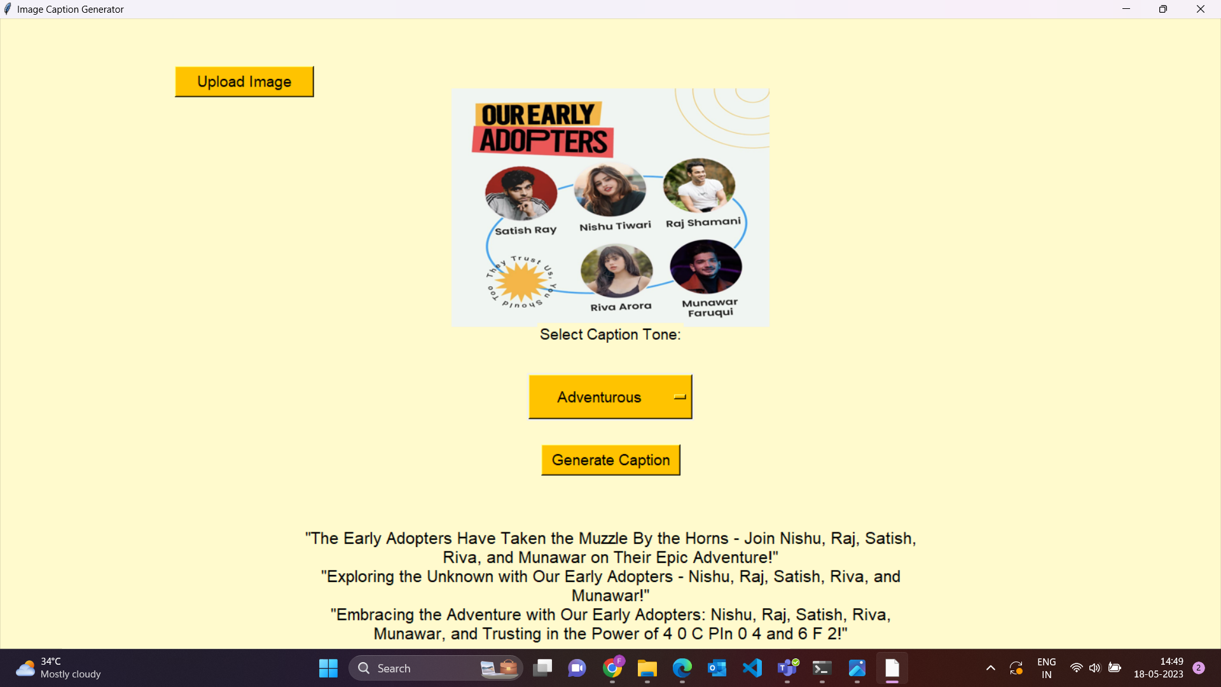
In case of Text in image, I have used EASYOCR to recognize the text and generate caption based on it.

