Slide 1
MSP 2017
MSIntro SP
GIT AND GITHUB for Beginners

Slide 2
Overview
What is git?
How does git work?
What is GitHub?
Quick example using git and GitHub
Install git and create a GitHub account

Slide 3
What is GIT
Distributed version control
Users keep entire code and history on their location machines
Users can make any changes without internet access
(Except pushing and pulling changes from a remote server)

Slide 4

What is GIT
Started in 2005
Created by Linus Torvald to aid in Linux kernel development

Slide 5

What is GIT
Git isn’t the only version control system
But (we think) it’s the best

Slide 6
How does GIT work?
The way git keeps track of your code history
Essentially records what all your files look like at a given point in time
• You decide when to take a snapshot, and of what files

Slide 7
commit
The act of creating a snapshot • Can be a noun or verb
“I commited code”
“I just made a new commit”
Essentially, a project is made up of a bunch of commits

Slide 8
Repositories
Often shortened to ‘repo’
A collection of all the files and the history of those file
Consists of all your commits
Place where all your hard work is stored
Can live on a local machine or on a remote server (GitHub!)
The act of copying a repository from a remote server is called cloning
Cloning from a remote server allows teams to work together
*The process of downloading commits that don’t exist on your machine from a remote repository is called pulling changes
*The process of adding your local changes to the remote repository is called pushing changes

Slide 9
Branches
All commits in git live on some branch
But there can be many, many branches
The main branch in a project is called the master branch
A bunch of commits linked together that live on some branch, contained in a repository

Slide 10

What is GitHub
Founded in 2008
Also has an Enterprise edition for businesses
www.github.com
Largest web-based git repository hosting service
Aka, hosts ‘remote repositories’
Allows for code collaboration with anyone online
Adds extra functionality on top of git
UI, documentation, bug tracking, feature requests, pull requests, and more!

Slide 11

Install GIT
Linux (Debian)
Command: sudo apt-get install git!
Linux (Fedora)
Command: sudo yum install git!
Mac
- http://git-scm.com/download/mac
Windows
- http://git-scm.com/download/win

Slide 12
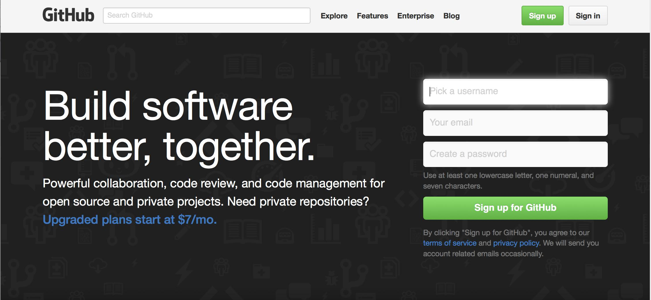
Create a GitHub account
www.github.com
Free for public repositories

