Slide 1


Automatic space subdivision for multi-story pathfinding on a 3D point cloud using an octree
F.W. Fichtner, 2016-02-23
f.w.fichtner@student.tudelft.nl

Slide 2
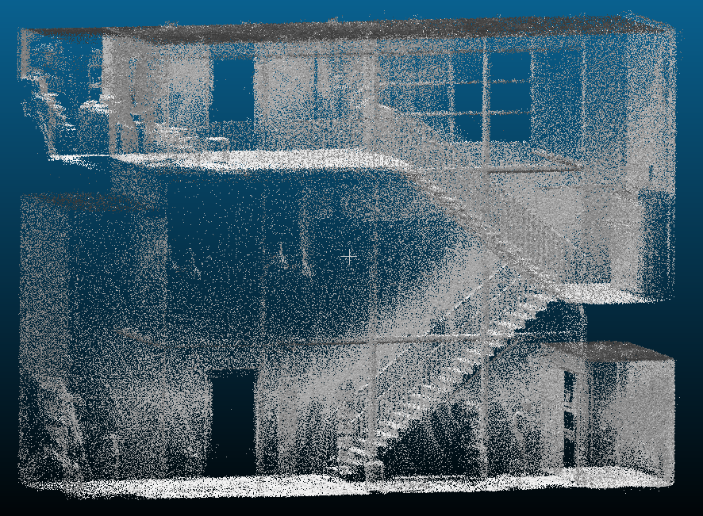
ZEB1 point cloud Fire Brigade in Berkel en Rodenrijs

Slide 3
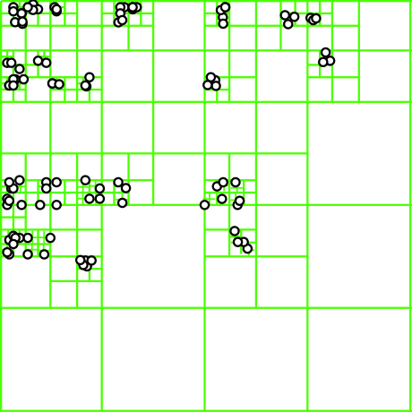
Octree

Slide 4
Reconstruction for pathfinding
Subdivide and semantically enrich the structure
Derive pathfinding network
Match model with localizer

Slide 5
How to?
Histograms
Plane fitting
Line detection

Slide 6
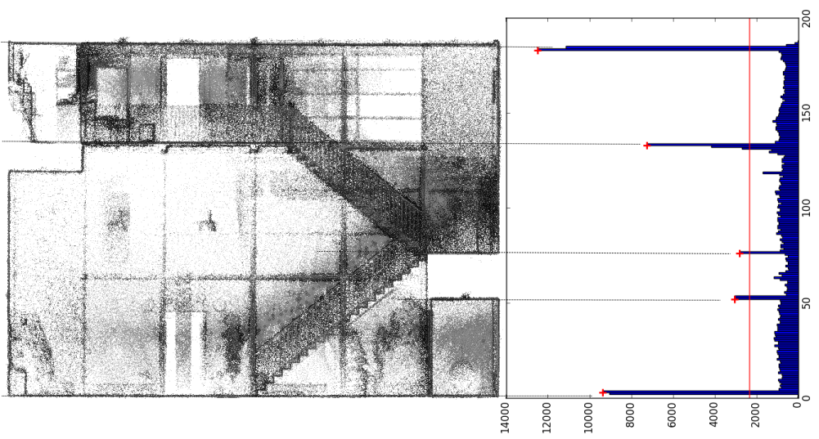
Story separation

Slide 7
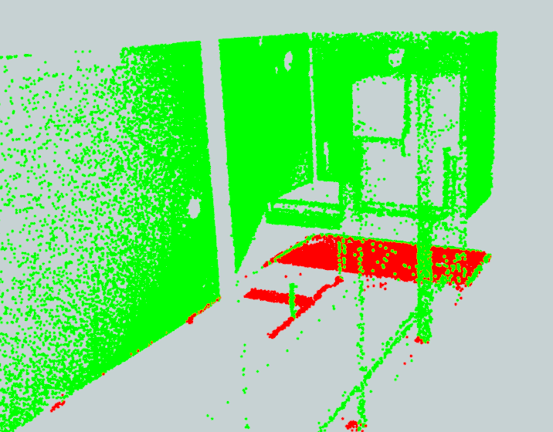
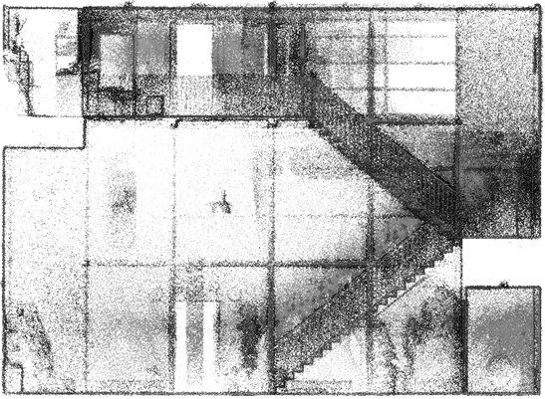
First story, problem hanging ceilings

Slide 8
But what if there would be a table?
Histogram would have the same peak attributes
To be fixed when stairs are known?

Slide 9
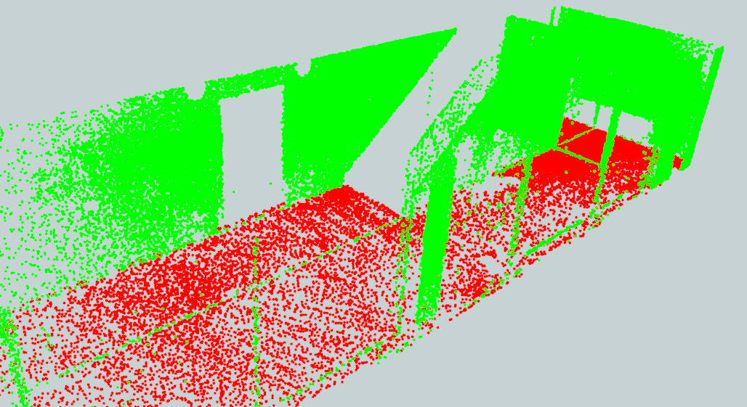
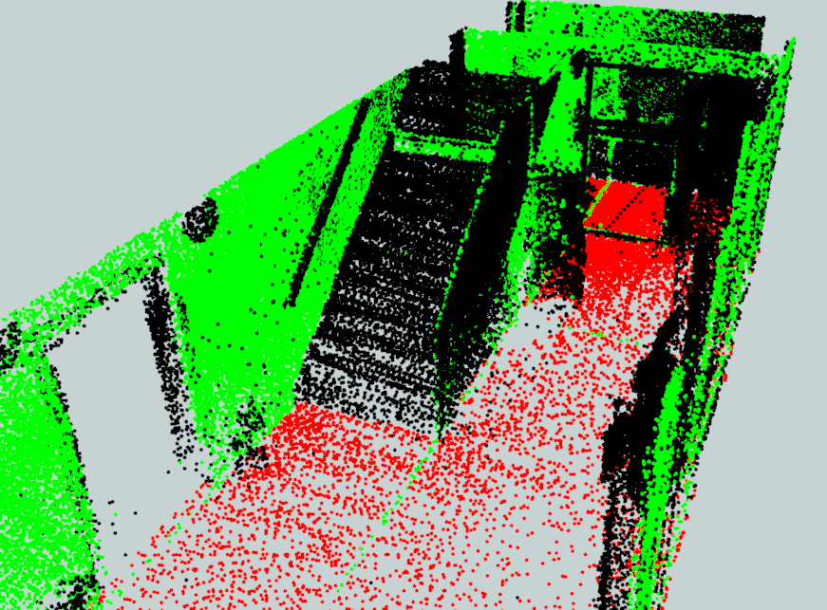
Ground story

Slide 10
Vertical & Horizontal histograms
According to normal direction of plane through points in octree leaf and direct neighbours

Slide 11
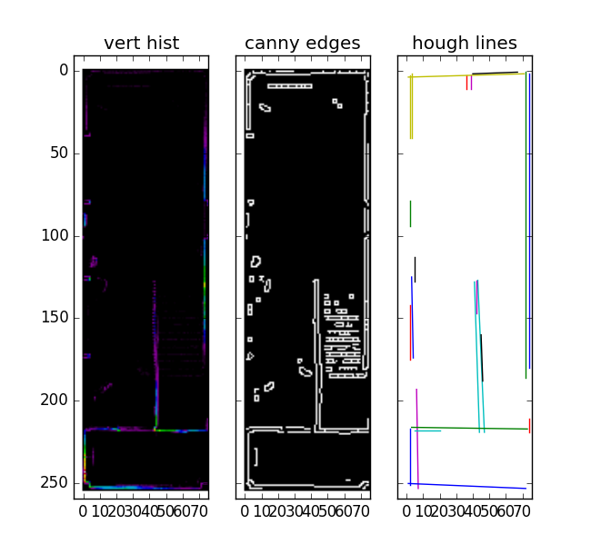
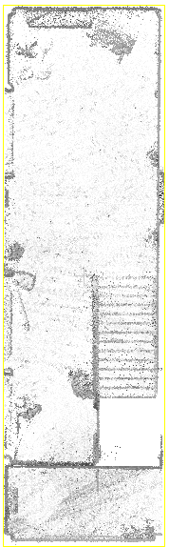
Improve wall detection
Hough transform
point cloud cut floor 0
Next: project to octree, correct result of histogram method

Slide 12
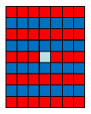

Stairs
Matched filter for vertical & horizontal histogram
point cloud cut floor 0
stair vertical filter stair horizontal filter
Blue=positive filter weights
Red=negative filter weights
Light blue=centre of filter

Slide 13
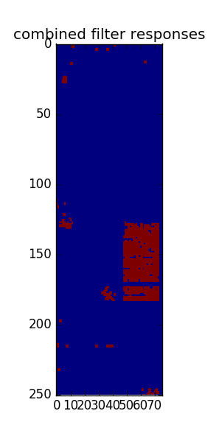
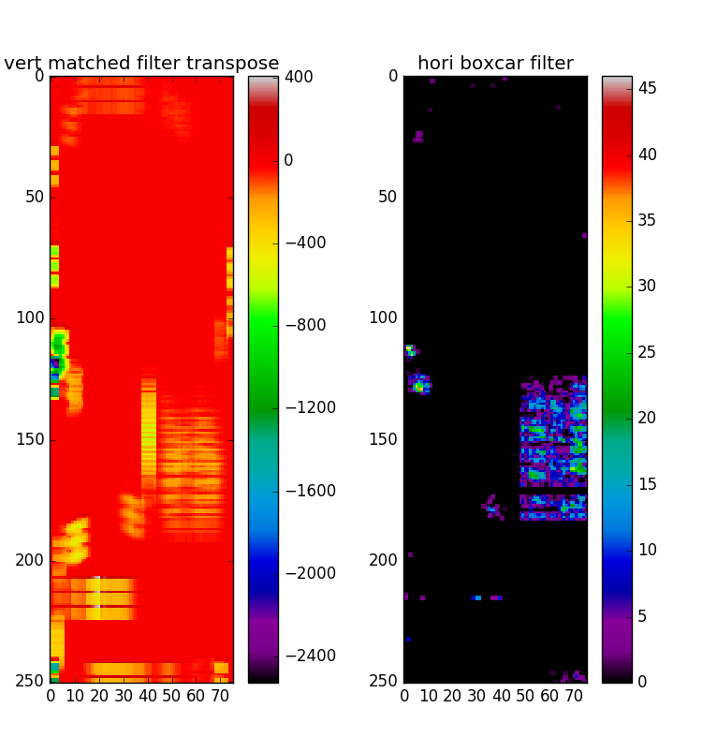
Stairs
Filter responses
Next: grow regions → calculate slope & aspect, should link two floors

Slide 14
Tools
SciPy (NumPy, Matplotlib, Scikit-image)
PostgreSQL
CloudCompare
FME Workbench

Slide 15
References
Bansal, M., Matei, B., Southall, B., Eledath, J., and Sawhney, H. (2011). A lidar streaming architecture for mobile robotics with application to 3d structure characterization. In Robotics and Automation (ICRA), 2011 IEEE International Conference on, pages 1803–1810.
Broersen, T., Fichtner, F., Heeres, E., de Liefde, I., and Rodenberg, O. (2015). Project pointless. identifying, visualizing and pathfinding through empty space in interior point clouds using an octree approach. Geomatics Synthesis Project.
Jamali, A., Rahman, A. A., Boguslawski, P., Kumar, P., and Gold, C. M. (2015). An automated 3d modeling of topological indoor navigation network. GeoJournal, pages 1–14.
Khoshelham, K. and Díaz-Vilariño, L. (2014). 3D Modelling of Interior Spaces: Learning the Language of Indoor Architecture. ISPRS - International Archives of the Photogrammetry, Remote Sensing and Spatial Information Sciences, pages 321–326.
Liu, L. and Zlatanova, S. (2013a). Generating navigation models from existing building data. In Acquisition and Modelling of Indoor and Enclosed Environments 2013, Cape Town, South Africa, 11-13 December 2013, ISPRS Archives Volume XL-4/W4, 2013. ISPRS.
Oesau, S., Lafarge, F., and Alliez, P. (2014). Indoor scene reconstruction using feature sensitive primitive extraction and graph-cut. fISPRSg Journal of Photogrammetry and Remote Sensing, 90:68 – 82.
Okorn, B., Xiong, X., Akinci, B., and Huber, D. (2010). Toward automated modeling of floor plans. In Proceedings of the Symposium on 3D Data Processing, Visualization and Transmission, volume 2.

