Slide 1

BlueStock Mutual Fund Analytics Platform
Capstone Project | End-to-End Data Analytics
From Raw Data to Investment Insights
PREPARED BY : SINDHU M
DATE : JUNE 2026

Slide 2
PROBLEM & OBJECTIVE
Problem: Retail investors and fund managers lack a unified view of mutual fund performance, risk, and investor behavior — making it difficult to compare funds, track portfolio health, or identify at-risk investors.
Objective: Build a full-stack analytics platform that:
Ingests and cleans multi-source MF data
Creates a structured analytical database
Computes industry-standard performance metrics
Delivers an interactive dashboard for decision-making
Target Users: Fund managers, retail investors, financial advisors

Slide 3
DATA SOURCES
8 Datasets | 40 Schemes | 10 Fund Houses | 4-Year History
Coverage: Jan 2022 – Apr 2026 | Pan-India investors
DATASET | KEY FIELDS
NAV History (150K+ rows) | amfi_code, date, nav
Scheme Performance (40 rows) | returns, Sharpe, Alpha, Beta
Investor Transactions (10K+ rows) | type, amount, state, age_group
SIP Trends (48 months) | month, sip_inflow_crore
Benchmark (NIFTY50, NIFTY100) | date, close_value
AMC Details | fund_house, total_aum

Slide 4
ARCHITECTURE
RAW DATA (CSVs)
↓
Data Cleaning
(Pandas, Python)
↓
SQLite Database
(Star Schema, 5 Tables)
↓
Python Analytics → CSV Outputs
(Colab Notebooks) (Scorecard, VaR)
↓
Power BI Dashboard
(4 Pages, 20+ Charts)
↓
Final Report + Presentation

Slide 5
EDA HIGHLIGHTS
Investor Behavior Insights:
SIP = 60% of all transactions (dominant mode)
Maharashtra, Karnataka, Tamil Nadu = top 3 states by volume
T30 cities contribute 72% of total transaction value
Age 31–40 = highest average SIP amount
Tax-saving season (Jan, Mar) drives transaction spikes
NAV Distribution:
Mean daily return: 0.06% | Std Dev: 1.03%
Distribution is approximately normal with positive skew
Zero extreme outliers (>±10% moves)

Slide 6
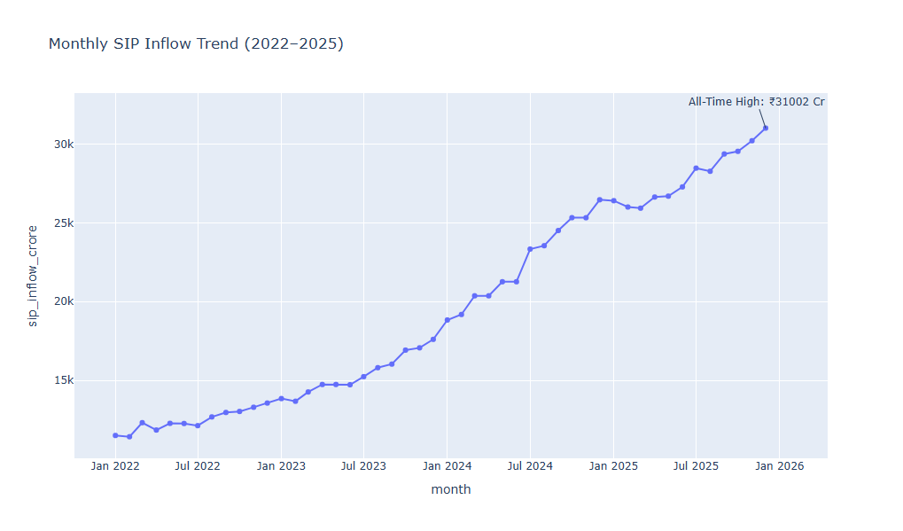
EDA HIGHLIGHTS
SIP Trend vs Market:
Key observations:
SIP inflows grew consistently despite market volatility
Mid-cap and small-cap categories captured highest FY25 inflows
Strong positive correlation between market sentiment and SIP growth
Dip in SIP inflows during Q3 2022 (market correction period)

Slide 7
PERFORMANCE METRICS
3-Year CAGR Champions:
Rank | Fund | Score
1 | ICICI Pru Midcap | 100.00
2 | Axis Midcap | 91.4
3 | Mirae Asset Large Cap | 87.2
Fund Scorecard — Top 3 (Composite 0–100):
Scorecard: 30% return + 25% Sharpe + 20% Alpha + 15% expense + 10% drawdown
Rank | Fund | 3yr CAGR
1 | Axis Midcap | 35.11%
2 | DSP Small Cap | 32.8%
3 | ICICI Pru Midcap | 30.5%

Slide 8
PERFORMANCE METRICS
Fund | Sharpe | Max DD | VaR (95%)
Mirae Large Cap | 1.45 | −24.3% | 1.6%
ICICI Midcap | 1.31 | −38.1% | 2.4%
SBI Small Cap | 0.71 | −52.6% | 3.1%
Key Insight: Small-cap funds offer highest returns but carry 2× the drawdown risk of large-cap funds. The risk-return tradeoff is clearly visible in the scatter plot.

Slide 9
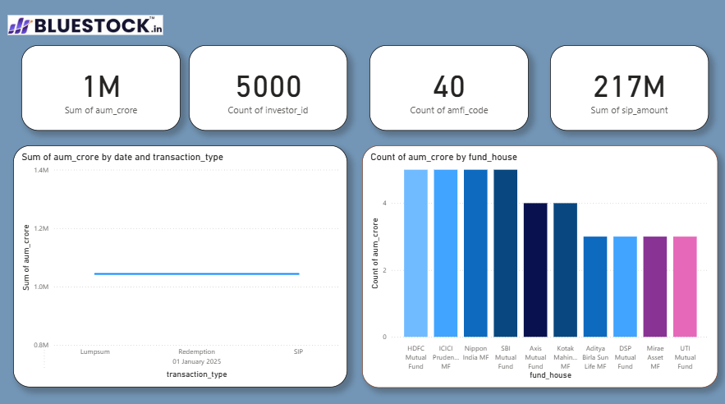
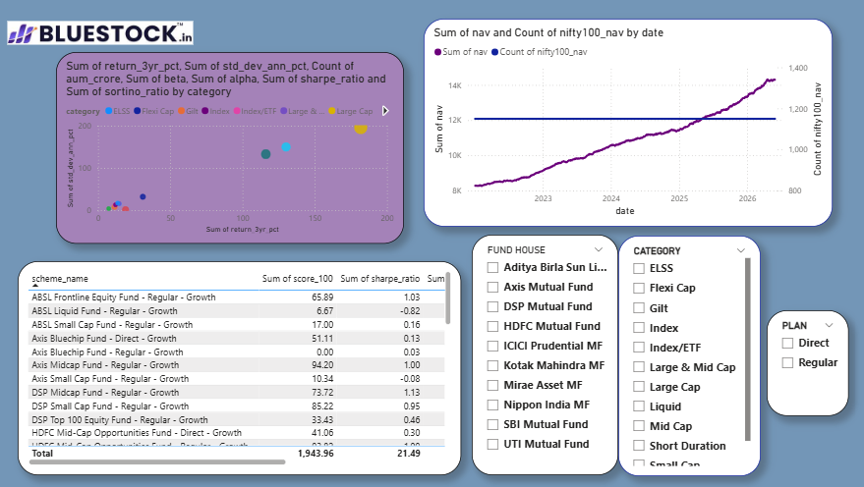
DASHBOARD SCREENSHOT

Slide 10
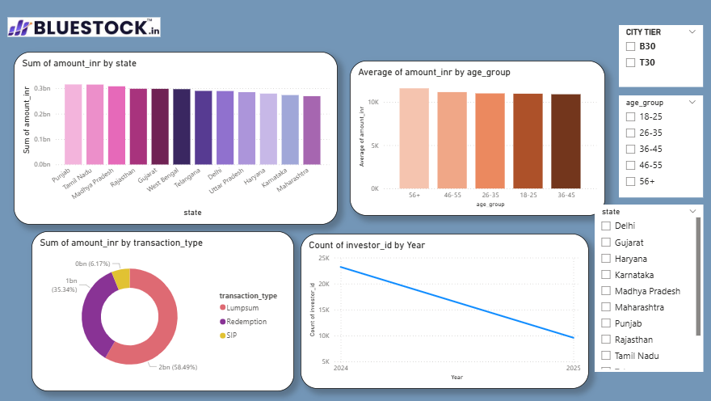
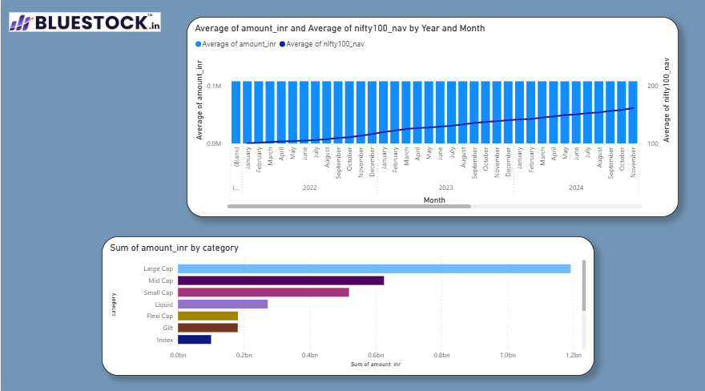
DASHBOARD SCREENSHOT

Slide 11
KEY FINDINGS & RECOMMENDATIONS
Top Findings:
Mid-cap funds deliver 2.5× the risk-adjusted return of large-cap over 3 years
At-risk SIP investors (gap >35 days) = opportunity for retention campaigns
HHI analysis: Small-cap funds are 2.5× more concentrated than large-cap
T30 investors drive 72% of value — high-value segment for personalization
Rolling Sharpe drops sharply during corrections — early warning signal
Recommendations:
Use composite scorecard for fund selection (not just returns)
Flag at-risk SIP investors for proactive outreach
Automate ETL pipeline for live data refresh
Expand to all 1,908 schemes via AMFI API

Slide 12
THANK YOU
BlueStock Mutual Fund Analytics Platform Complete | Scalable | Data-Driven
GitHub: https://github.com/SINDHU071/BlueStock_Capstone_Project
Deliverables Completed: Data Cleaning & ETL | SQLite Database | SQL Queries Performance Analytics | Advanced Analytics | Power BI Dashboard Final Report |Presentation

