Slide 1
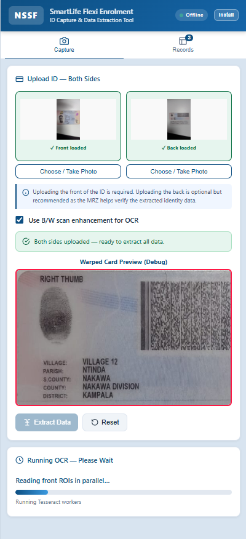

NSSF
SmartLife Flexi
ID Capture Tool
Solving the Field Data Collection Problem
Enterprise & Growth Department · June 2026

Slide 2
THE PROBLEM
Field data collection is
breaking the enrolment process.
!
Handwriting Errors
⏱
Slow Processing
▤
Data Quality Issues
NINs, names and dates copied manually from IDs — leading to frequent transcription mistakes and invalid records.
Each member requires a full manual form. High volumes during drives means delays, queues and staff fatigue.
Inconsistent formatting, missing fields and illegible entries when capturing data will in the field requiring costly re-verification before onboarding.

Slide 3
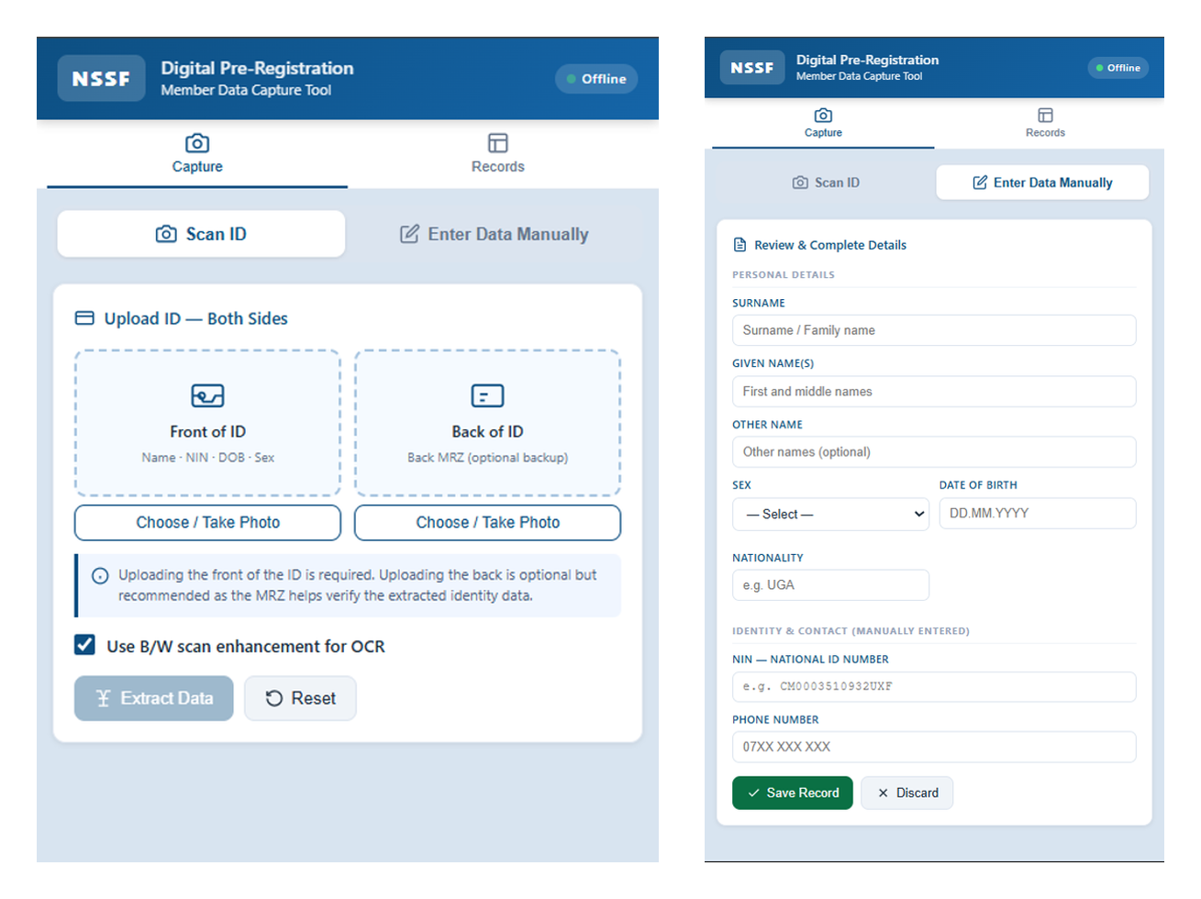
Photo-to-Data Automation
THE SOLUTION
A tool that extracts extracts pre-registration memeber data for inidviduals wishing to join NSSF and its products i.e smart life flexi. The data includes name, NIN, sex, date of birth, nationality and phone number through Scanning an ID or Entering the data manually. This data is then converted to an excell file which which can be used to easily register new memebrs or for bulk registraiton in cases with a high number of members looking to be regsitered.

Slide 4
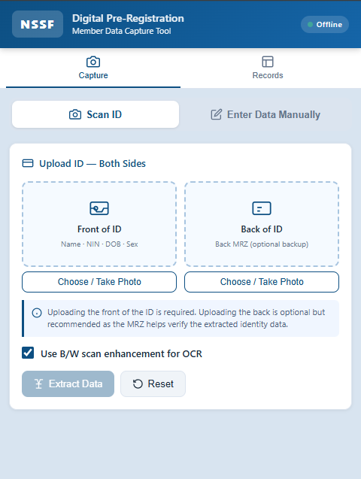
SCAN ID OPTION
Photo-to-Data Automation
How It Works
1
Staff photographs the ID
Upload front and back of the member's National ID directly from a phone or laptop camera.
2
OCR reads the card
The tool extracts name, NIN, date of birth, expiry, village and district automatically.
3
Staff review & confirm
A form pre-fills with extracted data. Staff verify, add the phone number, and save.
4
Export to Excel
All captured records export instantly as a formatted .xlsx file, ready for bulk registraiton.

Slide 5
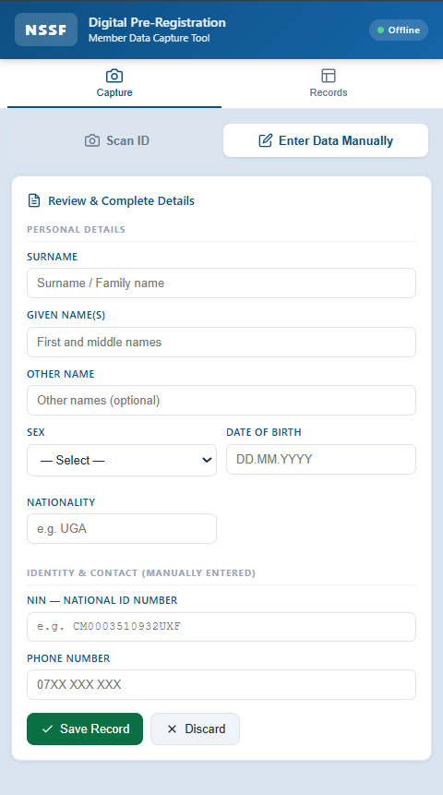
ENTER DATA MANUALLY
Manual Data Capture
How It Works
1
Staff manually enters data
Manually enter the Name, Sex, Date of Birth, Nationality, NIN and Phone number of an aspiring member.
2
Staff review & confirm
Staff verify the data, and save.
3
Export to Excel
All entered records export instantly as a formatted .xlsx file, ready for upload to bulk registraiton.

Slide 6
SCAN ID OPTION
STEP 1: SELECT DATA ENTRY OPTION
Staff selects their desired data capture option. In this case Scan ID option.
📷
Photo-to-Data
Automation

Slide 7
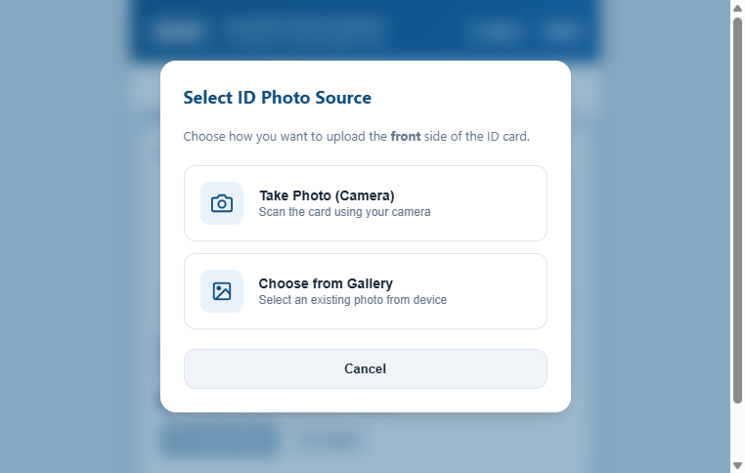
SCAN ID OPTION
STEP 2: CAMERA CAPTURE & GALLERY UPLOAD
Staff can scan the member's National ID directly using a phone or laptop camera, or choose a file from the device gallery. A custom source selector prevents Android/iOS browser camera lockout bugs.
📷
Photo-to-Data
Automation

Slide 8
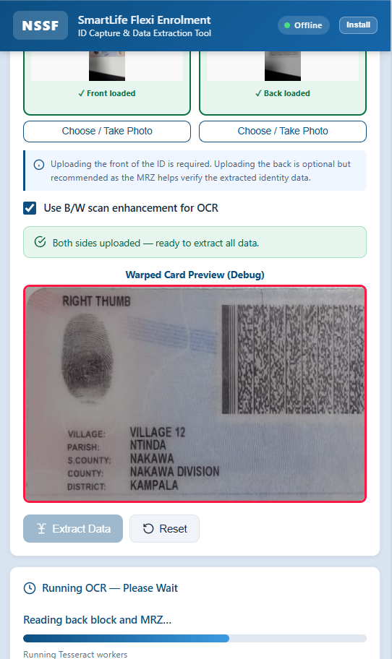
SCAN ID OPTION
STEP 3: EDGE DETECTION & PERSPECTIVE WARPING
The tool automatically detects card boundaries using OpenCV.js. If auto-detection fails (e.g. due to lighting), staff can manually adjust the 4 corners using a touch-friendly interface.
📷
Photo-to-Data
Automation

Slide 9
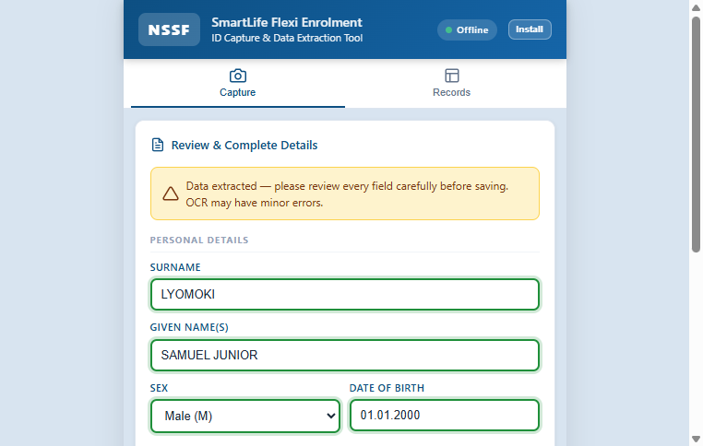
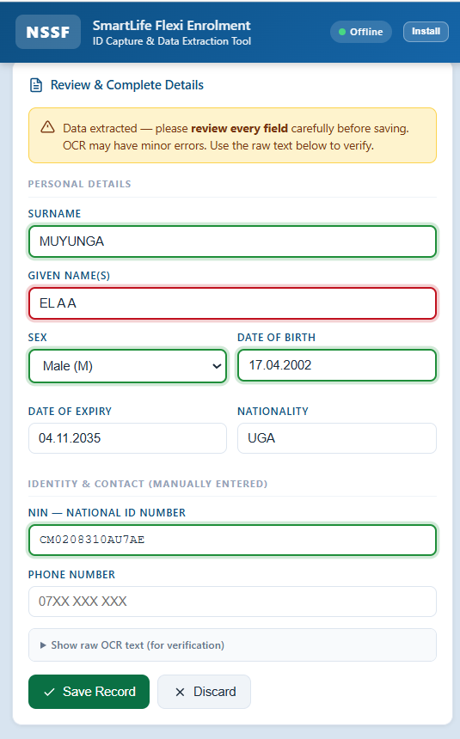
THE
SOLUTION
STEP 4: OCR DATA EXTRACTION & VALIDATION
Tesseract.js extracts names, NIN, DOB, and expiry. Fields are visually highlighted based on confidence levels (green for high confidence, amber for review, red for critical errors).
📷
Photo-to-Data
Automation
A lightweight tool that reads any Uganda National ID with a phone camera — no typing.

Slide 10
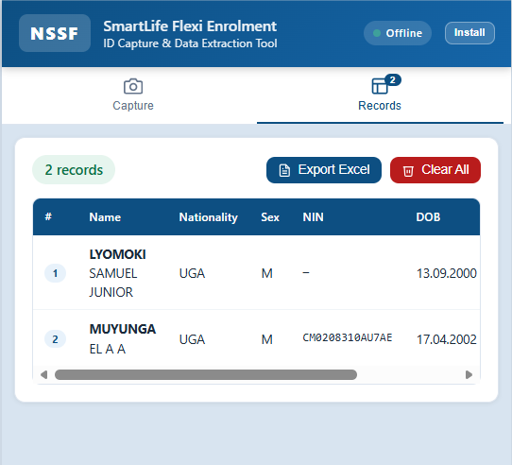
THE
SOLUTION
STEP 5: OFFLINE RECORDS & EXCEL EXPORT
All captured data is saved locally on the device (fully offline). Staff can review, search, and export the entire drive's records to a formatted Excel spreadsheet with a single click.
📷
Photo-to-Data
Automation
A lightweight tool that reads any Uganda National ID with a phone camera — no typing.

Slide 11
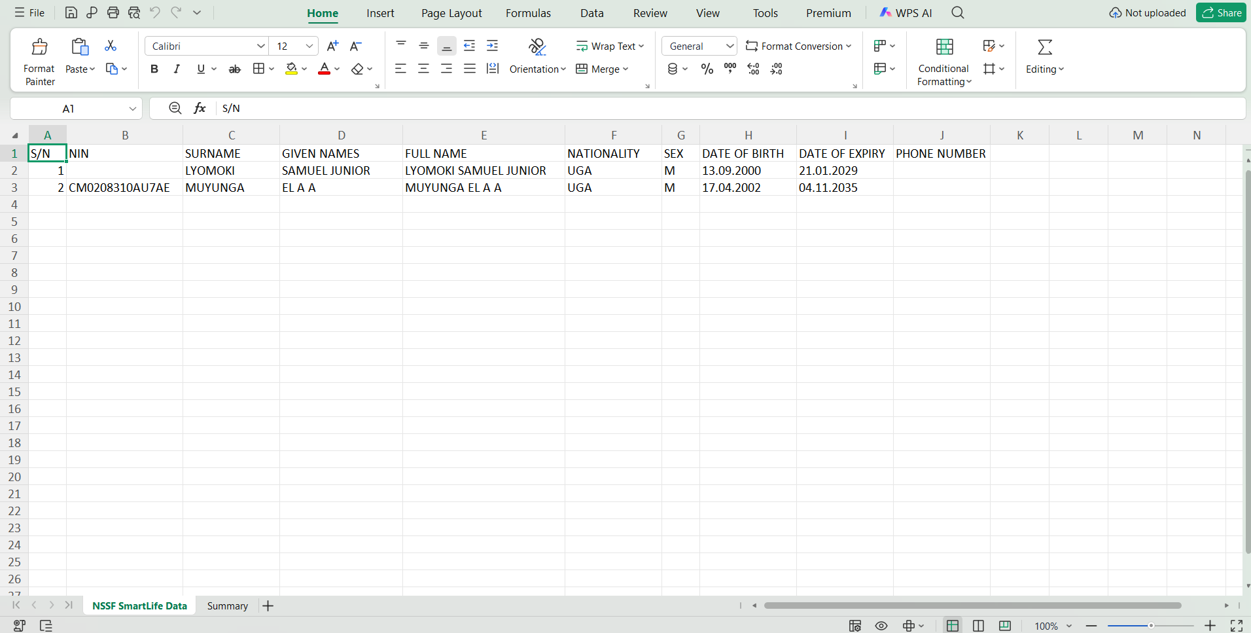
EXCEL EXPORT DATA VIEW
THE
SOLUTION

Slide 12
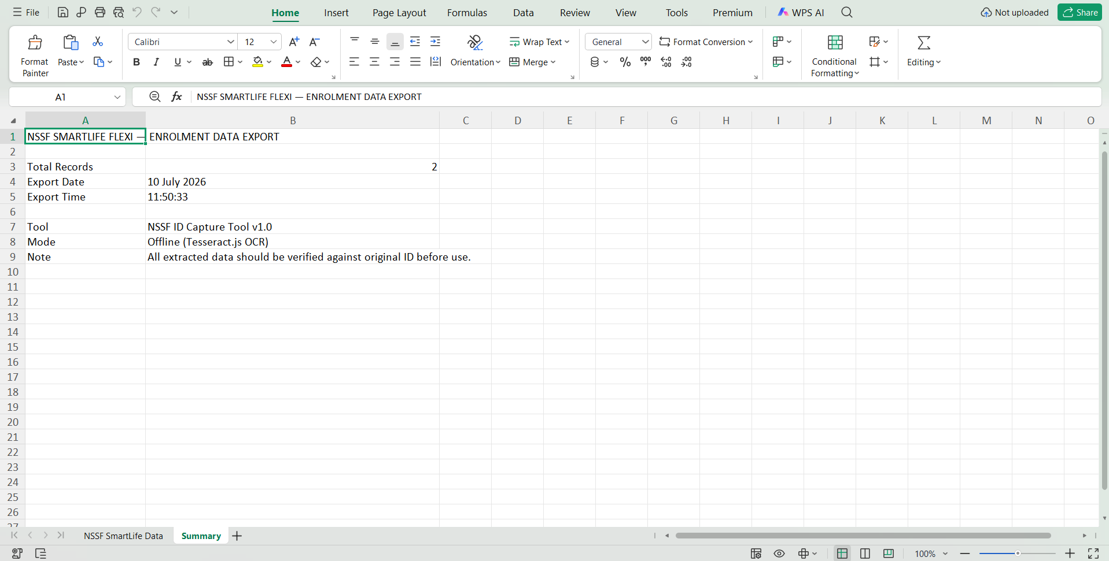
EXCEL EXPORT DATA VIEW
THE
SOLUTION

Slide 13
STEP 1: SELECT DATA ENTRY OPTION
ENTER DATA MANUALLY
Staff selects their desired data capture option. In this case Enter Data Manually.
📷
Manual Data Capture

Slide 14
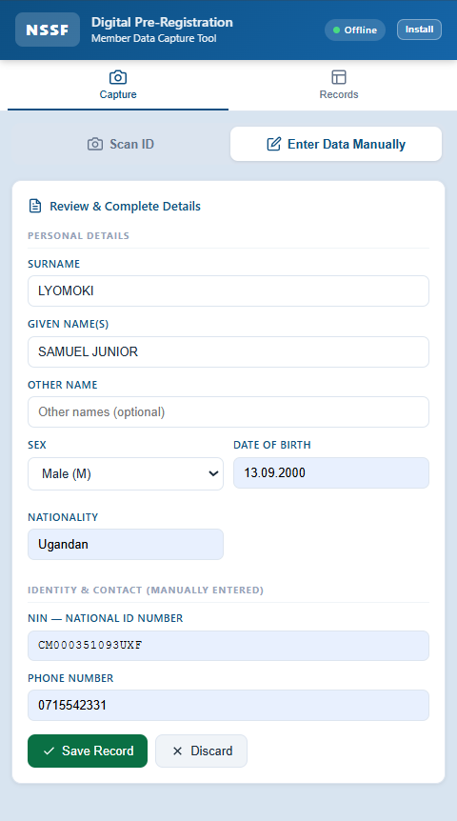
STEP 2: STAFF REVIEW & CONFIRM
SCAN ID OPTION
Staff verify the data, and save record.
📷
Manual Data Capture

Slide 15
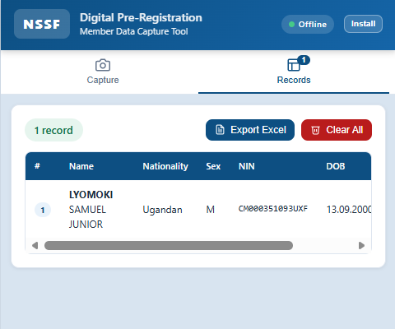
STEP 3: OFFLINE RECORDS & EXCEL EXPORT
SCAN ID OPTION
All entered records export instantly as a formatted .xlsx file, ready for upload to bulk registraiton.
📷
Manual Data Capture

Slide 16
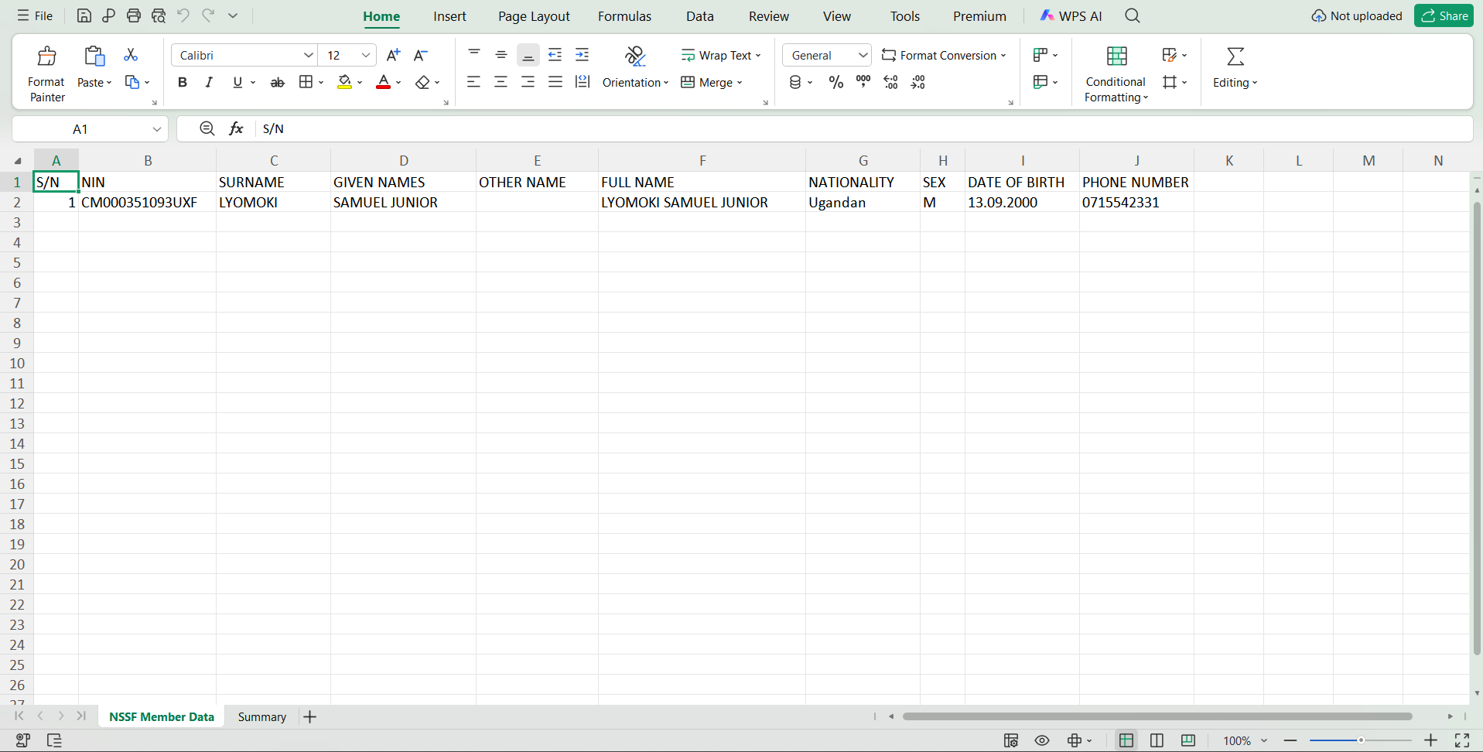
EXCEL EXPORT DATA VIEW
THE
SOLUTION

Slide 17
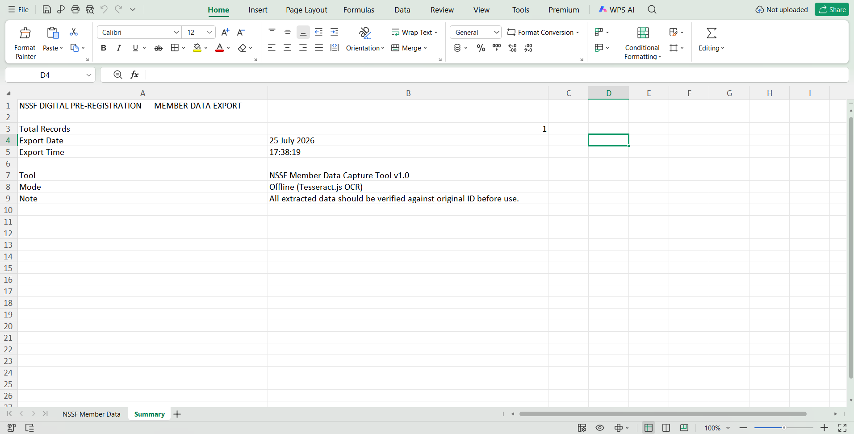
EXCEL EXPORT DATA VIEW
THE
SOLUTION

Slide 18
KEY BENEFITS
↓ 90%
↑ 3×
0
Manual
data entry
Members
per session
Internet
required
✓
Accurate Data, First Time
🔒
Secure & Fully Offline
OCR reads directly from the ID plus manual accurate data entry— eliminating handwriting misinterpretation and transcription errors on NINs, names and dates.
No data leaves the device. The tool runs entirely on the user's machine with no cloud connection or external server involved.
📄
Instant Excel Export
📶
Works Anywhere — No Internet
All records from a session export in one click to a formatted spreadsheet, ready for direct upload to the NSSF system.
Designed for field conditions. The app runs offline in remote areas, market drives or locations with no reliable data signal.

Slide 19
Before vs. After
The same enrolment drive — two very different outcomes.
BEFORE
AFTER
• Staff copy NINs by hand from physical cards
• Staff photograph the ID — no typing required
• Frequent transcription errors on names & numbers
• OCR reads NIN, names, DOB and location instantly
• Illegible handwriting causes rejected records
• Form pre-fills automatically for staff to confirm
• Missing fields require follow-up calls to members
• Phone number added manually — all other fields auto
• Manual data entry into spreadsheets takes hours
• One click exports all records to a clean Excel file
• Data quality checks delay onboarding by days
• Data is accurate and ready for upload same day

Slide 20
Ready for Deployment
The tool is built, currently in testing and ready for a pilot run across field enrolment teams.
✓
No installation required — runs directly in any web browser on a phone, tablet or laptop
✓
Fully offline — no internet connection, external account or cloud service needed in the field
✓
Field staff can be trained and actively collecting accurate member data within minutes of setup
NSSF SmartLife Flexi Enrolment · Enterprise & Growth Department · 2026
N S S F

Slide 21

D E V E L O P E D B Y
The Tool
Digital Pre-Registration Member Data Capture Tool
Captures Registration Data Using ID
Allows Manual Registration Data Entry
NIN, Name, Sex, DOB, Nationality, Phone number & location
Samuel
Lyomoki Junior
Auto-fills a verification form
Global Leadership & Governance
Exports records as .xlsx Excel
USIU-Africa
100% offline — no internet needed
Intern — Enterprise & Growth Dept.
NSSF A Better Life
Summer Internship 2026

