Slide 1
OwnIt.
Democratizing Real Asset Ownership in Uganda
Co-own properties, commodities, minerals, and trade routes from as low as UGX 50,000 with direct Mobile Money returns.
PITCH DECK · JUNE 2026

Slide 2
THE PROBLEM
The Investment Barrier for Everyday Ugandans
High Barriers, Low Incomes, Few Options
• High Entry Costs: Traditional real estate, agricultural exports, and infrastructure projects require hundreds of millions of UGX.
• Inflation & Currency Risk: Local savings are eaten away by inflation. Everyday Ugandans lack access to high-yielding, inflation-hedging real assets.
• Lack of Liquidity & Transparency: Fragmented markets, complex legal procedures, and lack of trust in operators lock out retail investors.
95%
of Ugandans are locked out of institutional-grade investments due to capital constraints.
OwnIt Uganda Pitch Deck · www.ownit.ug

Slide 3
THE SOLUTION
OwnIt Uganda: Fractional Crowd Funding Platform
Fractional, Direct, and Secure
• Fractional Ownership: Co-own high-value real assets (apartments, exports, factories) with low-ticket sizes starting at UGX 50,000.
• Passive Income Stream: Profit shares from rental income, agricultural sales, or trade yields are disbursed automatically to MTN/Airtel Mobile Money.
• Escrow & Legal Verification: KCCA title deeds and assets are fully vetted by licensed valuers, secured in legal escrow accounts for co-owners.
UGX 50K
Minimum investment ticket, democratizing access to institutional real estate and agriculture yields.
OwnIt Uganda Pitch Deck · www.ownit.ug

Slide 4
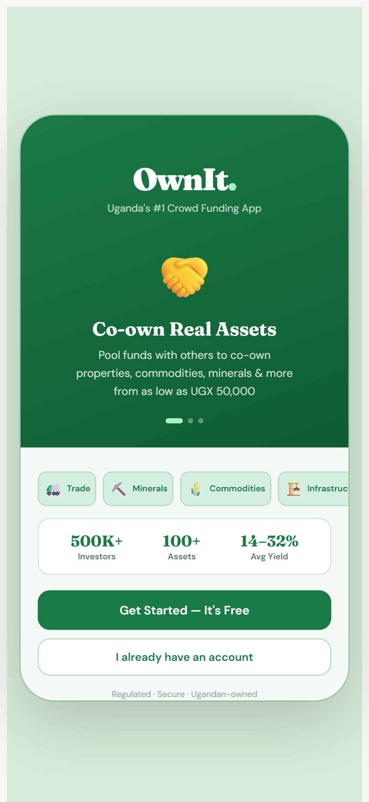
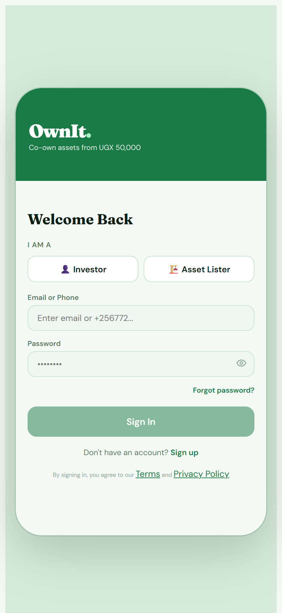
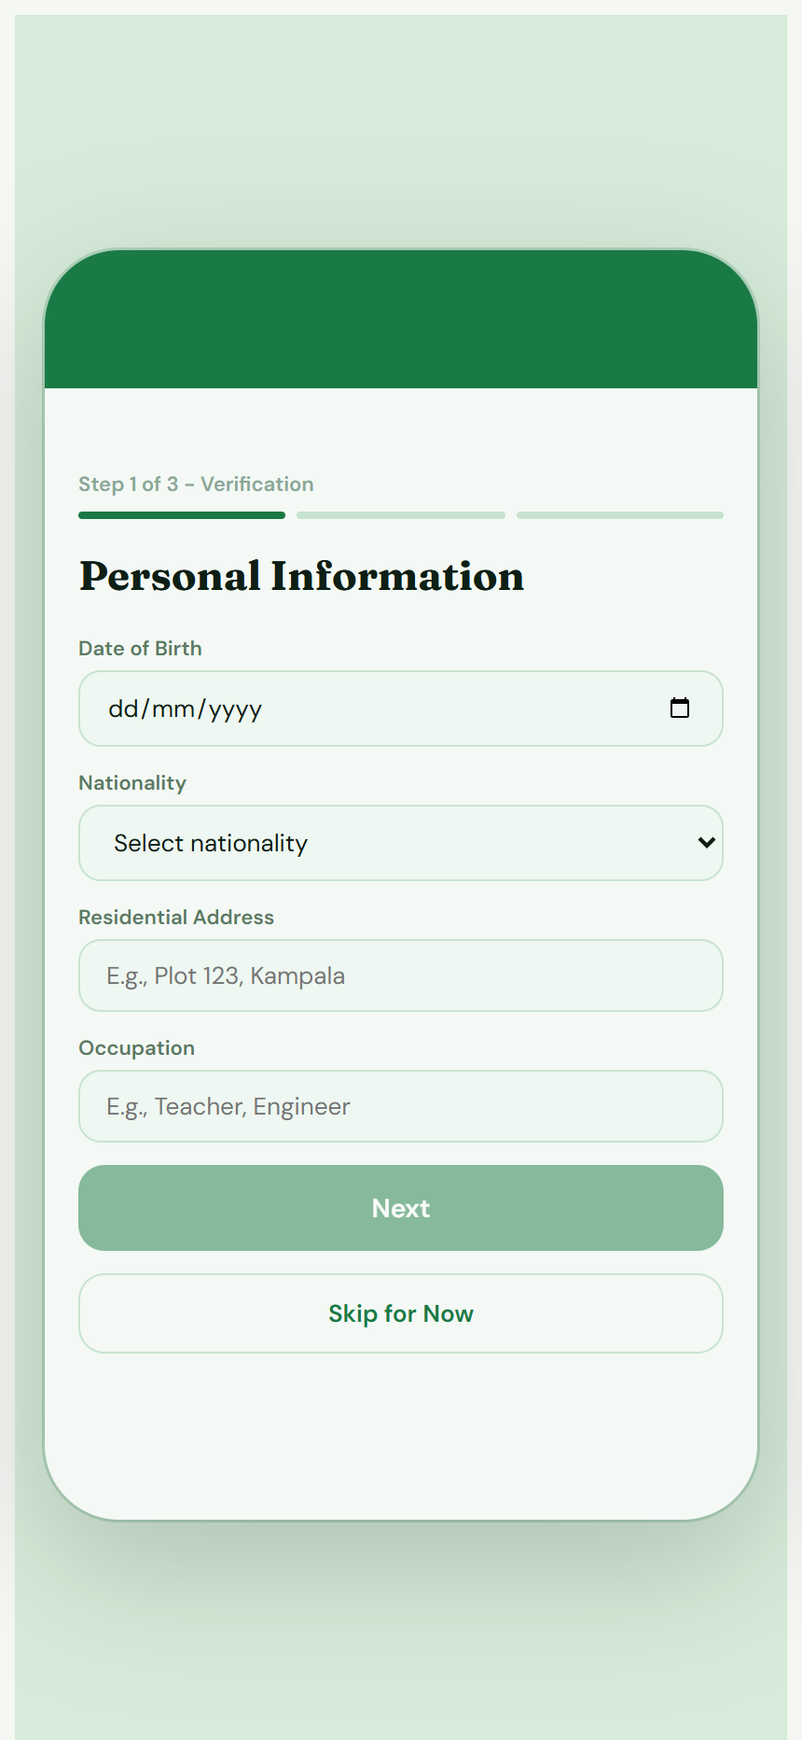
PRODUCT DEMO
Frictionless and Compliant Onboarding
Simple Registration & 3-Step Identity Verification
• Brand Identity:
Modern interface that is mobile-responsive and high contrast green theme.
• KYC Compliance:
Fully digital KYC including Date of Birth, ID type/number, ID file upload, and consent selfie verification.
• Flexibilty:
Option to "Skip for Now" lets users explore the market before uploading files.
1. Welcome Slide
2. Simple Login
3. KYC Step 1
OwnIt Uganda Pitch Deck · www.ownit.ug

Slide 5
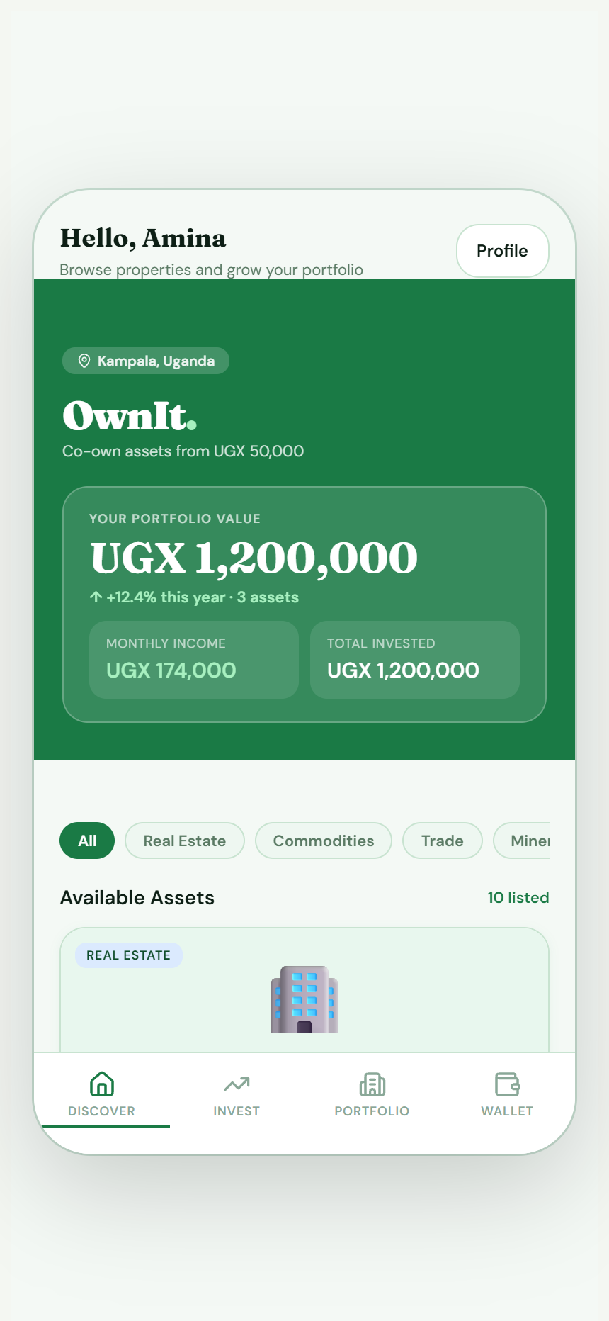
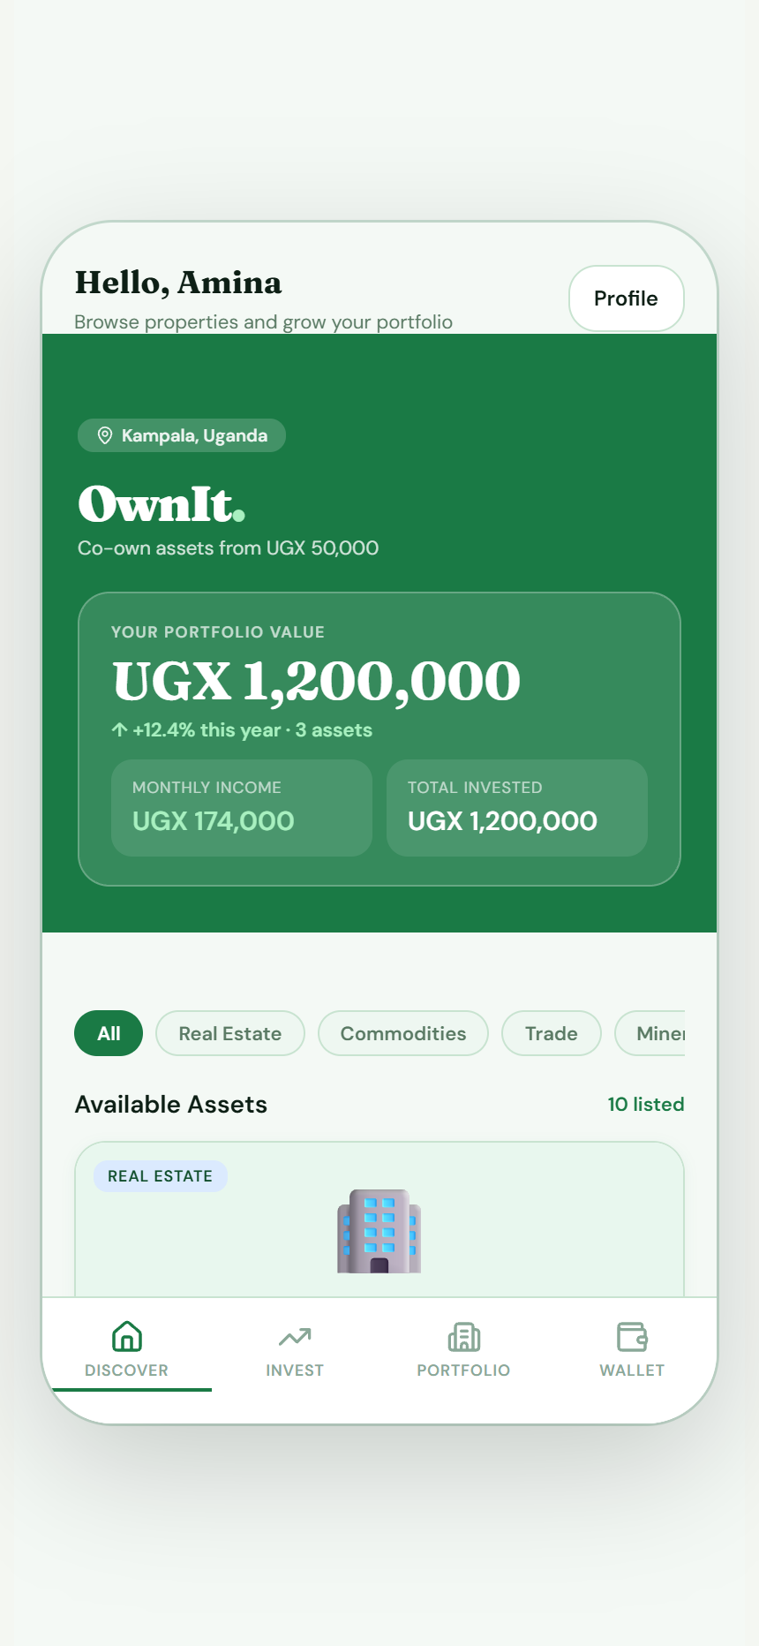
PRODUCT DEMO
Browse and Filter Diversified Real Assets
Diverse Asset Classes & Direct Discovery
• Discover Tab:
Browse a vetted selection of real-world assets. Funding progress bar showing co-ownership status in real-time.
• Asset Diversity:
Properties, agricultural commodities, export trade finance, infrastructure toll-kiosks, solar mini-grids, and mineral sales.
• Filtering:
Easy filtering options (All, Apartment, Land, Commercial) for custom portfolios.
OwnIt Uganda Pitch Deck · www.ownit.ug
Investor Discover Screen
Vetted Asset Details

Slide 6
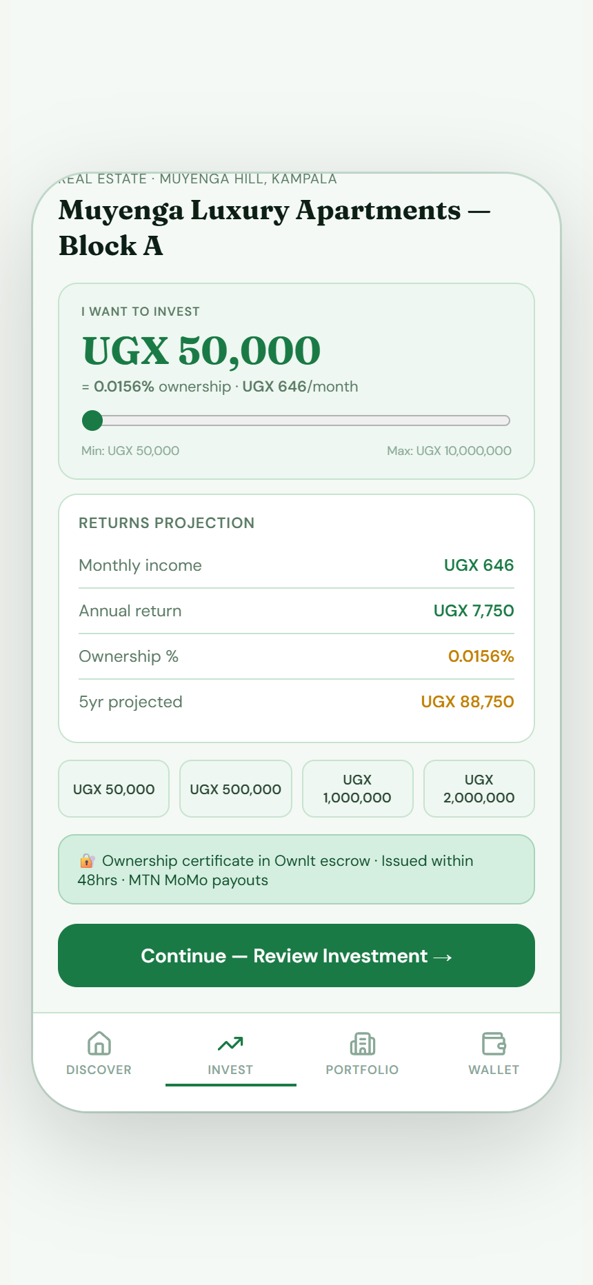
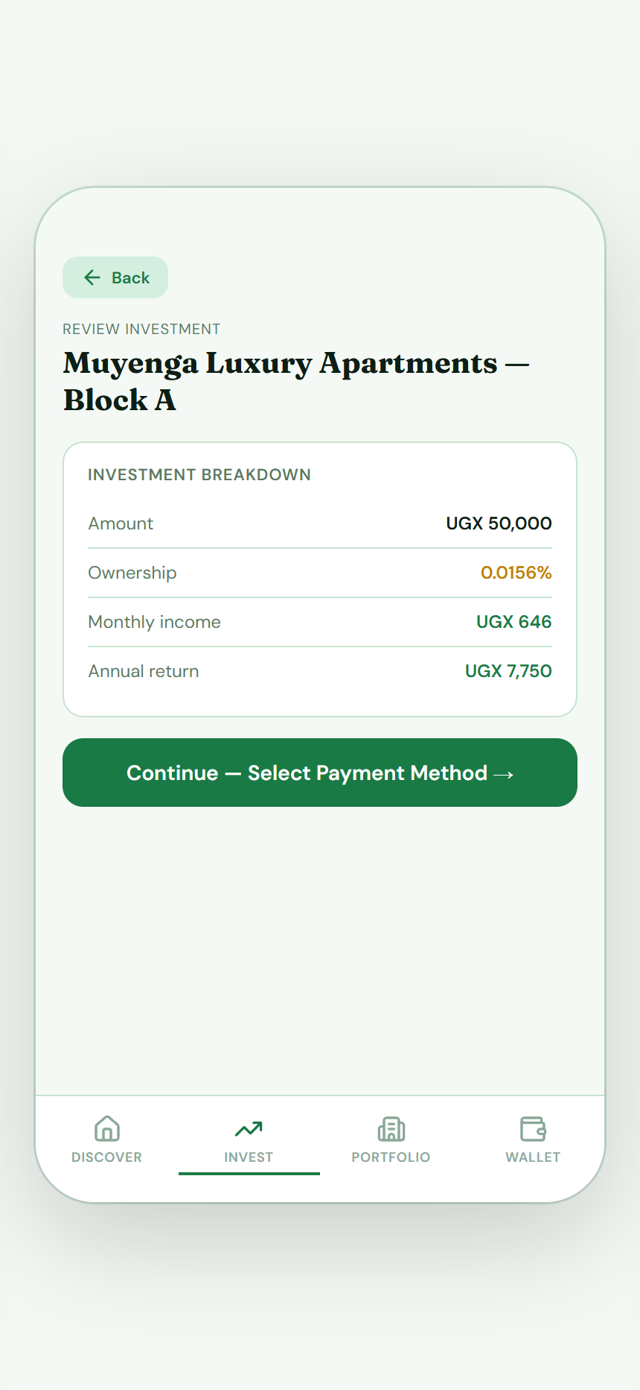
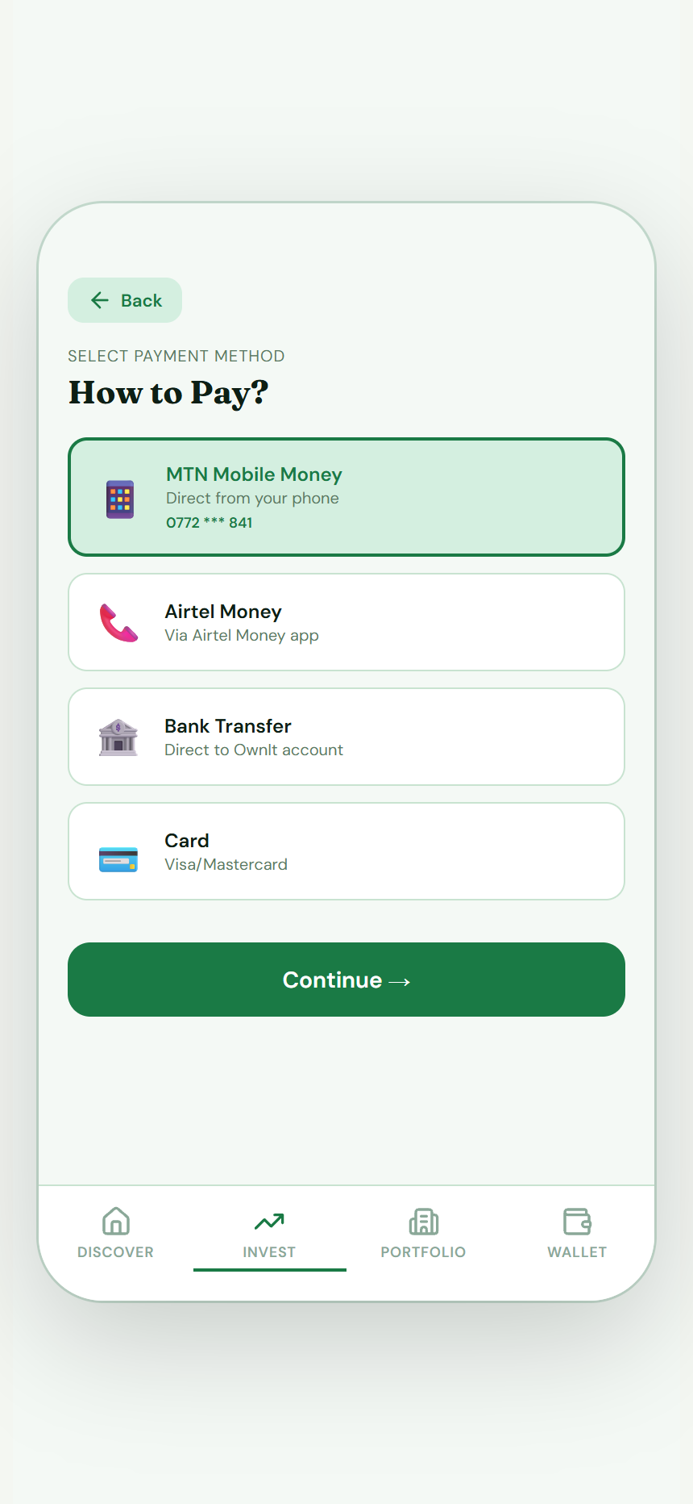
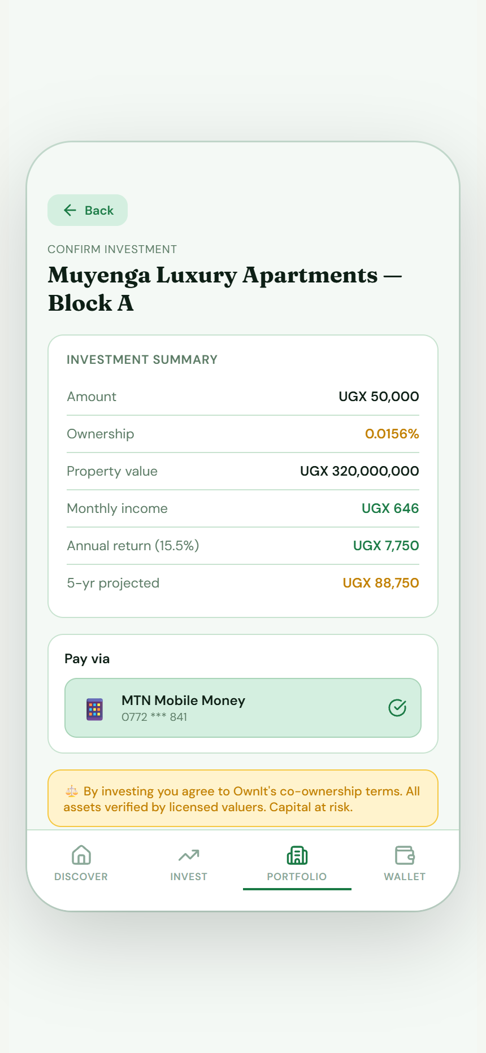
PRODUCT DEMO
Seamless Co-Ownership Flow in 4 Steps
• Interactive Yield Slider:
Select amount and view real-time monthly return and ownership projection.
• Mobile Money Integration:
Supports MTN Mobile Money and Airtel Money for instant local payments.
1. Choose Amount
2. Review Return
3. Select Payment
4. Co-owner Confirmed
OwnIt Uganda Pitch Deck · www.ownit.ug

Slide 7

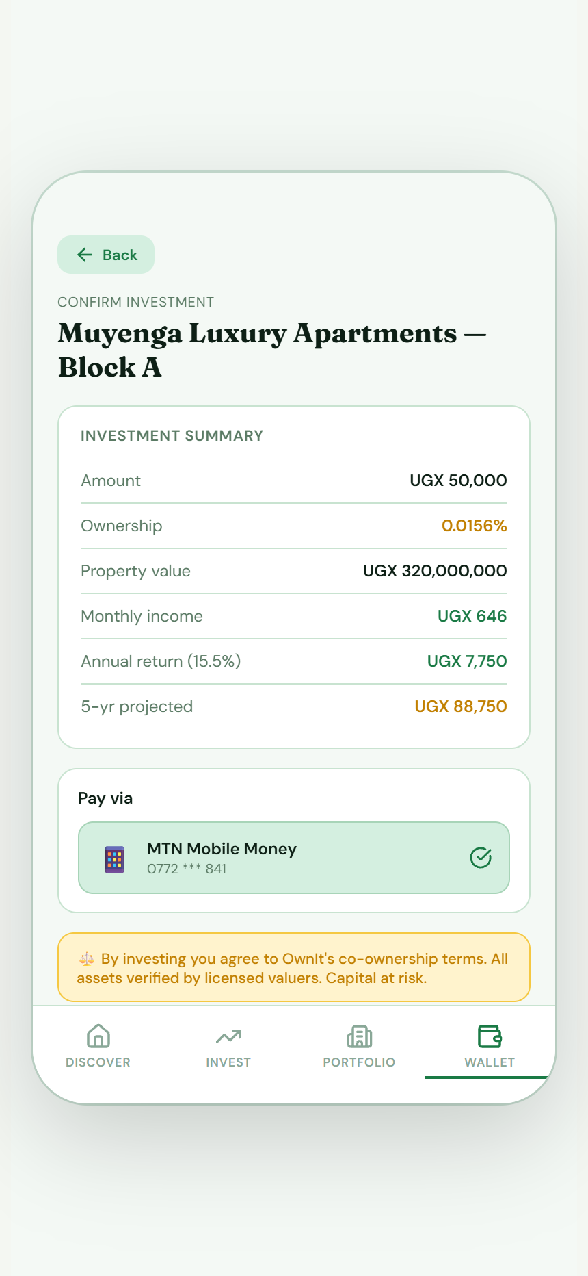
PRODUCT DEMO
Track Portfolio Growth and Passive Yields
Real-time Portfolio Ledger & Digital Wallet
• Portfolio Tab:
Tracks your exact co-owned share across multiple properties and commodities, showing combined passive income and average yield.
• Smart Wallet:
Deposit or withdraw funds securely. Supports scheduled monthly disbursements directly to your active Mobile Money number.
• Transaction Ledger:
Fully transparent ledger logs all investments, deposits, withdrawals, and payouts.
OwnIt Uganda Pitch Deck · www.ownit.ug
Co-ownership Portfolio
Integrated Local Wallet

Slide 8

PRODUCT DEMO
Lister Dashboard: Manage Assets & Payouts
A Specialized Interface for Asset Listers
• Lister Portal Overview:
Asset listers get a custom dashboard showing total asset value listed, funded status, co-investor count, and pending payouts.
• Co-owners Management:
Check details of all fractional co-owners holding equity in your projects.
• Scheduled Disbursements:
Set up and trigger payouts directly to co-owners in a single step.
OwnIt Uganda Pitch Deck · www.ownit.ug
Lister Home Dashboard
Co-owner Payouts Portal

Slide 9
MARKET OPPORTUNITY
Attractive Real-world Asset Class Yields
Real Estate
Agriculture & Trade
Energy & Minerals
15% - 20%
Annual Yield
Stable commercial and residential apartments (Muyenga, Ntinda, Entebbe Road).
23% - 32%
Turnaround Yield
Fast export cycles (Lira sesame, Bugisu Arabica coffee, Guangzhou trade imports).
21% - 36%
Premium Yield
High utility assets (solar grids, toll roads) & bulk refined mineral sales (Busia lithium, gold).
OwnIt Uganda Pitch Deck · www.ownit.ug

Slide 10
OwnIt.
Join the Crowd Funding Revolution
Email: contact@ownit.ug
Phone: +256 772 123 456
Website: www.ownit.ug
Address: Plot 4, Kampala Road, Kampala, Uganda
Co-Own Vetted Assets · Earn Real Profit Share

Slide 11
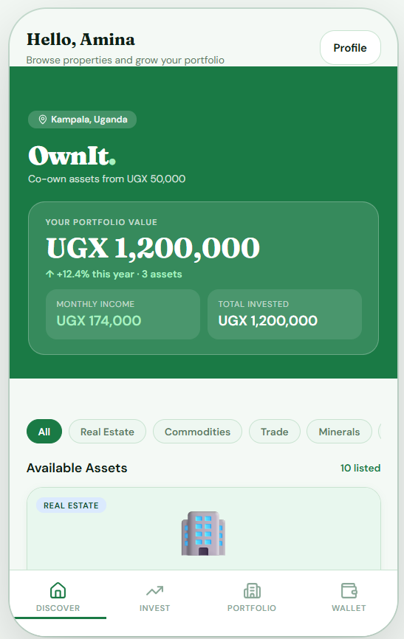
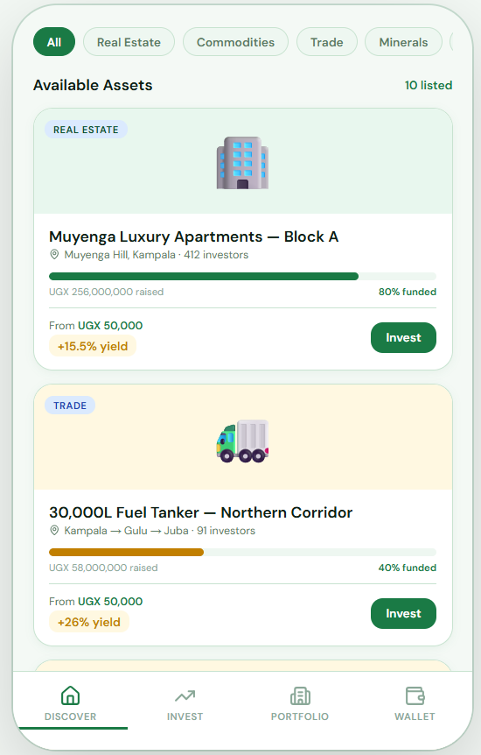
APP FLOW DEMO
1. User Registration & Compliance Onboarding

Slide 12
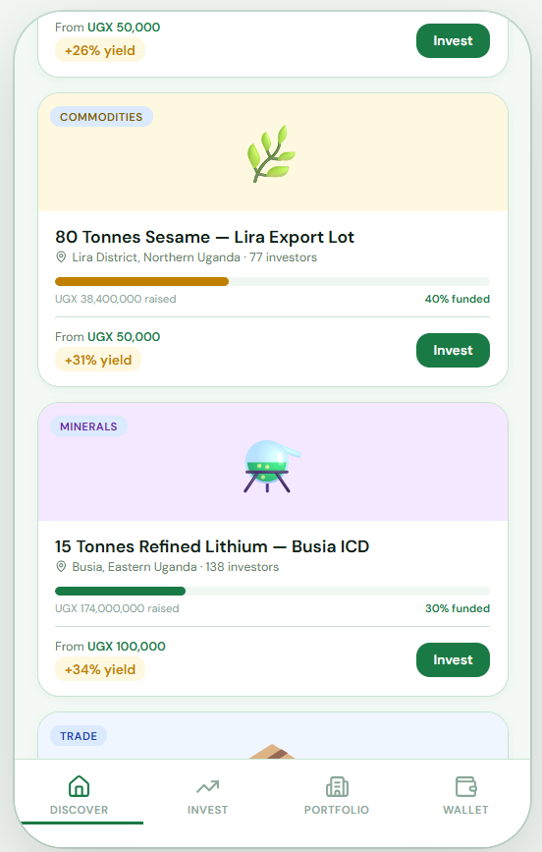
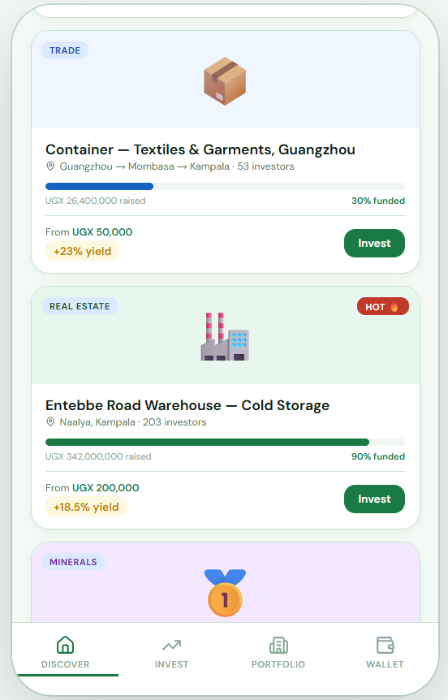
APP FLOW DEMO
2. Document Upload & Automated OCR Verification

Slide 13
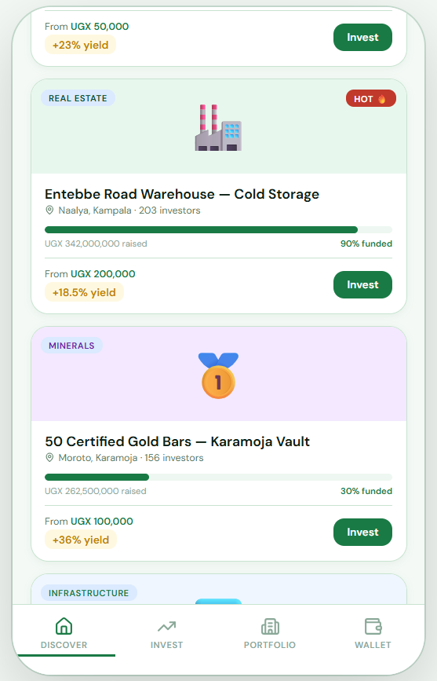
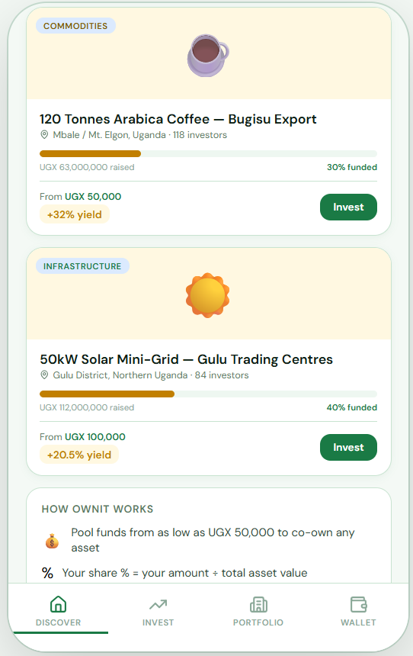
APP FLOW DEMO
3. NIRA NIN Database API & NSSF Registry Sync

Slide 14
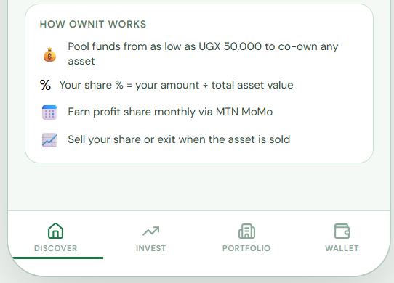
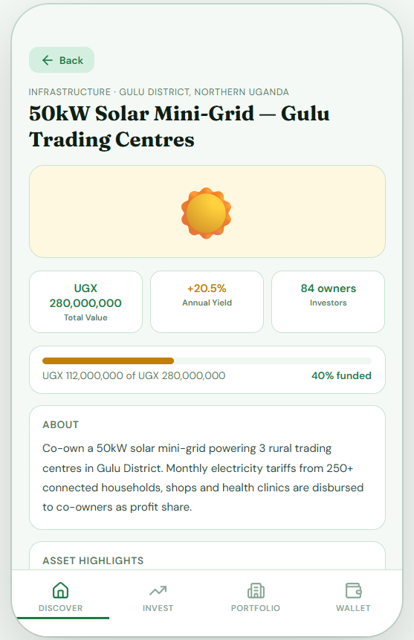
APP FLOW DEMO
4. Browse and Filter Diversified Asset Listings

Slide 15
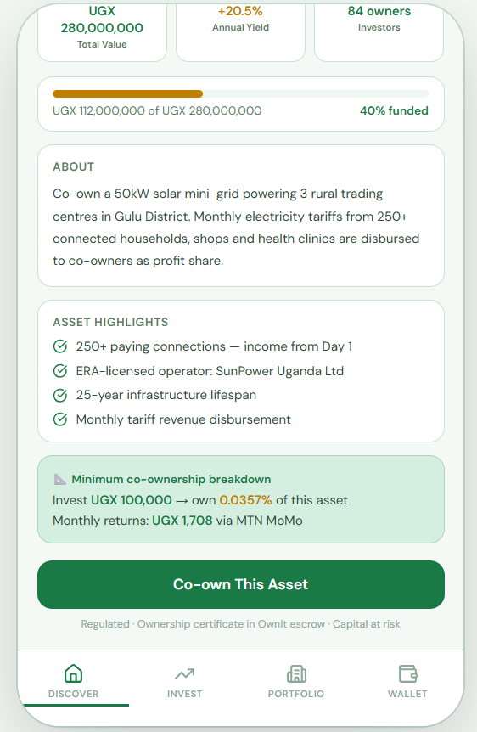
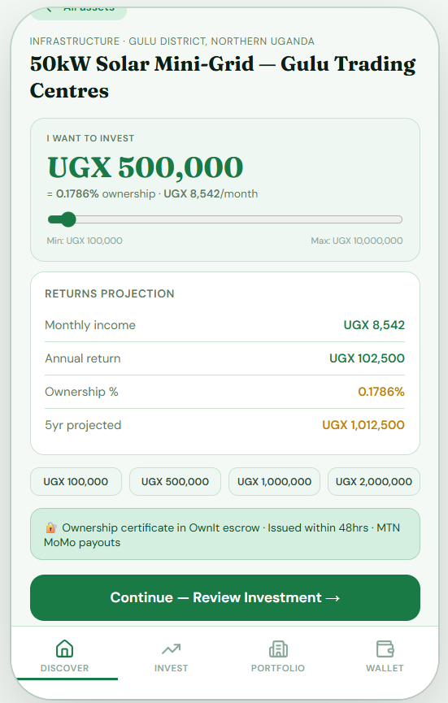
APP FLOW DEMO
5. Fractional Hisa Selection & Yield Calculator

Slide 16
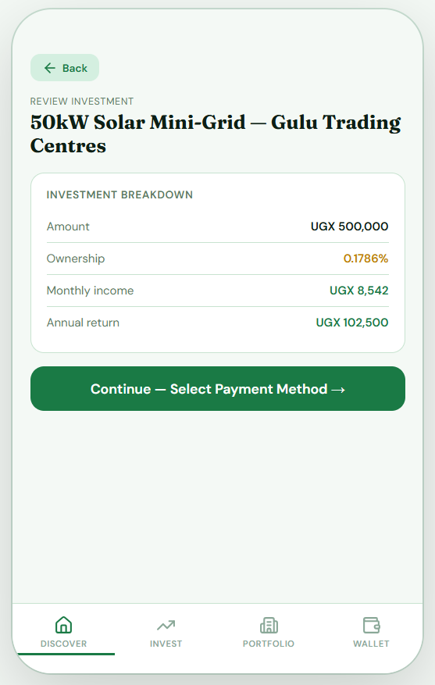
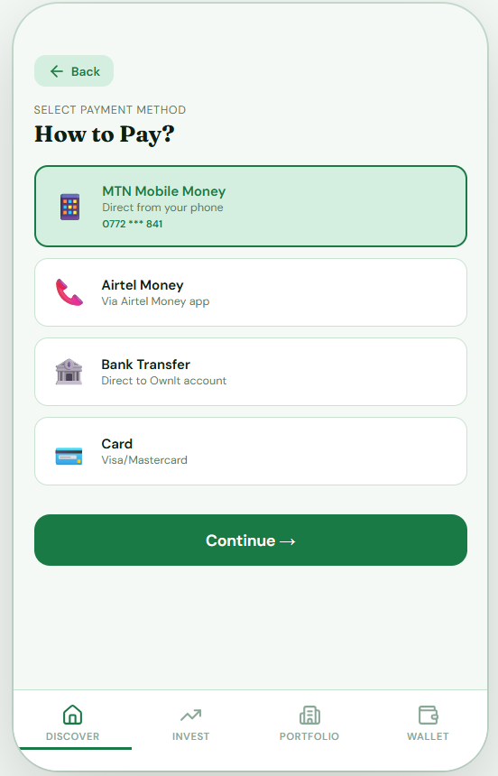
APP FLOW DEMO
6. Mobile Money Payment & Escrow Deposits

Slide 17
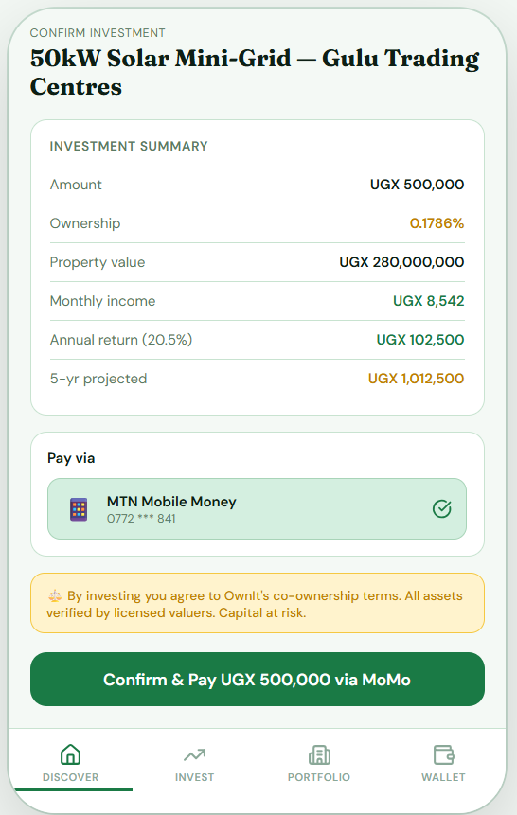
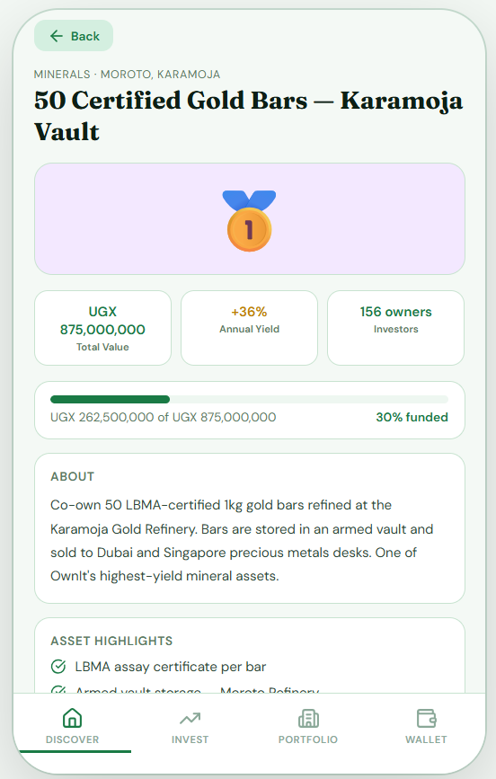
APP FLOW DEMO
7. Real-Time Portfolio Ledger & Wallet Balance

Slide 18
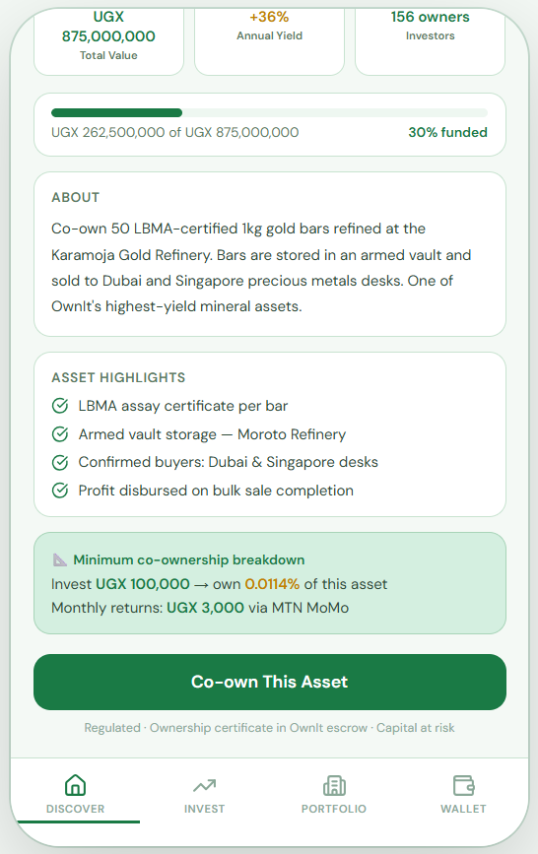
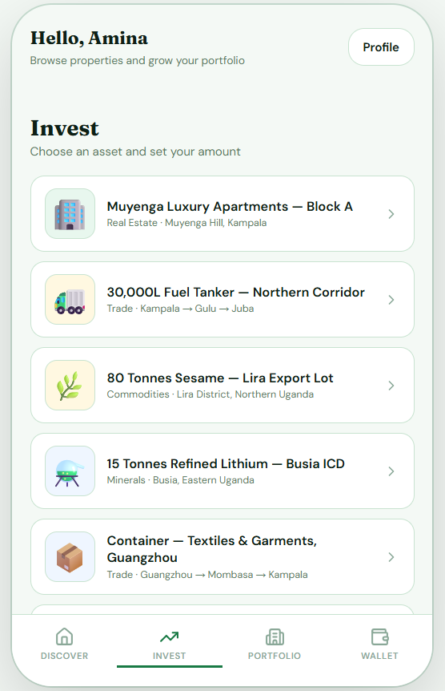
APP FLOW DEMO
8. SmartLife Flexi NSSF Pension Auto-Sweeps

Slide 19
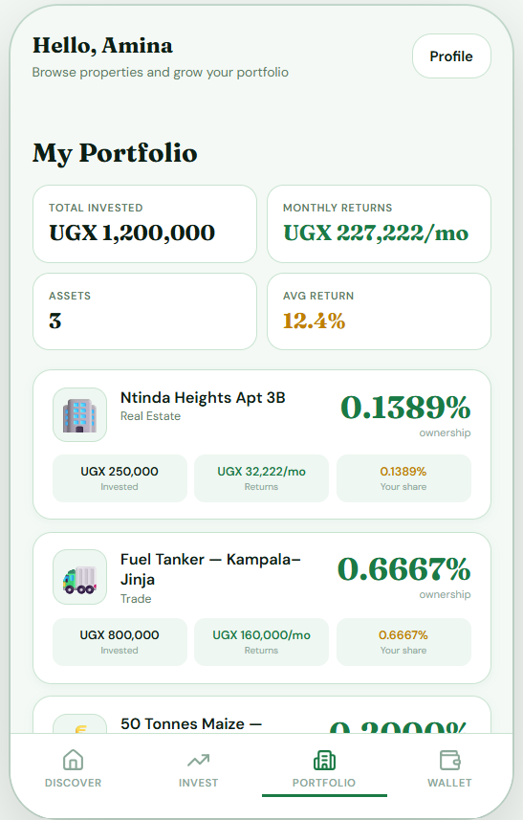
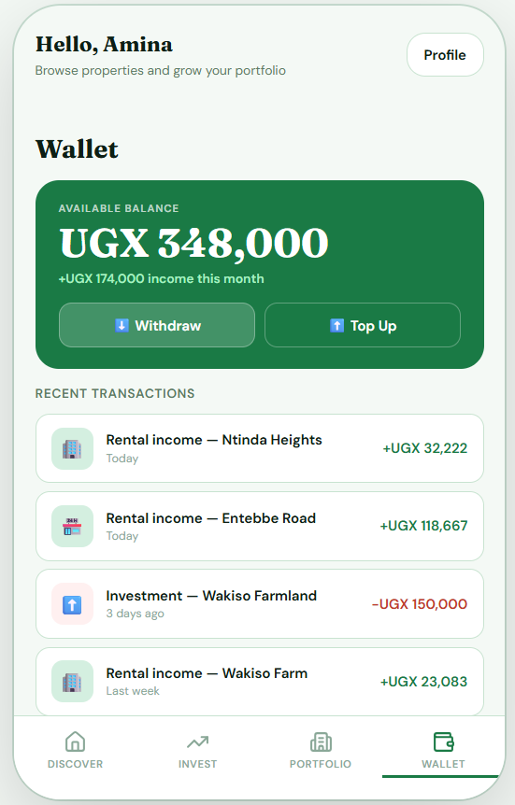
APP FLOW DEMO
9. Lister Dashboard & Real Property Performance

Slide 20
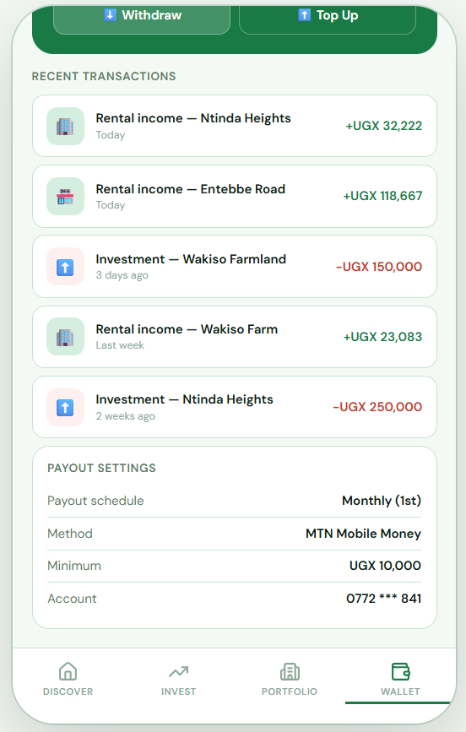
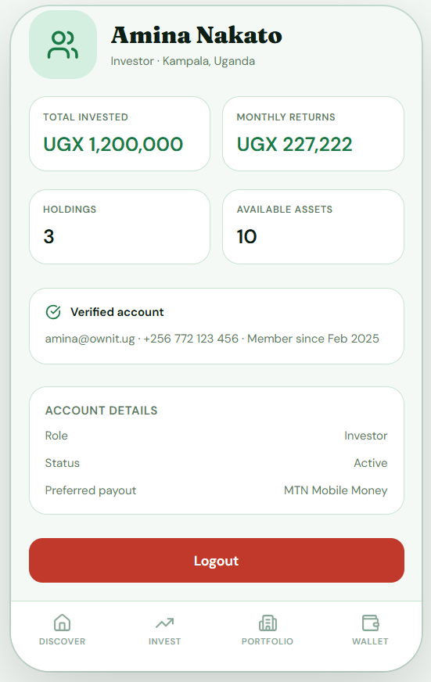
APP FLOW DEMO
10. Asset Admission Submission & Vetting Flow

