Slide 1
Contents
Abstract
Introduction
Existing System
Disadvantages
Proposed System
Advantages
Modules
Hardware Requirements
Software Requirements
References

Slide 2
Abstract
Steganography is a method for hidden information in such a way that can only be detected by its intended recipient.
The project is an application developed to embed an audio or video or Image files in any manner.
It is concerned with embedding of information in safe and secure robust manner.
This system makes the files more secure by using the concepts steganography and cryptography.
The project steganography provides implementation of various algorithms to embed image, audio, video with any another document.

Slide 3
Existing System
Most image steganographic algorithms adopt Only Hiding of Plain Text in Images.
Current Algorithms does not Encrypts Hidden Piece of Text.
As the text is Hidden as it is the size of the File is Increased.
Does Not Provides Compression or Encryption.
Does not Provides Password Security.

Slide 4
Dis - Advantages
Less security.
Provides only Image and File Stegnography.
Fewer users friendly.
Does not Provides Compression and File Security.

Slide 5
Proposed System
The proposed scheme can achieve sub-linear search time and deal with the deletion and insertion of documents flexibly.
This paper proposes a secure tree-based search scheme over the encrypted cloud data, which supports multi-keyword ranked search and dynamic operation on the document collection.

Slide 6
Advantages
Provides all types of Files Embed and De-Embed
Many options for users friendly with application.
Provides Compression and File Security.
Current Steganography Provides all Types of File Embed Process
Steganography provides Encryption, Compression Activities for file to increase security
Current Steganography is High Security
Steganography provides all types of Files
The song can be played on all multi-media audio players.
o High audio quality.
o A relatively good text file size.

Slide 7
MODULES
PLAIN TEXT FILE STEGANOGRAPHY WITH ENCRYPTION
IMAGE FILE STEGANOGRAPHY WITH ENCRYPTION
AUDIO FILE STEGANOGRAPHY WITH ENCRYPTION
VIDEO FILE STEGANOGRAPHY WITH ENCRYPTION

Slide 8
Plain Text File Steganography With Encryption
In the module we perform steganography with encryption for Plain Text files in which module reads any files like image/audio/video and hides plain text in selected source file. For this module we implement LSB steganography technique with RSA Encryption for Embedding and de-embedding file

Slide 9
Image File Steganography With Encryption
In the module we perform steganography with encryption for Image files in which module reads any files all categories of image files and hides any other file like audio/video/text/image files in selected source image. For this module we implement LSB steganography technique, RSA Encryption Technique is used for Embedding and de-embedding file

Slide 10
Audio File Steganography With Encryption
In the module we perform steganography with encryption for Image files in which module reads any files all categories of audio files and hides any other file like audio/video/text/image files in selected source image.
For this module we implement LSB steganography technique, RSA Encryption Technique is used for Embedding and de-embedding file

Slide 11
Video File Steganography With Encryption
In the module we perform steganography with encryption for Image files in which module reads any files all categories of video files and hides any other file like audio/video/text/image files in selected source image.
For this module we implement LSB steganography technique, RSA Encryption Technique is used for Embedding and de-embedding file

Slide 12
Hardware Requirements
System : Intel core
Hard Disk : 1 TB
RAM : 4 GB

Slide 13
Software Requirements
Operating system : Windows 7, Windows 8
Coding Language : Java
Front End : Java Swings

Slide 14
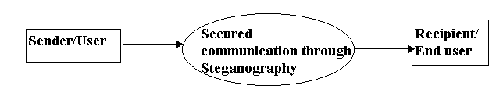
UML

Slide 15
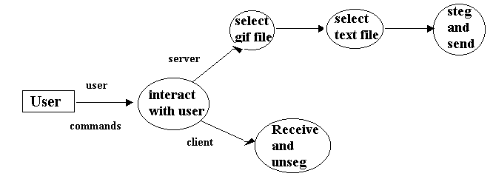

Slide 16
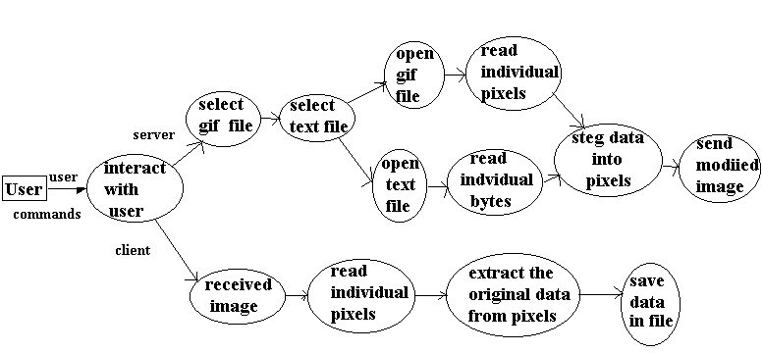

Slide 17
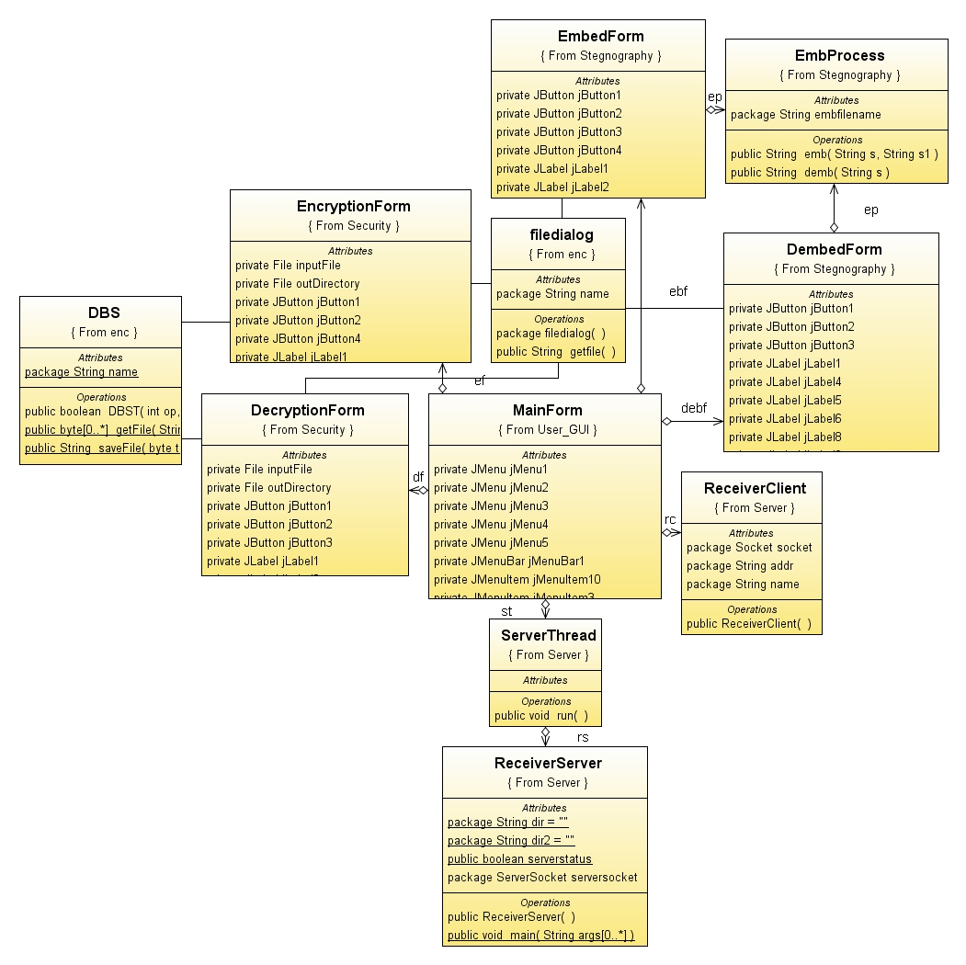

Slide 20
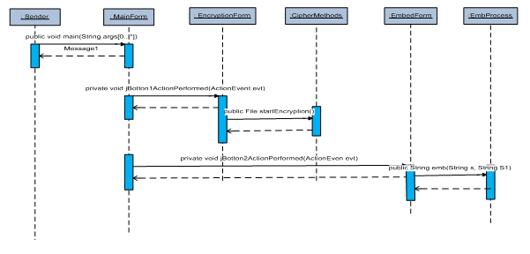

Slide 22
Conclusion
Steganography can be used for hidden communication. We have explored the limits of steganography theory and practice.
We pointed out the enhancement of the audio and video steganographic system using DES, RSA approachs to provide a means of secure communication. A stego-key has been applied to the system during embedment of the message.

Slide 23
References
1. E. Cole and R.D. Krutz, Hiding in Plain Sight: Steganography and the Art of Covert Communication, Wiley Publishing, Inc., ISBN 0-471-44449-9, 2003.
2. Stefan Katzenbeisser and Fabien A. P. Petitcolas, Information Hiding Techniques for Steganography and Digital Watermarking, Artech House Books, ISBN 1-58053-035-4, 1999.
3. D. Stanescu, M. Stratulat, B. Ciubotaru, D Chiciudean, R. Cioarga and M. Micea, Embedding Data in Video Stream using Steganography, in 4th International Symposium on Applied Computational Intelligence and Informatics, SACI-2001, pp. 241-244, IEEE, 2007.
4. Feng Pan, Li Xiang, Xiao-Yuan Yang and Yao Guo, Video Steganography using Motion Vector and Linear Block Codes, in IEEE 978-1-4244-6055-7/10/, pp. 592-595,2010.

Slide 24
THANK YOU

